Slide 1
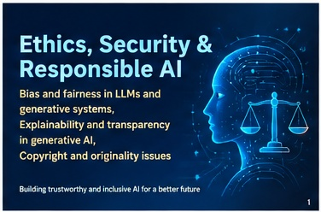
ETHICS, SECURITY &
RESPONSIBLE AI
Bias and fairness in LLMs and generative systems
Explainability and transparency
Copyright and originality
FAIRNESS
TRANSPARENCY
ORIGINALITY
Reduce unjustified differences in outcomes.
Make AI behavior and limitations understandable.
Respect rights, provenance, and human creativity.
Teaching presentation • B.Tech / Generative AI

Slide 2
Learning outcomes
By the end of this session, students should be able to…
01 Explain bias
02 Interpret AI outputs
Identify sources of bias and distinguish fairness metrics.
Describe explainability, transparency, and limitations.
03 Assess originality
04 Apply safeguards
Discuss training data, generated content, and copyright risk.
Recommend practical checks and human oversight.
ETHICS • SECURITY • RESPONSIBLE AI
2

Slide 3
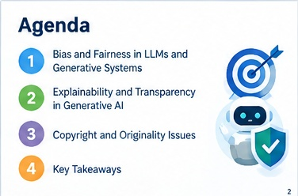
Why responsible AI matters
Generative systems can scale both benefits and harms.
BENEFIT
RISK
Speed, accessibility, creativity, and personalization.
Bias, fabricated claims, privacy loss, and IP disputes.
RESPONSIBLE APPROACH
Evaluate data and outputs; explain limitations; respect rights; keep humans accountable.
Core idea: trust is earned through evidence, safeguards, and accountability—not through fluent output alone.
ETHICS • SECURITY • RESPONSIBLE AI
3

Slide 4
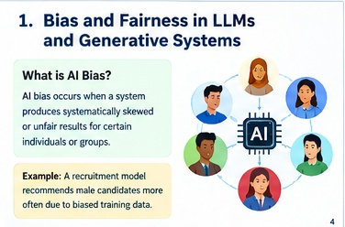
1. Bias and fairness in LLMs and generative systems
Bias can enter through data, labels, objectives, evaluation, or deployment.
BIAS
FAIRNESS
Systematic skew that can produce inaccurate or unfair outcomes.
Treating people equitably, with attention to context and impact.
• Models learn patterns—including harmful stereotypes—from training data.
• Outputs may differ by language, dialect, identity cues, or cultural context.
• Fairness is application-specific; no single metric solves every case.
ETHICS • SECURITY • RESPONSIBLE AI
4

Slide 5
Common sources of bias
Use this checklist when designing or evaluating a generative AI system.
Historical
Sampling
Representation
Past inequalities reflected in source data.
Some groups or languages are underrepresented.
Stereotypes or narrow portrayals are repeated.
Labeling
Measurement
Deployment
Human annotations contain inconsistent judgments.
The target or proxy does not capture real-world needs.
A tool is used outside the context it was designed for.
Example: a chatbot that performs well in English may misunderstand regional-language questions.
ETHICS • SECURITY • RESPONSIBLE AI
5

Slide 6
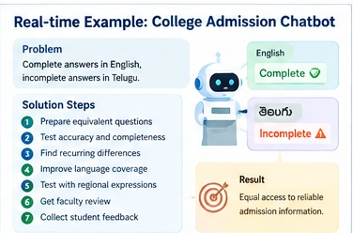
Case study: college admissions chatbot
A model gives complete answers in English but incomplete answers in Telugu.
OBSERVED ISSUE
POSSIBLE CAUSE
Different answer quality across languages.
Uneven training and evaluation coverage.
• Create equivalent test questions in both languages.
• Measure accuracy, completeness, refusal rates, and user success.
• Improve coverage with reviewed data and native-speaker evaluation.
• Retest after each model or prompt change.
ETHICS • SECURITY • RESPONSIBLE AI
6

Slide 7
Fairness metrics: useful, but not universal
Select measures based on the task, legal context, and potential harm.
Demographic parity
Equal opportunity
Equalized odds
Compare positive decision rates across groups.
Compare true-positive rates across groups.
Compare true-positive and false-positive rates.
Important: metrics can conflict. A model can satisfy one fairness criterion while failing another. Evaluate outcomes, context, and lived impact—not just a score.
Practical controls: representative data • subgroup testing • independent review • user feedback • monitoring
ETHICS • SECURITY • RESPONSIBLE AI
7

Slide 8
Reducing bias: a lifecycle approach
Fairness must be checked before launch and throughout deployment.
1. Data
2. Design
3. Evaluate
4. Review
5. Monitor
Check coverage, consent, quality, and provenance.
Define intended use and unacceptable outcomes.
Test groups, languages, prompts, and edge cases.
Include domain experts and affected users.
Track complaints, drift, and unequal outcomes.
→
→
→
→
Do not assume that removing demographic fields eliminates bias: other features may act as proxies.
ETHICS • SECURITY • RESPONSIBLE AI
8

Slide 9
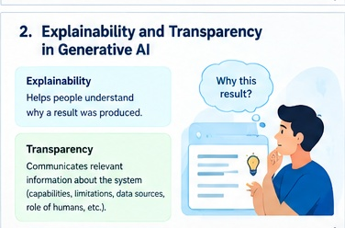
2. Explainability and transparency in generative AI
Related concepts that answer different questions.
EXPLAINABILITY
TRANSPARENCY
Why might the system have produced this output?
What is the system, how is it used, and what are its limits?
• Explain the evidence or factors relevant to a result.
• Disclose AI involvement and meaningful limitations.
• Distinguish verified facts, model-generated claims, and uncertainty.
ETHICS • SECURITY • RESPONSIBLE AI
9

Slide 10
Ways to improve explainability
Choose techniques appropriate to the model and question.
Feature importance
SHAP / LIME
Highlights input factors associated with a prediction.
Can estimate feature contributions for supported model types.
Retrieval evidence
Model documentation
Shows source documents used in a retrieval-augmented answer.
Describes intended use, evaluation, limitations, and risks.
Human-readable rationale
Audit trail
Gives a concise explanation without claiming access to hidden reasoning.
Records versions, prompts, sources, and decisions where appropriate.
Caution: explanations can be incomplete or misleading; validate them against system behavior.
ETHICS • SECURITY • RESPONSIBLE AI
10

Slide 11
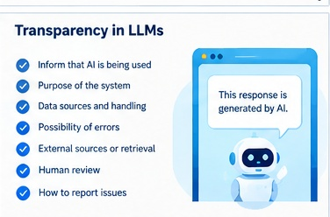
Transparency checklist for an AI product
Users need enough information to make informed decisions.
• Tell users when they are interacting with AI, where appropriate.
• Explain intended purpose and prohibited uses.
• Describe relevant data sources and data handling practices.
• State limitations, uncertainty, and known failure modes.
• Identify whether external sources or tools are used.
• Provide reporting, correction, and human escalation paths.
ETHICS • SECURITY • RESPONSIBLE AI
11

Slide 12
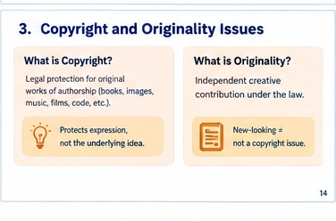
3. Copyright and originality issues
Generative output raises questions about inputs, outputs, attribution, and human contribution.
COPYRIGHT
ORIGINALITY
Legal protection for qualifying original expression, subject to applicable law.
Whether a work is sufficiently independent or creative under relevant rules.
• Training data may include protected works; permissions and legal rules vary.
• Generated content may resemble existing works or protected characters.
• Authorship and copyright eligibility can depend on jurisdiction and human contribution.
ETHICS • SECURITY • RESPONSIBLE AI
12

Slide 13
Where copyright and originality risks arise
Assess the entire workflow, not only the final prompt.
Training data
Generated output
Was content lawfully collected and used? What licences or exceptions apply?
Could it reproduce or closely imitate protected expression?
Style and likeness
Human contribution
Does the request target a living artist's distinctive style or a real person's identity?
What meaningful human selection, editing, or authorship occurred?
A result that looks new is not automatically free of legal or ethical concerns.
ETHICS • SECURITY • RESPONSIBLE AI
13

Slide 14
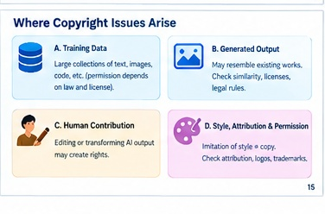
Practical safeguards for copyright and originality
Use these checks before publishing or commercializing AI-generated work.
• Use tools and datasets with clear terms and provenance.
• Do not assume that publicly accessible content is copyright-free.
• Review outputs for substantial similarity to known works.
• Keep records of prompts, edits, sources, licences, and human decisions.
• Provide attribution where required by law, licence, or institutional policy.
• Seek legal advice for high-value or high-risk commercial uses.
ETHICS • SECURITY • RESPONSIBLE AI
14

Slide 15
Classroom activity: audit an AI-generated answer
Small groups • 10 minutes • Use a fictional scenario.
SCENARIO
TASK
An AI assistant recommends candidates for a scholarship and drafts promotional images.
Identify at least one bias risk, one transparency gap, and one copyright concern.
• What evidence would you request before trusting the recommendation?
• What should be disclosed to users or reviewers?
• What human checks and safeguards should be added?
• How would you test whether the fixes work?
ETHICS • SECURITY • RESPONSIBLE AI
15

Slide 16
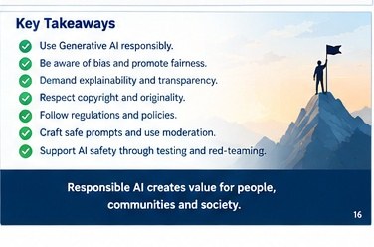
KEY TAKEAWAYS
• Fairness requires representative data, subgroup evaluation, and ongoing monitoring.
• Explainability helps people assess outcomes; transparency reveals system purpose and limits.
• Copyright and originality depend on context, applicable law, licences, and human contribution.
• Human oversight, documentation, and feedback are essential safeguards.
• Responsible AI is a continuous process—not a one-time checklist.
Build AI that is useful, fair, understandable, and respectful of people and rights.
16

