Slide 1
Introduction to Ansible
Presented by
Varra sivareddy

Slide 2
Introduction to Ansible
Ansible is a radically simple IT automation platform that makes your applications and systems easier to deploy.
It support configuration management with examples as below.
Configuration of servers
Application deployment
Provisioning
Orchestration
Automation of tasks

Slide 3
Why Ansible
It is a free open source application
Agent-less – No need for agent installation and management
Phython/yaml based
Highly flexible and configuration management of systems.
Large number of ready to use modules for system management
Custom modules can be added if needed
Configuration roll-back in case of error
Simple and human readable
Self documenting

Slide 4
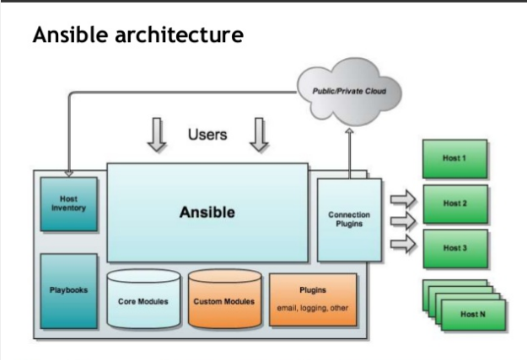
Ansible Architecture

Slide 5
Installation of Ansible
Install packages below on the Server Machine
sudo Yum install python-yaml python-jinja2 python-paramiko python-crypto python-keyczar ansible
Install packages below on the client Machines
sudo yum install python-crypto python-keyczar

Slide 6
AWS EC2 Instance with windows Nodes
sudo yum install epel
yum install ansible
Powershell 3.0 or higher should be installed. (Version 5 is present on AWS EC2 Windows instance). Check version using below command
WinRM setup on windows machine(we need to run poweshell script
https://github.com/ansible/ansible/blob/devel/examples/scripts/ConfigureRemotingForAnsible.ps1
powershell.exe -File ConfigureRemotingForAnsible.ps1
powershell.exe -File ConfigureRemotingForAnsible.ps1
ansible web -i inventory -m win_ping

Slide 7
Configuration of ansible
Do the following on the Server machine
Create the list of client machines you wish to access via this server
vi /etc/ansible/hosts ( And enter the following lines and save file)
[web]
54.174.10.158
54.174.10.159
Run the ping command below to see if indeed you are reaching both client nodes
ansible -m ping all

Slide 8
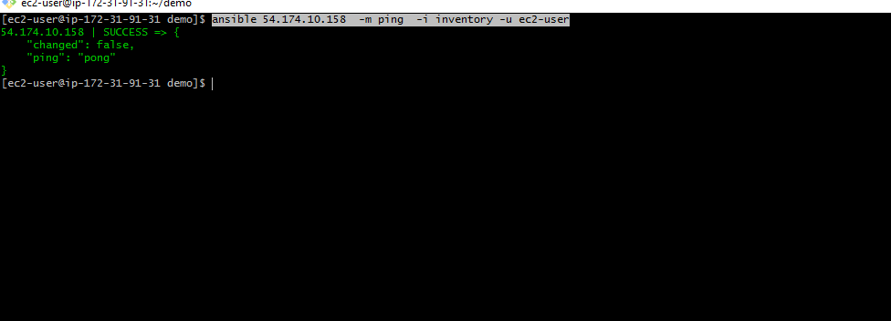
Examples of ansible commands
The output show ping result success as shown below

Slide 9
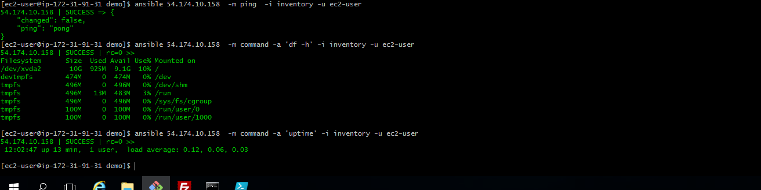
Examples of ansible commands (Cnt)
How to run commands to fetch hard drives utilization
ansible 54.174.10.158 -m command -a 'df -h' -i inventory -u ec2-user
How to run commands to fetch system uptime
ansible 54.174.10.158 -m command -a 'uptime' -i inventory -u ec2-user

Slide 10
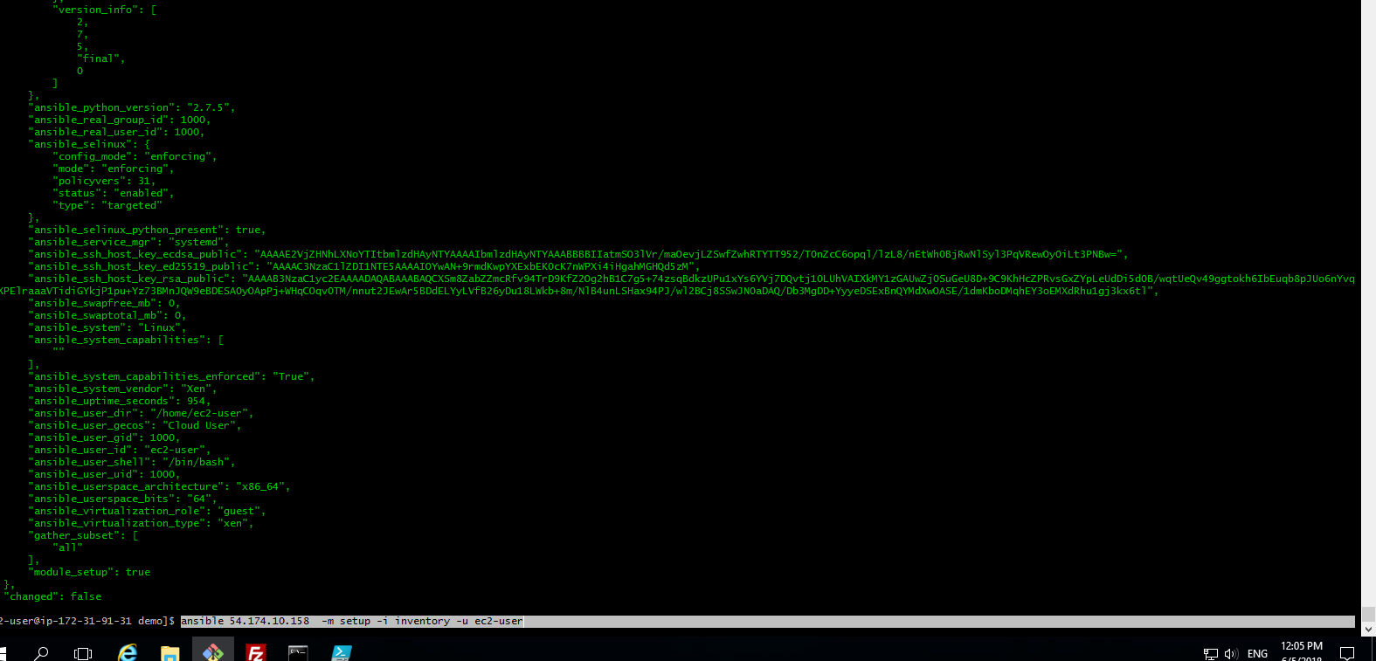
Examples of ansible commands ( Cnt)
The full configuration environment inventory of a particular client machine can be obtain using the command below.
ansible 54.174.10.158 -m setup -i inventory -u ec2-user
( output as shown below)

Slide 11
Understanding ansible playbook configurations
In order to use ansible with SSH passwords you will need to install the program below
sudo apt-get install sshpass
Ansible-playbook command can be executed to run the ntp.yml file as below
ansible-playbook -k -K ntp.yml
The –k –K switches allow you to be able to use your ssh key and passwordless sudo.
Every playbook configuration begins with triple dash ( ----)
The hosts, tasks, name, action are various instructions commands to help automate your ntp installation process.

Slide 12
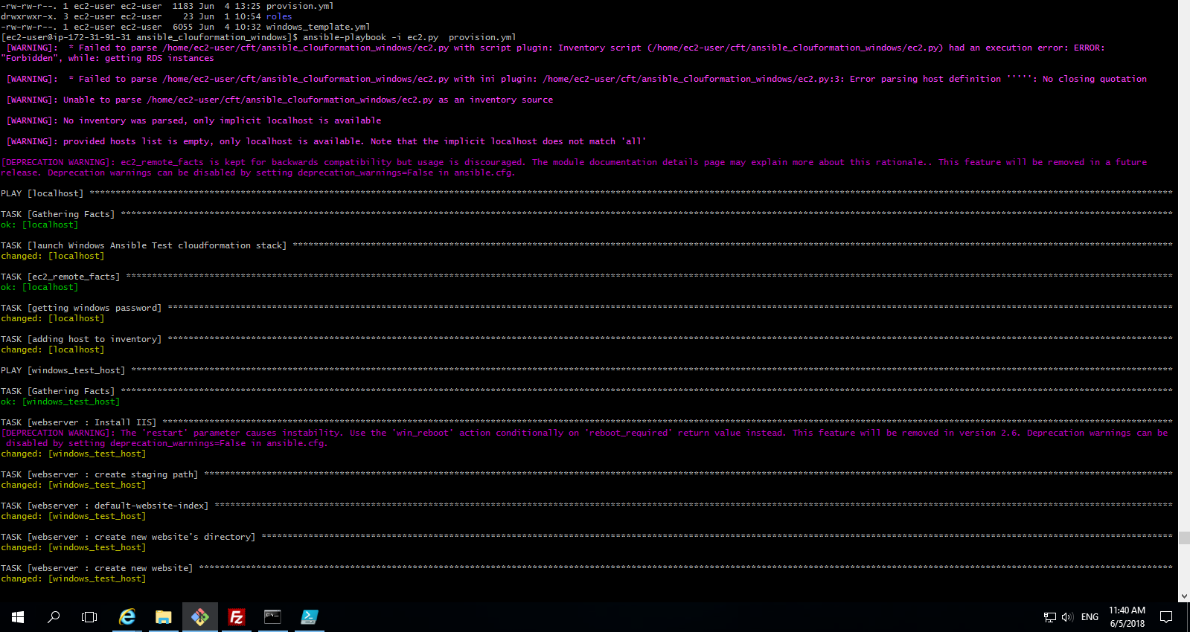
Understanding ansible playbook configurations (cnt)
The output of the ansible-playbook command as below

