Slide 1
Project Title
Presented by Team 1
M Karthik Reddy, T Siva Reddy, I Sushma Meghana, R Navya Sri
Guide: Dr. G. Kishore | CSE - AI & ML
👤 M Karthik Reddy (Lead)
1

Slide 2
ABSTRACT: REVOLUTIONIZING PREDICTION
The Power of Privacy & Accuracy
■ Traditional systems share raw data (privacy risk).
■ Our solution: Federated Learning (train locally, share weights).
■ CNN-2D model achieves 99.9% accuracy.
■ Three Pillars: FL + Privacy + CNN-2D.
👤 M Karthik Reddy
2

Slide 3
INTRODUCTION: THE URGENCY
Why Advanced Forecasting?
■ Floods cause massive loss of life and property annually.
■ Krishna River Basin needs a station-level early warning system.
■ Existing systems are centralized, slow, and not privacy-safe.
👤 M Karthik Reddy
3

Slide 4
EXISTING SYSTEM
The Centralized Approach
■ All stations send raw data to one server.
■ Server processes everything = massive bottleneck.
■ Serious data privacy and bandwidth concerns.
■ If the server fails, the entire warning system fails.
👤 M Karthik Reddy
4

Slide 5
DISADVANTAGES OF CENTRALIZATION
Why We Need FL
■ 🚨 Privacy Leakage: Raw hydro data is exposed.
■ 📉 High Bandwidth: Constant transmission is expensive.
■ 💥 Single Point of Failure: Server crash = total failure.
■ ⏳ High Latency: Slow alerts delay emergency responses.
👤 M Karthik Reddy
5

Slide 6
PROPOSED SYSTEM
Federated Learning Framework
■ Each station trains its model locally on its own data.
■ Raw data NEVER leaves the station.
■ Only model weights are shared and aggregated by the server.
■ Delivers Privacy + Accuracy + Collaboration.
👤 T Siva Reddy
6

Slide 7
WORKING OF PROPOSED SYSTEM
The 4-Step FL Cycle
■ 1. Station trains CNN-2D on local rainfall data.
■ 2. Weights encoded as Base64 and sent via TCP socket.
■ 3. Server runs FedAvg to merge all weights.
■ 4. Global model is redistributed for better predictions.
👤 T Siva Reddy
7

Slide 8
ADVANTAGES OF FL APPROACH
Key Benefits
■ 🛡️ Enhanced Privacy: Zero raw data sharing.
■ ⚡ Reduced Bandwidth: Small weight files only.
■ 📈 Better Generalization: Learns from all stations without seeing data.
■ 🚀 High Scalability: Plug-and-play new stations easily.
👤 T Siva Reddy
8

Slide 9
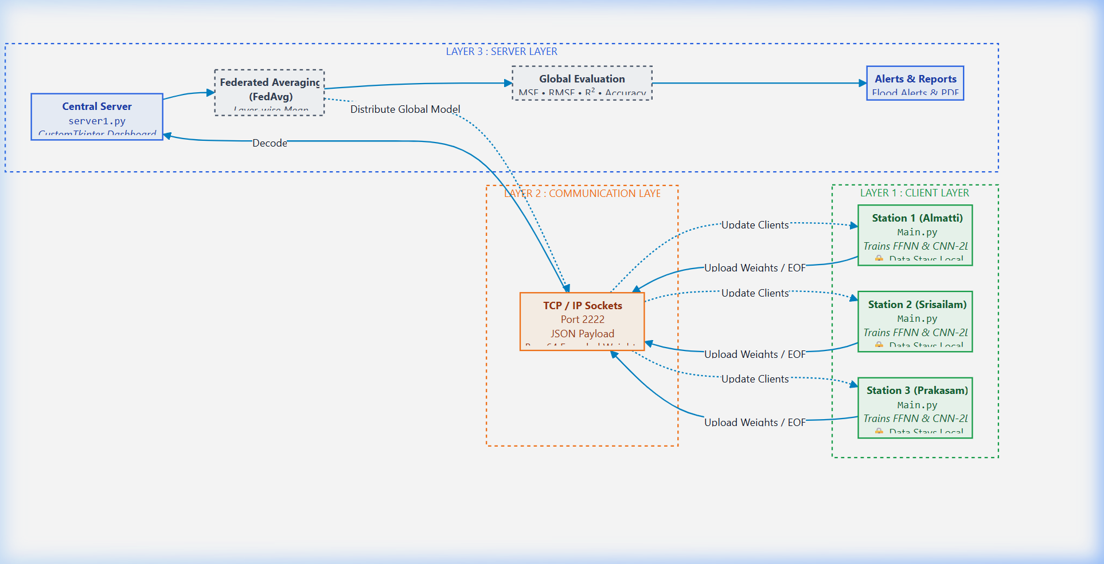
SYSTEM ARCHITECTURE OVERVIEW
Three-Layer Architecture
👤 T Siva Reddy
9

Slide 10
CLIENT SIDE MODULE
Local Processing
■ Receives historical monthly rainfall CSV.
■ Preprocessing: MinMaxScaler, 80/20 train/test split.
■ Trains FFNN (Dense) and CNN-2D (Conv) models locally.
■ Uploads model weights to central server.
👤 T Siva Reddy
10

Slide 11
DATA PREPROCESSING DETAILS
Handling Time-Series Data
■ Input: Historical rainfall & water level data.
■ Applied Min-Max normalization mapping values to [0, 1].
■ Used shuffle=False to preserve crucial temporal patterns.
■ 80% Training / 20% Testing split.
👤 I Sushma Meghana
11

Slide 12
SERVER SIDE MODULE
Global Model Aggregation
■ Server receives encoded weights from all stations.
■ FedAvg averages weights layer by layer.
■ Calculates exact metrics: MSE, RMSE, R².
■ Applies Inverse-Transform to return to real water levels.
👤 I Sushma Meghana
12

Slide 13
CNN-2D LOCAL ALGORITHM
6-Step Neural Sequence
■ 1. Input Reshaping: Data to (N, 12, 1, 1).
■ 2. Conv2D + ReLU: Spatial monthly patterns.
■ 3. MaxPooling: Key feature extraction.
■ 4. Flatten: 2D maps to 1D.
■ 5. Dense Layers: High-level relationships.
■ 6. Adam Optimizer + MSE Loss.
👤 I Sushma Meghana
13

Slide 14
FEDERATED AGGREGATION
The FedAvg Pipeline
■ 1. Server initializes global model.
■ 2. Clients train locally until convergence (150 epochs).
■ 3. Base64 encoded weights transferred via JSON.
■ 4. Server calculates global mean (FedAvg).
■ 5. Evaluates using R² and MSE convergence.
👤 I Sushma Meghana
14

Slide 15
SYSTEM REQUIREMENTS
Minimal Resource Usage
■ Hardware: standard Intel i5+, 8GB RAM.
■ Software: Python 3.10, TensorFlow, Pandas.
■ Dataset: 6 CSV files under 1MB total.
■ Proof: Complete system runs efficiently on local laptops without cloud.
👤 I Sushma Meghana
15

Slide 16
LITERATURE SURVEY
Basis of our Work
■ Studied FedAvg by McMahan et al. (2017).
■ CNN proven effective for time-series sequential data.
■ FFNN used as benchmark baseline.
■ Found FL provides superior privacy over standard systems.
👤 R Navya Sri
16

Slide 17
RESULTS & PERFORMANCE
Model Efficacy
■ 🏆 CNN-2D achieves 99.9% accuracy.
■ 📊 FFNN strong baseline comparison.
■ 🔒 Full Data Privacy guaranteed.
■ 🚨 Trigger threshold: Alerts at Water Level > 25 units.
👤 R Navya Sri
17

Slide 18
CONCLUSION
Final Takeaways
■ Privacy-Preserving: Raw data stays at stations.
■ Effective FL: FedAvg successfully merges local knowledge.
■ Scalable & Secure: Seamless station integration.
■ Real-World Ready: Tested on Krishna River Basin data.
👤 R Navya Sri
18

Slide 19
FUTURE SCOPE
Roadmap Ahead
■ Add more monitoring stations along river length.
■ Connect live IoT sensors for real-time water feeds.
■ Develop Hybrid LSTM+CNN models.
■ Integrate with government disaster portals.
👤 R Navya Sri
19

Slide 20
SYSTEM DEMONSTRATION
Thank You / Q&A
■ We have successfully built a privacy-safe, AI-driven flood forecasting system.
■ The floor is open for Questions.
■ Thank You!
👤 R Navya Sri
20

