Slide 1

Bapatla Engineering College: Bapatla – 522102
(Autonomous)
Department of Computer Science and Engineering
Smart Application Tracking System: Utilizing Generative AI for Efficient Resume Matching
Presented by
V.VENKATA ANITHA [Y21ACS587]
SK.RAHEEMAN [L22ACS606] R.VENKATA SIVA PRASAD [Y21ACS552]
U.MUKHESH RAMANA [Y21ACS581]
Batch No – C10
Under the Guidance of
Dr. P.PARDHASARADHI, _{M.Tech.,Ph.D.}
_{PROFESSOR}

Slide 2
Agenda
2
Abstract
Scope of the project
Problem Statement
Engineering Knowledge
Analysis
Existing methodologies
Literature Review
Proposed System
Objectives

Slide 3
Agenda
3
Design Methodology
Planning of Project and Teamwork
Hardware and Software Requirements
Outline of the Implementation code
Inputs and Outputs of the Project
Analysis of Results
Conclusion
Future Scope
References

Slide 4
Abstract
4
In the age of digital transformation, hiring procedures are changing quickly, and GENAI is a key factor in making hiring procedures more efficient.
The Smart Application Tracking System (ATS) is an advanced AI-powered tool that revolutionizes the resume evaluation process.
Leveraging advanced Generative AI models from Google, the system empowers users to submit their resumes for a comprehensive analysis based on a provided job description.
The system evaluates resumes in the highly competitive job market, particularly in software engineering, data science, and big data engineering.
By automating and refining the resume screening process, this project aims to bridge the gap between job applicants and modern recruitment systems, improving hiring accuracy and job placement success.

Slide 5

Scope of the project
5
Automating resume screening to save time and improve accuracy
Utilizing AI-driven insights for resume enhancement
Ensuring ATS compatibility through keyword optimization
Providing an accessible and user-friendly interface
Empowering job seekers with data-driven resume improvements

Slide 6
Problem Statement
6
In today's competitive job market, both job seekers and HR professionals face significant challenges in the recruitment process. The candidate screening process is a challenging task due to the dynamic, heterogeneous, and context-dependent nature of applicant profiles.
The traditional methods of resume screening and candidate evaluation are often time-consuming, inefficient, and prone to human error. Moreover, they fail to capture the intricate patterns and relationships between candidate skills, experiences, and job requirements.
This study aims to develop a Smart Application Tracking System for accurate candidate evaluation. It leverages AI techniques like NLP and contextual analysis of resumes and job descriptions. The model addresses existing limitations to optimize screening and selection.

Slide 7
Engineering Knowledge
7
The Smart ATS integrates Generative AI, NLP, and Machine Learning to enhance resume screening and job matching.
Key Technologies:
NLP & Machine Learning: Extracts skills, experiences, and keywords using NER, TF-IDF, and for precise resume-job matching.
Generative AI: Uses models like Google Gemini for resume enhancement, job fit analysis.
Software Engineering Principles: Knowledge of system design, Agile methodologies, and version control.

Slide 8
Analysis
Existing Methodologies:
1.Manual Resume Screening (Traditional Method):
Manual resume screening is the traditional method used by recruiters and hiring managers to evaluate job applications.
This process involves human reviewers scanning resumes to assess candidates' qualifications, experience, and skills.
Limitations: Time-consuming, biased, and inconsistent
2. Keyword-Based ATS Screening (Basic AI):
Rule-based filtering – Matches resume with predefined keywords
Used by most ATS software (e.g., Taleo, Workday)
Limitations: Cannot understand context, skills synonyms, or career gaps.

Slide 9
.
3.Online Resume Score Checkers:
Enchacv:
Provide AI-driven resume feedback
Expensive for full features
Resume worded:
AI-powered resume feedback Tool
Limitations:
Take user logins
Don’t check resume against job description
Generic Advice – Feedback is often template-based and may not be role-specific
Paid Features Restriction – Free versions often limit scans & advanced insights

Slide 10
Literature Review
10
The recruitment process has evolved significantly over the years, driven by advancements in technology and changing workforce dynamics.
This Literature review explores ATS functionalities and challenges, highlighting AI/ML's role in enhancing recruitment.
Referred Paper 1: Schmidt. F. L., & Hunter, J. E. (1998). The Validity and Utility of Selection Methods in Personnel Psychology: A Meta-Analysis. Psychological Bulletin, 124(2), 262-274.(link)
Challenges in Traditional Recruitment Methods
High Application Volume: Hard to manage manually.
Inconsistent Evaluation: Varying recruiter standards.
Cognitive Overload: Risk of missing qualified candidates (Kuncel et al., 2013).
Selection Bias: Subjective decisions due to non-standardized metrics (Schmidt & Hunter, 1998).

Slide 11
.
Referred Paper 2: Jatobá, Ade Lima, J. M., & de Oliveira, J. F. (2020). Machine Learning in Recruitment: A Systematic Review. Journal of Business Research, 116, 1-12.
The Role of AI and Machine Learning in ATS
Machine Learning: Identifies hiring success patterns (Jatobá et al., 2020).
NLP: Enhances resume-job description understanding (Manning et al., 2008).
Improved Candidate Ranking: Boosts selection accuracy.
Referred Paper 3: Kahn, W. A. (1990). Psychological Conditions of Personal Engagement and Disengagement at Work. Academy of Management Journal, 33(4), 692-724. (link)
Bias and Fairness in Recruitment
Algorithmic Bias: Risk of perpetuating hiring biases (Barocas & Selbst, 2016).
Fairness & Transparency: Essential for equitable candidate evaluation.
Mitigation Strategies: Use fairness metrics and transparent design (Zliobaite, 2015).

Slide 12
.
Referred Paper 4: KPMG. (2018). The Future of Recruitment: How Technology is Transforming Talent Acquisition. (link)
Integration and Scalability of ATS
Integration with HRMS & Job Boards: Ensures seamless recruitment workflow.
Benefits: Enhances data sharing and decision-making (KPMG, 2018).
Scalability: Must handle varying application volumes efficiently.
Referred Paper 5: K. Sri Surya, Reguri Sharanya, Afrah Zilani, Dr. CH. Niranjan, “Smart Applicant Tracking System using Gen AI”, 2024 International Journal for Innovative Engineering and Management Research, 13(4), 505-516. (link)
Key Insights from the Paper
AI-Powered ATS: Utilizes Generative AI for accurate resume-job description matching.
Automated Shortlisting: Identifies missing keywords and ranks candidates efficiently.
Efficiency in Hiring: Reduces manual screening time and enhances recruitment speed.

Slide 13
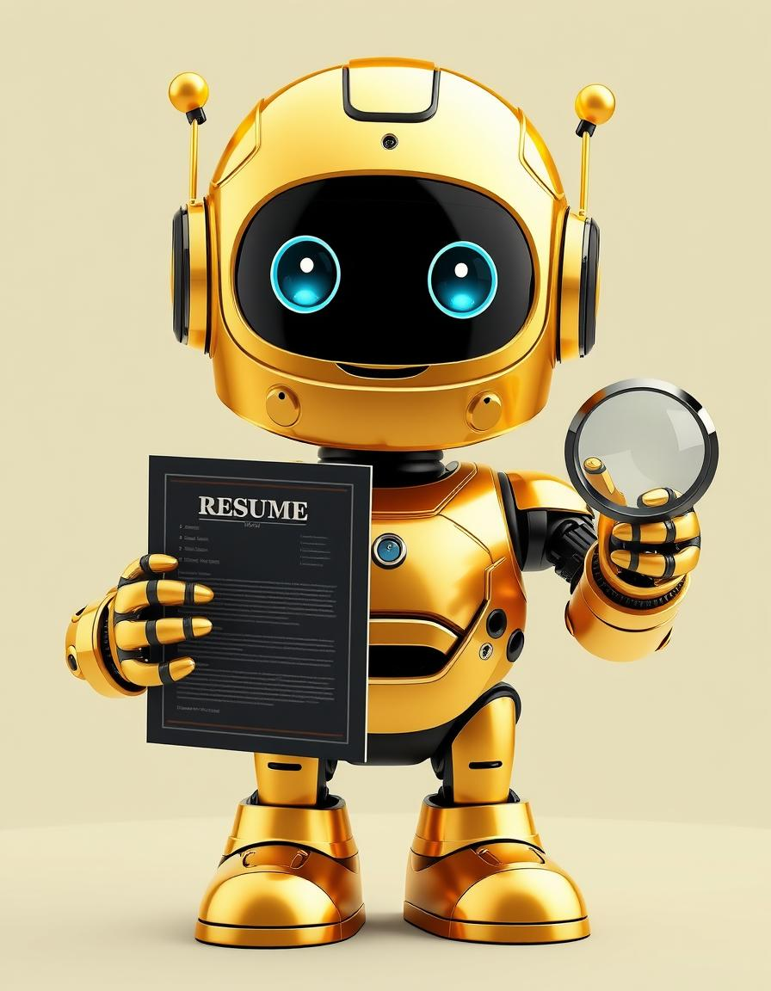
Proposed System
The Smart Application Tracking System (ATS) is designed to overcome the challenges of manual resume screening and enhanced by integrating AI-driven automation and intelligent resume analysis using Generative Ai
This System has two interfaces
Job seeker
HR Portal
The job seeker interface takes job description and resume as input and give job description matching percentage, missing keywords, profile summary and tips to improve resume score as output.
The HR Portal interface takes job description and multiple resumes as input and give Hierarchical order based on job description matching percentage and provide Exportable shortlist in PDF format
LLM model such as GeminAi is used in this application. We integrate the LLM model in the form of API keys.
The system enhances resume evaluation, keyword optimization, and job description matching to improve hiring outcomes.

Slide 14
.
14
Objectives
Automated Resume Screening – Develop an AI-powered system to analyze resumes and match them against job descriptions efficiently
ATS Score Calculation – Implement an algorithm to calculate an ATS match score based on keyword relevance, experience alignment, and skill compatibility.
Missing Keyword Identification – Identify and suggest missing keywords in resumes to improve candidate shortlisting.
Resume Optimization – Provide AI-driven recommendations to enhance resume quality and increase compatibility with job postings.
HR Candidate Evaluation System – Enable recruiters to screen multiple resumes, compare ATS scores, and rank candidates based on job relevance and provide shortlist candidate pdf
User-Friendly Interface – Develop an intuitive and interactive UI using Streamlit for both job seekers and HR professionals.
Performance Enhancement – the system for faster resume processing and real-time analysis to streamline recruitment workflows.

Slide 15
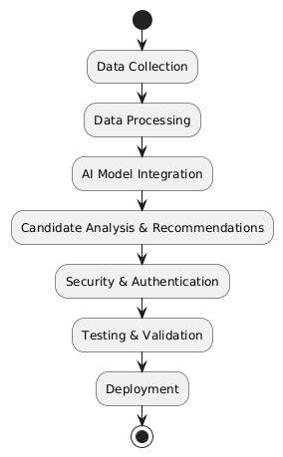
Design Methodology

Slide 16
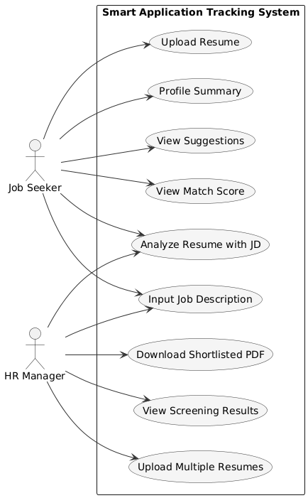
Use-Case Diagram

Slide 17
.
Step 1: Data Collection
Resume and Job Description Input:
Job Seekers: Upload resume in PDF format and input job descriptions via text area.
HR Portal: Upload multiple resumes (PDF) and define job requirements using text input.
Data Sources:
Resumes (PDF files) parsed using PyPDF2.
Job descriptions provided as free-text input.
Step 2: Data Preprocessing
Text Extraction & Cleaning
Use PyPDF2 (or similar) to parse PDFs and extract raw text.
Clean data by removing stopwords, special characters, and irrelevant sections.
Tokenization & Normalization
Convert text to lowercase, tokenize words, and remove punctuation.
Standardize terms (e.g., “DevOps” vs. “Dev Ops”).
Feature Extraction
Identify skills, experience duration, education level.
Map each candidate’s resume to a structured format for AI processing.

Slide 18
.
Input Validation:
Ensure non-empty job descriptions and valid PDF files before processing.
Handle errors (e.g., corrupted PDFs) with try-except blocks.
Step 3: AI Model Integration
Weighted Algorithm:
Calculate ATS Score based on:
Keyword Matching (50%)
Experience Relevance (30%)
Skills Alignment (20%)
Generative AI Analysis:
Used Google’s Gemini model (gemini-1.5-pro-latest) to analyze resumes against job descriptions.
Generate missing keyword suggestions and highlight skill gaps.

Slide 19
.
Step 4: Candidate Analysis & Recommendations
Resume Analysis
Compare each resume against the job description to generate an analysis report.
Identify missing keywords and areas for improvement.
Improvement Suggestions
Auto-generate recommendations (e.g., adding specific skills, adjusting format).
HR Portal
Batch process multiple resumes for a single JD.
Bulk Processing: Upload multiple resumes, track progress with a progress bar.
Candidate Ranking: Sort candidates by ATS score, display results in columns with expandable analysis.
Exportable shortlisted PDF.

Slide 20
.
Step 5: Security and Authentication
API Key Management
Securely store Google API key using1 `python-dotenv` and `.env` file.
HR Portal Authentication
Basic login system with username/password validation (e.g., `admin`/`passwors`).
Step 6: Testing & Validation
Unit Testing:
Validate PDF text extraction, regex parsing, and session state caching.
User Testing:
Test with diverse resumes (formats, languages) to refine AI accuracy.
Error Handling:
Gracefully handle API failures, empty inputs, and invalid files.
Step 7: Deployment :
Host the Streamlit app on cloud platforms (Streamlit Cloud).

Slide 21
Planning of Project and Teamwork
Weeks | Tasks | Deliverables | Status
Week 1 | Project Initiation | - The problem statement and objectives are clearly defined. - The scope of the project is agreed upon. - The team roles are assigned. | Completed
Week 2 | Literature Review | - Summarize existing ATS methodologies. - Identify research gaps in resume screening. - Develop an initial approach for weighted scoring and NLP. | Completed
Week 3 | Data Collection | - Gather sample resumes (PDFs). - Collect job descriptions from various domains. - Confirm data sources and structure for AI analysis. | Completed
Week 4 | Data Preprocessing | - Extract text from PDFs using PyPDF2. - Clean and normalize text by removing stopwords and punctuation. - Tokenize and format data for AI input. | Completed

Slide 22
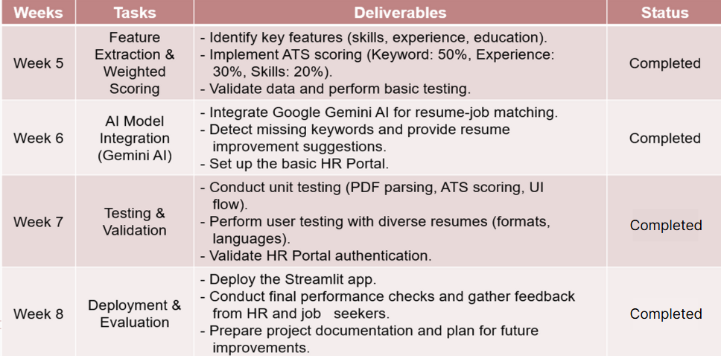
Planning of Project and Teamwork

Slide 23
Hardware and Software Requirements
Hardware Requirements:
Processor: Intel Core i5
Hard Disk: Minimum 100GB
RAM: Minimum 8GB
Internet Connection: Stable connection (10 Mbps)
Software Requirements:
Operating System: Windows 10/11, macOS, or Linux (Ubuntu 20.04+)
Programming Language: Python 3.8 or higher
Framework: Flask
UI Framework: Streamlit (for frontend development)
Version Control: Git & GitHub
Virtual Environment: venv
IDE: Visual Studio Code

Slide 24
Outline of the Implementation code
24
Framework Used:
Python with Streamlit for Web UI
Google Gemini AI for NLP tasks
Key Modules:
job_seeker_interface() – Resume analysis and improvement
hr_portal_interface() – HR screening and candidate ranking
PDF parsing, text preprocessing, keyword extraction
Gemini AI Integration:
Prompt-based analysis of Resume against Job Description
Keyword gap detection and match scoring

Slide 25
Outline of the Implementation code
25
Output Generation:
AI-modified resume
PDF export of shortlisted candidates
GitHub Code URL:
https://github.com/AnithaVarikallu/Smart-Application-Tracking-System.git

Slide 26
Inputs and Outputs of the Project
26
Inputs of the Project
Job Seeker Mode:
Resume (PDF format)
Job Description (Text format)
HR Portal Mode:
Login page
Multiple Resumes (PDF format)
Single Job Description (Text format)

Slide 27
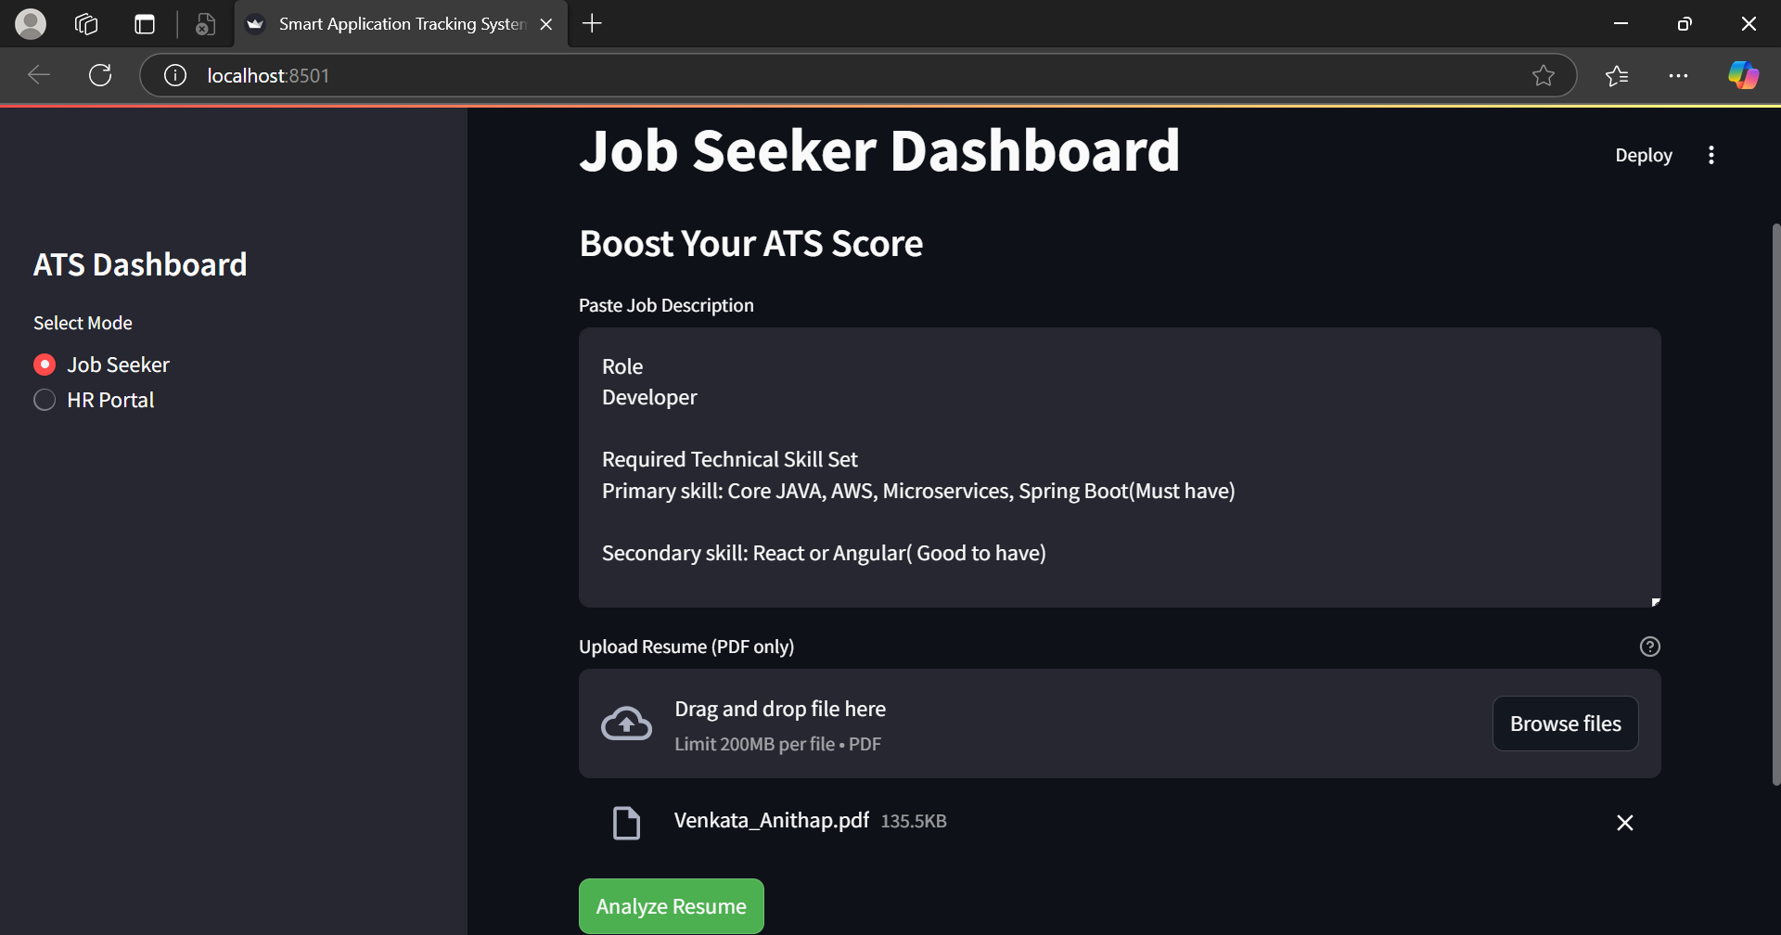
27
Figure1: Job Seeker mode Input

Slide 28
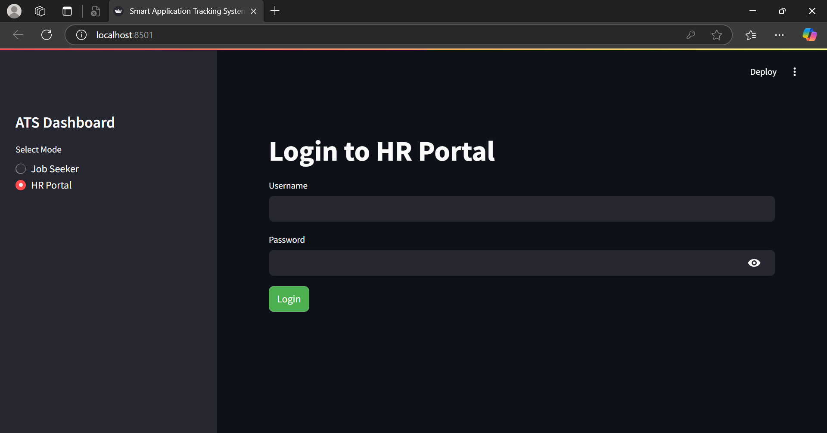
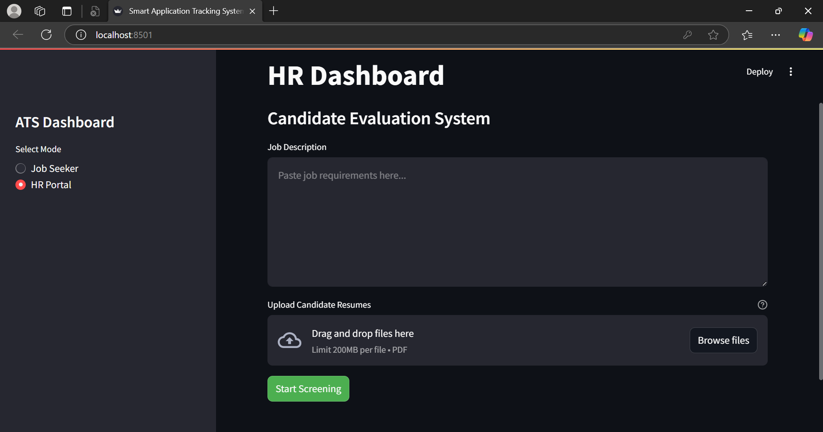
28
Figure2: HR Portal Input

Slide 29
Inputs and Outputs of the Project
29
Outputs of the Project
Job Seeker Output:
ATS Match Score (out of 100)
Missing Keywords
Profile Summary
Improvement Suggestions

Slide 30
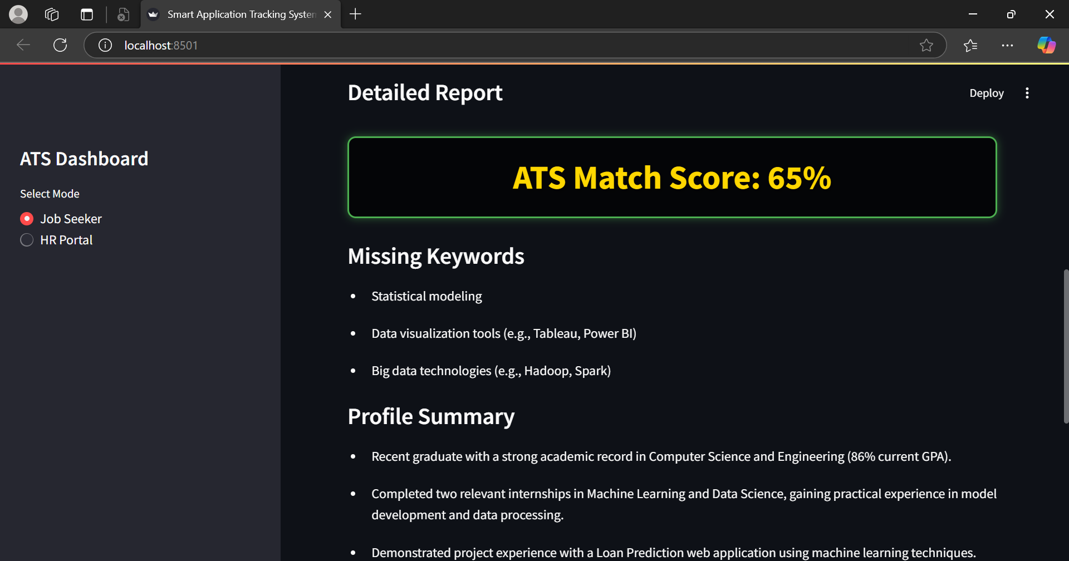
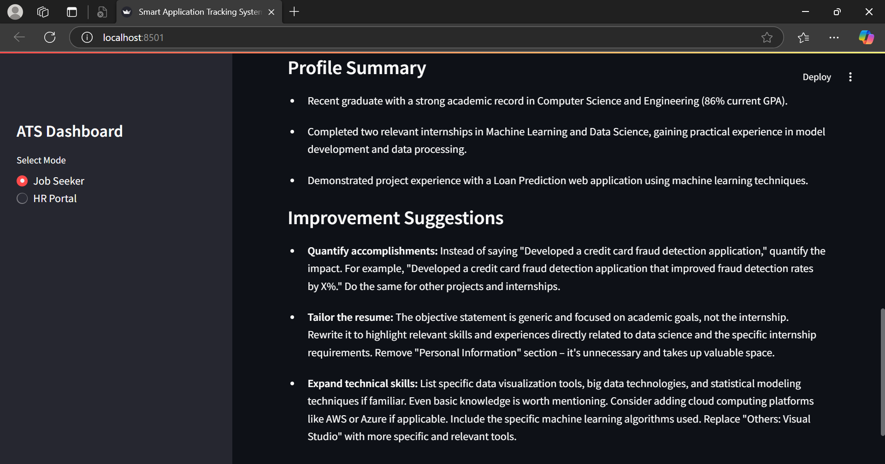
30
Figure3: Job Seeker Output

Slide 31
Inputs and Outputs of the Project
31
Outputs of the Project
HR Portal Output:
Ranked list of candidates
Shortlisting summary
Exportable shortlist in PDF format

Slide 32
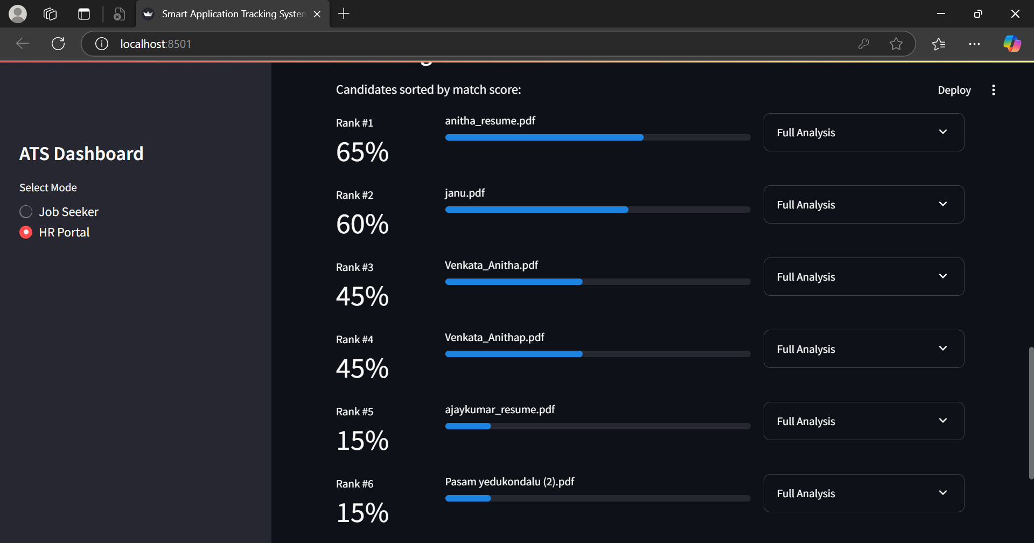
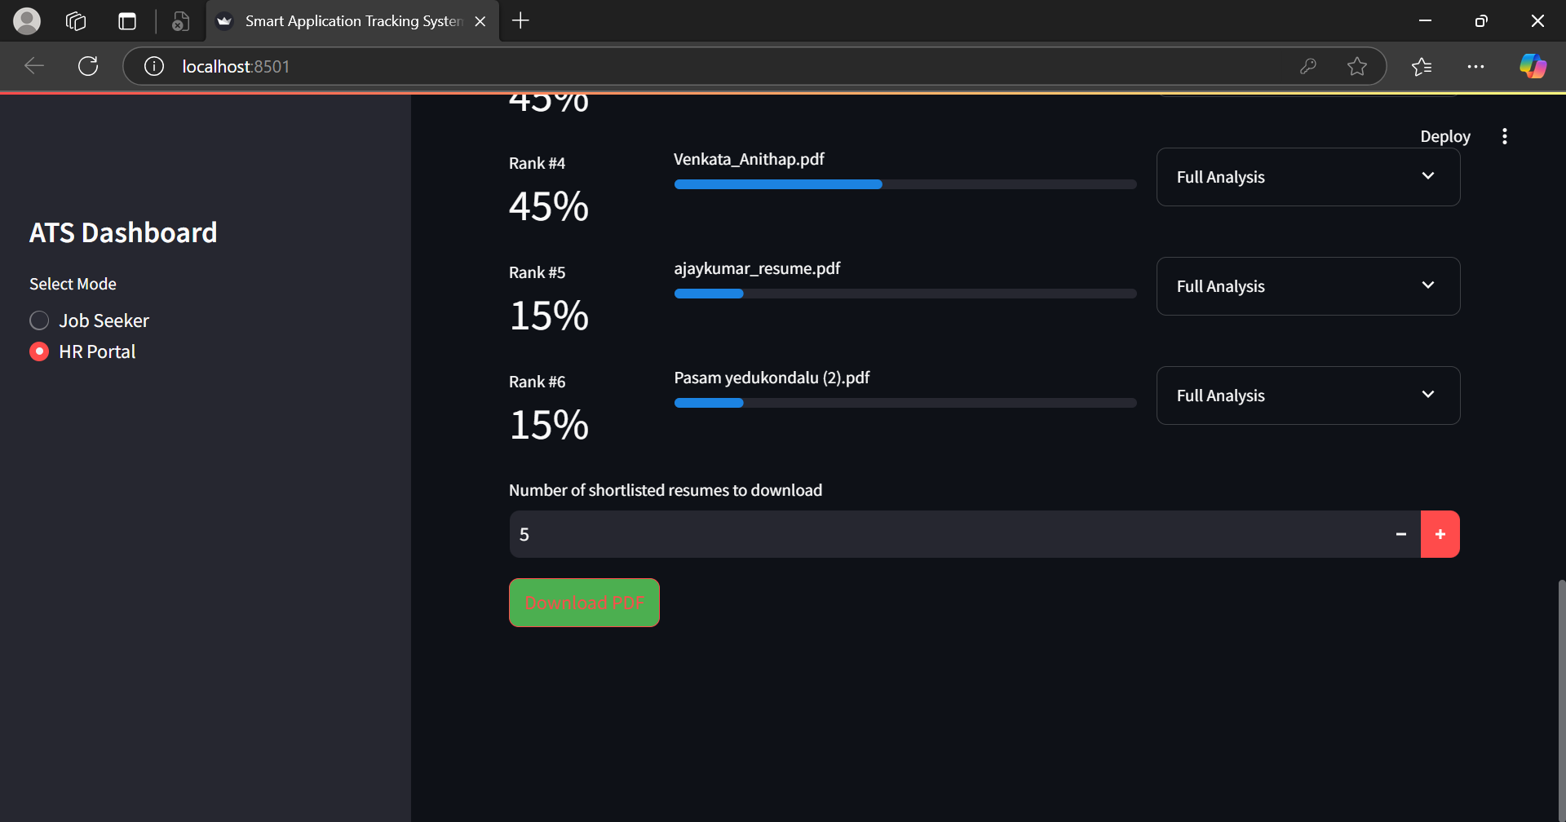
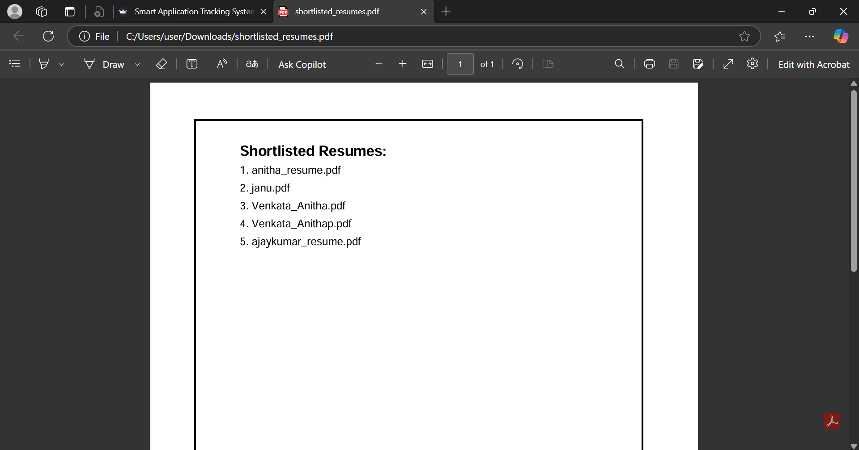
32
Figure4: HR Portal Output

Slide 33
Analysis of Results
Job Seeker Portal Result Analysis
Matching Accuracy:
Match score generated using Gemini AI shows consistent, relevant results.
Resume updates improve match percentage significantly.
Keyword Detection:
Accurately identifies skills and terms missing in resume.
Performance:
Fast PDF parsing and real-time AI analysis (<5 seconds).
User Experience:
Streamlit UI offers an intuitive two-mode interface.
Clear visualization of match scores and keyword feedback.

Slide 34
Analysis of Results
HR Portal Result Analysis
Candidate Ranking System:
Accurately ranks resumes based on JD alignment and ATS scores.
Gemini AI ensures that contextual relevance is factored in .
Shortlisting Efficiency:
Reduces manual screening time significantly.
Can process and rank multiple resumes within seconds.
Exportable Reports:
Shortlisted candidates exported as PDF with ranking.
Scalability:
Works seamlessly for 1 to 100+ resumes per job post.

Slide 35
Conclusion
Developed a Smart ATS using NLP and AI to bridge the gap between job seekers and recruiters.
Utilized Streamlit for UI and Google Gemini AI for resume-JD analysis.
Built features like resume scoring, keyword analysis, auto-enhancement, and HR shortlisting/export.
Gained deep insight into how real-world ATS systems function.
Learned AI API integration, data handling, and visual analytics.
Focused on user experience design for both job seekers and recruiters.
Improved teamwork and project planning through effective task distribution.
Helps job seekers optimize resumes and boost hiring chances.
Assists HR in screening candidates efficiently, saving time.

Slide 36
Future Scope
Deployment on the Internet:
Move from local deployment to full web deployment for global access.
Multi-format Resume Support:
Add support for formats other than PDF (e.g., DOCX, TXT).
Upgrade API Plan:
Shift from free to paid Google Gemini API to improve speed, increase resume processing limit, and access advanced features.
Auto Resume Generation:
Implement automated PDF generation of the improved resume with missing keyword suggestions applied.

Slide 37

References
37
K.Sri Surya, Reguri Sharanya, Afrah Zilani, DrCH.Niranjan, “Smart Applicant Tracking System using Gen AI”, 2024 International Journal for Innovative Engineering and Management Research, 13(4), 505-516.(Link)
Shubham Bhor, Vivek Gupta, Vishak Nair, Harish Shinde, Mansi Kulkarni. “A Resume Parser Using Natural Language Processing Technique.” International Journal of Research in Engineering and Science (IJRES)
Generative Deep Learning: Teaching Machines To Paint, Write, Compose, and Play, Second Edition (Grayscale Indian Edition) Paperback – 24 May 2023

Slide 38

.

