Slide 1
TalentMind AI — Candidate Ranking
Hybrid recruiter intelligence with Gemini, FAISS search, explainability, and dashboard export.

Slide 2
Problem Statement
Hiring teams struggle to rank candidates consistently and quickly.
Traditional ATS systems prioritize resumes, not candidate fit signals.
Need an AI-first recruiter assistant that is explainable and fast.

Slide 3
Existing ATS Limitations
Keyword matching misses candidate intent and skill relevance.
Little to no insight into candidate behaviors or recruiter fit.
Ranking is rarely explainable or semantically aware.

Slide 4
Proposed Solution
A hybrid ranking platform combining embeddings, skills, experience, and LLM recruiter signals.
End-to-end dashboard with job understanding, candidate explainability, and exports.
Fallback logic keeps the system robust when Gemini is unavailable.

Slide 5
System Architecture
React dashboard communicates with Django REST APIs.
Backend computes embeddings, ranking, and Gemini recruiter analysis.
Results are exported to CSV and submission-ready formats.

Slide 6
Data Pipeline
Job description analysis produces structured required skills and behavioral themes.
Candidate profiles are embedded for semantic matching.
Scores are combined through a weighted hybrid formula.

Slide 7
Job Understanding Engine
Extracts key skills, experience focus, and behavioral expectations.
Supports recruiter input through structured JD analysis.
Feeds downstream ranking and explainability layers.

Slide 8
Semantic Search + FAISS
Candidate embeddings are indexed for fast nearest-neighbor retrieval.
Semantic score captures intent and overall resume fit.
FAISS enables scalable similarity search in production.

Slide 9
Skill Intelligence Engine
Matches required skills against candidate skill profiles.
Generates strengths and gap detection.
Contributes to explainable role fit scoring.

Slide 10
Experience Intelligence Engine
Evaluates years of experience and career trajectory.
Looks for stability, growth, and role alignment.
Provides experience-specific explainability text.

Slide 11
Behavioral Intelligence Engine
Assesses recruitability signals like response and completion rates.
Captures open-to-work status and profile completeness.
Improves ranking with practical hiring readiness metrics.

Slide 12
Gemini Recruiter Agent
Invokes Gemini for qualitative recruiter analysis.
Produces an LLM fit score, recommendation, strengths, weaknesses, and summary.
Falls back to deterministic logic when Gemini is unavailable.

Slide 13
Hybrid Ranking Formula
final_score = 0.35*semantic + 0.25*skill + 0.15*experience + 0.15*recruitability + 0.10*llm.
Combines structured and generative signals for balanced ranking.
Supports explainable decisions at each scoring stage.

Slide 14
Explainable AI
Each candidate receives semantic, skill, experience, behavioral, and Gemini explanations.
Strengths, weaknesses, and missing skills are surfaced.
Enables recruiter trust and fast shortlist decisions.

Slide 15
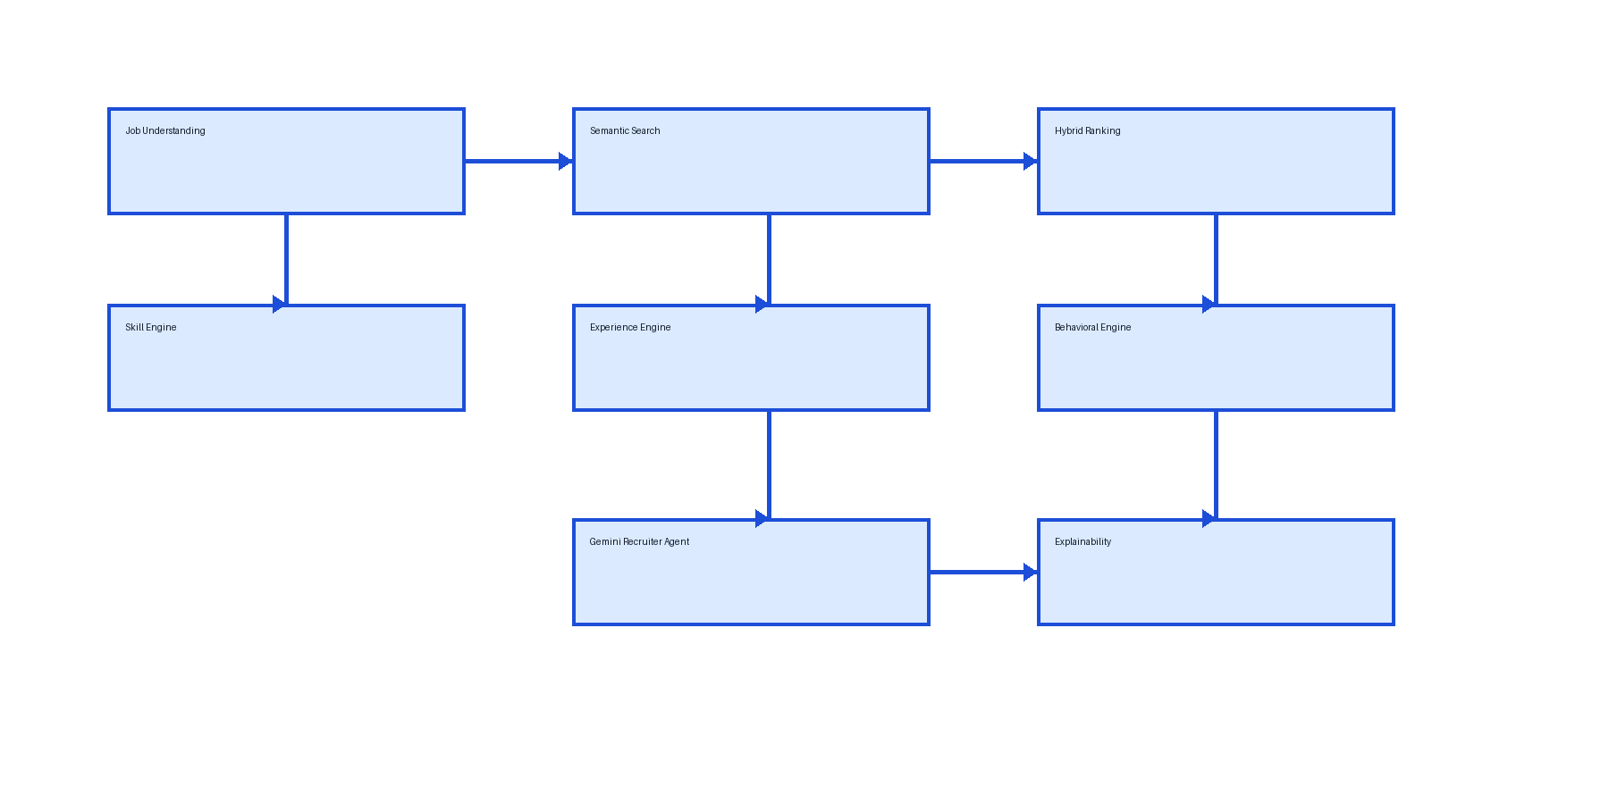
Architecture Diagram

Slide 16
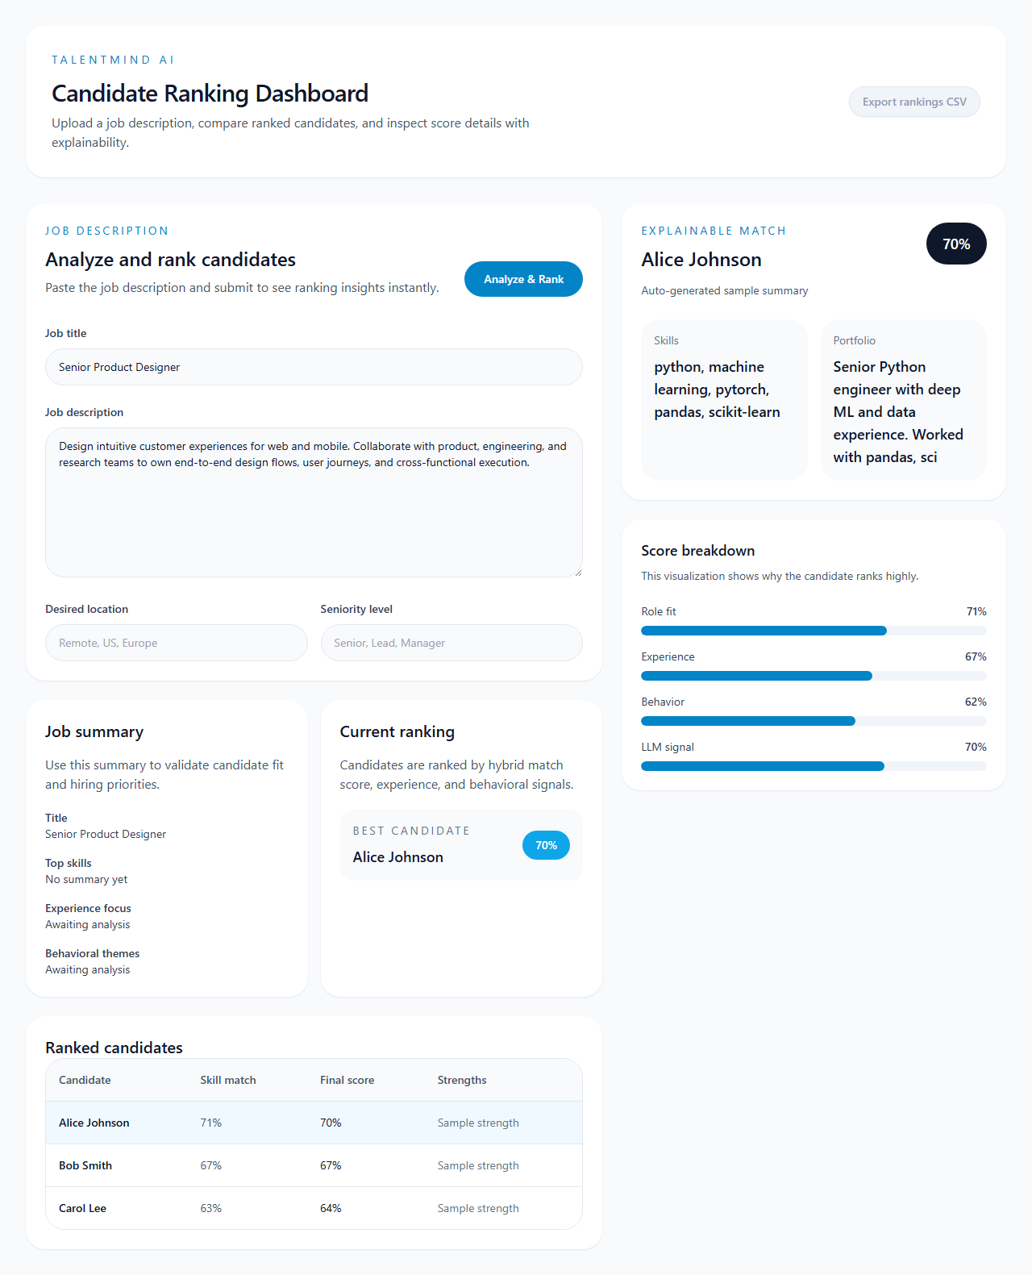
Dashboard Home

Slide 17
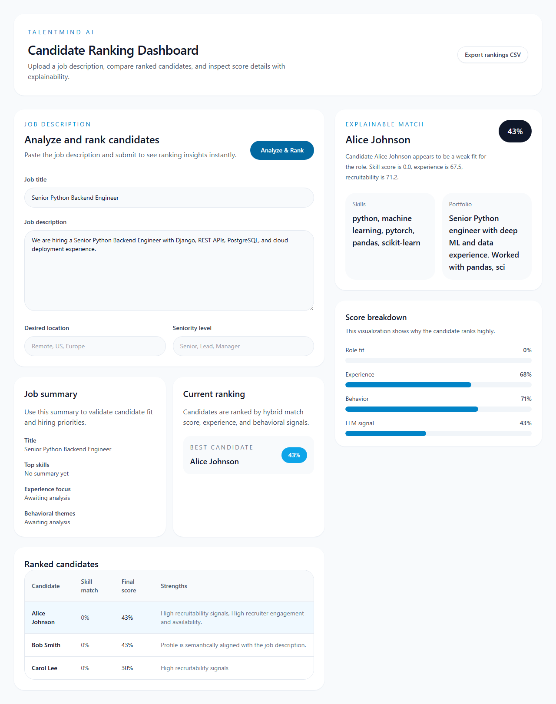
Dashboard Ranked

Slide 18
Results & Impact
Generated submission-ready ranked outputs and candidate explainability data.
Automation script creates the final submission package and screenshots.
Demonstrated a robust fallback for Gemini API availability.

Slide 19
Future Enhancements
Add enterprise-grade persona and diversity-aware ranking.
Extend candidate sourcing with resume parsing and ATS ingestion.
Build a multi-user role-based dashboard and interview insights.

