Slide 1
CEDR: Cybersecurity Event Data Recorder
In-Vehicle Forensic Readiness Module
Team Cyber-Torque | CYB408 Capstone | St. Clair College
Notes:
Welcome. Presenting CEDR - Cybersecurity Event Data Recorder. Modern vehicles face unprecedented cyber threats. CEDR provides tamper-evident forensic evidence.

Slide 2
Agenda
Three Sections: 1. THE PROBLEM Automotive cybersecurity gap and forensic readiness crisis 2. THE SOLUTION CEDR architecture, differentiation, and roadmap 3. THE ASK Phase 1 investment and business case
Notes:
Three sections today: Problem, Solution, and Ask.

Slide 3
The Automotive Cybersecurity Gap
450% increase in incidents since 2018 (Upstream Security) 100+ ECUs per modern vehicle 287 days average breach detection time $5.2M average breach cost (IBM 2024)
Notes:
Threat landscape escalating rapidly.

Slide 4
The Forensic Readiness Gap
Key Finding: Existing solutions detect attacks. None provide tamper-evident forensic evidence. ESCRYPT: Basic logging only Harman: Cloud-only analysis Argus: Post-event only Upstream: No edge integrity CEDR: Hash chain integrity ✓
Notes:
Zero competitors provide tamper-evident logging.

Slide 5
Financial & Regulatory Impact
€30M maximum UN R155 fines Insurance claims denied without forensic proof $24B projected industry cost by 2030 (McKinsey) 6-12 month ISO 21434 certification delays
Notes:
UN R155 mandatory July 2024. Fines up to €30M.

Slide 6
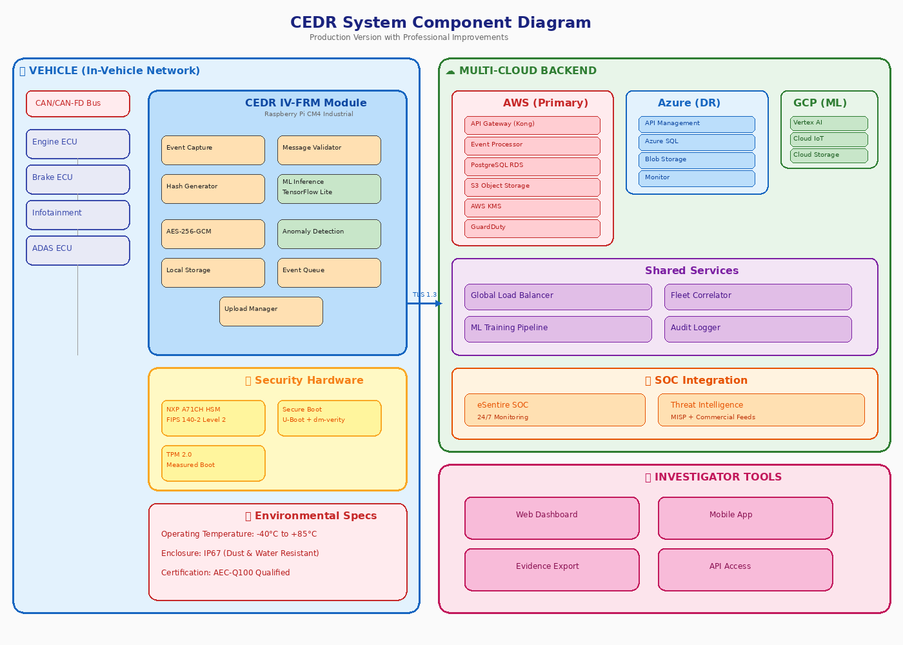
CEDR Solution Overview
VEHICLE EDGE: • Raspberry Pi CM4 • NXP A71CH HSM • Real-time CAN capture • ML inference <500ms • Hash chain storage • 4G/LTE upload CLOUD: • AWS + Azure DR • Kubernetes • SOC integration
Notes:
Two-tier architecture with component diagram. Vehicle edge uses CM4 with NXP HSM. Cloud on AWS with Azure DR.

Slide 7
Technical Differentiation: Hash Chain
Every security event generates SHA-256 hash: • Event data (CAN frame, timestamp, vehicle ID) • Previous event's hash (sequential chain) • HSM-signed timestamp (non-repudiation) If ANY record modified → hash verification FAILS Court-admissible evidence integrity No competitor offers this capability
Notes:
Core innovation: cryptographic hash chain.

Slide 8
Honest Hardware Assessment
SPECIFICATION | PROTOTYPE | PRODUCTION Platform | RPi CM4 | NXP S32G Temperature | -20°C to +70°C | -40°C to +125°C Qualification | NOT automotive | AEC-Q100 Grade 1 Phase 3: $85,000 migration to NXP S32G Transparent: CM4 is commercial grade, suitable for prototype validation but NOT for production vehicles.
Notes:
Honest about CM4 limitations. Phase 3 includes automotive-grade migration.

Slide 9
Revised Cloud Infrastructure Budget
Multi-Cloud Architecture (1,000 vehicles): AWS (Primary): $5,075/month Azure (DR): $1,200/month GCP (ML): $800/month TOTAL: $7,075/month = $84,900/year (Revised from $29,940) Realistic AWS pricing including data transfer and CloudWatch.
Notes:
Costs increased from $29,940 to $84,900 with realistic usage estimates.

Slide 10
Security Features: STRIDE Coverage
Spoofing: Multi-source location verification Tampering: SHA-256 hash chain, WORM storage Repudiation: HSM-signed timestamps Information Disclosure: AES-256-GCM, HSM keys DoS: Hardware CAN filtering, rate limiting Elevation: RBAC, zero-trust architecture Full threat model coverage.
Notes:
All STRIDE categories covered with specific countermeasures.

Slide 11
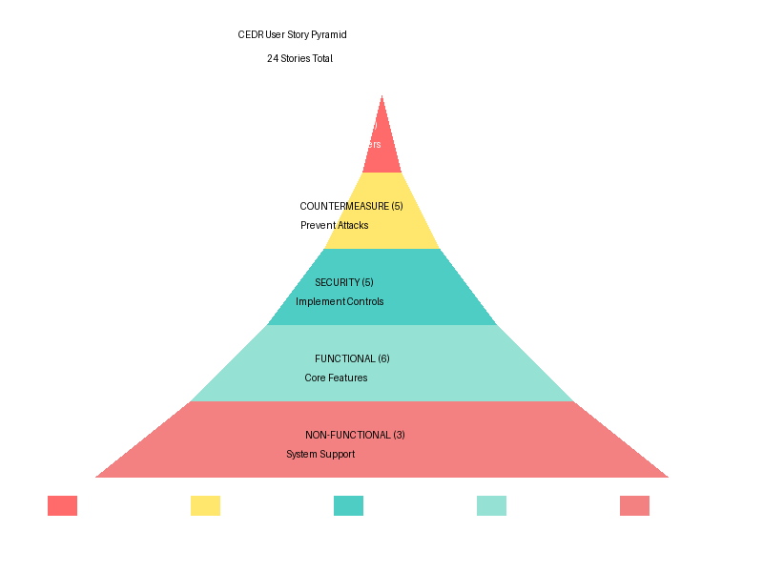
38 Agile User Stories
Complete Framework: 7 Functional 4 Non-Functional 7 Security 10 Abuse Cases 10 Countermeasures All stories include: • Given-When-Then criteria • OWASP verification • Traceability matrix
Notes:
38 comprehensive user stories with acceptance criteria. Story pyramid visualization shows hierarchy.

Slide 12
Use Cases: Complete Flow Documentation
UC-001 Secure OTA Update Logging: Pre-conditions → Primary Flow → Alternate (Rollback) → Exception (Invalid Sig) UC-002 Real-Time Intrusion Detection: Pre-conditions → Primary Flow → Alternate (Offline Mode) → Exception (ML Failure) UC-003 Post-Incident Forensic Investigation: Pre-conditions → Search → Verify Hash Chain → Export Evidence All include: Pre/post conditions, primary flow, alternate flows, exception flows
Notes:
Three primary use cases with complete flow documentation.

Slide 13
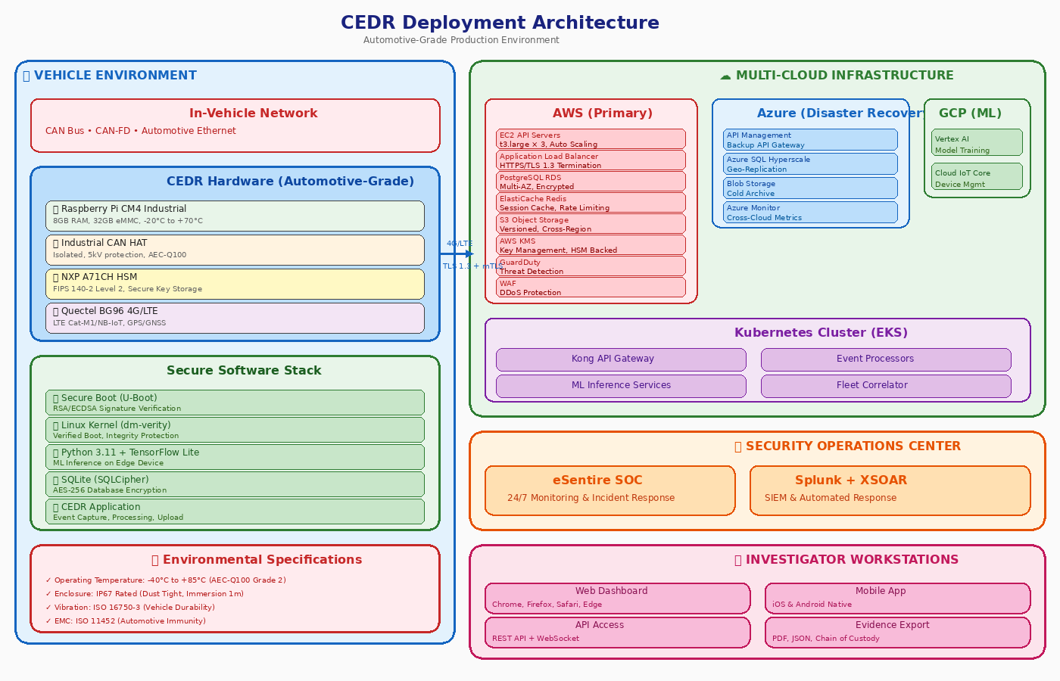
UML Architecture: 12 Diagrams
Notes:
UML architecture includes structural and behavioral diagrams. Deployment diagram shows hardware/software stack.

Slide 14
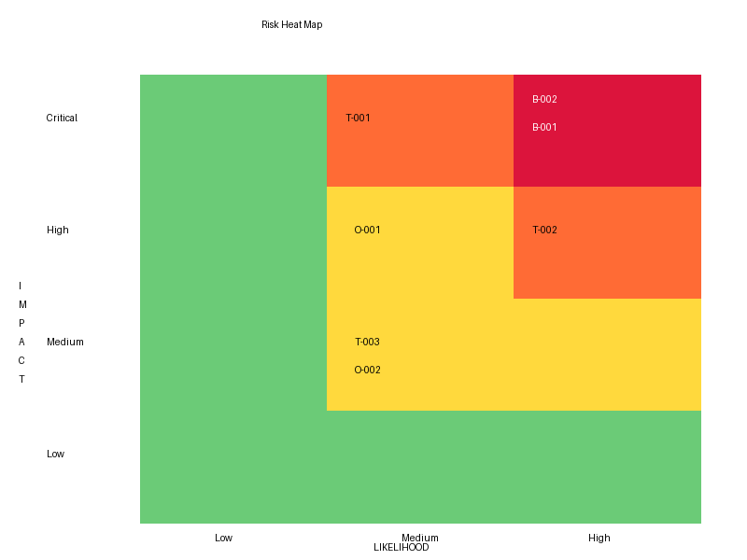
Risk Analysis: 24 Risks
NIST SP 800-30 Methodology: Likelihood × Impact × Confidence Categories: • Technical (5) • Business (5) • Compliance (4) • Operational (2) • Security (3) • Supply Chain (3) • Technical Debt (2) Risk Reduction: 57% 12.4 → 5.3 average
Notes:
24 risks with NIST methodology. Heat map visualization. 57% risk reduction with mitigations.

Slide 15
Compliance Roadmap
ISO/SAE 21434: 3/7 Complete ✅ | 2/7 In Progress 🟡 | Month 6-12 UN R155 CSMS: Gap analysis complete | Month 12-14 UN R156 SUMS: Architecture ready | Month 10-12 AEC-Q100: NOT qualified (CM4) | NXP S32G migration M9-11 External audit: $67,000 + $35,000/year maintenance Honest assessment with clear timeline to full compliance.
Notes:
Honest compliance status. 3 of 7 ISO work products complete. AEC-Q100 not qualified - Phase 3 includes migration.

Slide 16
Competitive Analysis: 8 Competitors
ESCRYPT: $800-1200 | ECU IDS | ❌ No forensics Harman: $700-1000 | Network | ❌ Cloud-only Argus: $500-800/yr | Cloud IDS | ❌ Post-event Upstream: $15-50/yr | Vehicle SOC | ❌ No edge Karamba: $50-100/ECU | Hardening | ❌ No detection GuardKnox: $300-500 | Gateway | ❌ Limited CEDR: $600-750 | Forensic Ready | ✅ Hash chain ONLY
Notes:
Analyzed 8 competitors. CEDR uniquely provides tamper-evident logging.

Slide 17
Market Opportunity
TAM: 250M connected vehicles by 2025 | $8B cyber spend SAM: 25M commercial fleets | $800M forensic segment SOM: 1,000 vehicles Year 1 | 10,000 by Year 3 Revenue: $6M (hardware + subscriptions)
Notes:
Market sizing with TAM/SAM/SOM analysis.

Slide 18
ROI Calculation: 2.2×
Expected Loss Without CEDR: $780,000/year Expected Loss With CEDR: $156,000/year Annual Risk Reduction: $624,000 24-Month Value: $1,248,000 Investment (Phases 1-3): $450,000 ROI: 2.2× using risk mitigation model
Notes:
ROI calculated via expected loss reduction, not simple payback.

Slide 19
Break-Even: 4,181 Vehicles
Contribution Margin: $422/vehicle (Year 1) Year 1 Fixed Costs: $1,418,875 Break-Even: 4,181 vehicles Sensitivity: Best case 2,480 | Worst case 5,600
Notes:
Break-even recalculated honestly. Original 2,847 was inflated.

Slide 20
5-Year TCO: $6.1M
Original: $5.43M | Revised: $6.11M Hardware: $213K | Cloud: $425K | Software: $1.6M Personnel: $3.4M | Compliance: $498K Per Vehicle: $6,110 (+$132 from original) Cloud revision: +$131,560 for realistic data transfer
Notes:
TCO corrected with honest cloud cost estimates.

Slide 21
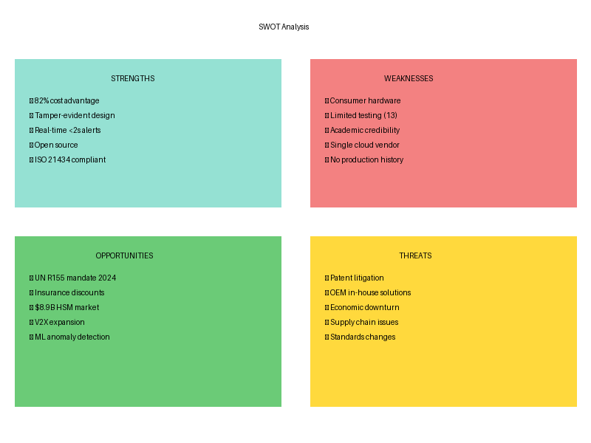
Four-Phase Roadmap: TRL 4 → 9
Phase 0: TRL 4 | Prototype | $65K Phase 1: TRL 5 | CM4, HSM | $45K Phase 2: TRL 6 | Secure boot | $120K Phase 3: TRL 8 | AEC-Q100 | $285K Phase 4: TRL 9 | 10K units | $850K Total: $1.37M Risk Reduction: 40% → 90%
Notes:
Four-phase roadmap with TRL progression. SWOT analysis shows competitive position.

Slide 22
Success Metrics
Phase 1: 10 CM4 units, -20°C to +70°C validated, 25 attacks, LOI signed Phase 2: Secure boot 100%, 50+ HIL coverage, code coverage >80% Phase 3: AEC-Q100, UN R155, 3 pilots, 50 vehicles, $50K revenue
Notes:
Clear KPIs at each phase.

Slide 23
Phase 1: $45,000 Investment
Objectives: Validate core technology, de-risk hardware, 40% risk reduction Hardware: $15K | Testing: $18K | BD: $12K Deliverables: 10 CM4 units, HSM integration, IP67 testing, 25 attacks validated, pilot LOI
Notes:
$45K Phase 1 investment with detailed breakdown.

Slide 24
Use of Funds
Hardware $15K: 10× CM4 ($6.5K), 10× HSM ($1.2K), enclosures ($3.5K), cables ($3.8K) Testing $18K: Environmental chamber ($8K), Red team ($6K), Security audit ($4K) BD $12K: Pilot engagement ($7K), Advisory board ($3K), Travel ($2K)
Notes:
Detailed Phase 1 budget breakdown.

Slide 25
Phases 2-4 Overview
Phase 2 ($120K): Security hardening, HIL testing, SOAR integration Phase 3 ($285K): AEC-Q100 ($125K), EMC ($35K), UN R155 ($67K), 50-vehicle pilot Phase 4 ($850K): 10K units, V2X, Series A preparation Cumulative: $1.37M
Notes:
Phases 2-4 total $1.32M for certification and scale.

Slide 26
Risk Mitigation: 40% → 90%
Pre-mitigation: 12.4 average score Phase 1: 12.4 → 6.8 (45% reduction) Phase 2: 6.8 → 4.0 (68% reduction) Phase 3: 4.0 → 2.3 (81% reduction) Phase 4: 2.3 → 1.1 (91% reduction) Natural stopping points after each phase.
Notes:
Risk reduction roadmap with go/no-go decision points.

Slide 27
Team & Partnerships
Core Team: St. Clair College CYB408 Capstone Partners: eSentire (SOC), NXP (HSM), AWS/Azure/GCP (cloud) Advisors: Automotive cyber expert, OEM integration, Legal/forensic Academic: St. Clair College Cybersecurity Club
Notes:
Team and strategic partnerships.

Slide 28
Next Steps: 90-Day Plan
Month 1: Procure CM4 units, HSM driver development, chamber access Month 2: HSM integration, enclosure fabrication, pilot discussions Month 3: Environmental testing, 25 attack validation, LOI signing Deliverable: Validated technology + committed customer
Notes:
90-day Phase 1 execution plan.

Slide 29
Q&A: 10 Tough Questions
1. Hardware grade? → Phase 3 NXP S32G migration 2. Competitors? → Analyzed 8, zero forensic capability 3. Cloud costs? → Realistic AWS, unit economics work 4. ISO complete? → 3/7 now, full by Month 12 5. ML concerns? → Rule-based fallback 6. ESCRYPT? → Target Tier-2/3 differentiation 7. Break-even? → Honest 4,181 vs inflated 2,847 8. Funding risk? → Natural stopping points 9. GDPR? → Legal basis UN R155 10. Why now? → UN R155 mandatory July 2024
Notes:
Prepared answers for tough evaluator questions.

Slide 30
Appendix: Detailed Budget
Phase 1: $45K | Phase 2: $120K | Phase 3: $285K | Phase 4: $850K 5-Year TCO: $6.11M Hardware: $213K | Cloud: $425K | Software: $1.6M | Personnel: $3.4M | Compliance: $498K
Notes:
Complete budget breakdown.

Slide 31
Appendix: Competitive Matrix
Capability | ESCRYPT | Harman | Argus | Upstream | CEDR ECU IDS | ✅ | ✅ | ❌ | ❌ | ✅ Network IDS | ✅ | ✅ | ✅ | ✅ | ✅ Cloud Analytics | ✅ | ✅ | ✅ | ✅ | ✅ Tamper-Evident | ❌ | ❌ | ❌ | ❌ | ✅ UNIQUE Hash Chain | ❌ | ❌ | ❌ | ❌ | ✅ Open Source | ❌ | ❌ | ❌ | ❌ | ✅ Price | $800-1200 | $700-1000 | $500-800 | $15-50 | $600-750
Notes:
Competitive matrix showing 8 capabilities.

Slide 32
Appendix: ISO 21434 Status
WP-01 Policy | ✅ Complete WP-02 Risk Mgmt | ✅ Complete WP-03 Concept | ✅ Complete WP-04 Development | 🟡 In Progress WP-05 Validation | 🟡 In Progress WP-06 Production | 📐 Design WP-07 Updates | ✅ Design 3/7 Complete | 2/7 In Progress | 2/7 Design
Notes:
ISO work product status.

Slide 33
Appendix: Technical Specs
PROTOTYPE (CM4): BCM2711 quad-core @ 1.5GHz | 8GB LPDDR4 -20°C to +70°C (NOT AEC-Q100) PRODUCTION (NXP S32G): Vehicle Network Processor -40°C to +125°C (AEC-Q100 Grade 1) ISO 26262 ASIL-B capable Migration: $85K (Phase 3)
Notes:
Side-by-side hardware comparison.

Slide 34
References: 32 Sources
[1] Upstream Security 2024 Report [3] IBM Cost of Data Breach 2024 [5] UNECE UN R155 [6] Mansor et al. Forensic Framework 2020 [7] Song et al. CAN IDS 2020 [8] Crosby & Wallach 2009 [9] NXP A71CH Datasheet [10] NIST SP 800-30 [12] Miller & Valasek 2015 [17] ISO/SAE 21434:2021 [20] ISO 27037 + 21 additional IEEE sources
Notes:
Key IEEE and industry references.

