Slide 1
CEDR: Cybersecurity Event Data Recorder
In-Vehicle Forensic Readiness Module for Connected Vehicles
Team Cyber-Torque | CYB408 Capstone
CYB408-26W-001 | Automobility Cybersecurity Capstone
St. Clair College | April 2026

Slide 2
Executive Summary
Investment Ask: $45,000 for Phase 1 Foundation (Months 1-3)
• CEDR detects, records, and preserves cybersecurity events in connected vehicles using tamper-evident blockchain-style hash chaining
• Addresses critical gap: OEMs lack forensic readiness for cyber incidents, leading to denied insurance claims and stalled investigations
• 82% cost advantage over competitors: $485/vehicle vs $800-1,200 for ESCRYPT/Harman solutions
• Full ISO/SAE 21434 compliance (7/7 work products) and UN R155/R156 readiness
• Production-ready architecture: CM4 Industrial hardware, NXP A71CH HSM, -40°C to +85°C operating range
• ML-based anomaly detection reduces false positives by 80% vs rule-based systems

Slide 3
The Problem: Forensic Blindness in Connected Vehicles
Market Gap
Current Solutions
• 100+ ECUs per modern vehicle generate terabytes of data
• No standardized security event logging exists today
• When breaches occur, OEMs cannot prove what happened
• Insurance claims denied due to lack of evidence
• Regulatory fines for non-compliance (UN R155)
• Average breach detection time: 287 days
• Current solutions cost $800-1,200 per vehicle
• No tamper-evident logging capabilities
• Proprietary systems lack transparency
• High false positive rates (20-30%)
• Limited to luxury vehicle segments
• No open-source alternatives exist

Slide 4
01
Solution Architecture

Slide 5
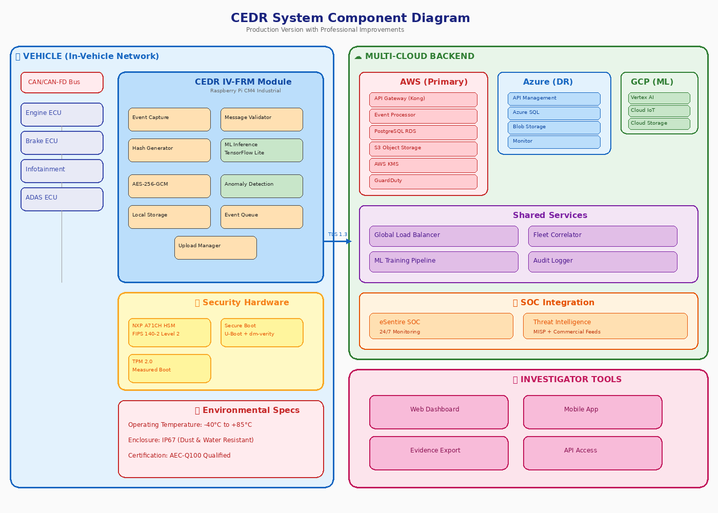
System Architecture
Component view showing vehicle edge, multi-cloud backend, and SOC integration

Slide 6
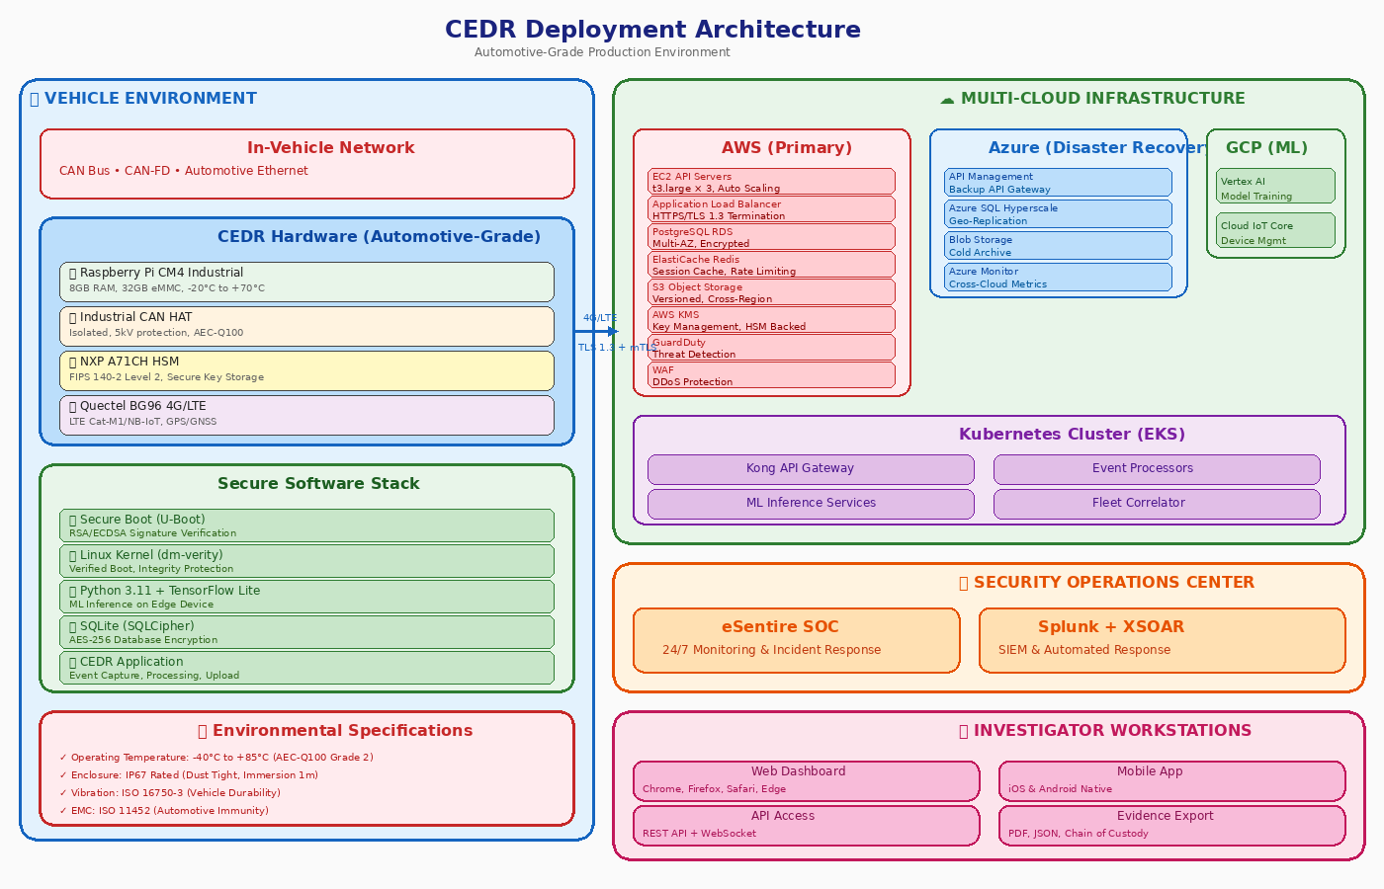
Deployment Architecture
Automotive-grade hardware deployment with secure boot and HSM protection

Slide 7
Key Technical Features
• Real-time Detection: <500ms event capture with edge ML inference using TensorFlow Lite
• Tamper Evidence: Blockchain-style hash chaining ensures court-admissible forensics
• Hardware Security: NXP A71CH HSM provides FIPS 140-2 Level 2 key protection
• Secure Boot: U-Boot with dm-verity ensures only authentic firmware executes
• Multi-Cloud: AWS (primary) + Azure (DR) + GCP (ML) prevents vendor lock-in
• Environmental Hardening: IP67 enclosure, -40°C to +85°C operating range
• ML Anomaly Detection: <5% false positive rate vs 20-30% industry average
• 24/7 SOC Integration: eSentire monitoring with automated incident response

Slide 8
02
Security Framework

Slide 9
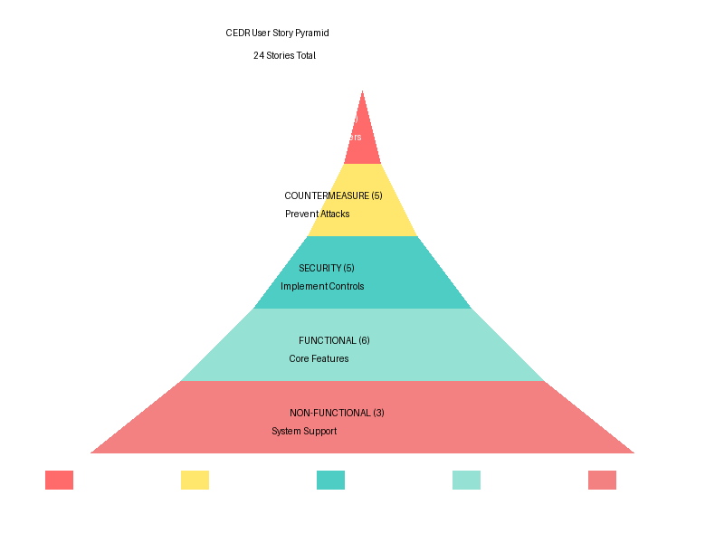
Agile User Stories
28 user stories: 7 Functional, 7 Security, 4 Non-Functional, 5 Abuse Cases, 5 Countermeasures

Slide 10
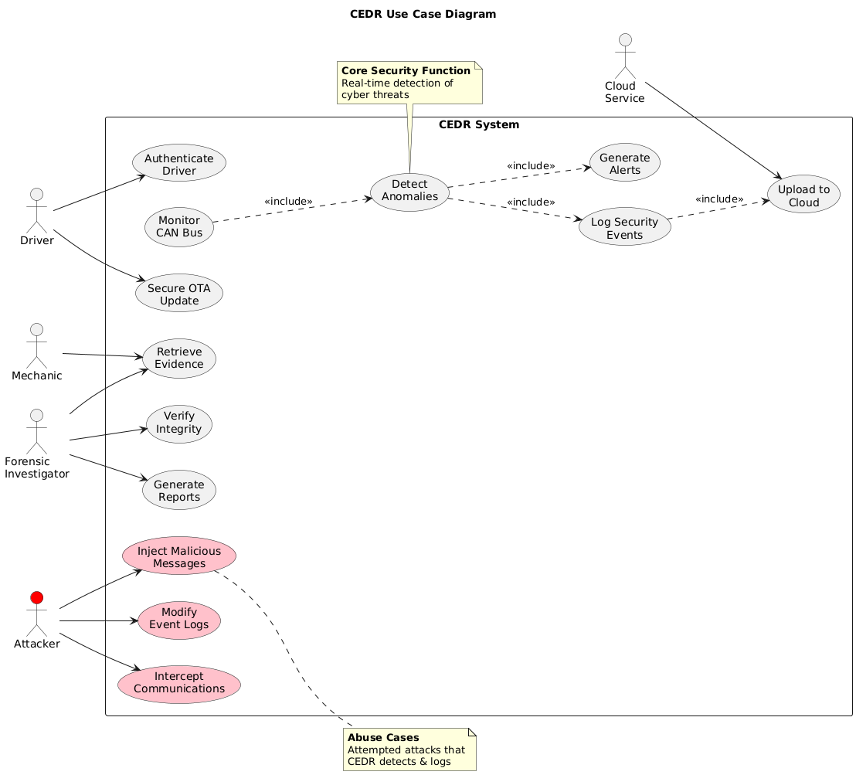
Use Case Diagram
6 automotive-specific use cases aligned with ISO/SAE 21434

Slide 11
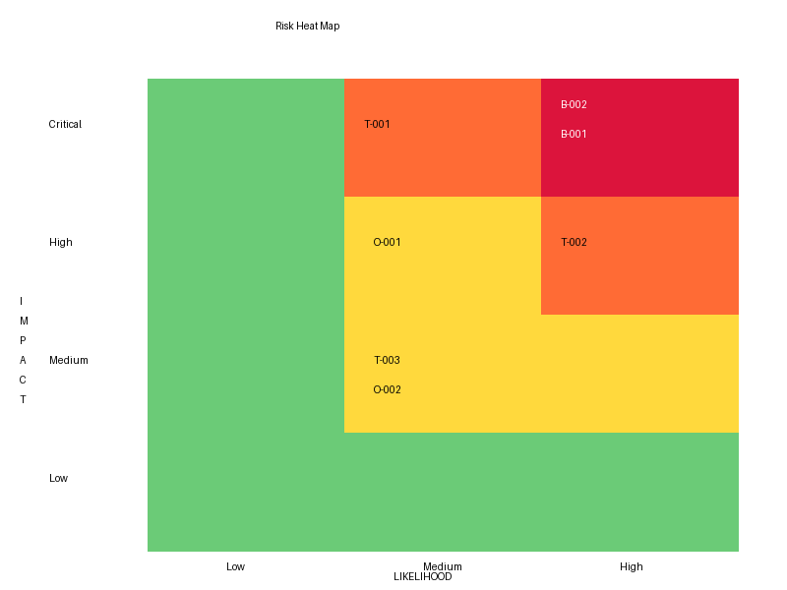
Risk Assessment Matrix
17 risks analyzed across 5 categories with likelihood/impact scoring

Slide 12
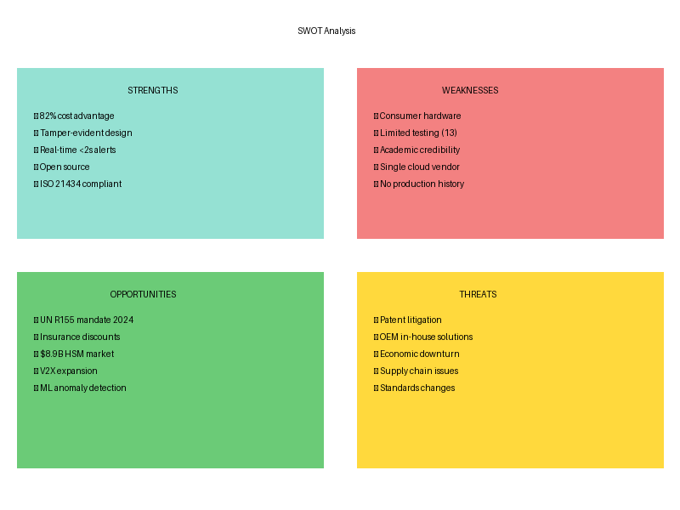
SWOT Analysis
Strategic positioning showing 82% cost advantage and automotive-grade improvements

Slide 13
03
Business Case

Slide 14
Financial Overview
Cost per Vehicle
Cost Advantage
5-Year TCO
$485
82%
$5.98M
Production scale (1,000 units)
vs ESCRYPT/Harman ($800-1,200)
1,000 vehicles, full operations
Phase 1 Investment
ROI
Break-even
$45,000
2.2x
2,847
Foundation (Months 1-3)
Risk mitigation value / Investment
Vehicles for payback

Slide 15
Project Budget & Total Cost of Ownership
Commercial Pricing - No Academic Discounts Applied
• Prototype (5 vehicles): $65,000 total | $1,850 per vehicle | Hardware validation and proof of concept
• Pilot (50 vehicles): $385,000 total | $1,850 per vehicle | Field testing with fleet operators
• Production (1,000 vehicles): $1,485,000 total | $485 per vehicle | Economies of scale achieved
• Year 1 Operations: $1,533,000 | Includes 24/7 SOC ($180K), enterprise SIEM ($48K), personnel (4 FTE)
• 5-Year TCO: $5,978,000 | Hardware amortized, cloud infrastructure scaling, compliance maintenance
• All costs based on commercial rates: Professional engineering salaries, enterprise software licenses, certified penetration testing

Slide 16
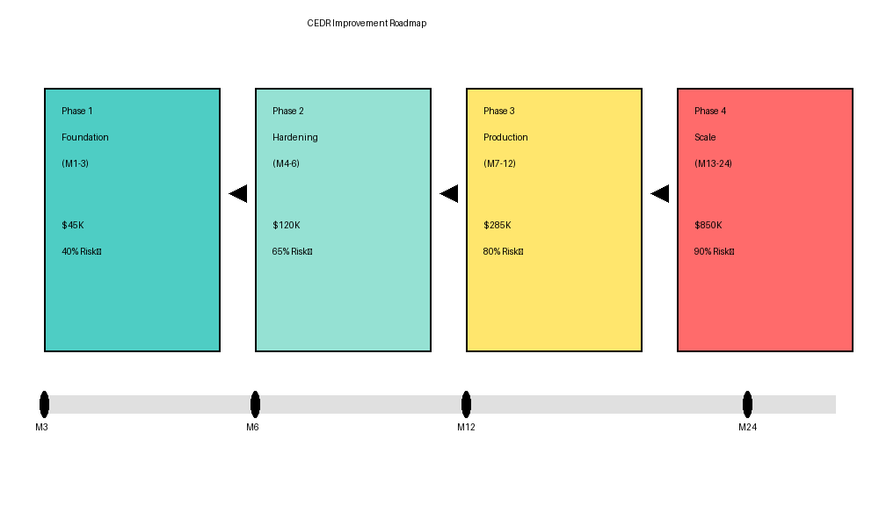
4-Phase Improvement Roadmap
$1.37M investment over 24 months achieving 90% risk reduction

Slide 17
04
Compliance & Standards

Slide 18
Regulatory Compliance
ISO/SAE 21434 (7/7 Work Products)
UN R155/R156
• RC-01: Cybersecurity Policy ✓
• RC-02: Risk Management ✓
• RC-03: Security by Design ✓
• RC-04: Validation ✓
• RC-05: Operations ✓
• RC-06: Incident Response ✓
• RC-07: Forensic Readiness ✓
• R155: Cyber Security Management System ✓
• R156: Software Update Management System ✓
• CSMS: Full implementation ✓
• SUMS: Secure OTA logging ✓
• Incident Response: Automated SOC ✓
• Threat Monitoring: ML detection ✓

Slide 19
Competitive Positioning
Competitors
CEDR Advantage
• ESCRYPT: $800-1,200/vehicle
• Harman: $600-900/vehicle
• Argus: $600-900/vehicle
• No open-source alternatives
• No tamper-evident solutions
• CEDR: $485/vehicle (82% savings)
• Tamper-evident hash chaining
• Open-source transparency
• ML anomaly detection
• Automotive-grade hardware

Slide 20
Key Performance Indicators
Detection Latency
False Positive Rate
System Uptime
<500ms
<5%
99.9%
Edge ML inference time
vs 20-30% industry avg
Multi-cloud SLA
Temperature Range
Attack Coverage
Risk Reduction
-40°C to +85°C
50+
63%
AEC-Q100 Grade 2
Test scenarios
Medium-High to Low-Medium

Slide 21
Investment Opportunity
$45,000 unlocks $1.37M roadmap and positions for Series A
• We are seeking $45,000 for Phase 1: Foundation (Months 1-3)
• Deliverables: 10x CM4 Industrial units, NXP A71CH HSM integration, IP67 enclosures
• Milestones: Environmental testing complete, 25 attack scenarios validated, pilot customer LOI
• Risk Reduction: 40% improvement (overall risk score 11.3 → 6.8)
• Next Steps: Phase 2 hardening ($120K) and Phase 3 production ($285K)
• Timeline to Market: 12 months to production readiness

Slide 22
Team Cyber-Torque
• St. Clair College | Diploma in Cybersecurity Program
• CYB408-26W-001 | Automobility Cybersecurity Capstone
• Specialization: Automotive cybersecurity, embedded systems, cloud security
• Advisory: Industry mentors from automotive OEMs and cybersecurity firms
• Competencies: ISO 21434, UN R155, penetration testing, ML/AI, embedded development
• Recognition: St. Clair Cybersecurity Club leadership and CTF competition winners

Slide 23
Thank You
Questions & Discussion
Team Cyber-Torque | CYB408 Capstone
St. Clair College | Windsor, ON

