Slide 1

GRIEVANCEGRID
Evidence-Aware Civic Complaint
and Resolution Platform
BY
DIAN DEBAM DEBASISH
JAKE S PUTHUSSERY
BOGGU SIVA SAI
MAHENDRA. K
Guided By
Dr. Jisha Mariyam John

Slide 2
Introduction
GrievanceGrid is a civic complaint and resolution platform for reporting local issues through a mobile app or web interface.
A single complaint may contain multiple issues, and multiple citizens may report the same underlying incident.
The system separates individual issues and links them with relevant evidence, responsibility, departmental work, and responses.
AI assists with issue extraction, evidence analysis, and identification of potentially related incidents.
Authorised officers verify AI suggestions and retain final decision-making authority.

Slide 3
Why GrievanceGrid?
Multiple Issues
One complaint may contain several issues, such as road damage, garbage accumulation, waterlogging, or open-drain blockage, requiring separate attention.
Repeated Reports
Different citizens may report the same incident.
Responsibility & Evidence
Each issue may require a different department and supporting evidence.
Complete Resolution
A response to one issue does not mean that all reported issues are resolved

Slide 4
Literature Review
Paper | Main Work | Key Limitation | Relevance to GrievanceGrid
CitySolution (Shama et al., 2024) [1] | Android citizen and authority apps with image-based civic complaint classification using transfer learning. | Focuses on image classification and a limited set of complaint categories; does not model multiple issues or issue-level response coverage. | Motivates visual evidence analysis and transfer learning for civic complaints.
Transformer-GNN for Social Governance (Yang et al., 2026) [2] | Combines Transformer and GNN models to learn temporal, textual, spatial, and service relationships from NYC 311 data. | High computational cost; evaluated on one city dataset; uses a relatively static graph; complex models reduce interpretability. | Motivates relationship-aware incident analysis. We begin with explicit text, location, time, and issue matching.
Multimodal LLM Grievance Framework (Rajkumar et al., 2026) [3] | Uses text and voice processing for grievance classification, urgency estimation, routing, and abuse detection. | Voice performance can degrade with noise and dialects; routing can be ambiguous for multi-department complaints; image evidence is not included. | Supports NLP-based grievance understanding while leaving room for image evidence and issue-level resolution analysis.
Public Service Grievance Topic Modelling (Deka & Srivastava, 2025) [4] | Compares LSA, NMF, LDA and BERTopic for discovering themes in government grievance data. | Finds broad topics rather than individual issues and does not evaluate responsibility, incident linking, or resolution coverage. | Supports grievance-text analysis and careful data cleaning; GrievanceGrid works at the individual issue level.
Citizen Request Classification in Boston (Kim & Hong, 2021) [5] | Applies deep-learning and data-balancing methods to classify unstructured transportation requests. | Focused on transportation requests from one city; classification is the main task and does not follow complaints through departmental resolution. | Supports automated text classification while GrievanceGrid extends analysis beyond classification.

Slide 5
Literature Review
Paper | Main Work | Key Limitation | Relevance to GrievanceGrid
Intelligent Government Complaint Prediction (Chen et al., 2022) [6] | Uses ML-based text classification and automatic label correction to improve government complaint prediction and department assignment. | Mainly treats complaint handling as classification; noisy and imbalanced labels remain a challenge; does not model multi-issue resolution. | Highlights the importance of reliable labels and structured complaint data for our NLP models.
Structure of 311 Service Requests (Wang et al., 2017) [7] | Uses the spatial and temporal structure of 311 requests to characterize urban locations. | Service-request categories differ between cities and over time; analysis is mainly at aggregated location level rather than individual incident level. | Supports our use of spatial and temporal information when identifying related reports.
Citizen Complaints as an Accountability Mechanism (Olivos et al., 2023) [8] | Uses NLP and topic modelling to identify patterns in 1,623 complaints and study changes over time. | Focuses on thematic patterns in police complaints rather than operational routing, evidence, departmental work, or resolution. | Shows how complaint text can reveal meaningful patterns while GrievanceGrid focuses on the complete complaint lifecycle.
Machine Learning Analysis of 311 Requests (Cheng et al., 2022) [9] | Applies Random Forest, SVM, regularised regression and XGBoost to analyse 311 request volumes and spatial patterns in Miami-Dade County. | Focuses on predicting request volume and community characteristics rather than linking individual reports or evaluating resolution. | Supports the use of spatial patterns and ML for civic-service analysis.
Social Sensing with 12345 Complaint Data (2022) [10] | Builds an urban problem classification tree, automatically classifies complaints, and improves departmental responsibility assignment. | Focuses mainly on classification and responsibility allocation; it does not provide issue-level evidence provenance or response-coverage auditing. | Closely supports our classification and responsibility stage, while GrievanceGrid extends the workflow through evidence and resolution review.

Slide 6
CPGRAMS: Existing AI and Next-Generation Developments
IGMS 2.0 already uses AI/ML to analyse grievances, including detection of repetitive or spam complaints, semantic analysis, topic identification, and spatiotemporal analysis [5].
Samadhan Didi, launched in May 2026, enables citizens to submit grievances through voice and uses AI-based language processing to identify the appropriate ministry, department, category, and sub-category [6].
NextGen CPGRAMS is being developed with capabilities such as AI-based categorisation, intelligent routing, multilingual access, automated escalation, analytics, and AI-assisted validation of grievance redressal quality [7], [8].

Slide 7
Motivation and Research Focus
Research Question: How can AI assist in understanding, connecting, and evaluating civic grievances using individual issues, multimodal evidence, related reports, and resolution responses?
AI-Assisted Understanding: Extract individual issues, analyse text and images, identify related incidents, and support categorisation, prioritisation, and departmental routing.
Evidence-Aware Resolution: Connect each confirmed issue with its evidence, incident, department, work, and response, and assist in identifying whether it is addressed, partially addressed, not addressed, or unclear.
Evaluation & Analytics: Use spatial and temporal analysis to identify recurrence and civic hotspots, and compare AI-assisted methods with simpler baselines using locally relevant data.

Slide 8
Scope of Work
Prototype Scope: One configured municipality with selected civic categories; supports text, images, location, and voice-based reporting, with multilingual support added using validated local-language data.
AI-Assisted Workflow: AI supports issue extraction, text/image analysis, categorisation, prioritisation, incident linking, departmental routing, response auditing, and escalation, with officer verification.
Evidence & Analytics: Maintain issue-level evidence and resolution records, linking issues with incidents, departments, work, responses, and status; support recurrence and hotspot analysis.
Evaluation & Boundaries: Evaluate AI components using locally relevant data and simpler baselines. Nationwide deployment, direct government integration, forecasting, and GNN-based modelling are outside the initial prototype.

Slide 9
Problem Statement
A single municipal complaint may contain multiple issues involving different departments, while multiple citizens may report the same underlying incident, making issue identification and responsibility assignment difficult.
Similar reports may represent the same incident, a different incident, or a recurrence after resolution; therefore, simple duplicate detection is insufficient.
Evidence, actions, and responses are difficult to trace to individual issues, making it challenging to determine whether every reported issue has been adequately addressed.
A unified, evidence-aware workflow is needed to connect individual issues with their evidence, incidents, responsible departments, actions, responses, and resolution.

Slide 10
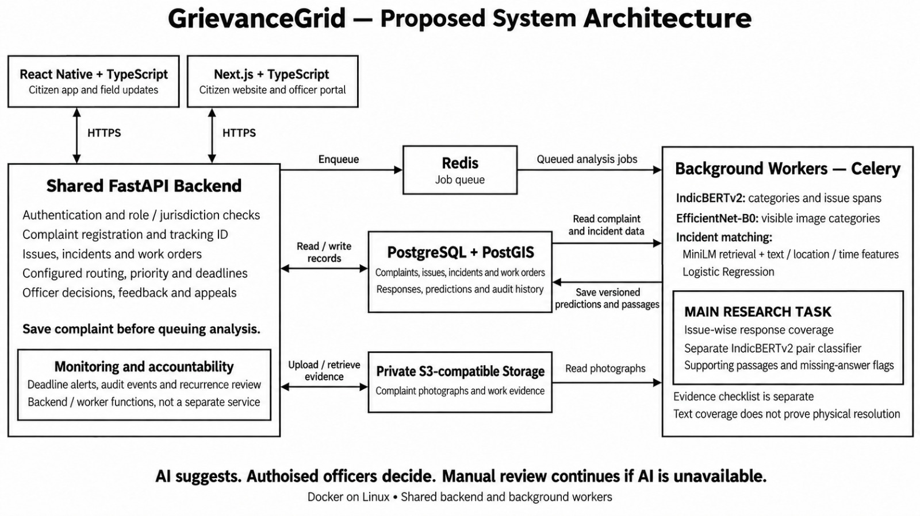

Slide 11
Architecture: Processing Flow
1 Register complaint
Citizen submits text, image, location and planned voice input. Validate access, save complaint and return tracking ID.
2 AI-Assisted Processing
Background AI analyses the complaint and evidence.
Extract issues, predict categories, analyse images and identify related incidents.
3 Store & Link Evidence
Save versioned AI suggestions and source information.
Maintain links between issues, evidence, incidents, locations and audit history
6 Review and decide
AI checks issue coverage
Officer decides, citizen may appeal
5 Submit work response
Teams add actions and evidence
GRO consolidates the reply
4 Confirm and assign
GRO reviews issues and routing
Supervisors assign field work
AI suggests. Officers confirm. Manual review remains available if a model fails.

Slide 12
Technology Choices: Why This Stack
React Native + Next.js: Shared TypeScript development for citizen and officer apps/web, with a mobile app for field workers and a web dashboard for senior authorities.
FastAPI + Python: A single modular backend for authentication, role-based access, workflow management, and AI/ML integration.
IndicBERTv2 + MiniLM + EfficientNet-B0: Support issue extraction, semantic retrieval and related-report matching, and civic image analysis.
PostgreSQL + PostGIS + pgvector: Manage workflow records, spatial data and semantic embeddings, enabling geographic matching, hotspot analysis and similarity retrieval. S3-compatible storage stores evidence.
Redis + Celery + Docker + Vercel/Railway: Enable background processing and reproducible deployment, with Vercel for web applications and Railway for backend services.

Slide 13
Methodology: AI Models & Evidence Analysis
Text Understanding
Category Prediction: TF-IDF + One-vs-Rest Logistic Regression as baseline; IndicBERTv2 for supervised prediction.
Issue Extraction: IndicBERTv2 + BIO tagging to identify individual issues.
Related Retrieval: Multilingual MiniLM for semantic similarity and candidate retrieval.
Image & Evidence Analysis
Image Classification: EfficientNet-B0 with transfer learning for visible civic issue categories.
Evidence Relevance: Compare image evidence with complaint/issue context.
Evidence Concerns: Flag potential reuse or synthetic-risk cases for review.
Human Review
Officers validate AI suggestions and confirm evidence relevance

Slide 14
Methodology: Incident Linking & Resolution
Incident Linking
Candidate Retrieval: MiniLM identifies semantically related reports.
Matching Signals: Text similarity + location + time.
Incident Scoring: Logistic Regression combines matching signals.
Human Confirmation: Officer confirms same incident / separate incident / recurrence candidate.
Response Coverage
Response Retrieval: MiniLM identifies relevant response passages.
Coverage Classification: IndicBERTv2 pair classifier.
Output: Addressed / Partial / Not Addressed / Unclear.
Officer Verification: Municipal Officer reviews the result before resolution.
Recurrence & Hotspots
Recurrence: Event history + similarity identifies later reports after resolution.
Hotspots: PostGIS identifies spatial concentrations of civic issues.

Slide 15
Methodology: Data, Workflow & Safeguards
Data & Annotation
Complaint Text: Reviewed local examples for issue and category labels.
Issue Spans: BIO annotations for issue extraction.
Images: RDD2022, TACO, and local scenes where required.
Incident / Response Pairs: Reviewed examples for matching and coverage.
Embeddings: Pretrained multilingual MiniLM.
Rules & Workflow
Jurisdiction & Routing: Configured rules and approved issue-to-department mappings.
Priority & SLA: Policy-based deadlines and escalation rules.
AI Failure: Manual workflow remains available.
Decision Safeguards
AI suggestions remain reviewable and traceable.
Officers verify field evidence before resolution.
Feedback, appeals, and audit records are maintained.
Role-based access protects workflow data.

Slide 16
Methodology: Training & Evaluation
Training Strategy
Use reviewed labels for supervised tasks and maintain separation by incident/source.
Train baselines first, then fine-tune selected models.
Tune thresholds on validation data and evaluate on held-out examples.
Local complaint-response data will be acquired subject to permission and availability.
Task | Comparison | Measures
Category Prediction | TF-IDF vs IndicBERTv2 | Per-category F1, Macro-F1
Issue Extraction | Rules vs BIO tagging | Exact-span F1, Missed Issues
Incident Linking | Text-only vs Combined Signals | Matching Precision, False-link Rate
Response Coverage | Similarity/Checklist vs Pair Classifier | Missed Issues, Wrong “Addressed” Labels
Image Analysis | EfficientNet-B0 | Image-label performance
Usability & Safety | AI-assisted workflow | Review time, access correctness, safe fallback

Slide 17
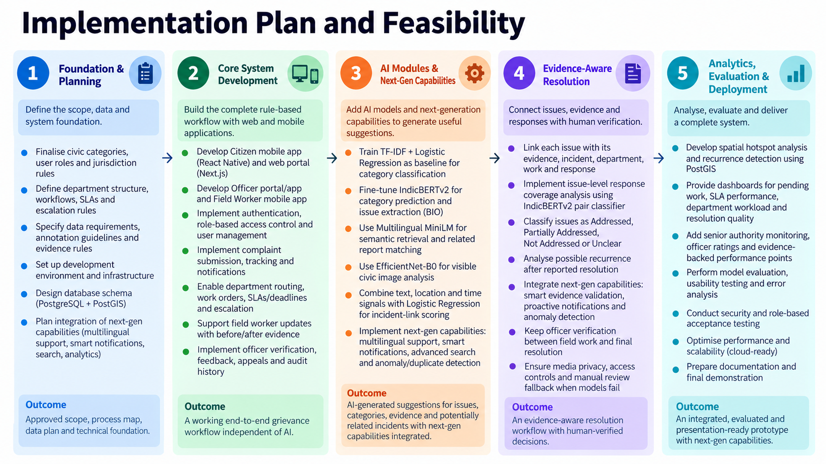

Slide 18
Applications of the Proposed Work
Citizens / Residents: Submit complaints with text, images and location, track issue-level progress, and provide feedback or appeals.
Municipal Officers: Review AI-assisted issues and evidence, confirm jurisdiction and departments, manage work orders, verify field responses, and make final resolution decisions.
Field Workers: Receive assigned work through the mobile app, update work status, and upload before/after evidence for officer verification.
Senior Municipal Authorities: Monitor department and officer performance, SLA compliance, recurring issues and civic hotspots, with evidence-backed ratings and performance points.

Slide 19
Conclusion
GrievanceGrid is an AI-assisted, evidence-aware civic grievance platform that separates complaints into individual issues and connects them with evidence, incidents, departments, actions, responses, and resolution.
AI assists while authorised officers verify and decide, supporting issue extraction, categorisation, multimodal evidence analysis, incident linking, and issue-level response coverage.
The end-to-end workflow connects citizens, municipal officers, field workers, and senior authorities, supporting work orders, before/after evidence, feedback and appeals, recurrence, hotspot analysis, SLA monitoring, and accountability.
The system will be developed incrementally, starting with the rule-based workflow and reviewed data, followed by AI integration and evaluation against simpler baselines.

Slide 20
References
[1] F. Shama, A. Aziz, and L. B. M. Deya, “CitySolution: A complaining task distributive mobile application for smart city corporation using deep learning,” SoftwareX, vol. 27, Art. no. 101829, 2024. [Online]. Available: https://doi.org/10.1016/j.softx.2024.101829 | [8] Press Information Bureau, Government of India, “Centralised Public Grievance Redress and Monitoring System (CPGRAMS),” Aug. 9, 2026. [Online]. Available: https://www.pib.gov.in/PressReleasePage.aspx?PRID=2296724
[2] Z. Yang, M. Lu, and S. Huang, “A hybrid transformer-GNN framework for social governance and urban service allocation,” Scientific Reports, vol. 16, Art. no. 21118, 2026. [Online]. Available: https://doi.org/10.1038/s41598-026-49982-2 | [9] DARPG, Government of India, “Comprehensive guidelines for handling the public grievances,” Office Memorandum, Aug. 23, 2024. [Online]. Available: https://darpg.gov.in/sites/default/files/Comprehensive_guidelines_for_handling_the_Public_Grievances.pdf
[3] S. C. Rajkumar, D. Yuvasini, S. Selvarajan, and N. R. Sivakumar, “A zero-shot LLM framework for multimodal grievance classification, urgency scoring, and abuse detection in civic feedback systems,” Scientific Reports, vol. 16, Art. no. 2299, 2026. [Online]. Available: https://doi.org/10.1038/s41598-025-32079-7 | [10] AI4Bharat, “IndicBERTv2-MLM-only,” model card. [Online]. Available: https://huggingface.co/ai4bharat/IndicBERTv2-MLM-only
[4] R. Deka and R. K. Srivastava, “Improving public service grievance analysis: A comparative study of topic modelling techniques with a multi-metric data cleaning framework,” Journal of Information Technology, Cybersecurity, and Artificial Intelligence, vol. 2, no. 3, pp. 41–53, 2025. [Online]. Available: https://doi.org/10.70715/jitcai.2025.v2.i3.031 | [11] Sentence Transformers, “paraphrase-multilingual-MiniLM-L12-v2,” model card. [Online]. Available: https://huggingface.co/sentence-transformers/paraphrase-multilingual-MiniLM-L12-v2
[5] Press Information Bureau, Government of India, “Dr. Jitendra Singh launches the Intelligent Grievance Monitoring System (IGMS) 2.0 Public Grievance portal and Automated Analysis in Tree Dashboard,” Oct. 11, 2023. [Online]. Available: https://www.pib.gov.in/Pressreleaseshare.aspx?PRID=1966498 | [12] PyTorch, “efficientnet_b0,” Torchvision documentation. [Online]. Available: https://docs.pytorch.org/vision/main/models/generated/torchvision.models.efficientnet_b0.html
[6] Press Information Bureau, Government of India, “Minister of State (PP) Dr Jitendra Singh launches the CPGRAMS AI-enabled Voice Chatbot Samadhan Didi,” May 30, 2026. [Online]. Available: https://www.pib.gov.in/PressReleasePage.aspx?PRID=2266985 | [13] Sekilab, “RoadDamageDetector,” project repository and RDD2022 resources. [Online]. Available: https://github.com/sekilab/RoadDamageDetector
[7] Press Information Bureau, Government of India, “Parliament question: Strengthening of CPGRAMS,” Aug. 12, 2026. [Online]. Available: https://www.pib.gov.in/PressReleasePage.aspx?PRID=2298140 | [14] P. Proença and P. Simões, “TACO,” dataset toolkit. [Online]. Available: https://github.com/pedropro/TACO

