Slide 1
FAKE NEWS DETECTION USING PASSIVE AGGRESSIVE CLASSIFIER
BY:
RASHMI BONGIRWAR
NARASIMHA SIVA SAKETH EMANI

Slide 2
INTRODUCTION
The age of digitalization has come with its set of pros and cons. When we talk about news, earlier they used to be spread only via non digital means, but now major source of information has become social media and other online platforms. It is good because this means wider reach to public but has also become dangerous since there is often spread of fake news too.

Slide 3
MOTIVATION
So, what is the solution for the problem of spread of false information? Try best that it is filtered. This filtering can be done by a few ways, one of which includes big data analysis. That is the aim for us selecting this topic combining it with usage of cloud resources to make the whole project more efficient.

Slide 4
METHOD USED
First, we chose the dataset and decided on performing prediction via classification using passive and aggressive classifier. The aim was to predict correctly whether the given text is real or fake. We chose to use distributed data processing system Apache Spark for Amazon EMR, S3 for storage and retrieval of data.

Slide 5
DATASET
We downloaded huge csv type of dataset having four columns:
Identification number
Title of news
Text
Label (REAL or FAKE)
Dataset: https://drive.google.com/file/d/1oC0l_4okLSooKSzcixtMNlzem8H2fG2m/view?usp=sharing

Slide 6
DATASET continued
We chose to use a csv type of format because of its advantages of being structured and availability of headers. We performed pre- processing on the data set which included removal of stop words to make out prediction as accurate as possible.

Slide 7
STORAGE
The method we used for storage was S3 and uploaded the files on it.
S3 stores files in a flat organization of containers which are called buckets.
It is highly scalable.
Individual S3 objects can store as much as 5 TB of data.

Slide 8
WHY AMAZON S3?
We chose it over options like NoSQL database because we needed a service that provides easy storage and retrieval. Database creation was not required.
It was a convenient one stop shop to store our dataset as well as data analysis code which could be accessed easily from anywhere on the web at any time.

Slide 9
DATA PROCESSING SYSTEM
Distributed data processing system was the heart of our project.
Amazon EMR enables easy processing of vast amount of data.
It utilizes a hosted Hadoop framework (the engine of EMR) running on infrastructure of EC2 and S3.
It allows to instantly perform data- intensive tasks for various types of analysis.

Slide 10
DATA PROCESSING SYSTEM continued
We chose Apache Spark as our distributed system because of its fast execution over data of any size.
It is because of in- memory caching feature of Spark.

Slide 11

DATA ANALYSIS
The data that we analysed is the news articles data.
Each article is labelled as REAL or FAKE
Our machine Learning model analyses the data and predicts the credibility of the news

Slide 12
Why EMR?
The same script can be run on a local machine too
But the EC2 instance running on a cloud using EMR processing is efficient
EC2 is scalable
EC2 allocates resources on demand
An EMR is further efficient than a single EC2 instance because EMR operates on master-slave nodes
EMR accesses s3 storage faster than individual EC2

Slide 13
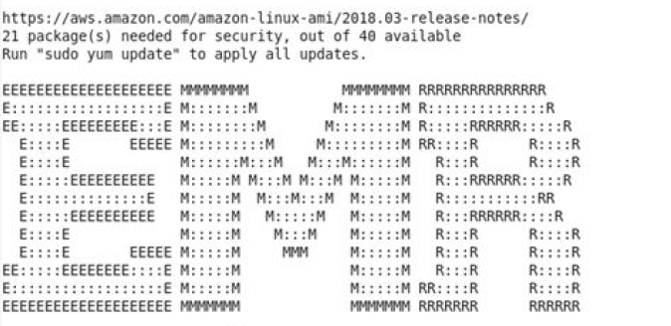
SSH into the EMR instances
SSH facilitates access to remote systems using secure key
The key is generated in AWS and used by the local machine as a signature to prove its authenticity.
Ssh -i ~/Downloads/cloudprojectkey.pem hadoop@ec2-54-186-83-102.us-west-2.compute.amazonaws.com
Confirmation that the connection is made to the remote machine on cloud

Slide 14
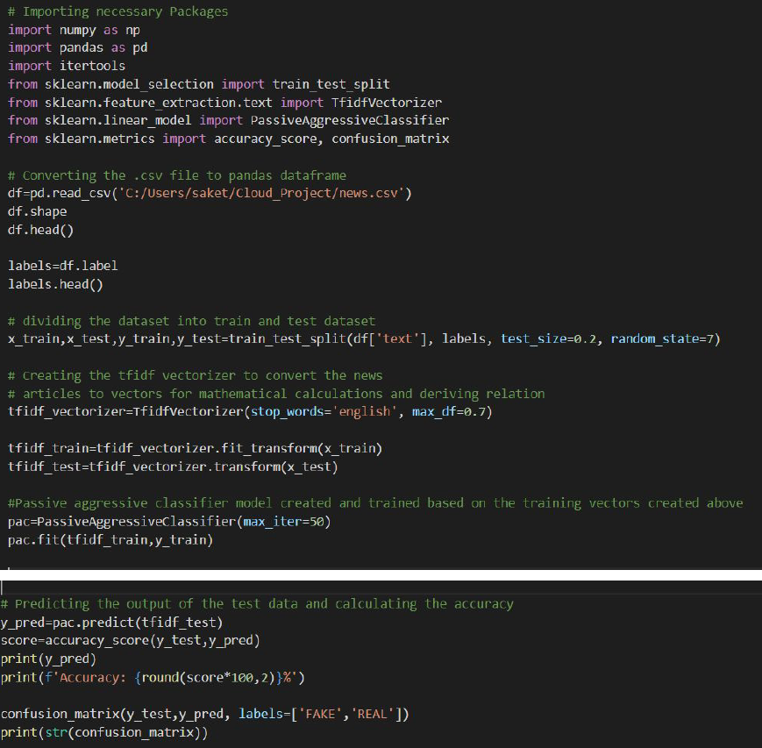

Slide 15
RESULTS
Files copied to EMR master node instance
wget https://<url of the file>
The accuracy of the predictions - 92.82%
The confusion matrix - [[587 51]
[ 43 586]]
True Positives = 587
True Negatives = 586
False positives = 51
False Negatives = 43
So, Precision - 0.92
Recall - 0.93

Slide 16
CONCLUSION
Understood the impact of EMR on Big data
Learnt the advantages of EMR over normal EC2 instances
Gained hands on experience in accessing AWS cloud and creating instances using EMR
Used SSH to access remote machines which helped us learn the basics of SSH and linux

Slide 17
THANK YOU

