Slide 1

DATA ANALYTICS PORTFOLIO PROJECT
Amazon Warehouse Operations
Performance & Efficiency Analytics
An end-to-end SQL + Power BI Business Intelligence solution analyzing the full warehouse lifecycle
Prepared by
Sivasakthi
AF05266746 | SQL • Power BI • DAX • Excel

Slide 2
Project Overview
This industrial analytics project develops an end-to-end SQL + Power BI Business Intelligence solution for analyzing warehouse performance across the complete operational lifecycle. It helps management identify bottlenecks, delayed orders, inventory problems, employee productivity, shipping performance, operating costs, and customer satisfaction — across a six-page interactive Power BI dashboard.
Orders
→
Inventory
→
Picking
→
Employees
→
Shipping
→
Delivery
→
Returns
→
Cost
End-to-end operational story: from order receipt through returns and cost analysis
6
11
7
40+
Power BI
Dashboard Pages
Fact / Dimension
Data Tables
SQL Analysis
Script Modules
DAX Measures
& KPIs
Amazon Warehouse Operations Analytics
2

Slide 3





Project Objectives
Order & Fulfillment
Warehouse Performance
Analyze orders received, processed, fulfilled and shipped; measure fulfillment, cancellation and accuracy rates.
Compare warehouse performance, utilization and identify delayed or priority orders.
Inventory Health
Workforce Productivity
Identify low-stock and out-of-stock products; analyze inventory value, reserved and damaged quantities.
Measure employee productivity by employee, role and shift across the warehouse network.
Shipping & Delivery
Returns & Cost
Evaluate carrier and shipping-mode performance; analyze delivery delays and shipping costs.
Measure return rate, refund value and restockable returns; calculate operating cost per order.
Amazon Warehouse Operations Analytics
3

Slide 4
MAIN BUSINESS PROBLEMS & KEY QUESTIONS
1. Order Fulfillment Efficiency
2. Warehouse Performance
3. Picking Operation Efficiency
• Received, fulfilled & shipped orders
• Fulfillment & cancellation rates
• Pending & priority order delays
• Productivity & utilization
• Operating cost & order accuracy
• Poor delivery performance
• Picking time & travel distance
• Fastest zones & productive employees
• Picking exceptions & efficiency
4. Inventory Management
5. Employee Productivity
6. Shipping & Delivery Performance
• Available, low & out-of-stock inventory
• Stock value & damaged products
• Replenishment priorities
• Workforce productivity & attendance
• Roles, shifts & warehouse comparison
• Labor cost & employee performance
• On-time & average delivery time
• Carrier & shipping-mode comparison
• High-delay destinations & costs
7. Returns & Customer Experience
OVERALL BUSINESS OBJECTIVE
• Return volume & return rate
• Return reasons & refund value
• Restockable returns & late-delivery impact
Optimize warehouse operations • Reduce costs • Improve inventory control • Increase delivery performance • Enhance customer satisfaction
Industrial Project Presentation

Slide 5







Tools & Technologies
The technology stack powering this end-to-end analytics solution
SQL
Power BI
Power Query
DAX
Data analysis, aggregation, filtering, joins & KPI calculations
Interactive dashboard and management reporting
Data cleaning and transformation
Calculated measures and business KPIs
Data Modeling
Data Visualization
GitHub / Markdown
Dimension / fact star-schema model
KPI cards, charts, matrices, maps, treemaps
Project repository and documentation
Amazon Warehouse Operations Analytics
4

Slide 6
Dataset Description
Operational datasets covering the full warehouse activity lifecycle (fact & dimension tables)
Orders
Inventory
Employees
Orders, quantities, sales, shipping fees & status
Closing stock, stock value, damaged & reserved qty
Employee info, hours worked, units handled, productivity
Picking_Operations
Shipping
Returns
Pick time, accuracy, travel distance, exceptions
Shipments, delivery status, time, cost & delay hours
Return qty, refund amount, reason, restockable status
Daily_KPIs
Warehouse / Warehouse_Master
Products
Daily orders, accuracy, delivery, utilization, cost
Warehouse operations & dimension information
Product and category information
Dim_Date
Date dimension for time-based analysis
Amazon Warehouse Operations Analytics
5

Slide 7
SQL Analysis &
DAX Measures
Sample DAX — Fulfillment Rate
Fulfilled Orders =
CALCULATE([Total Orders],
Orders[order_status] IN {"Picked","Packed","Shipped","Delivered"})
Fulfillment Rate = DIVIDE([Fulfilled Orders], [Total Orders])
SQL forms the analytical layer for extracting and validating performance data; DAX powers the live Power BI KPIs.
Orders Analysis
Example SQL — Order Analysis
Warehouse Analysis
SELECT COUNT(DISTINCT order_id) AS total_orders,
SUM(quantity) AS total_order_quantity,
SUM(sales_amount_inr) AS total_sales,
SUM(shipping_fee_inr) AS total_shipping_fees
FROM Orders;
Inventory Analysis
Employees Analysis
Picking Analysis
Shipping Analysis
40+ DAX measures were built across Orders, Inventory, Employees, Picking, Shipping, Returns and Warehouse KPI tables.
Returns Analysis
Amazon Warehouse Operations Analytics
6

Slide 8
Power BI Dashboard — Six Pages
1
Executive Overview
2
Warehouse Performance
3
Order & Fulfillment
Total Orders, Sales, Fulfillment & On-Time Delivery Rate
Utilization %, Dock & Equipment Uptime by Warehouse
Fulfilled, Delayed & Cancelled Order Analysis
4
Inventory & Product
5
Picking & Productivity
6
Shipping, Returns & CX
Stock Value, Low / Out-of-Stock Product Tracking
Pick Time, Accuracy, Travel Distance & Exceptions
Carrier Performance, Delays, Refunds & Return Reasons
Amazon Warehouse Operations Analytics
7

Slide 9
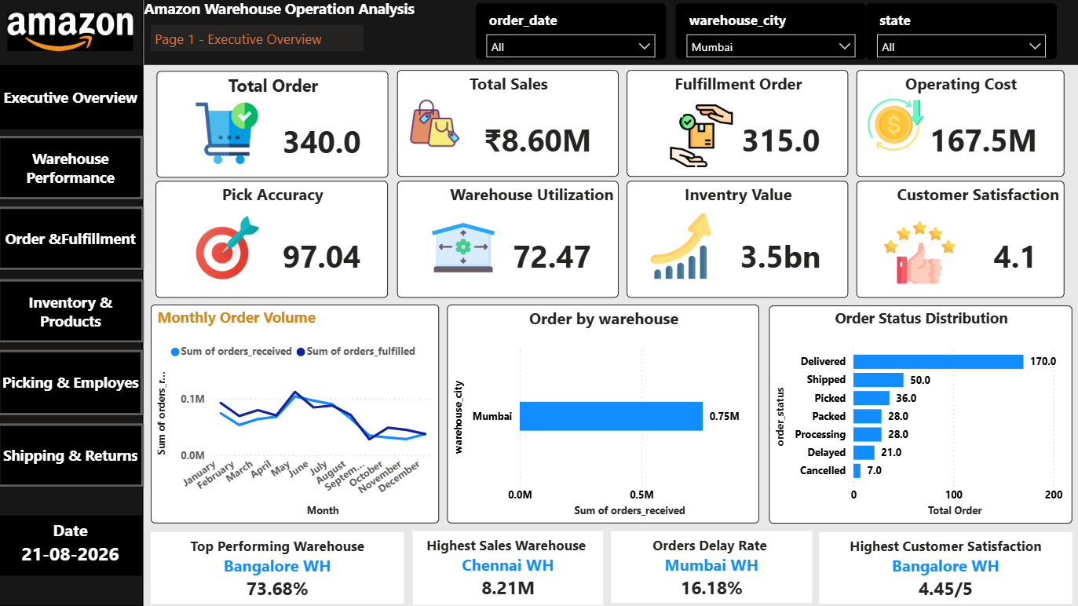
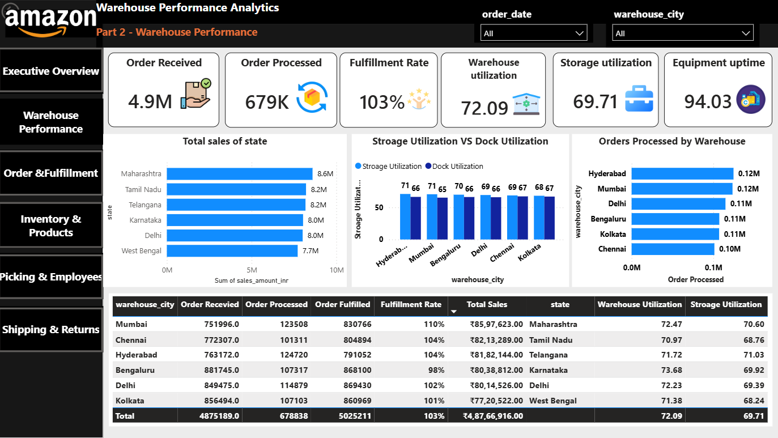
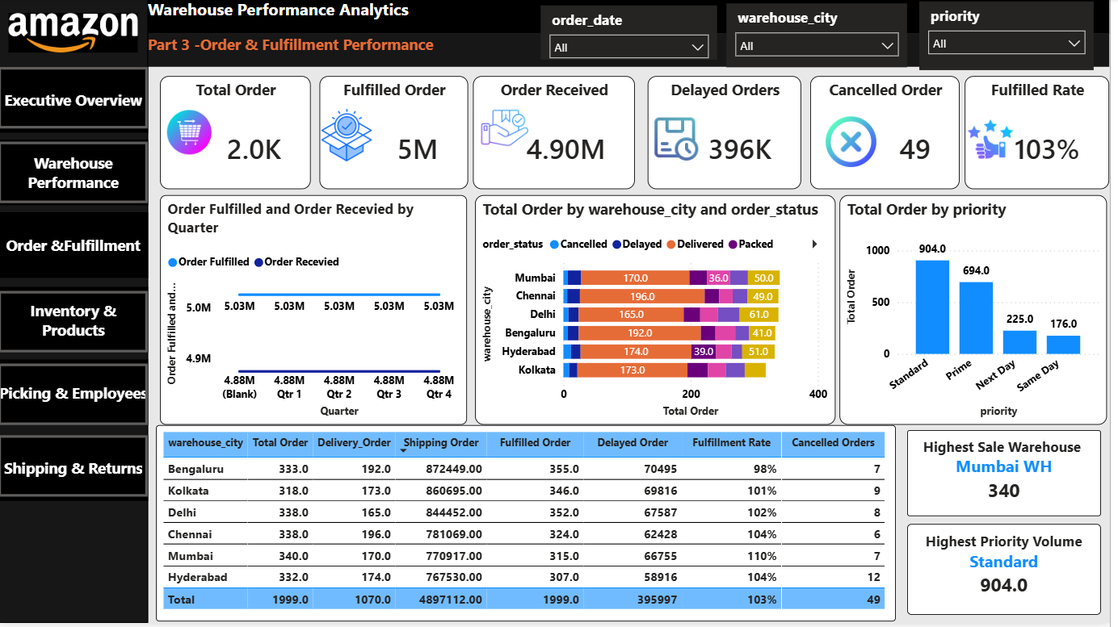
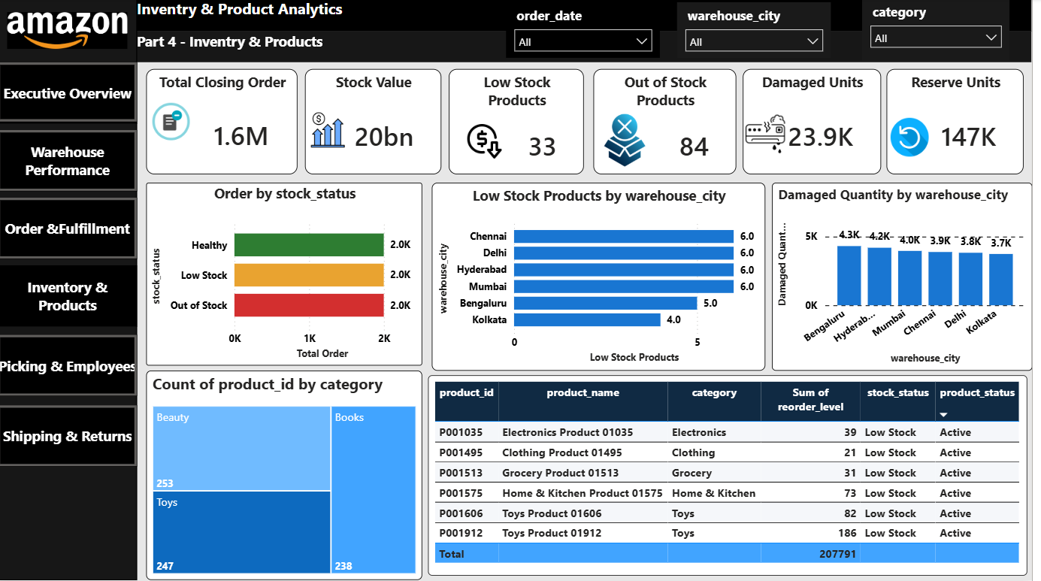
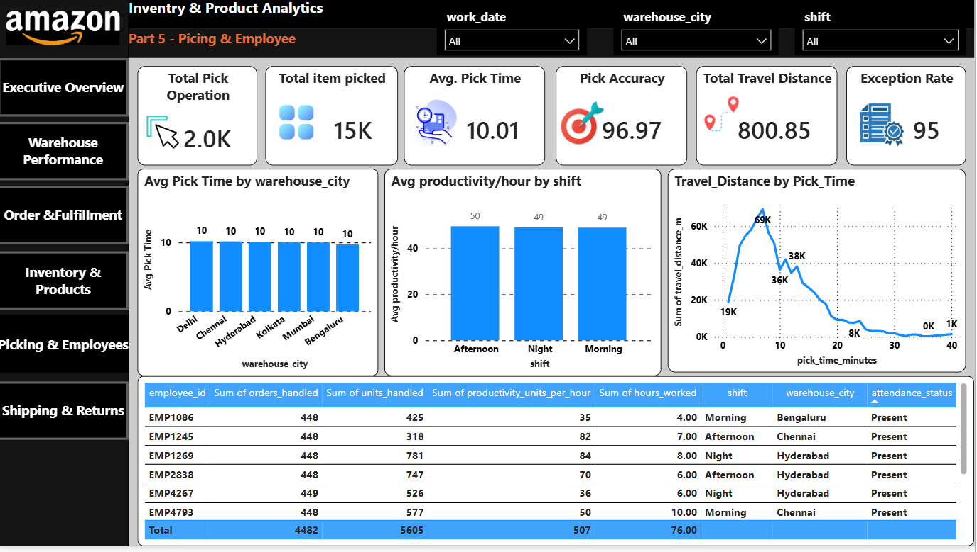
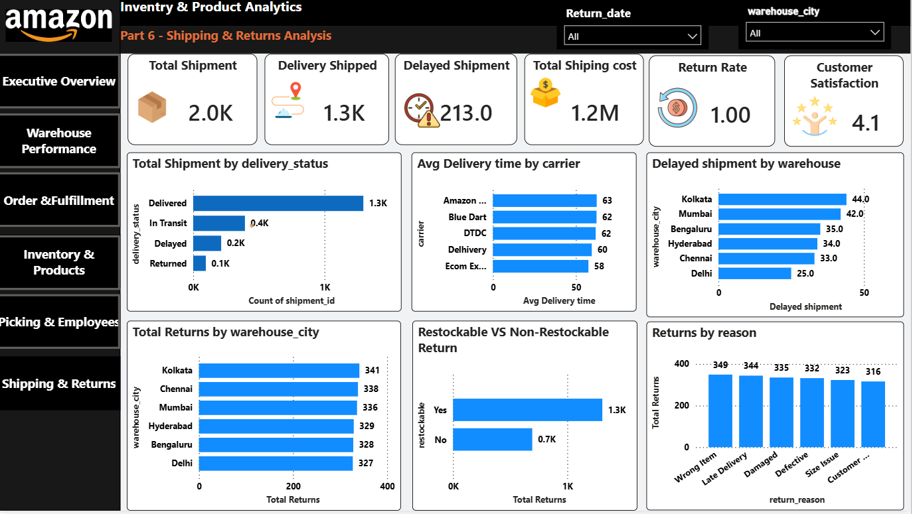
Dashboard Design – Page Overview

Slide 10




Key KPIs Tracked
Metrics that drive management decision-making across the warehouse network
Fulfillment Rate
On-Time Delivery %
Order Accuracy %
Warehouse Utilization %
Warehouse efficiency
Customer service
Operational quality
Capacity management
Average Pick Time
Employee Productivity
Stock-out Rate
Customer Satisfaction
Picking efficiency
Workforce efficiency
Inventory health
Experience quality
Amazon Warehouse Operations Analytics
8

Slide 11
Key Insights & Project Workflow
Warehouse
Orders
Inventory
Picking & Employees
Shipping & Returns
Best/worst performers, utilization & operating-cost hotspots
Volume trends, fulfillment bottlenecks & priority delays
Replenishment needs, low/out-of-stock & damaged goods
High pick-time locations, productivity by role & shift
Carrier delays, best modes & major return reasons
End-to-End Workflow
Raw Data
→
Cleaning &
Transform
→
SQL
Analysis
→
Data
Validation
→
Power BI
Data Model
→
DAX
Measures
→
Dashboard
Development
→
Business
Insights
Note
The source project specification defines the analytical questions and KPIs but does not provide final numerical findings — actual numerical insights are added once the datasets are analyzed, using the slicers: Date, Warehouse, City, Region, Order Status, Priority, Product Category, Shift, Employee Role, Carrier, Shipping Mode and Stock Status.
Amazon Warehouse Operations Analytics
9

Slide 12
GITHUB REPOSITORY – PROJECT STRUCTURE
Centralized repository for the complete Warehouse Analytics project
warehouse-analytics-project/
│
├── data/
│ ├── raw_data.csv
│ └── cleaned_data.csv
│
├── sql/
│ └── analysis_queries.sql
│
├── powerbi/
│ └── warehouse_dashboard.pbix
│
├── screenshots/
│ └── dashboard.png
│
├── README.md
└── requirements.txt
DATA
Raw and cleaned datasets used for warehouse analysis.
SQL ANALYSIS
Queries covering orders, warehouses, inventory, employees, shipping and returns.
POWER BI
Interactive dashboard with KPIs, trends and performance analysis.
DOCUMENTATION
README covering overview, objectives, workflow, insights and setup.
DATA COLLECTION → CLEANING → SQL ANALYSIS → POWER BI → BUSINESS INSIGHTS

Slide 13
Conclusion
Project Deliverables
The Amazon Warehouse Operations Performance & Efficiency Analytics Dashboard provides an integrated view of warehouse operations from order receipt through returns — combining fulfillment, utilization, inventory health, picking efficiency, productivity, shipping performance, returns and cost into one centralized BI solution.
Cleaned warehouse datasets
SQL analysis scripts
Power BI data model
DAX KPI measures
The Strongest Project Story
Six-page interactive Power BI dashboard
Orders → Inventory → Picking → Employees → Shipping → Delivery → Returns → Cost
Dashboard screenshots
Business insights
This end-to-end approach transforms operational data into actionable business intelligence for management decision-making.
Project documentation
GitHub repository
Thank You
Sivasakthi

