Slide 1

CMR TECHNICAL CAMPUS Accredited by NBA, Approved by AICTE, affiliated to JNTUH Kandlakoya (V), Medchal Road, Hyderabad -501401 UGC AUTONOMOUS Prediction And Classification Of Alzheimer Disease Severity Using Deep Learning Model
Under the guidance of
D Mounika Team members:
Aditya Singh(187R1A05C4)
Abhinav Dharipalli(187R1A05E0)
Rama Krishna Bollepally(187R1A05C6)

Slide 2
Contents
Abstract
Existing system
Disadvantages of existing system
Proposed system
Advantages of proposed system
Hardware requirements
Software requirements
Project Architecture
Modules
UML diagrams
Conclusion

Slide 3
ABSTRACT
Alzheimer is a neurodenerative disorder it is caused by abnormal build of proteins in and around brain cells.
It is mostly affected to older adults people affected by alzheimer are demented .
There is no cure available for people but there are treatments which can delay the onset of the disease.
Demented means losing the to ability to remember, think, or make decisions .
MRI scans are used to evaluate the patients suspected with AD (Alzheimer disease).

Slide 4
Existing approach
The existing system uses oasis longitudinal dataset .
Here the subjects scanned are divided into 2 groups demented and non demented .
It consists of certain features of the brain like brain volume, age etc of the subject scanned.
Based on the features specified in the dataset the classification was done.
The algorithms used where random forest and decision tree.

Slide 5
Disadvantages
Since the classification is done only on two types it is not much useful in predicting the alzheimers as early as possible
If the prediction of the alzheimers are not done early it will not be much useful for diagnosis of the disease

Slide 6
Proposed approach
In this we are using alzheimer_s dataset where it consists MRI scans of brain.
The dataset is divided into testing and training data.
Then it is further classified into 4 classes namely.
Mild demented, Moderate demented, non demented, very mild demented.
We are building a CNN model which will classify the subjects into 4 categories mentioned above based on the MRI scans.

Slide 7
Advantages of proposed system
Since the classification is done between 4 classes the model will be more useful treating and diagnosis of the disease in its early stages.
The accuracy rate will also be relatively high, since we are using cnn for classification, which said to be one of the best algorithms for image classification.

Slide 8
Hardware requirements
Processor: Intel i3
Hard disk: 20GB
Input devices: Keyboard, mouse
Ram: 1GB

Slide 9
Software requirements
Operating system: Windows 7,8,10,11
Coding language: Python
Tool: Google colab/Jupyter notebook/pycharm

Slide 10
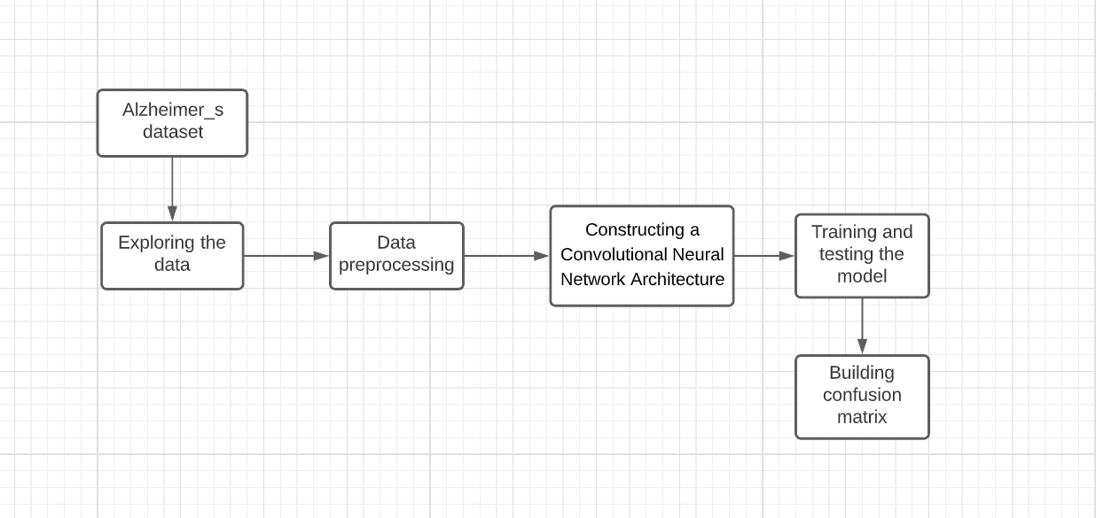
Project Architecture

Slide 11
Modules
Module 1: Exploring the data
Plotting graphs
Through this we may know if there are any imbalance in the number of observations between our classes present in our dataset.

Slide 12
Modules
Module 2: Data pre-processing
Resizing images present on dataset
Removing any noise if present

Slide 13
Modules
Module 3: Building the CNN architecture and train the model
Building a CNN model which could classify the MRI scans into 4 classes namely
1.Mild demented
2.Moderate demented
3.Non demented
4.Very mild demented

Slide 14
Modules
Module 4: Testing the Model
Testing the model which we built using test MRI scans present in the Alzheimer_s dataset.
This test data is unknown to the model built.

Slide 15
Modules
Module 5: Evaluating performance of the model
The performance of the model is evaluated by building the confusion matrix .

Slide 16
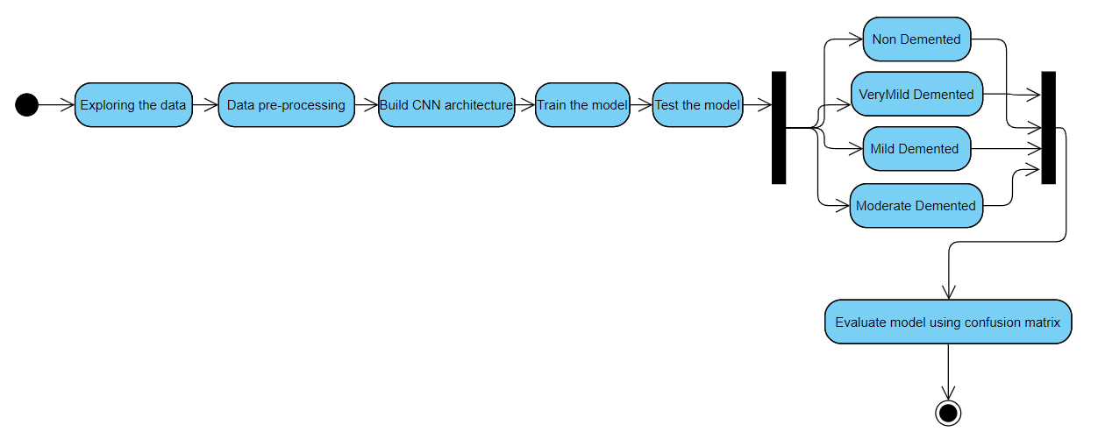
ACTIVITY DIAGRAM

Slide 17
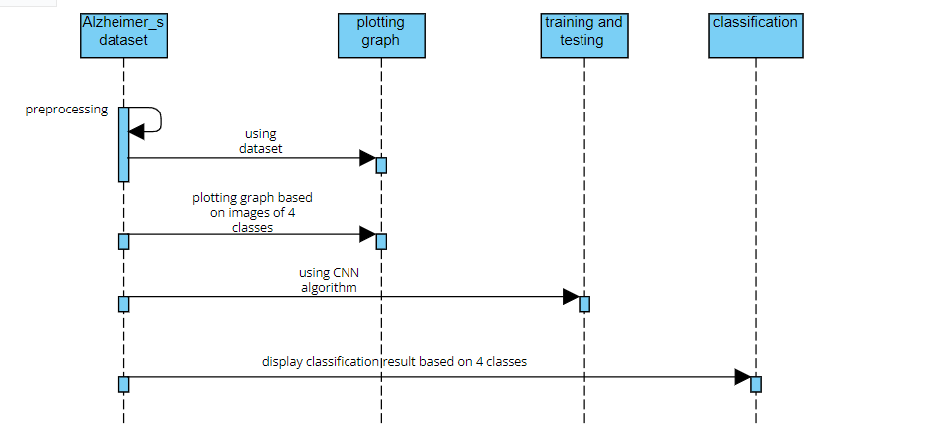
SEQUENCE DIAGRAM

Slide 18
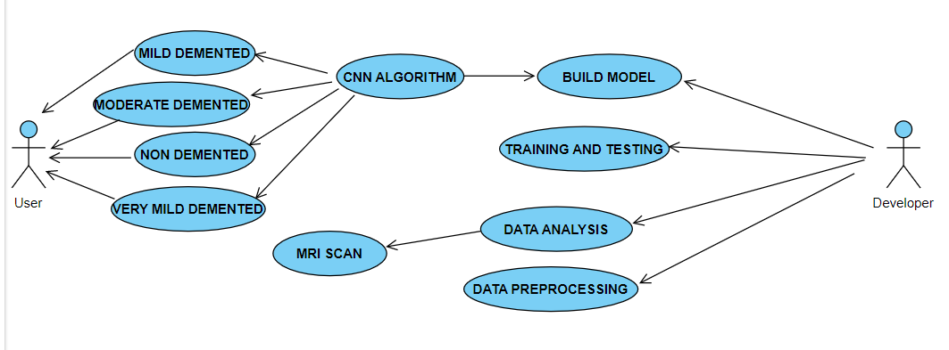
USECASE DIAGRAM

Slide 19
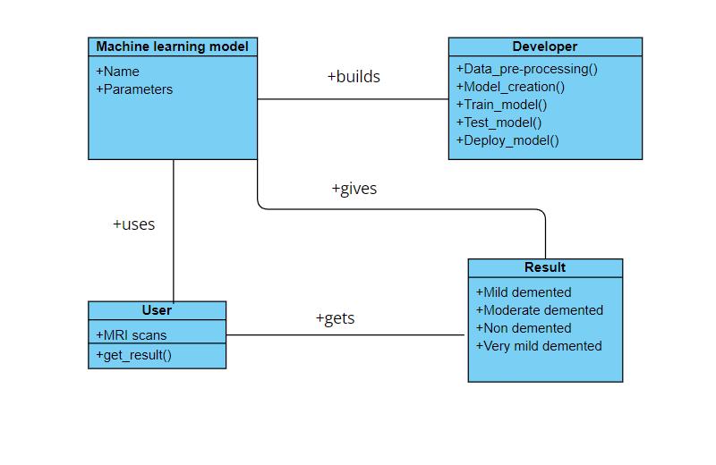
CLASS DIAGRAM

Slide 20
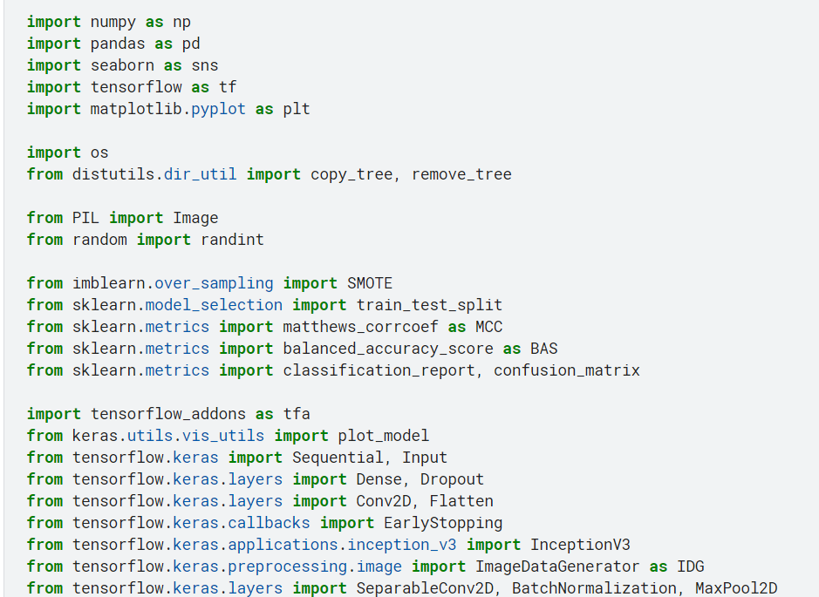
SAMPLE CODE

Slide 21
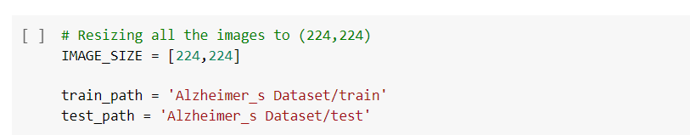
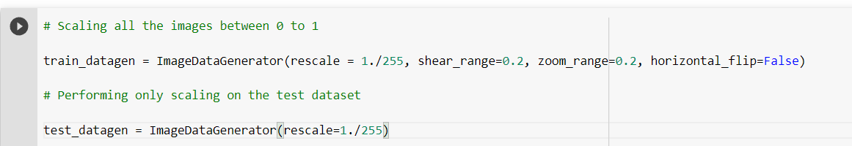
Data pre-processing

Slide 22
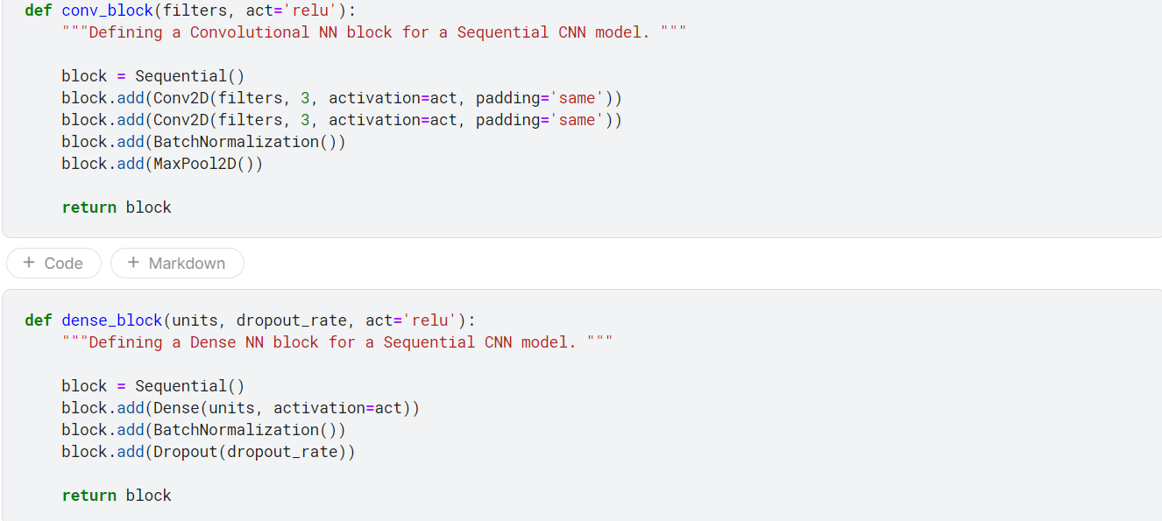
Building the model

Slide 23
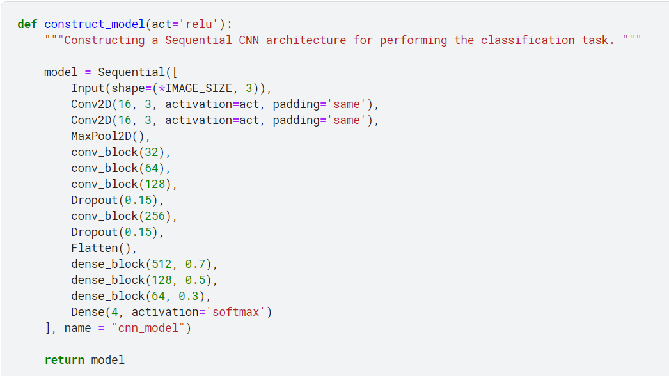
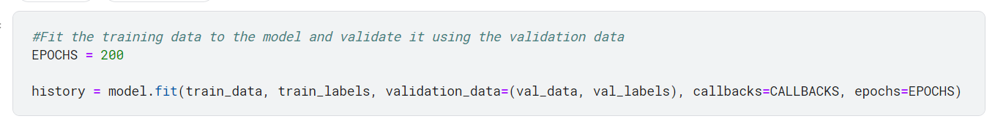

Slide 24
Conclusion
The model shows better accuracy in the results when compared to the existing approach and the classification is done between 4 classes, So the model will be useful for early diagnosis of the disease.

Slide 25

THANK YOU.

