Slide 1
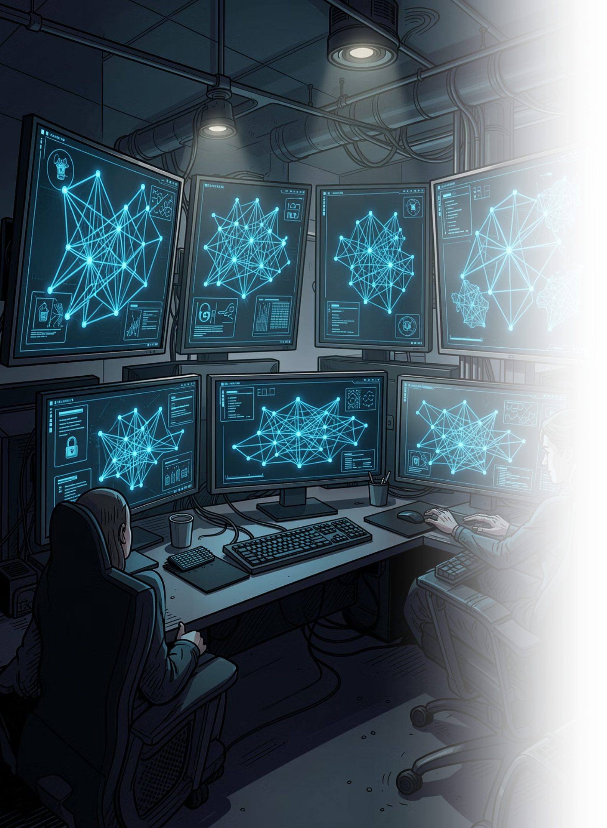

Enterprise Security Guardrail Auditor
Automated compliance enforcement and security posture validation at enterprise scale

Slide 2
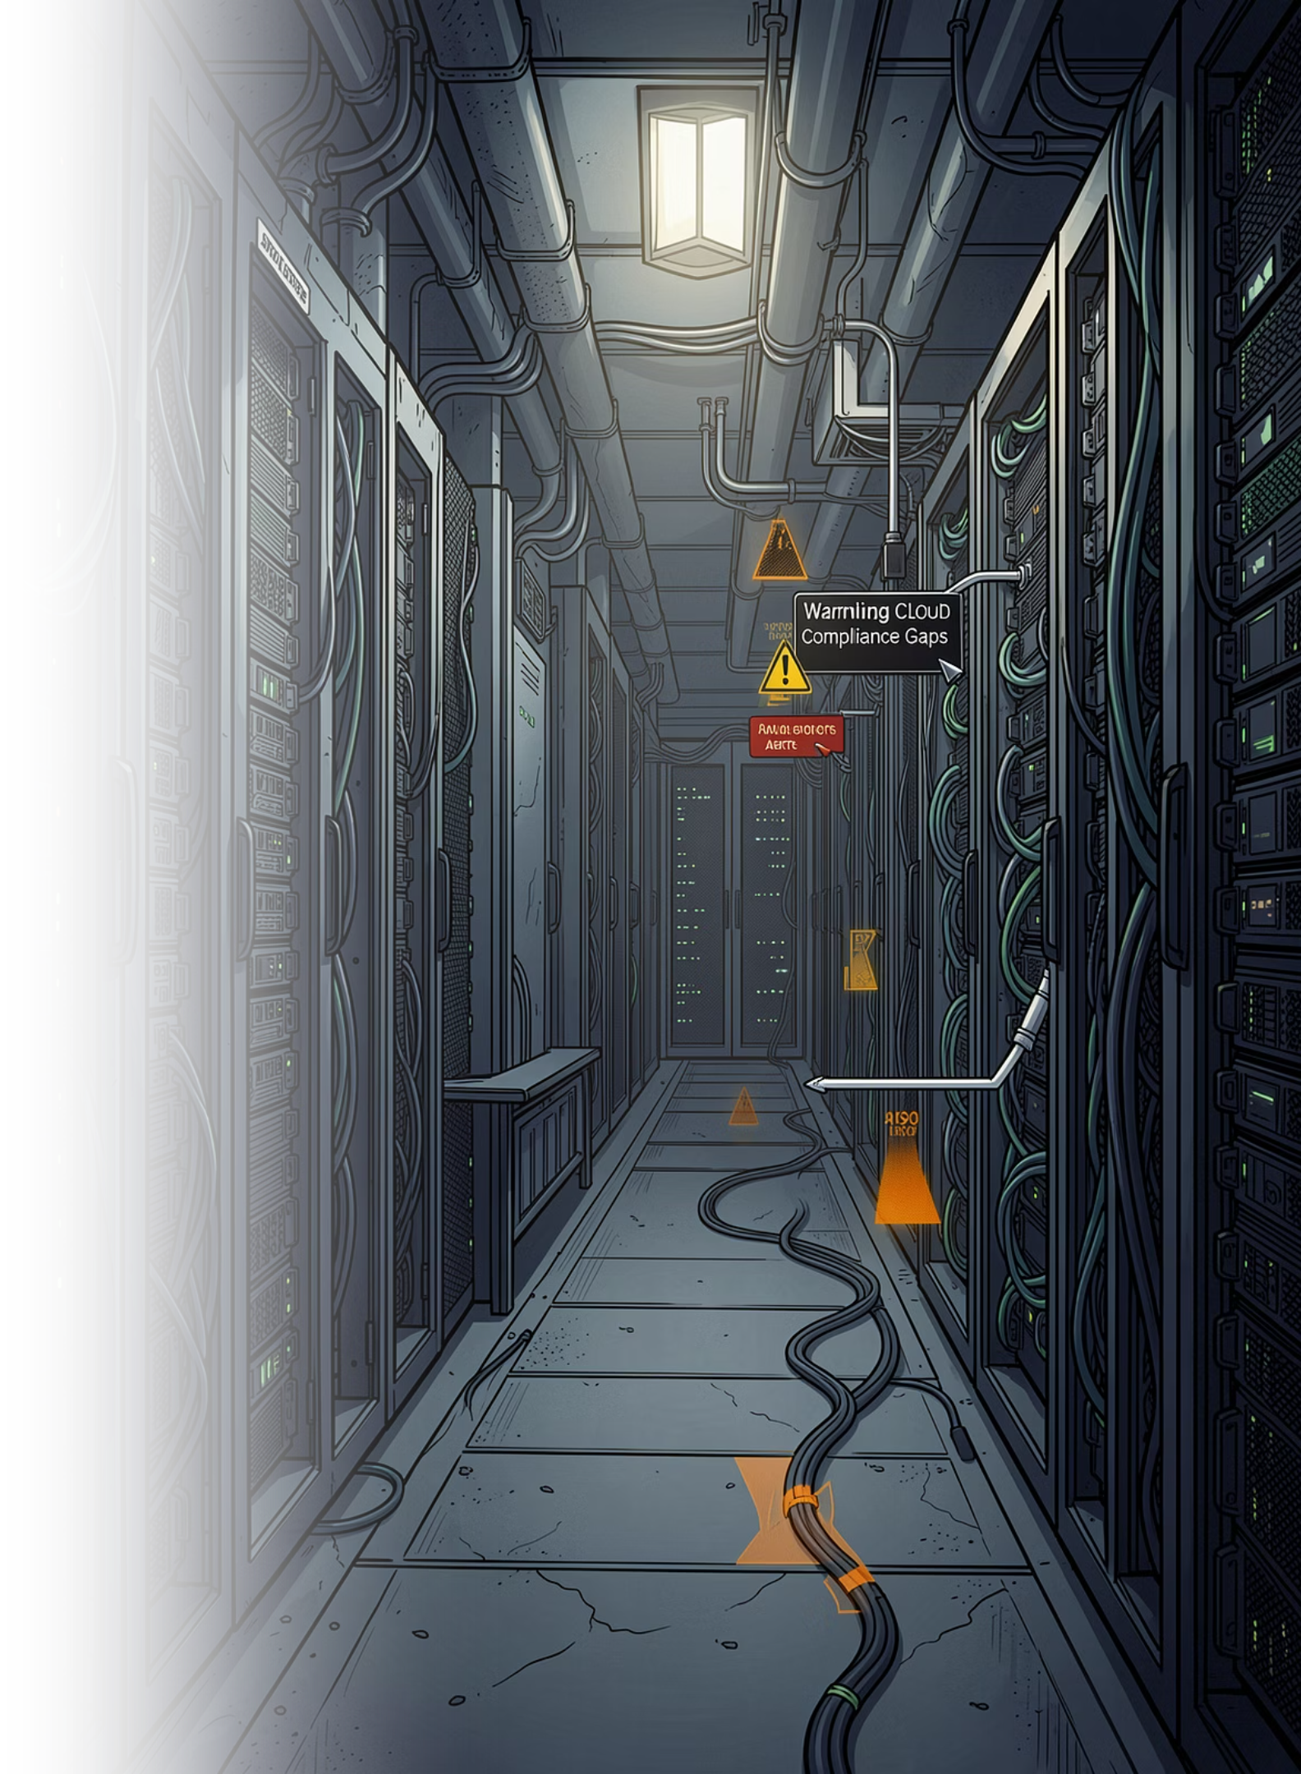
The Compliance Gap Is Growing
Manual Audits Don't Scale
Regulatory Exposure
Wolters Kluwer operates under strict mandates — GDPR, SOC 2, ISO 27001. A single misconfiguration can trigger audit failure and regulatory penalties.
Security reviews are periodic, inconsistent, and unable to keep pace with continuous cloud deployments across hundreds of accounts.
Alert Fatigue
Security teams are overwhelmed by raw scanner output with no prioritization, context, or automated remediation guidance.

Slide 3
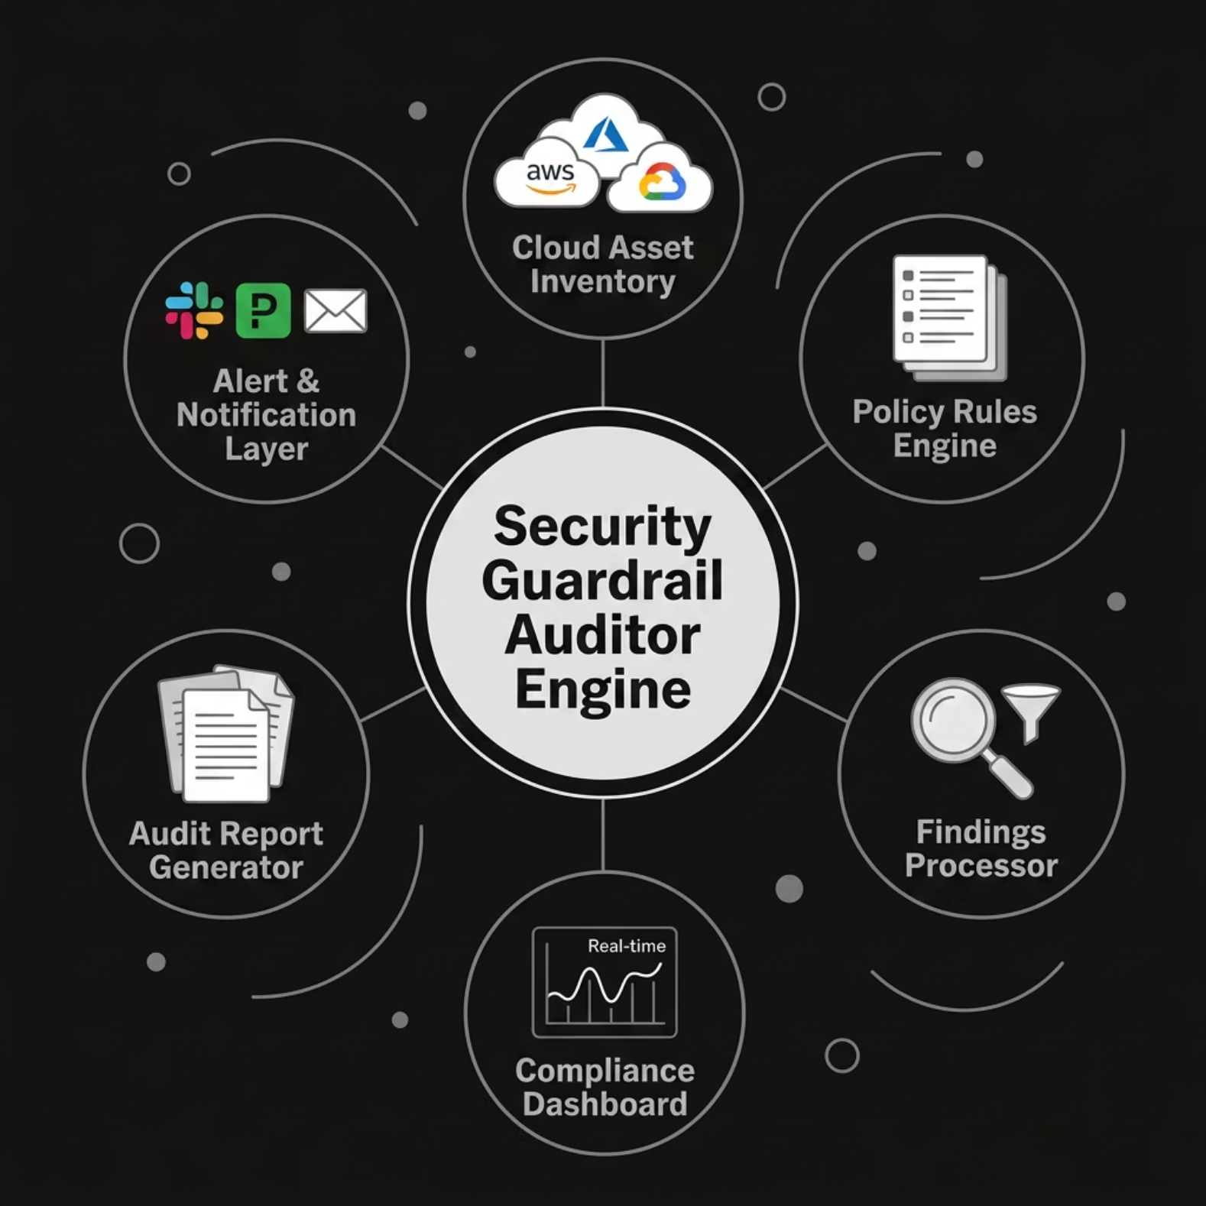

System Architecture
Design Principles
Agentless — integrates directly with cloud provider APIs
Event-driven — triggered on resource creation, modification, or scheduled scan
Extensible — policy packs are modular and version-controlled
Audit-ready — every finding is timestamped, attributed, and exportable

Slide 4
Technology Stack
Core Engine
Data Layer
Python 3.11 · FastAPI · Celery · Redis (task queue)
PostgreSQL (findings) · Elasticsearch (search) · S3 (report artifacts)
Security Integrations
Frontend & Observability
AWS Security Hub · Azure Defender · CSPM connectors · OPA (Open Policy Agent)
React · Grafana · Prometheus · OpenTelemetry tracing

Slide 5
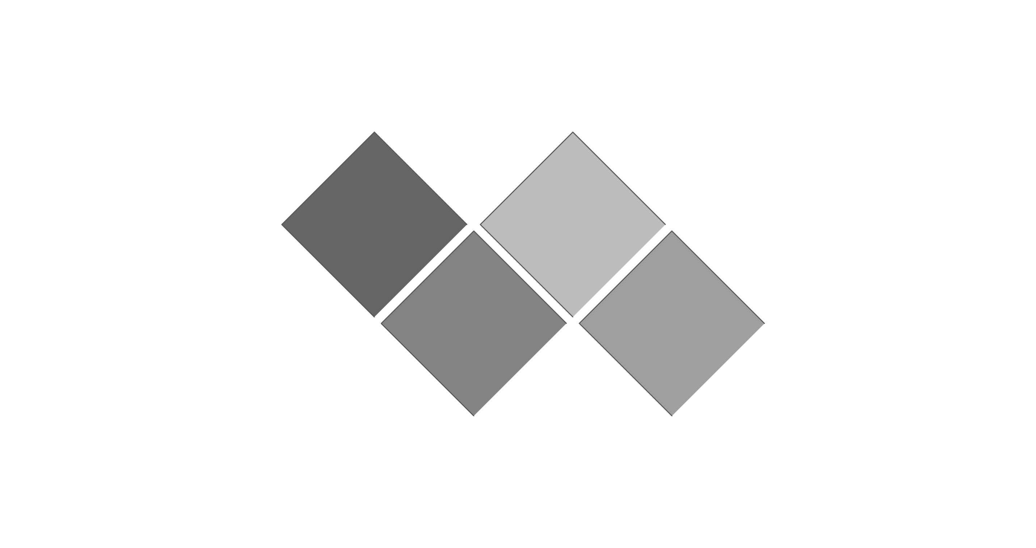
Security Findings Engine
Evaluate
Score
Policy rule matching (CIS/NIST).
Assign risk: Critical/High/Medium/Low.
Scan
Report
Cloud API enumeration of resources.
Deduplicate, enrich, and export findings.
The engine evaluates every cloud resource against a versioned policy library. Findings are deduplicated across scans, enriched with asset context, and assigned a composite risk score combining severity, exposure, and regulatory impact.

Slide 6
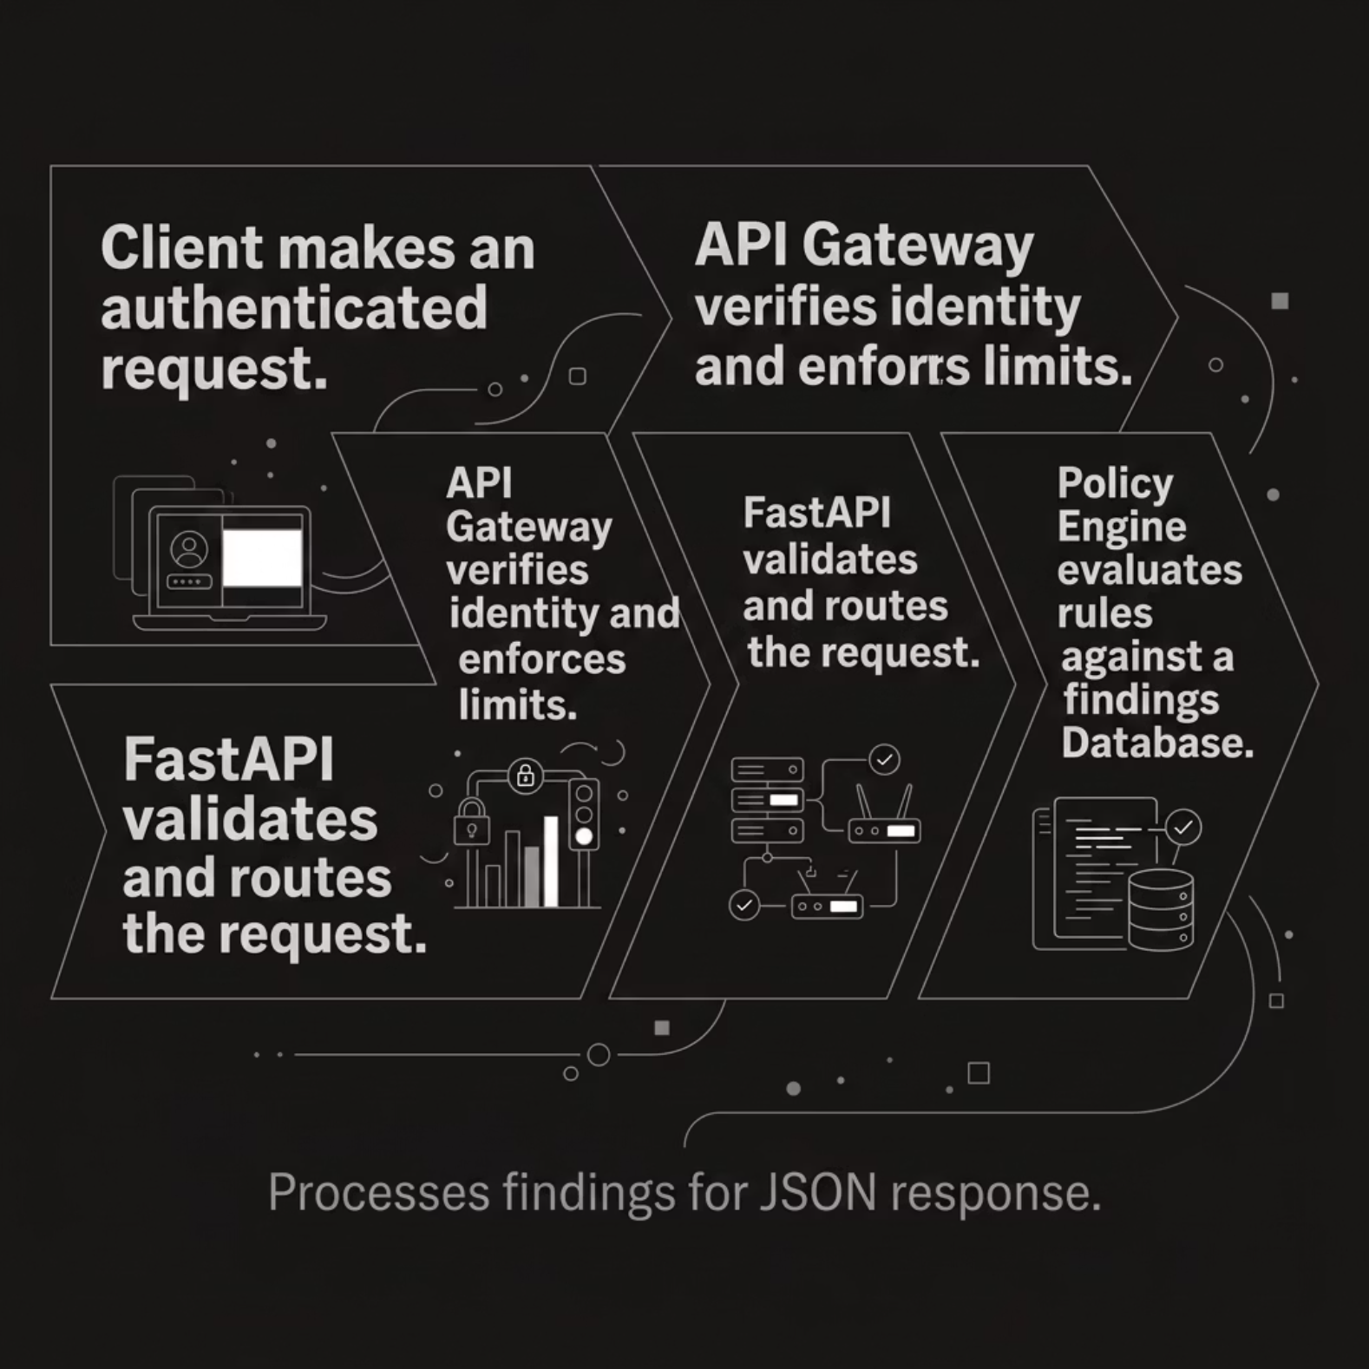

API Architecture
RESTful Design
GET /findings — filterable, paginated findings export
POST /scan — trigger on-demand audit scan
GET /compliance/{framework} — framework-specific posture report
POST /policies — upload custom guardrail rules
All endpoints are authenticated via OAuth2 with RBAC scopes. Audit logs are immutable and WORM-compliant.

Slide 7
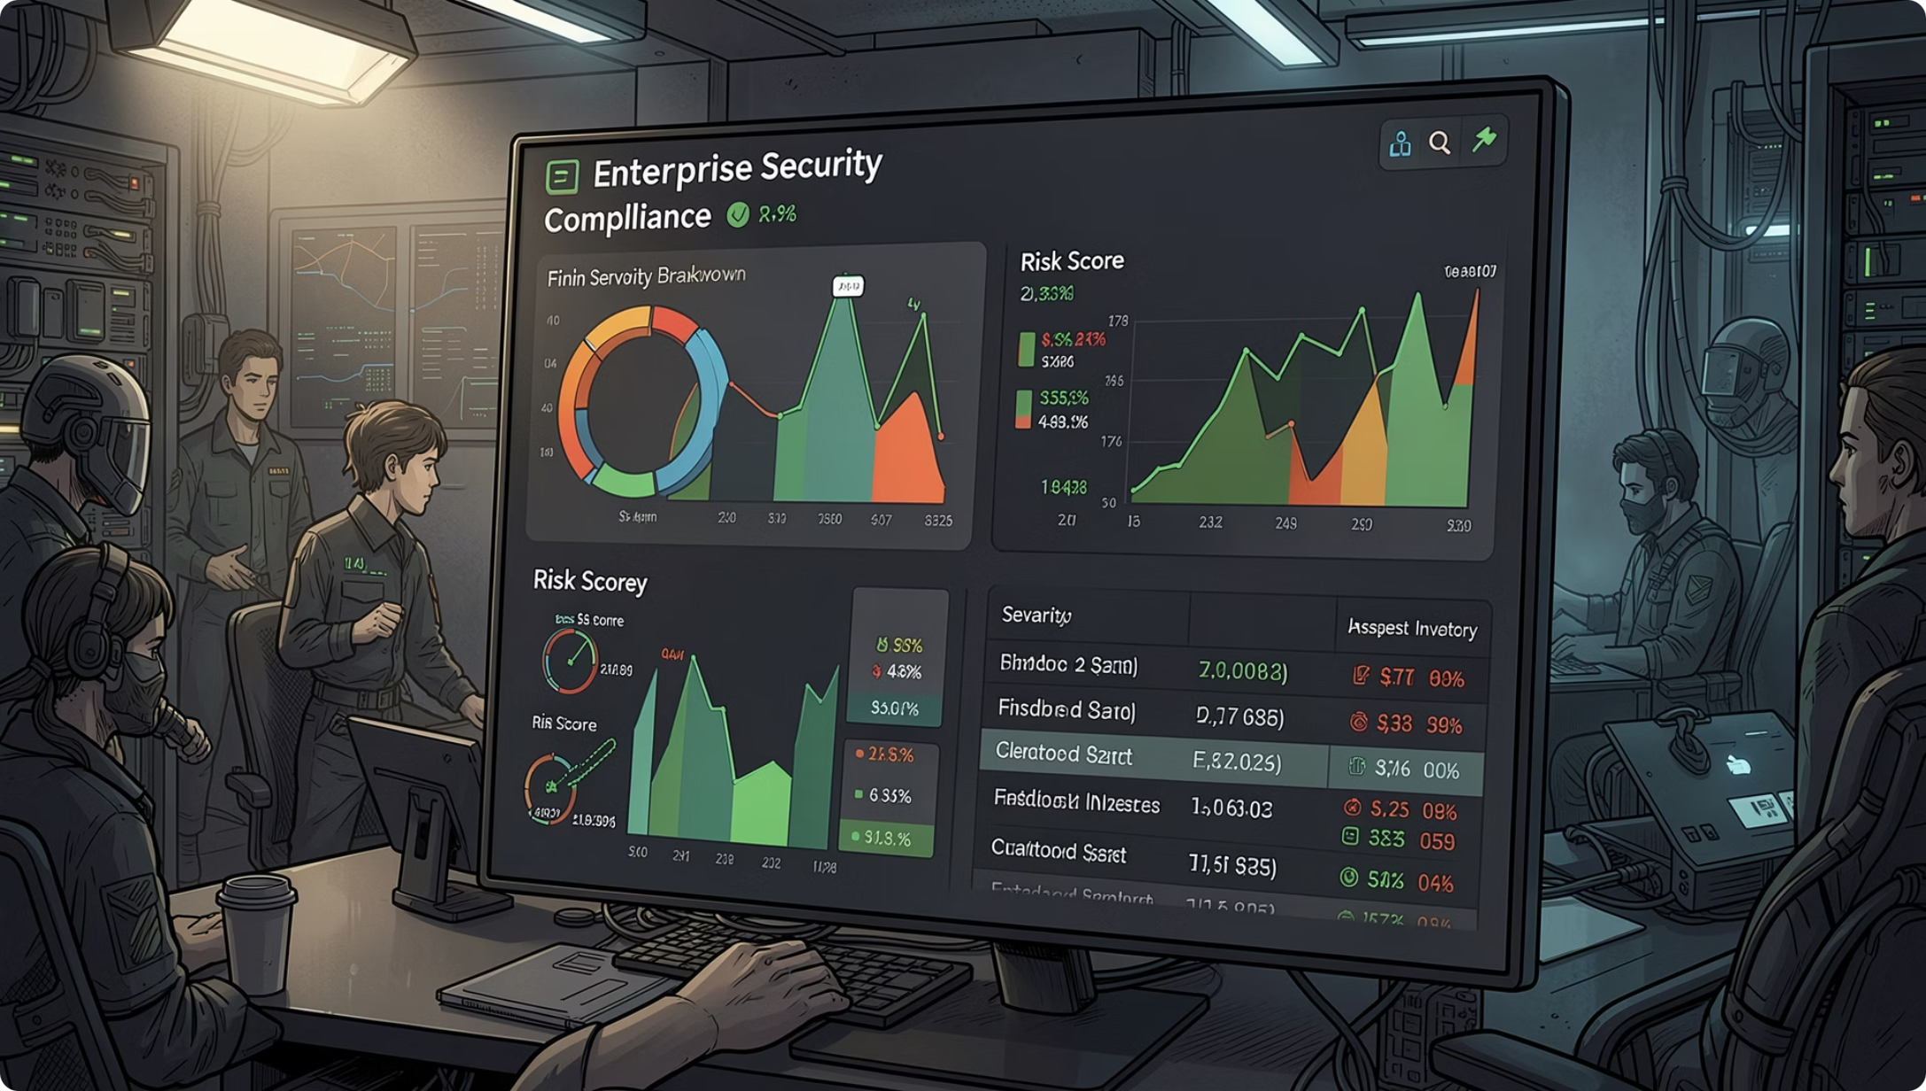
Dashboard & Data Model
Core Schema Entities
assets — cloud resource inventory (ARN, region, tags)
findings — deduplicated violation records with severity scores
policies — versioned rule definitions (CIS, NIST, custom)
scans — execution metadata, timestamps, status
remediations — ticket linkage, resolution state, SLA tracking
Schema supports multi-tenant isolation and point-in-time audit reconstruction.

Slide 8

CI/CD Pipeline
Code Commit
Build & Scan
Tests & SAST
Every policy change and engine update flows through a gated pipeline. Security scanning is embedded at two stages — SAST on source code and container vulnerability scanning post-build — ensuring no regression reaches production.

Slide 9
Demo Walkthrough
01
02
Trigger Scan
Review Findings
Initiate on-demand audit against a target AWS account via API or UI.
Dashboard surfaces Critical/High findings with resource context, policy reference, and remediation steps.
03
04
Export Compliance Report
Track Remediation
Generate ISO 27001 or SOC 2 aligned report — PDF or structured JSON — for auditors.
Findings link to Jira tickets; SLA countdown and resolution status tracked automatically.

Slide 10

Impact, Learnings & Roadmap
Business Impact
Estimated 70% reduction in manual audit effort. Continuous compliance posture replaces point-in-time reviews.
Key Learnings
Policy-as-code adoption requires stakeholder alignment early. Deduplication logic is critical to avoid alert fatigue.
Challenges Faced
Multi-cloud API inconsistency, false-positive tuning, and scaling scan concurrency under rate limits.
Future Improvements
AI-assisted remediation suggestions, auto-remediation via Terraform, and GRC platform integration (ServiceNow, Archer).

