Slide 1

Controlling Volume with Hand Gestures using a
Webcam
Milestone 3:(Weeks 5–6)

Slide 2
Volume Mapping and Control Module
Controls microphone volume using keyboard shortcuts or GUI buttons
Real-time volume display with visual indicators
Global hotkeys work from any application
Mute/Unmute toggle with visual feedback

Slide 3
Technology Stack
Python 3.x Programming
tkinter GUI FrameworkBuilt-in
pycaw Audio ControlWindows Core Audio API wrapper
comtypes COM InterfaceAccess Windows system APIs
Keyboard Hotkey DetectionGlobal keyboard shortcuts
Threading ConcurrencyNon-blocking Jupyter execution

Slide 4
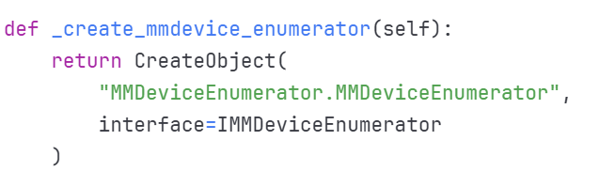
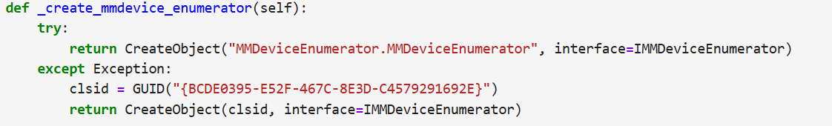
Device Enumerator
(Finds audio devices)

Slide 5
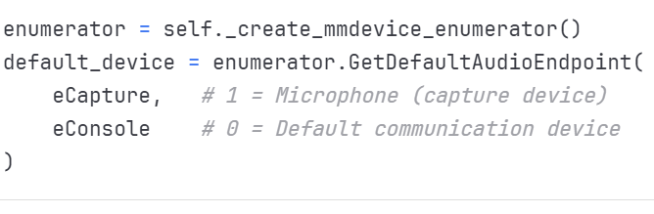
Getting Default Microphone

Slide 6
Explaination
Program explaination:

Slide 7
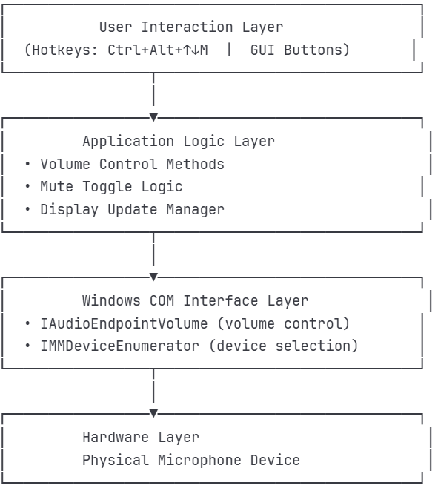
GUI Workout:

Slide 8
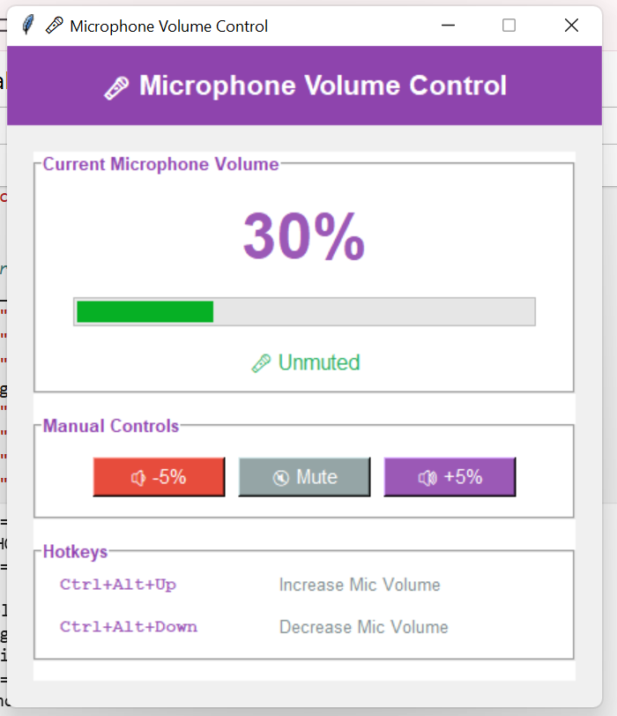
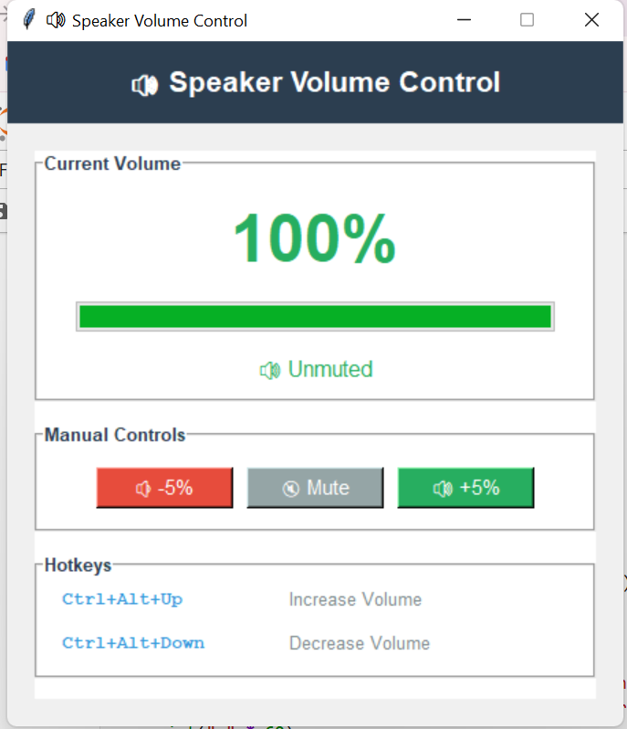
Implementation:

Slide 9
Thank you

