Slide 1
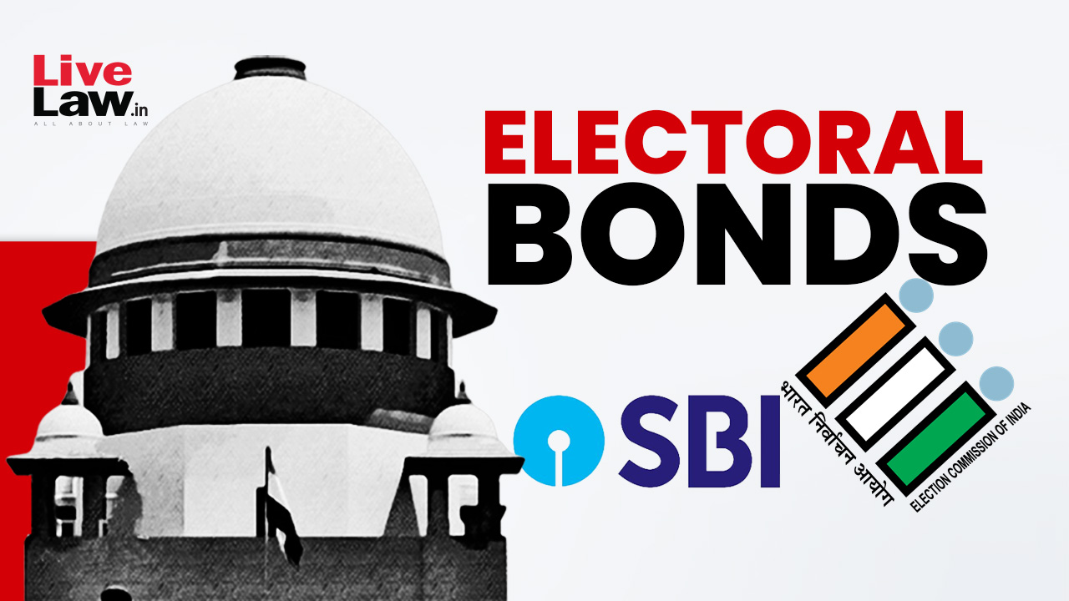
Electoral Bond Analysis

Slide 2
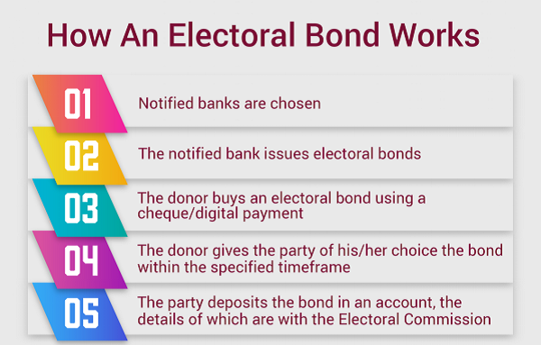

Slide 3
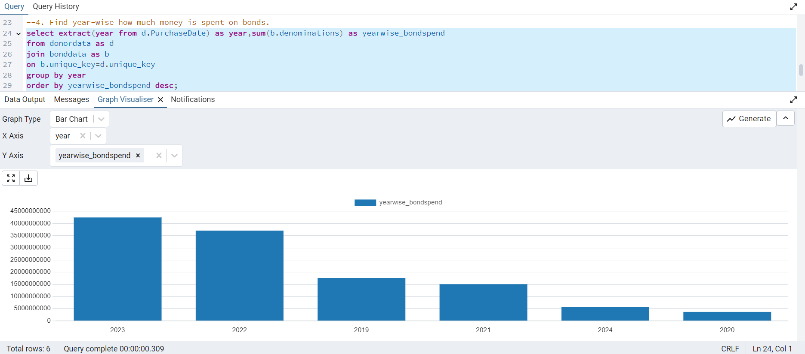
Year-wise money is spent on bonds

Slide 4
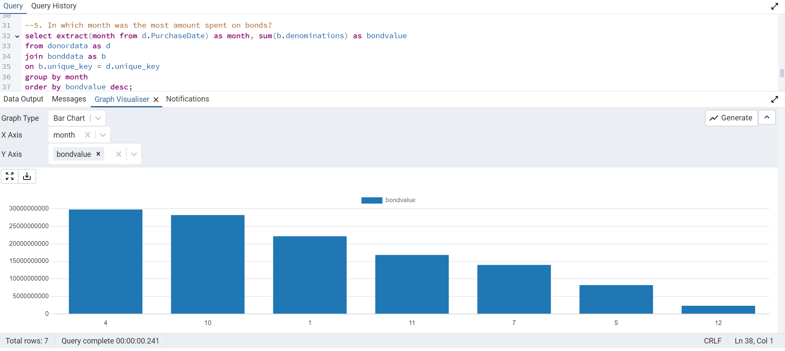
Month wise the amount spent on bonds

Slide 5
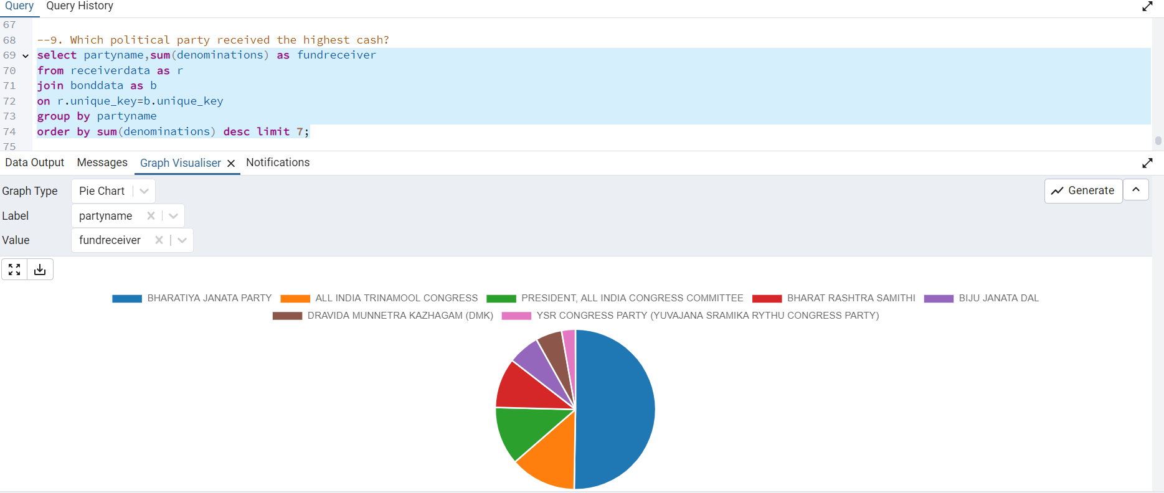
Political party received the highest cash

Slide 6
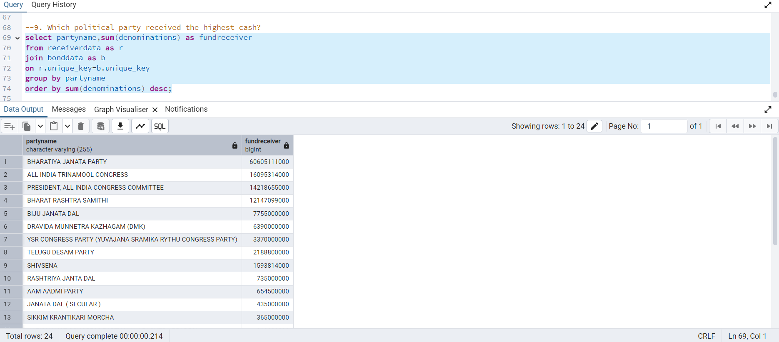
Political party received the highest cash - table

