Slide 1
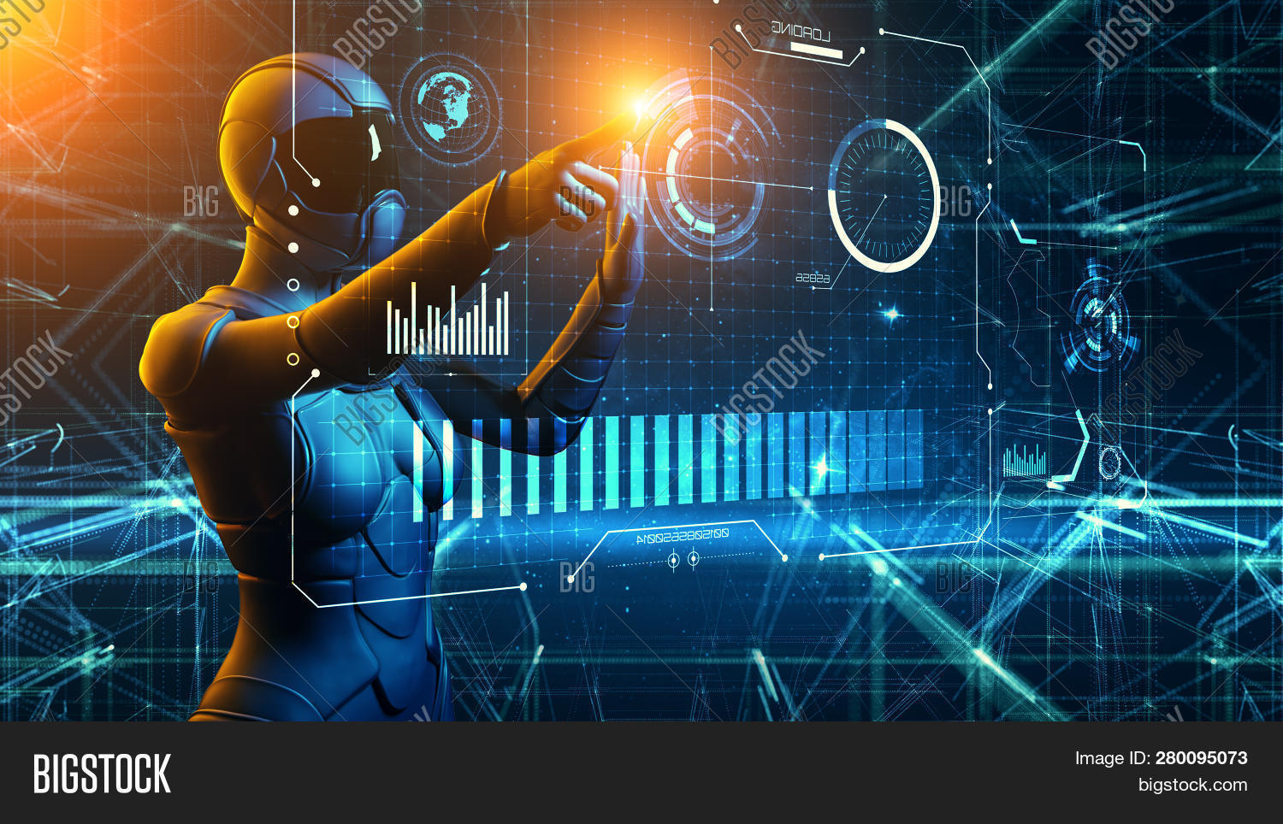
Web-3 Transparancy And Real Tracking

Slide 2
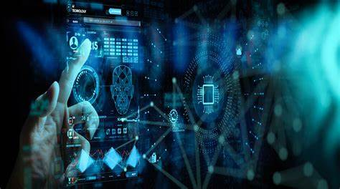
HAND GESTURE

Slide 3
Introduction to Hand Gestures
Hand gestures involve physical movements or signals used to communicate or interact with systems, making them an intuitive means of control.
Significance: Gesture-based technology enables natural user interaction, especially as the digital world evolves to offer more intuitive and immersive experiences.

Slide 4

Virtual Mouse
A virtual mouse system uses gesture recognition to replicate the function of a physical mouse, offering seamless, hands-free control of the cursor and other mouse functions.

Slide 5
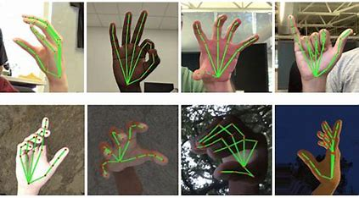
Virtual Mouse
Pointing & Clicking:Action: Pointing a finger or hand at the screen directs the cursor, while a gesture such as tapping or making a clicking motion performs the selection.
Example: Gesture-based software like Leap Motion allows users to "click" by making a pinching motion in the air.

Slide 6
Virtual Mouse: Concept & Features
Drag & Drop:
Action: A hand gesture, such as holding a hand or finger in a "grabbing" motion, can simulate dragging and dropping virtual objects on a screen.
Example: With software like Air Mouse, users can drag files simply by making a sweeping gesture with their hand.
Scrolling & Zooming:
Action: Swiping fingers or pinching gestures to simulate scrolling through content or zooming in and out.
Example: Touchless scrolling can be achieved with upward or downward finger swipes in air-based gesture systems.
Right/Left Click:
Action: Specific hand gestures replicate right or left mouse clicks, such as tapping two fingers for a right-click.
Example: With the Microsoft Kinect or a similar camera system, users can configure their gestures to perform the same actions as clicking a mouse.

Slide 7
Game Control: Hand Gesture Applications
Hand gesture-based gaming control systems use gestures instead of traditional controllers to interact with games, offering a more immersive, physical, and intuitive way to play.

Slide 8
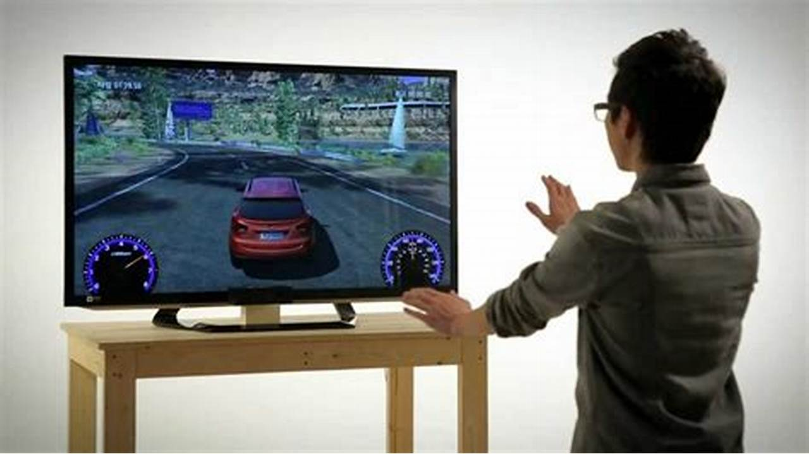
Gesture-Based Commands
Players can perform specific in-game actions (e.g., jumping, attacking, defending) by mimicking real-world movements with their hands.’
Example: In the game "Just Dance," players follow choreographed gestures to match on-screen movements.

Slide 9
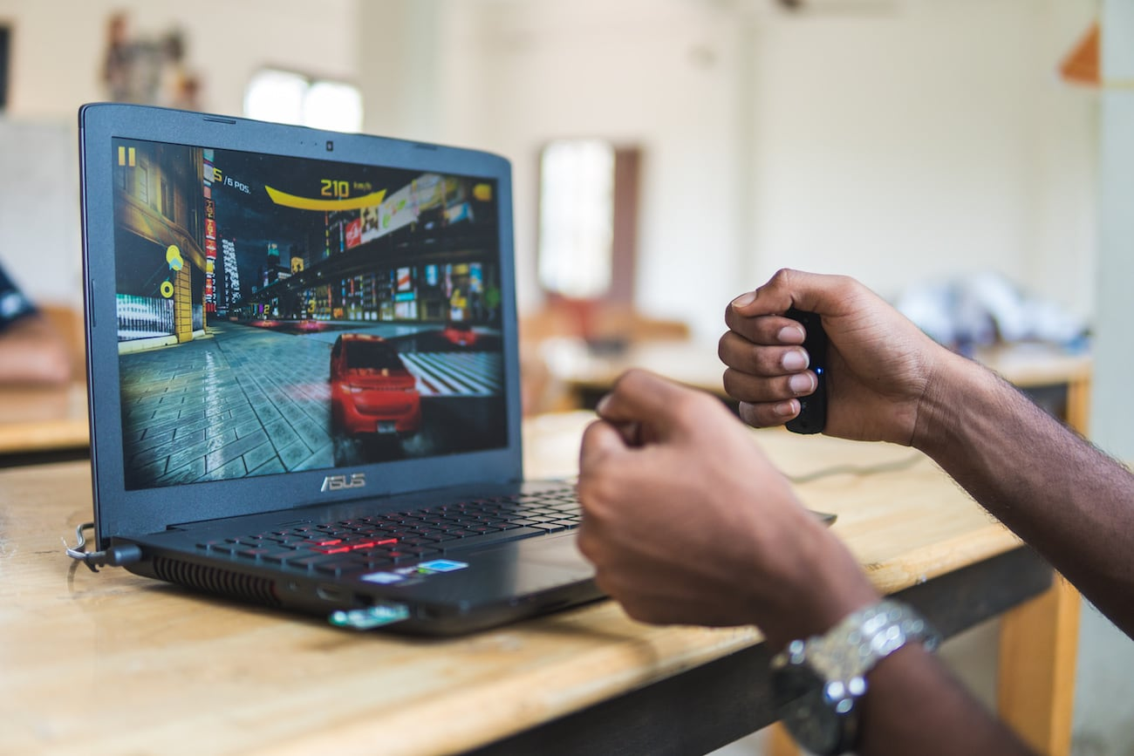
Motion Detection
Action: Systems like Kinect and PlayStation Move track body movements and translate them into in-game actions, providing a highly immersive experience.
Player Interaction:
Gestures can be used to interact with game environments, such as opening doors, throwing items, or solving puzzles by physically reaching out or performing symbolic gestures.

Slide 10

HAND GESTUERS FOR PRESENTATION
hand gestures in a presentation can make your delivery more dynamic and help emphasize key points Both hands open, palms facing upward or outward. To show openness, honesty, and engagement with your audience.
How to Use: When introducing yourself, explaining concepts, or presenting key points. It conveys trustworthiness and helps create rapport with the audience.
Example: “This is a problem we need to address…” (palms open as you speak, showing openness and engagement).

Slide 11
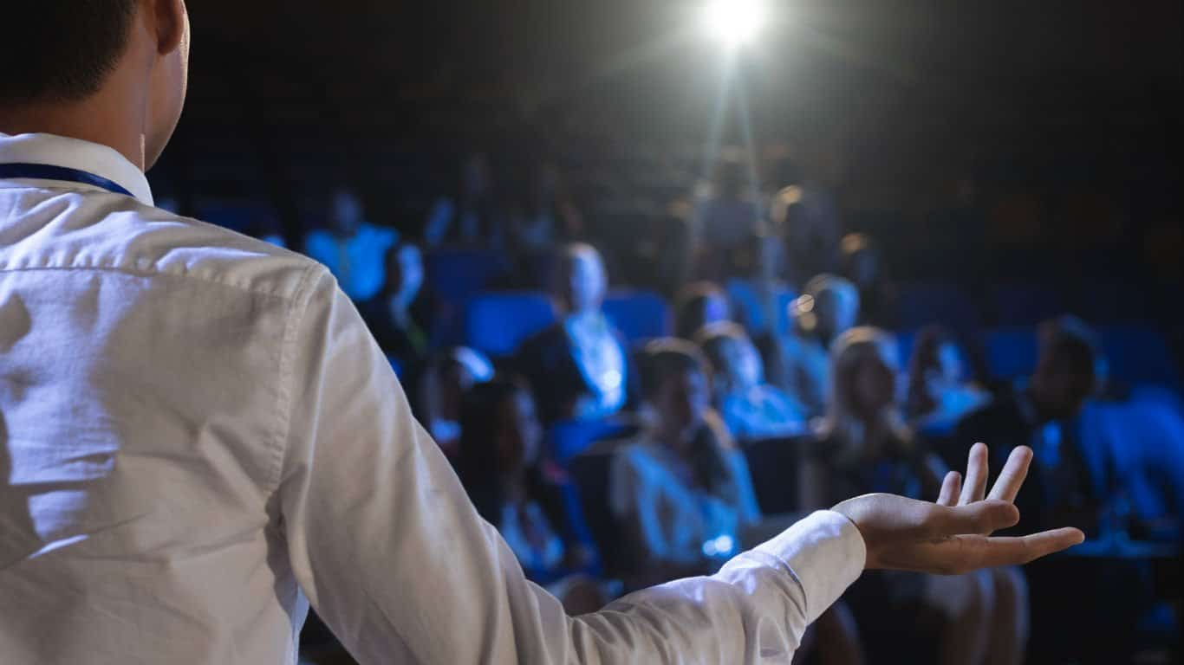
effective hand gestures for presentations:
Open Palm: Shows openness and honesty. Use when introducing topics.
Pointing: Directs attention to key visuals (charts, graphs). Use sparingly.
Counting: Uses fingers to list points. Helps structure ideas clearly.
Chopping: A downward motion to emphasize decisiveness. Use when making strong points.
Steepling Fingers: Shows confidence and authority. Use when stating important ideas.
Two-Handed Gesture: Shows size, scale, or range. Use when discussing magnitude.
Pause Gesture: Raises hand to signal a pause. Allows the audience to process info.
Open Arms: Conveys inclusivity and engagement. Use when discussing collaboration.
Thumbs Up/Down: Quick approval or disapproval. Use for informal feedback.
Sweeping Motion: Indicates movement or change. Use when talking about progress.
Mirroring: Subtly copy audience’s body language to build rapport.

Slide 12
Benefits of Hand Gesture Control
Advantages:
Hands-Free Interaction:
Convenience: No need for additional devices such as a mouse, keyboard, or controller, making interaction quicker and more intuitive.
Example: Home assistants (like Alexa or Google Home) that can be activated by hand gestures.
Natural Interaction: The gestures are instinctual, mirroring how we interact with the physical world (e.g., pointing to something to select it).
Inclusive Technology: People with physical disabilities or those unable to use traditional input devices can still control and interact with systems via hand gestures.

Slide 13
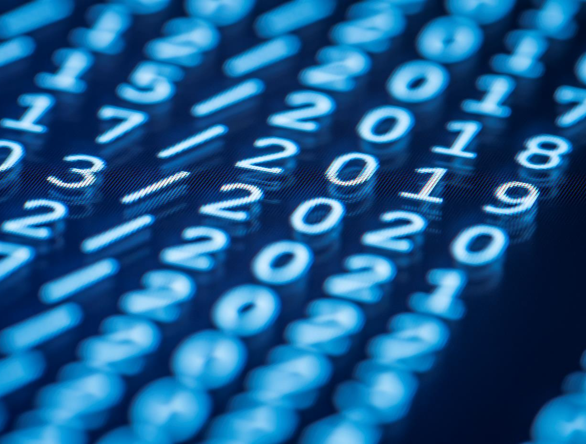
Thank You

