Slide 1






KONGU ENGINEERING COLLEGE
PERUNDURAI ERODE-638060
DEPARTMENT OF MCA
KEC Proof of concept
EcoTrack360: Real-Time Smart Bin Monitoring
PS CATEGORY – HARDWARE & SOFTWARE
Team Lead: SIVA K
Team Members: MOHAMUDHA SHIFA THAHSINA J
NISANTH G
RUBITHA D
Team Mentor with Designation and Department:
Dr.M.Sindhu
(Assistant Professor)
MCA Department
In association with:

Slide 2
AGENDA
Abstract
Problem statement
Proposed solution
Flow diagram
Feasibility and viability
Impact and benefits
Conclusion

Slide 3


OVERVIEW
Inefficient waste management and poor segregation lead to environmental hazards and high operational costs.
This project introduces an IoT-enabled smart waste management system for better waste tracking and control.
Smart bins with dual partitions separate organic and inorganic waste at the source.
Sensors detect waste type and bin fill levels, guiding users for proper disposal.
Real-time data is sent to a centralized cloud platform for monitoring and analysis.
Integration with a mobile app and AI waste classifier enhances user participation and accuracy.
The system supports optimized waste collection routes, reduced fuel usage, and improved recycling.
Overall, it contributes to cleaner cities and a more sustainable urban environment.

Slide 4
PROBLEM STATEMENT
Traditional waste management systems often suffer from inefficiencies such as overflowing bins, delayed collection schedules, and improper waste segregation, leading to environmental pollution, health hazards, and increased operational costs.
The solution should aim to reduce waste collection costs, minimize environmental impact, and improve waste segregation at the source to increase recycling rates.

Slide 5
PROPOSED SOLUTION
Smart Bins: Use sensors to detect waste type and bin fill level.
Live Monitoring: Sends real-time data to the cloud for tracking.
AI Waste Scanner: Mobile app uses AI to identify waste from photos.
EcoTrack360 App: Helps users find bins, scan waste, and get alerts.
Smart Collection Routes: Plans the best routes for waste trucks.
Admin Dashboard: Shows bin status and complaints for easy management.

Slide 6
IOT Products
Arduino UNO
Ultrasonic sensor
Inductive Proximity Sensor
Capacitive soil moisture sensor
Air quality sensor
Servo motor

Slide 7
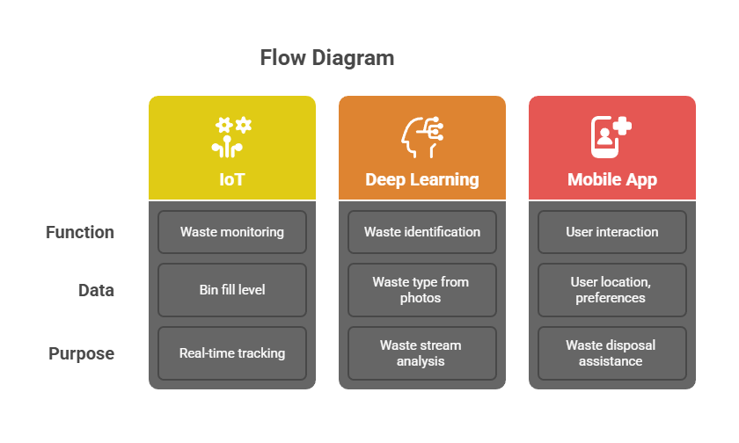
FLOW DIAGRAM

Slide 8
FEASIBILITY AND VIABILITY
Feasibility Analysis
Technical Feasibility
Economic Feasibility
Operational Feasibility
1.Technical Feasibility
Uses readily available sensors: ultrasonic, gas, moisture, and proximity sensors.
IoT platforms like Arduino UNO or ESP32 enable real-time data transfer.
AI-based waste classification is achievable using lightweight DL models (e.g., MobileNet).
Mobile app development is feasible with existing frameworks (Flutter, React Native).

Slide 9
2. Economic Feasibility
Low-cost sensors and microcontrollers reduce initial investment.
Cloud platforms offer scalable and cost-effective data storage and monitoring.
Route optimization reduces fuel consumption and labor costs.
Recyclable waste and compost generation can create additional revenue streams.
3. Operational Feasibility
Simple interface encourages user participation through the EcoTrack360 app.
Municipal workers can use dashboards for efficient waste management.
Regular maintenance (bin cleaning, sensor calibration) is manageable
.Public awareness campaigns and notifications support behavioral change.

Slide 10
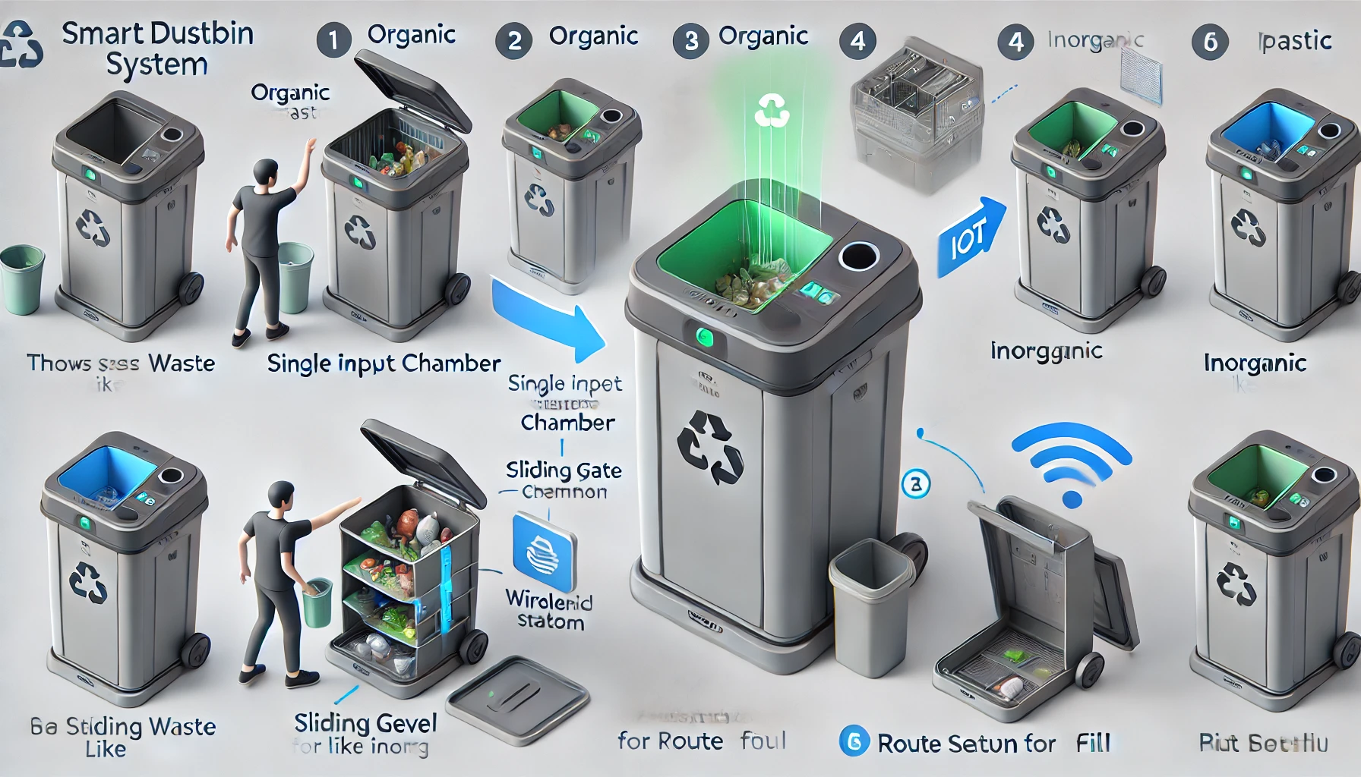
SMART DUSTBIN FOR HOME

Slide 11
Impact of the System
✅ Improved Waste Segregation: Encourages correct disposal at the source, increasing recycling efficiency.
🚮 Reduction in Landfill Waste: Organic and recyclable waste are processed separately, reducing landfill load.
🌫️ Lower Pollution Levels: Prevents overflow and illegal dumping, leading to cleaner surroundings.
🔄 Efficient Recycling: Segregated waste (plastics, metals, organics) can directly enter recycling or composting streams.
🧹 Better Sanitation and Hygiene: Timely collection reduces odor, pests, and disease risks in urban areas.
♻️ Supports Circular Economy: Promotes reuse and resource recovery from waste materials.

Slide 12
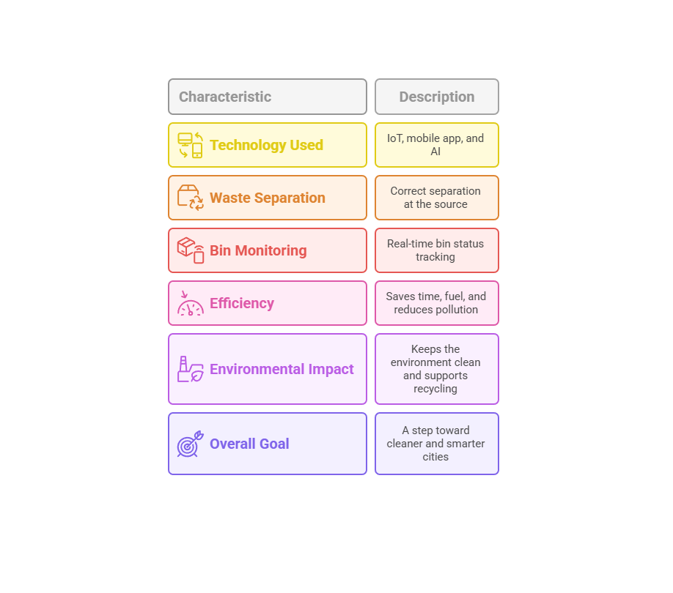

Slide 13
Conclusion
The system uses IoT, mobile app, and Deep Learning to manage waste smartly.
Helps people separate waste correctly at the source.
Tracks bin status in real-time for quick and clean collection.
Saves time, fuel, and reduces pollution with smart routes.
Keeps the environment clean and supports recycling.
A step toward cleaner and smarter cities.
"♻️ Waste isn’t just collected — it’s understood. 📡 EcoTrack360 makes every bin smarter."

Slide 14


