Slide 1
Spring Boot
E-Commerce Backend
Lab 1 • Building a REST API from scratch
SPRING BOOT
Controller → Service → Repository
Client
MySQL

Slide 2
The Application Architecture
We will build the backend one layer at a time.
SPRING BOOT APPLICATION
Client
Product
Controller
Product
Service
Product
Repository
MySQL
products
Receives HTTP
requests
Application
logic
Database access
through JPA
Relational
data
REQUEST
RESPONSE

Slide 3
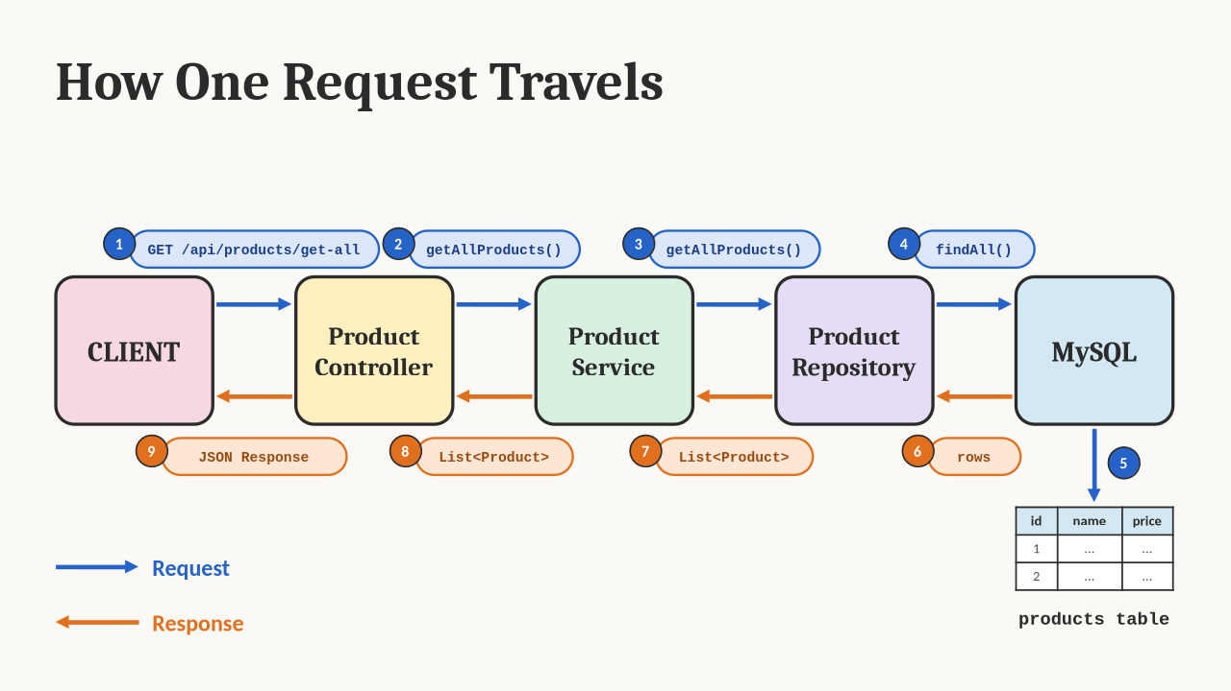
How One Request Travels
Follow one request all the way to MySQL — and back.

Slide 4
Our First Backend
A small Product API — enough to understand the complete request path.
GET /api/products/get-all
Get all products
Product
id
GET /api/products/get/{id}
Get one product
name
description
POST /api/products/add-product
Add a product
price
category
PUT /api/products/update/{id}
Update a product
stock
Now we build it: Entity → Repository → Service → Controller

