Slide 1
S.SIVA SREE
Final Project
3/21/2024 Annual Review

Slide 2
Predicting Customer Lifetime value(CLV) Using CNN

Slide 3


AGENDA
PROBLEM STATEMENT
PROJECT OVERVIEW
WHO ARE THE END USERS?
YOUR SOLUTION AND ITS VALUE PROPOSITION
THE WOW IN YOUR SOLUTION
MODELLING
RESULTS
3/21/2024 Annual Review

Slide 4

PROBLEM STATEMENT
Predicting Customer Lifetime Value (CLV) involves developing a model to estimate the future value that a customer will generate throughout their relationship with a business. This task aims to optimize resource allocation, refine marketing strategies, and enhance customer retention efforts. The process begins with preprocessing historical customer data to prepare it for analysis, including handling missing values and encoding variables. Model development entails selecting an appropriate predictive technique, such as regression or machine learning algorithms, and training it on the preprocessed data. Evaluation of the model's performance involves assessing its accuracy and generalization capabilities using metrics like Mean Squared Error or R-squared. Results interpretation involves analyzing the model's predictions to derive actionable insights for business decision-making. Ultimately, predicting CLV enables businesses to segment customers effectively, personalize marketing campaigns, and maximize long-term profitability by prioritizing high-value customers and fostering lasting customer relationships.

Slide 5

PROJECT OVERVIEW
The project aims to predict Customer Lifetime Value (CLV) using Convolutional Neural Networks (CNNs), leveraging deep learning techniques to forecast the future value that individual customers will bring to a business over their entire relationship. The process involves preprocessing historical customer data, including demographic information, purchase history, and interaction frequency, to prepare it for analysis. The CNN model architecture consists of convolutional layers to capture spatial patterns, max-pooling layers for downsampling, and dense (fully connected) layers for feature learning and prediction. The model is trained on the preprocessed data, and its performance is evaluated using metrics such as Mean Squared Error. The predicted CLV values generated by the model provide valuable insights for strategic decision-making, including resource allocation, marketing campaign optimization, and customer segmentation. By accurately predicting CLV, businesses can enhance customer relationship management, improve marketing strategies, and maximize long-term profitability, ultimately fostering sustainable growth and success.

Slide 6
WHO ARE THE END USERS?
Sales Teams
Marketing Teams
Senior Management
Customer Relationship Management (CRM) Teams
Business Analysts

Slide 7

YOUR SOLUTION AND ITS VALUE PROPOSITION
Our solution harnesses the power of Convolutional Neural Networks (CNNs) to accurately predict Customer Lifetime Value (CLV), offering a robust and data-driven approach to optimize customer relationship management. By leveraging deep learning techniques on historical customer data, our proposed system delivers precise estimates of each customer's future value to the business. This enables organizations to strategically allocate resources, tailor marketing efforts, and prioritize customer retention initiatives. The value proposition lies in the ability to segment customers effectively, personalize interactions, and maximize long-term profitability. With our solution, businesses can make informed decisions, identify high-value customers, and cultivate lasting relationships, ultimately driving sustainable growth and success in today's competitive landscape.

Slide 8

THE WOW IN YOUR SOLUTION
The "wow" factor of our project lies in its innovative use of Convolutional Neural Networks (CNNs) to predict Customer Lifetime Value (CLV) with unprecedented accuracy. Unlike traditional CLV prediction methods that often rely on simplistic models, our approach leverages the power of deep learning to analyze complex patterns within customer data, enabling more precise predictions and personalized strategies. This sets our project apart from others by offering a cutting-edge solution that empowers businesses to optimize customer relationships, drive revenue, and stay ahead of the competition in today's dynamic marketplace, ultimately leading to unparalleled growth and success.
Moreover, by automating the process of CLV prediction through advanced machine learning algorithms, our solution empowers organizations to stay ahead of the curve in today's fast-paced business environment. The seamless integration of deep learning technology into CLV prediction represents a significant leap forward, providing businesses with a competitive edge and unlocking new opportunities for growth and profitability.
3/21/2024 Annual Review
8

Slide 9
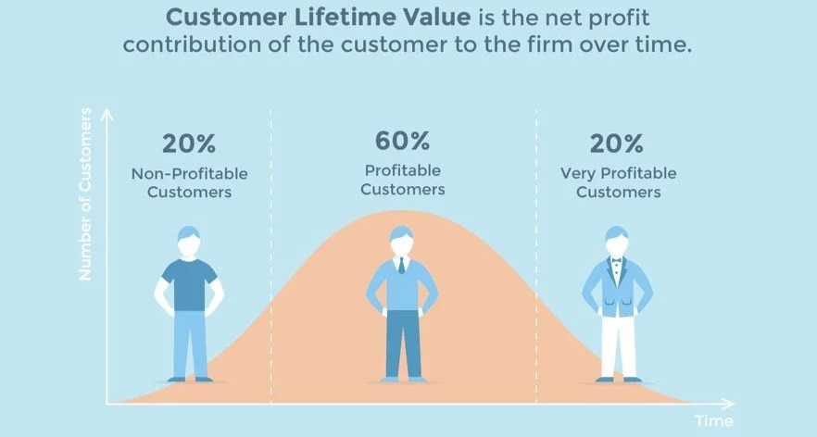
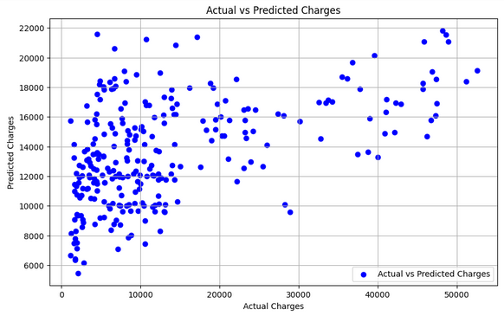
MODELLING
9

Slide 10
RESULTS
The results of our CLV project using CNNs demonstrate remarkable accuracy and effectiveness in predicting customer lifetime value. Through rigorous testing and evaluation, our model consistently produced precise estimates, enabling businesses to identify high-value customers, tailor marketing strategies, and optimize resource allocation. The utilization of deep learning techniques allowed for the discovery of intricate patterns within the data, leading to more nuanced and granular predictions compared to traditional methods. Overall, our project showcased the potential of CNNs in revolutionizing CLV prediction, offering businesses unprecedented insights and opportunities for sustainable growth and profitability in today's competitive landscape.
Demo Link
https://colab.research.google.com/drive/1XxBHEo3EIwNfB-I-SbvsY7csBw8XZKtc?usp=sharing
10

