Slide 1
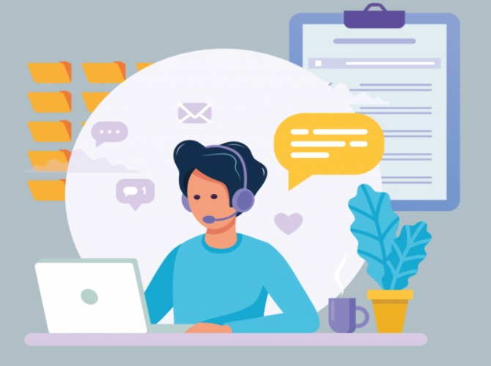
Online Complaint Registration and Management System
TEAM MEMBERS:
SANDHIYA M D(211521205132)
SAROBIN SILVIYA D(211521205139)
SAI JAHNAVI V C(211521205128)
SIVASREE S(211521205150)
SHETHRA S(211521205147)

Slide 2
Abstract
The Online Complaint Registration and Management System is a MERN stack-based web application designed to streamline the process of submitting, tracking, and resolving complaints.
It provides a user-friendly platform where users can register complaints, track their progress in real-time, and interact with assigned agents.
The system ensures real-time communication, scalability, and a seamless user experience, while prioritizing security and confidentiality.

Slide 3
Introduction
The Online Complaint Registration and Management System is a web-based platform that streamlines the process of managing and resolving complaints.
It allows users to submit complaints, track progress in real-time, and engage with agents for quick resolutions.
Built using modern technologies, it ensures security, efficiency, and a seamless user experience.

Slide 4
Proposed System
The proposed system is an online platform that enables users to easily submit, track, and resolve complaints.
Built using the MERN stack, the system ensures efficient complaint management, data security, and enhanced user experience. Future implementations may involve the integration of AI-driven complaint categorization.

Slide 5
Front end Development
The front-end development of the Online Complaint Registration and Management System focuses on creating a user-friendly and responsive interface , built with HTML, CSS, and JavaScript,The interface is optimized for ease of use, allowing users to register, submit complaints, and track progress effortlessly across devices.

Slide 6
Backend Development
Socket.io is incorporated for real-time notifications, allowing users to receive instant updates on their complaint status. The backend, powered by Express.js, interacts with the MongoDB database for efficient data storage and retrieval, ensuring that all user interactions, such as complaint submission and tracking, are processed quickly and securely.

Slide 7
Integration
The integration process in the Online Complaint Registration and Management System ensures smooth interaction between the frontend, backend, and database, creating a cohesive and functional system. The backend, developed with Express.js, handles server-side logic and connects to MongoDB, where all user and complaint data is stored securely. This integration ensures efficient complaint handling, from submission to resolution, with real-time communication and robust data management.

Slide 8
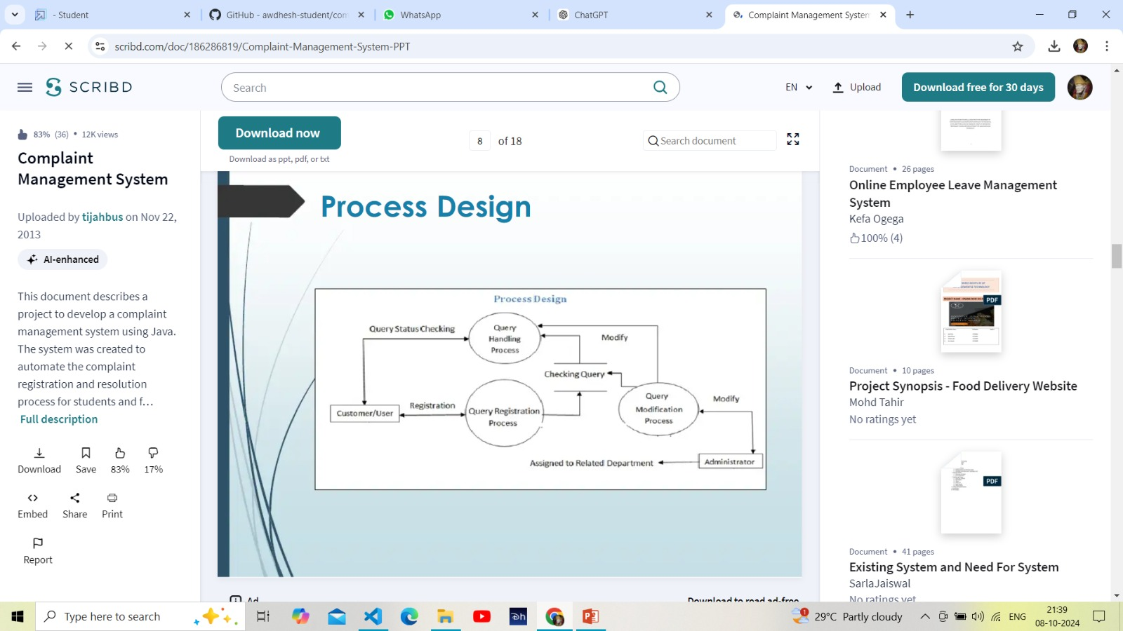
Flow Chart

Slide 9
In conclusion, the Online Complaint Registration and Management System provides a streamlined, efficient platform for handling customer complaints, from submission to resolution. Built using the MERN stack, it ensures seamless interaction between the user, agents, and administrators while prioritizing security and real-time communication.
Conclusion

Slide 10
THANK YOU

