Slide 1
Excel based leave management system
What This Project Represents
This project demonstrates how Excel can be transformed into a mini HR management system using formulas and structured sheet linking.
This project simulates a real-world HR Leave Tracking System built using Microsoft Excel. Instead of using paid HR software like: SAP SuccessFactors, Zoho People

Slide 2
Business Problem
Real-World Problem
Leave data is managed manually
HR calculates balances manually
Mistakes happen in leave deduction
No real-time visibility
Risk
Overuse of leave
Payroll calculation errors
Conflicts between HR & employees
This system solves manual tracking errors by automating leave calculation and balance management

Slide 3
Project Objective (Detailed)
Automate leave tracking
Avoid manual calculation errors
Ensure only approved leaves reduce balance
Maintain centralized leave database
Provide quick summary for management
The system works dynamically — if leave status changes from "Pending" to "Approved", balance updates automatically.

Slide 4
System Architecture
Employee Master
Leave Application
Leave Balance Calculation
Leave Summary Report
EXPLANTION
The system works in a structured flow. Master data is fixed. Transaction data is entered in Leave Application. Then formulas calculate leave usage and summary updates automatically.

Slide 5
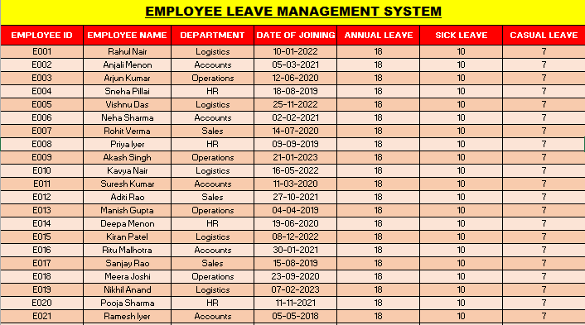
Employee Master
This sheet acts as a Master Table.
It stores:
Employee ID (Primary Key)
Name
Department
Leave allocation
Employee ID is used to link all sheets together, ensuring accurate calculation and avoiding duplication errors.

Slide 6
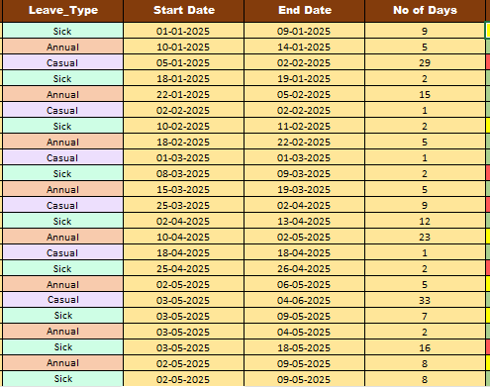
Leave Application
It records
Who applied
What leave type
Start date
End date
Status
Important Formulas Used
Number of Days =End Date - Start Date + 1
Only if Status = "Approved“
(Leave will be deducted.)
This ensures business validation logic is applied before leave deduction.

Slide 7
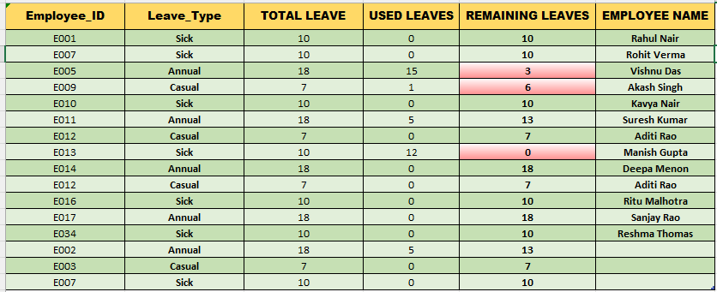
Leave Balance Sheet
SUMIFS Function
It filters:
Employee ID
Leave Type
Status = "Approved"
SUMIFS works like a database query inside Excel. It filters rows based on multiple conditions and returns accurate leave usage. multiple conditions need to be checked simultaneously in sumifs

Slide 8
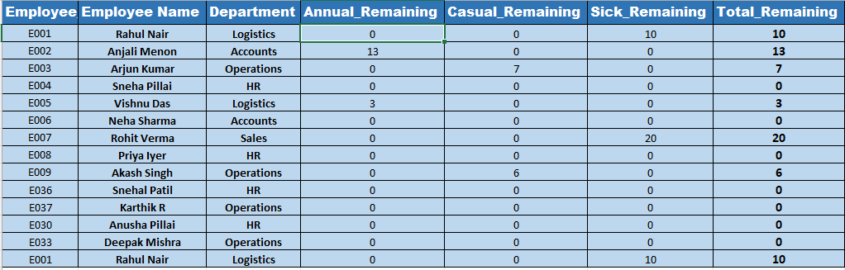
Leave Summary Sheet
Employee-wise remaining leaves
Department-wise tracking possible
Total leave overview
This sheet converts raw data into management-level information.

Slide 9
Excel Features Used
SUMIFS (conditional aggregation)
Sumproduct, If’s, VLOOKUP
Date arithmetic
Data validation dropdown
Cross-sheet linking
Logical condition filtering
This project integrates database logic, conditional computation, and reporting within Excel without using macros.

Slide 10
Conclusion
Successfully developed an automated Employee Leave Management System using Excel
Implemented real-time leave tracking using formulas
Applied conditional logic (SUMIFS) for accurate leave deduction
Created a structured system with Master, Transaction, and Report layers
Reduced manual errors and improved efficiency

