Slide 1
Recommender System using Collaborative Filtering and Performance Analysis
Team Nimbus:
Divya Ginjupalli
Gopikrishnan Narayanan
Prabal Kanodia
Priyanka
SivaSrinivas Amara

Slide 2
Overview
Process the datasets Netflix and IMDB
Implement a movie recommender system using the collaborative filtering and other techniques available in Mahout
Implement our version of collaborative filtering algorithm using Map-Reduce on Hadoop
Visualize recommendations dynamically using D3.js
Compare the performance of our algorithm vs Mahout using Confusion matrix and RMSE

Slide 3
Use Cases
Movie recommendation – Netflix, IMDB
Helps to increase the viewership
Helps in Advertisements and Sales
Others:
Product recommendation – Amazon
Spam detection
Stock prediction
Sentiment analysis
Message routing decision
Article and Blog recommendation

Slide 4


Architecture – Mahout/MapReduce version
1. Merge and organize data from multiple datasets
2. Load data into HDFS
3. Use Mahout / Develop our MapReduce algorithm for collaborative filtering
4. Submit MapReduce job
Hadoop Cluster
We
5. Retrieve recommendations and other aggregated output data from HDFS
6. Visualize and analyze trends and statistics based on output

Slide 5
Datasets
NetFlix dataset
Movie ratings by using Netflix users
17770 movies; 480189 users
Ratings are on a scale from 1 to 5
IMDB dataset
Movie Id/Name with various genre tags associated with each movie
Data Merging
Combined Netflix and IMDB dataset using either Fuzzy Join and Mymovieapi.com
Extended netflix dataset with genres attribute.
Other attributes like location, actors, directors may also be retrieved

Slide 6
Fuzzy Join
Use approximate string matching algorithms
Jaccard measure
Levenshtein distance
Use MapReduce framework to merge datasets and normalizing (trim and upper case) the movie titles
Movie API
Used simple HTTP GET to access information about the movies in XML or JSON format
Information included genre, actors, directors, plot, imdb rating etc

Slide 7
Results of Data Merging
With equality join:
10293/17770 movie titles matched
With Jaccard fuzzy join (0.8 threshold):
10530/17770 movie titles matched
Note:
Mix and match of Levenshtein (for smaller strings) and Jaccard (for larger strings) could be used

Slide 8
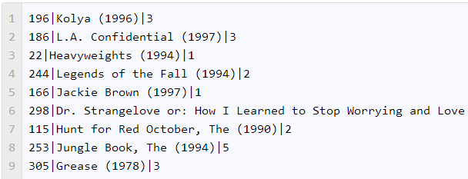
Collaborative based Algorithms
Input Requirements:
Input - 1
Input - 2
User_id of movie rater
Movie_id
Ratings by the users
Movie_id
Movie_name
Genre

Slide 9
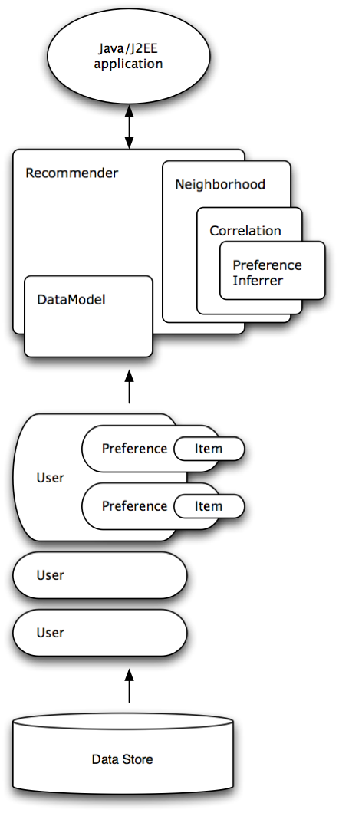
Mahout Architecture
Mahout has Interfaces to below abstractions
Data Model
(File data model)
User Similarity
Item Similarity
User Neighborhood
Recommender
Implementations
mahout.cf.taste.impl
https://cwiki.apache.org/confluence/display/MAHOUT/Recommender+Documentation

Slide 10
Mahout Version
User-based
Create DataModel from CSV file
Find UserSimilarity using correlation similarities
Find UserNeighbourhood and Create Recommender
Non-distributed version made concurrent using pseudo recommender job
Item-based
Map-reduce based library for recommendation
various configuration options like similarity measure to use and maximum number of similar items per item
Output format
[UserID1 [ItemId1:rating1] [ItemId2:rating2] [ItemId3:rating3]…….]

Slide 11
Item-based C.F. – MR Version
Step-by-step breakdown
For every pair of movies A and B, find all the people who rated both A and B
Use these ratings to form a Movie A vector and a Movie B vector
Calculate the correlation between those two vectors
When someone watches a movie, you can recommend the movies most correlated with it

Slide 12
Item-based C.F. – MR Version
Module 1 : Count_ratings
Mapper: For each user, emit a row containing their 'postings' (item, rating)
Key: (UserId), Value: (ItemId, Rating)
Reducer: Emit the user rating sum and count for use later steps
Output: (UserId, Rating_sum,Rating_count, {all_rating_pairs})
Module 2:Calculate_similarity
Mapper: Emits all possible combinations of movie pairs(item x, item y)
Key: (Movie1, Movie2), Value: (Rating1, Rating2)
Reducer: Sum components of each pair across all users who rated both item x and item y, then calculate pairwise similarity and co-rating counts
Output: (Movie1, Movie2), Similarity, count

Slide 13

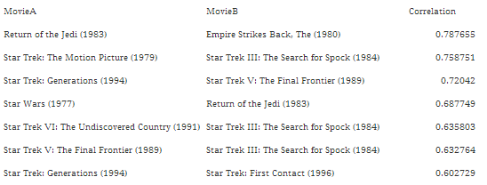
Item-based C.F. – MR Version
The correlation can be expressed as:
Module 3:Calculate_Ranking
Mapper: Emit items with similarity in key for ranking
Reducer: For each item emit K closest items

Slide 14
User based CF - MR Version
Step by Step crackdown
For a given user A, find similar users using user correlation
Find a user B with more similarity
Recommend a movie to user A that he hasn’t rated and rated by user B
Modules
Create user profiles
Find user similarity neighborhood
Recommend movies

Slide 15
User based CF - MR Version
Module 1 - User profiles
Mapper: For each row, emit user id and movie
Reducer: Emit user id and movies list
Module 2 - User neighborhood
Mapper: For a user profile, emit different combinations of user pairs
Reducer: Emit user profile and correlation
Find K users with more correlation

Slide 16
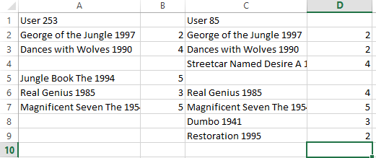
User based CF - MR Version
Module 3-Movie recommendation
Recommend movies that user A has not rated yet

Slide 17
Output
Recommended movies for users based on rating
Predict a movie rating for a user
Top-rated movies for various time ranges (for an year/period of 5 years/decade)
Top-viewed and trending movies for various ranges.
Other:
Top-rated genre for various time ranges

Slide 18
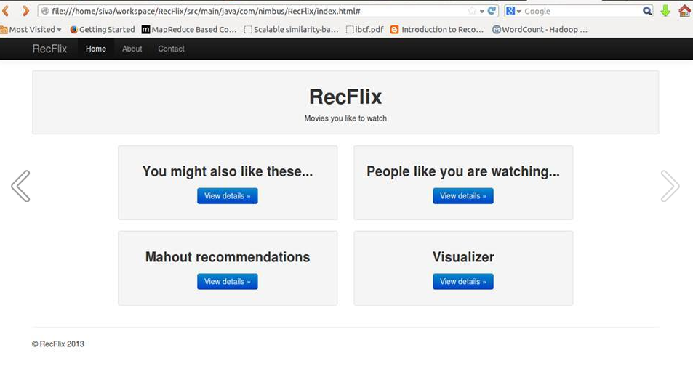
Web-based Tool
D3.js powered web-based interactive tool for displaying and analyzing recommendations and other statistics

Slide 19

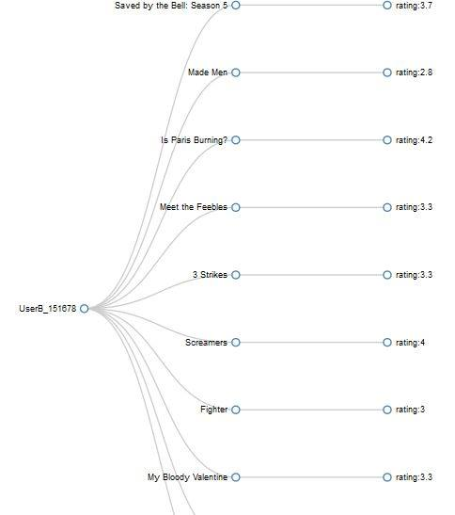
Recommendation Results

Slide 20
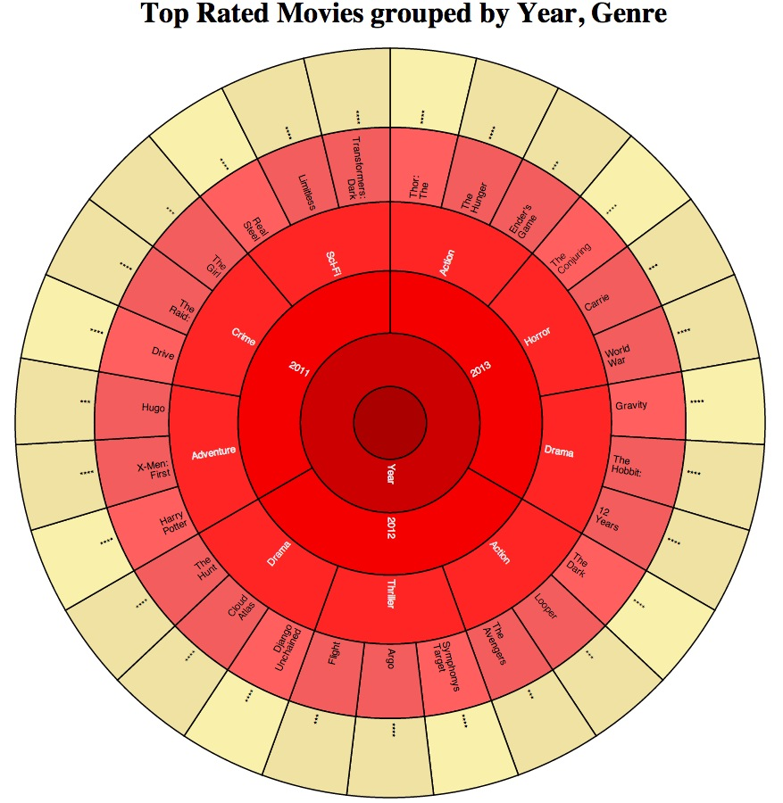
Visualization – Coffee Wheel

Slide 21
Root Mean Square Error (RMSE)
RMSE = √(Σ(ActualRating – PredictedRating)²/n)
RMSE for sample Netflix probe dataset with
Mahout User-based: 1.3167
Custom User-based: 1.3658
Mahout Item-based: 1.2667
Custom Item-based: 1.2708

Slide 22
Performance Analysis
Confusion matrix
 |  | MapReduce based recommendation
 |  | User1 | User2 | User3 | …. | ….. | User N
Mahout based | User 1 | 3 | 0 | 0 | 2 | 0 | 0
 | User 2 | 1 | 2 | 0 | 0 | 0 | 0
 | User 3 | 0 | 0 | 2 | 1 | 0 | 0
 | …. | 0 | 0 | 3 | 0 | 0 | 0
 | ….
 | User N
Only the non-zero values in the matrix will be used for analysis

