Slide 1


Currency Converter
A currency converter is an online tool that allows users to quickly and easily convert one currency to another. It provides real-time exchange rates, making it a valuable resource for international transactions, travel planning, and financial management.

Slide 2
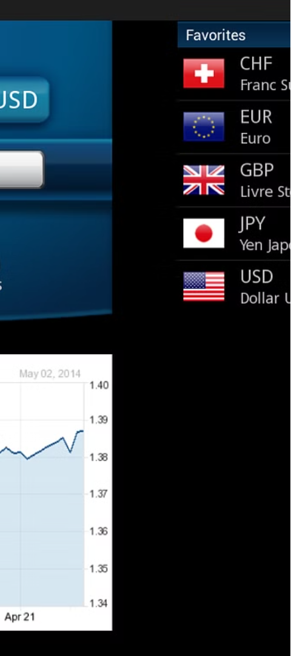
What is a Currency Converter?
Definition
Why?
A currency converter is a digital tool that allows users to convert one currency to another based on current exchange rates.
It helps individuals and businesses understand the value of different currencies for international transactions, travel, and financial planning.
Accessibility
Currency converters are widely available online and as mobile apps, making them easily accessible to users worldwide.

Slide 3

How Does a Currency Converter Work?
1
Input
The user inputs the amount and the currency they want to convert from.
2
Lookup
By Using The Tkinter , ttk , Image , CurencyConverter python packages
The project is going to implemented
3
Calculation
The converter applies the exchange rate to the input amount and displays the converted value.

Slide 4
Benefits of Using a Currency Converter
Accurate Conversions
Eliminates the need for manual calculations and ensures precise exchange rates.
Time-saving
Provides instant access to currency conversions, streamlining financial tasks.
Informed Decisions
Helps users make informed decisions about international transactions and travel budgets.
Cost Savings
Reduces the risk of overpaying or underestimating currency exchange costs.

Slide 5
thank you…
Siva Sri Venkatesu S S

