Slide 1
ShelfSense AI
Autonomous retail friction detection, root-cause intelligence, and self-optimization
Partner Tools Used
Google DeepMind Gemini: micro-decisions + root-cause reasoning
Braintrust: evaluation, scoring, safety checks, optimization feedback loop
Modulate: voice alerts for Decision + RCI outputs

Slide 2
What It Solves In The Real World
Shoppers get stuck in aisles and leave without help.
Store teams miss friction moments when staffing is tight.
Static rule systems create alert fatigue and low trust.
ShelfSense closes the loop: detect -> decide -> evaluate -> optimize.
Business Impact
Faster assistance
Fewer false alerts over time
Better conversion in high-friction zones
Actionable operational insights

Slide 3
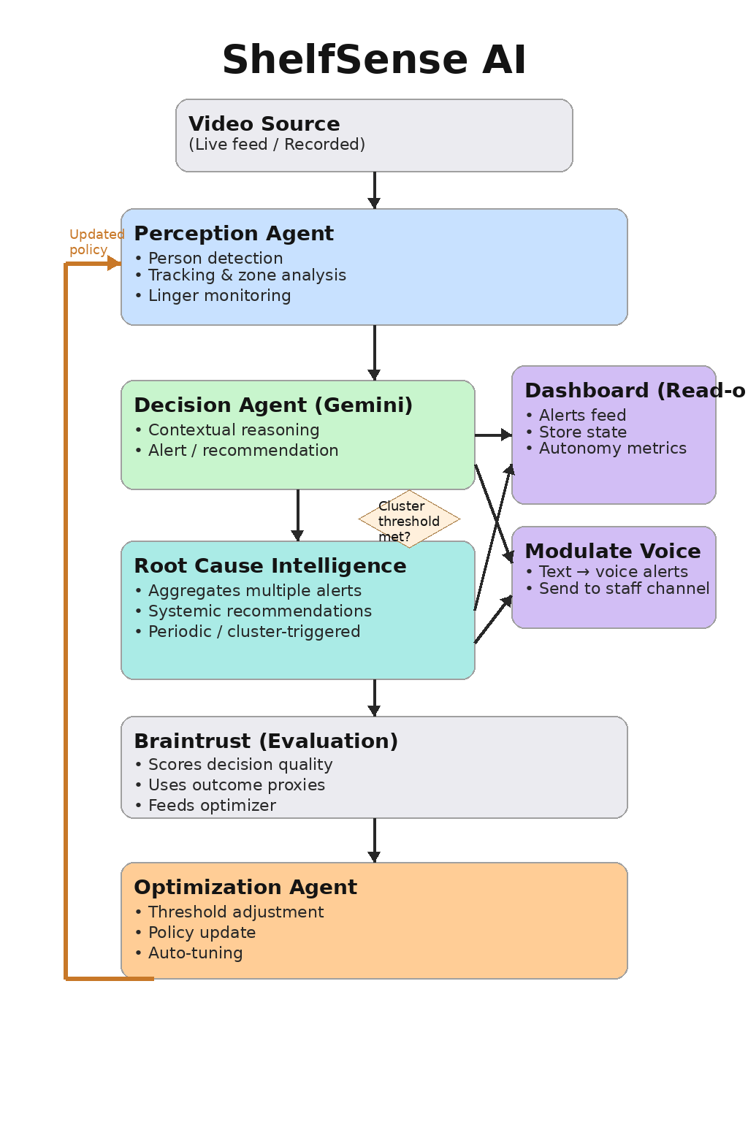
System Architecture (with Partner Tools)

Slide 4
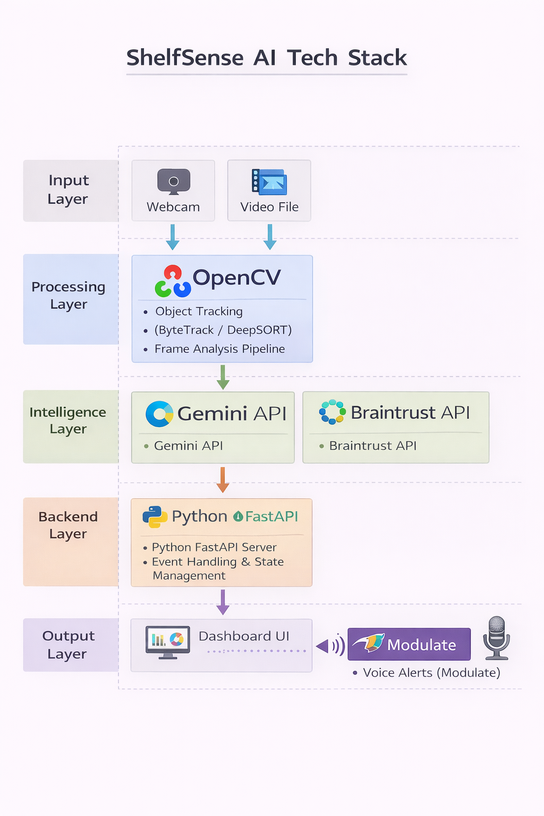
Agent Flow & Runtime View
Live Outcomes
Decision alert appears on dashboard
RCI recommendation appears on cluster
Braintrust logs score breakdown
Policy version increments over runs

Slide 5
Why ShelfSense Matters
Autonomous loop: perception -> decision -> evaluation -> optimization
Privacy-first operations intelligence for physical retail
Built for practical rollout on existing camera infrastructure
Measurable outcomes: reduced false alerts + improved assist response

