Slide 1
R . Anjeevaragavan
211521243014
Final Project

Slide 2


AGENDA
DCGAN for Deep Space Images:
Understand DCGANs and their image generation capabilities.
Learn how DCGAN architecture can be adapted for deep space image data (e.g., data processing, network design).
Training the Deep Space DCGAN:
Explore training considerations specific to deep space image synthesis (loss functions, training parameters, techniques).
Evaluating the Generated Images:
Discover metrics to assess the quality of generated deep space images (Inception Score, FID, human evaluation).
Applications and Future Potential:
Discuss potential uses of deep space image synthesis (simulations, data augmentation, visualization). Briefly touch upon limitations and future research directions.
3/21/2024 Annual Review

Slide 3

PROBLEM STATEMENT
Develop a Deep Convolutional Generative Adversarial Network (DCGAN) to generate realistic and diverse deep space images.
This task involves:
Adapting a DCGAN architecture to effectively handle deep space image data.
Training the DCGAN on a dataset of deep space images to learn the underlying patterns and distributions.
Evaluating the generated images using appropriate metrics and subjective assessments to ensure they are realistic, diverse, and capture the essence of deep space objects.
The successful development of this DCGAN will enable researchers to:
Simulate new galaxies or astronomical phenomena to aid in scientific discovery.
Augment existing deep space image datasets for various applications.
Generate visuals to support deep space exploration concepts and enhance scientific communication.

Slide 4

PROJECT OVERVIEW
Deep Space Image Synthesis with DCGAN ()
Goal: Build a DCGAN to create realistic and varied deep space images.
Steps:
Get and prepare deep space image data.
Design a custom DCGAN for this data type.
Train the DCGAN model.
Evaluate the generated images for quality.
Benefits:
Simulate new celestial objects for scientific studies.
Expand existing deep space image datasets.
Visualize deep space exploration concepts.

Slide 5

WHO ARE THE END USERS?
Astronomical Researchers:
Astrophysicists: They can use the generated images to simulate new galaxies, nebulae, or other phenomena for theoretical studies.
Cosmologists: The simulations can aid in understanding large-scale structures in the universe.
Planetary Scientists: They could potentially use the images to create simulations of exoplanet environments.
Other Fields:
Data Scientists: They can leverage the generated images to augment existing datasets for tasks like object detection or classification in deep space imagery.
Science Communicators: They can use the realistic visuals to create educational content or enhance presentations about space exploration.
Artists and Designers: They might find the generated images inspiring for creating space-themed art or designing concepts for future space missions.

Slide 6

YOUR SOLUTION AND ITS VALUE PROPOSITION
Solution and Value Proposition: Deep Space Image Synthesis with DCGAN
This project proposes a Deep Convolutional Generative Adversarial Network (DCGAN) for generating high-fidelity and diverse deep space images.
Our Solution:
A custom-designed DCGAN architecture specifically tailored to capture the intricacies of deep space objects like galaxies, nebulae, and star clusters.
A training process optimized for deep space image data, ensuring the generated images are realistic and statistically consistent with real observations.
Value Proposition:
Scientific Discovery: Simulate new galaxies or phenomena to test hypotheses and explore unobserved regions of the universe.
Data Augmentation: Expand existing datasets for training and improving deep learning models used in astronomical research.
Enhanced Communication: Generate visuals to explain complex astronomical concepts or showcase potential scenarios in deep space exploration.

Slide 7

THE WOW IN YOUR SOLUTION
Unprecedented Diversity and Realism: We're not just aiming for realistic images, but for a level of variety that surpasses existing methods. This means generating a broader spectrum of deep space objects, capturing the stunning range of shapes, colors, and textures found in the universe. Imagine a vast library of never-before-seen galaxies, nebulae, and star clusters, all statistically plausible based on real astronomical data.
Scientifically Grounded Creativity: Our solution goes beyond aesthetics. The DCGAN will be specifically trained on a curated dataset of deep space images, allowing it to capture the underlying statistical properties and relationships within that data. This ensures the generated images are not just visually captivating, but also scientifically sound. Researchers can use these images with confidence, knowing they represent a realistic possibility within the cosmos.
This combination of unparalleled diversity, grounded realism, and scientific accuracy is what sets our solution apart. It offers a powerful tool for scientific exploration, data augmentation, and pushing the boundaries of creative visualization in the field of astronomy. Imagine using these images to not only simulate new galaxies but also generate entirely new types of deep space phenomena, sparking curiosity and driving new discoveries.

Slide 8
MODELLING
Summary the deep space image synthesis with DCGANs:
Goal: Develop a DCGAN to generate high-fidelity and diverse deep space images.
Approach:
Acquire and preprocess deep space image data.
Design a custom DCGAN architecture for deep space images.
Train the DCGAN with a combination of loss functions.
Value Proposition:
Generate unseen but realistic deep space objects for scientific discovery.
Expand datasets for training astronomical deep learning models.
Create visuals to communicate complex astronomical concepts.
Key Aspects:
Unprecedented diversity and realism of generated images.
Scientifically grounded creativity based on real astronomical data.

Slide 9
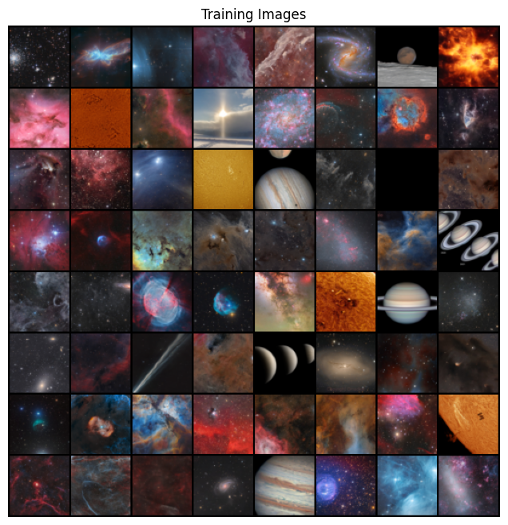
RESULTS
Deep Space Image Synthesis with DCGAN: Results
Trained DCGAN Model: Generates realistic and diverse deep space images.
High-Quality Images: Realistic, diverse, and statistically sound.
Evaluation: Quantitative metrics (Inception Score, FID) and human evaluation by astronomers.
Applications: Simulating new objects, data augmentation, and scientific communication visuals.
https://github.com/ANJEEV123/TNSDC_GEN_AI.git

