Slide 1
INVESTMENT ASSIGNMENT SUBMISSION
Name: Sivaramakrishnan Swaminathan

Slide 2
Strategy and Business Objective
Strategy
Invest where
Objective
Identify the best sectors, countries, and a suitable investment type for making investments for Spark Funds
investing
most others are

Slide 3
Approach Used
Identify the English Speaking Nations from Wiki Page
Start
Identify the top 3 English speaking most invested Countries
Treat the companies and funding data and merge them
Map the primary sector with main sector
Compute the representative value for desired funding types
Identify the top 3 sectors in the top 3 countries
Identify the Funding type(FT) best suited for Spark Funds
Output:
Suited Investment Type
Top 3 most invested Countries
Top 3 most invested sectors in those 3 countries
For the identified FT, find the top 9 most invested countries
End

Slide 4
Data Analysis
Funding data and companies data are loaded separately
Both the data frames are treated for missing values and Outliers
Companies data is left merged with funding data and treated again for missing values
Most representative values have been chosen for the four desired funding types, Seed, Angel, Venture and Private Equity
From the Mean values calculated, most suitable investment type for Spark Funds would be “Venture Type”
For the chosen Fund Type, “Venture Funding Type”, top countries have been identified based on total amount invested
English speaking countries have been discovered from the Wiki source
Top 3 English speaking countries identified based on the amount of Investment
United States of America (USA)
Great Britain (GBR)
India (IND)

Slide 5
Data Analysis (Cont)
From sector input data, each primary sector is mapped to a main sector
This data is merged with master frame to have a single view of the data
For each of the top 3 English speaking countries identified, below steps are performed
Data is grouped by main sector, top 3 sectors identified by count of investments and by amount of investment
Total amount invested across main sectors calculated
Most invested company in top 2 sectors identified by amount of Investment
Following graphs are plotted with the data analyzed so far
Fraction of count of total investments and the mean investment amount for the desired four funding types
Top 9 countries based on the amount of investment
Top 3 sectors in the top 3 English speaking countries for investment proposal

Slide 6
Results
Sector-wise Investment Analysis
Sl.no | Questions | C1 | C2 | C3
1 | Total number of Investments (count) | 12063 | 621 | 328
2 | Total amount of investment (USD) | 1.07757E+11 | 5379078691 | 2949543602
3 | Top Sector name (no. of investment-wise) | Others | Others | Others
4 | Second Sector name (no. of investment-wise) | Social, Finance, Analytics, Advertising | Social, Finance, Analytics, Advertising | Social, Finance, Analytics, Advertising
5 | Third Sector name (no. of investment-wise) | Cleantech / Semiconductors | Cleantech / Semiconductors | News, Search and Messaging
6 | Number of investments in top sector (3) | 2950 | 147 | 110
7 | Number of investments in second sector (4) | 2714 | 133 | 60
8 | Number of investments in third sector (5) | 2350 | 130 | 52
9 | For point 3 (top sector count-wise), which company received the highest investment? | Virtustream | Electric Cloud | FirstCry.com
10 | For point 4 (second best sector count-wise), which company received the highest investment? | SST Inc. (Formerly ShotSpotter) | Celltick Technologies | Manthan Systems

Slide 7
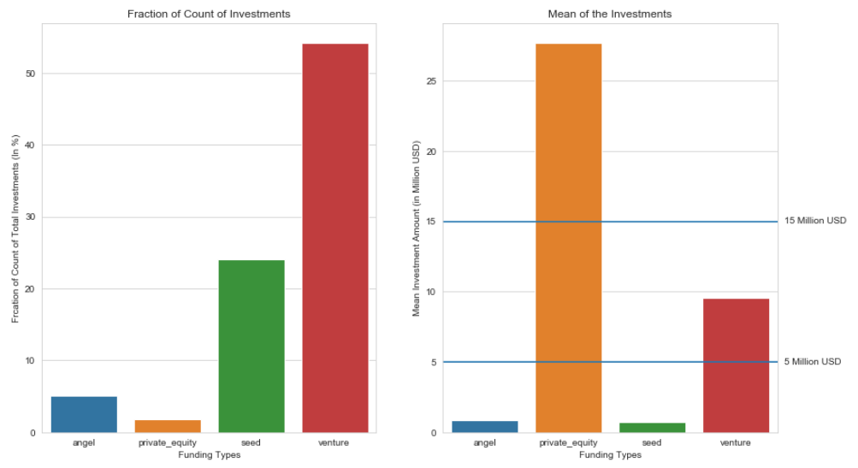
Plots of Fraction of Count of Total Investment and Average Amount of Investment

Slide 8
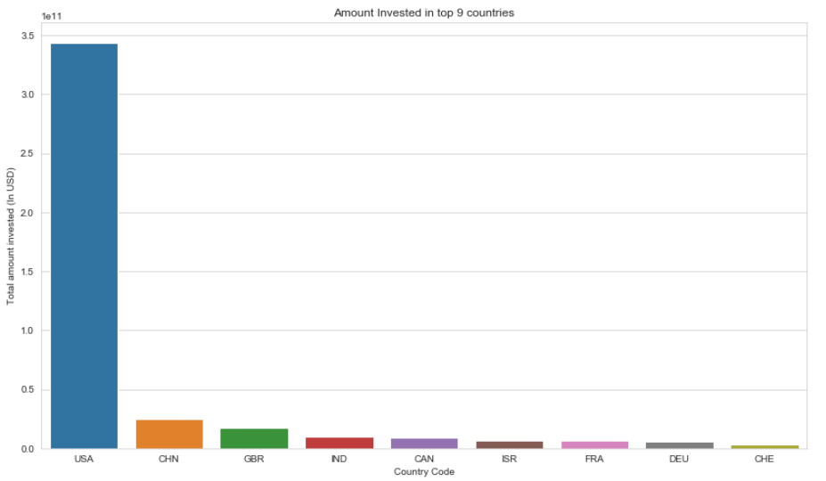
Plot of Total Amount invested across countries

Slide 9
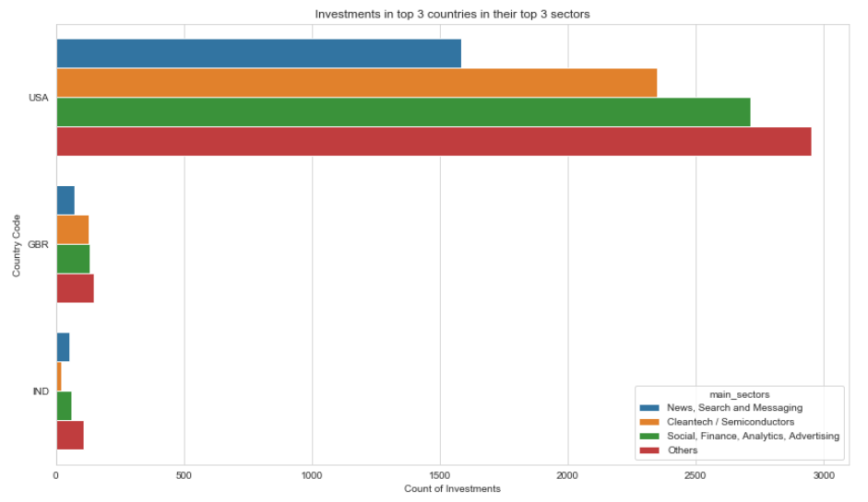
Count of investments in top 3 sectors in top 3 countries

Slide 10
Investment Proposal
Plot 1 clearly defines the best suited investment type for Spark Funds, Venture Type
Plot 2 shows the top countries suitable for Investment, USA, GBR and India
Plot 3 shows the sectors best suited for investments
Final Proposal for Investment for Spark funds based on the strategy would be the following
Best Investment type – Venture
Best Countries to invest – USA, GBR and India
Best Sectors to invest
Others
Social, Finance, Analytics, Advertising
Cleantech / Semiconductors
News, Search and Messaging

