Slide 1


Smart Stock
Inventory Optimization for
Retail Stores
ENHANCING BUSINESS EFFICIENCY THROUGH STREAMLINED STOCKS.
Vaishnavi Potu- Database Management
Sivateja Somisetty- Backend & Authentication
Hephzibai- Frontend Developer
Sahithya Kedala- ML training
Guided By- Shakthi Gopalkrishnan

Slide 2
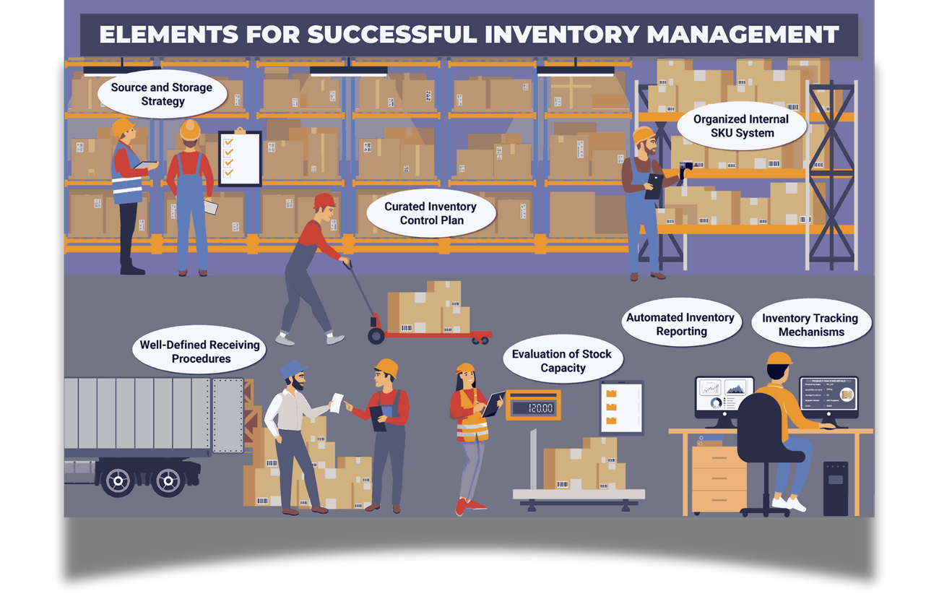
INTRODUCTION
In today’s competitive retail environment, efficient inventory management is essential for maximizing profitability and customer satisfaction.
This project introduces a Smart Inventory Optimization System that uses data analytics and machine learning to predict product demand and optimize stock levels.
This software-based system reduces manual effort, making it a practical and scalable solution for modern retail management.

Slide 3
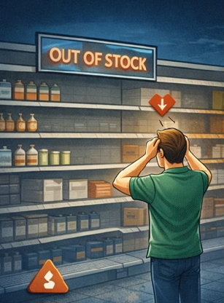



Problem Statement
Frequent stock-outs-Lost sales and customer dissatisfaction
2.Overstocking- Increased holding costs and product wastage
3.Manual inventory tracking- Time-consuming and error-prone
4.Inaccurate demand forecasting- Lack of data-driven analysis

Slide 4
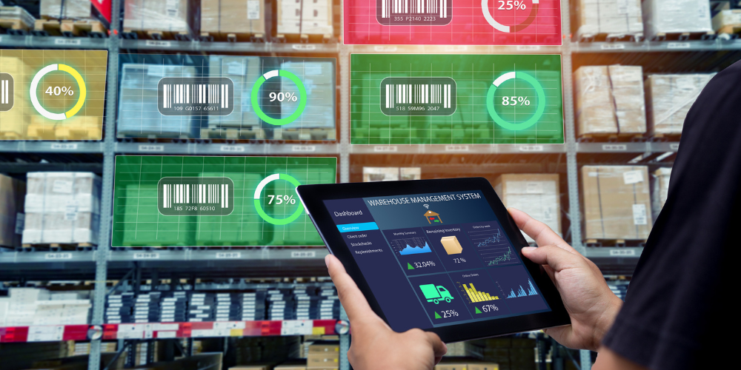
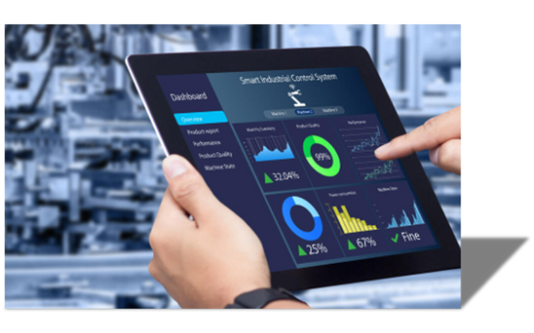
Smart Solutions
The system continuously monitors inventory levels and applies predefined stock thresholds derived from historical sales data.
A machine-learning demand forecasting model predicts future sales and identifies potential stock-out risks in advance.
Real-time dashboard alerts enable proactive restocking, reducing lost sales and ensuring better product availability.
Maintaining the perfect balance in stock levels.

Slide 5
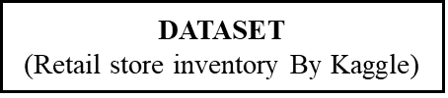

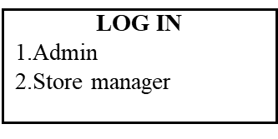


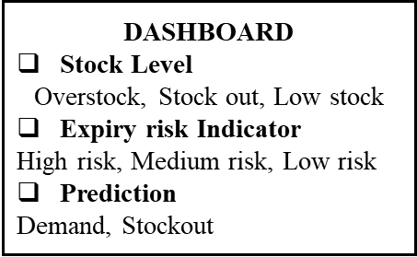

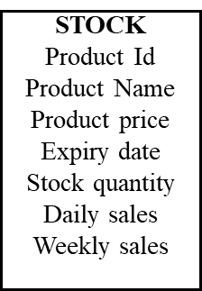
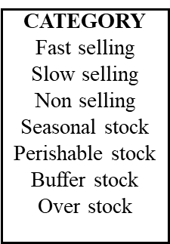
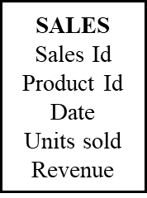
System Architecture
User Schema: Secure role-based management for Admins and Store Managers.
Product Schema: Comprehensive SKU tracking including city and store identifiers.
Sales Schema: Historical transaction data mapped to time-series sequences.

Slide 6
Technology Stack
FRONTEND
BACKEND
DATA & AI
INTELLIGENCE
ReactJs
Python
Prophet (Forecasting)
Firebase
FastAPI
XGBoost ML model for precise time-series sales forecasting.
MySQL (Database)
Scikit-Learn
NumPy
Recharts
Efficient Data Fetching
Material UI
SQLAlchemy

Slide 7

Database Schema MySQL
Users- User Id, Role , store_id, Gmail
Inventory Data- id, date , store_id , product_id , category , region, price
discount , competitor_pricing ,inventory_level , units_ordered , demand_forecast, holiday_promotion, weather_condition , seasonality, units_sold , city, store_name , product_name
Sales Records- Historical sales data for Model traning.
Optimized storage for faster order fulfillment.

Slide 8
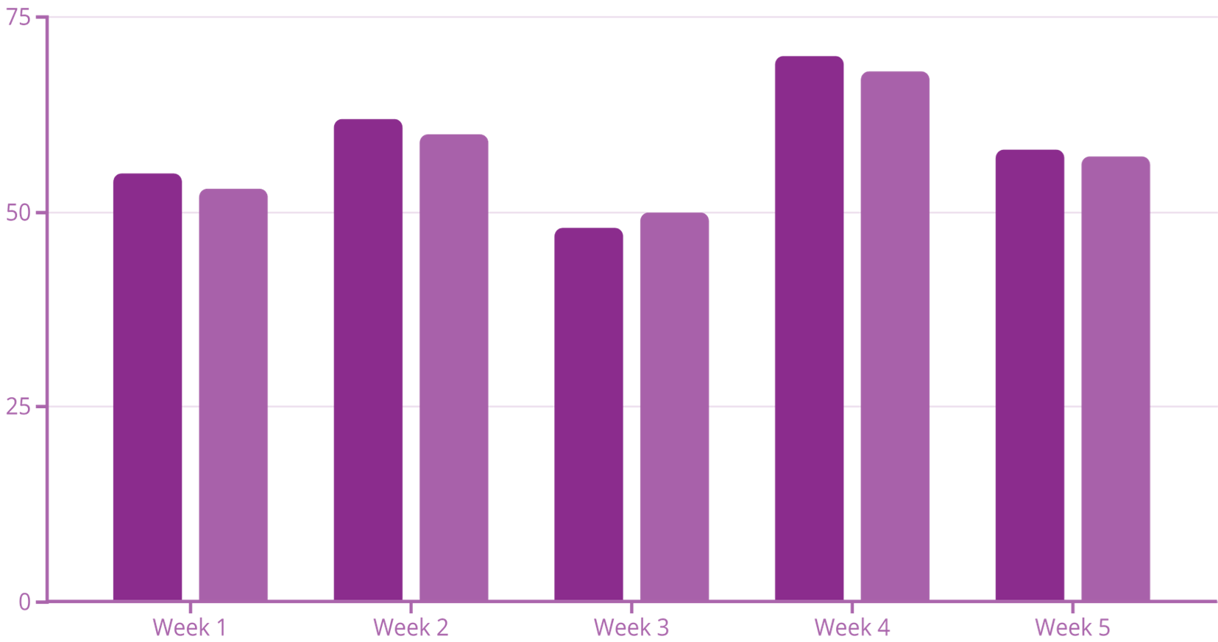

Trained Forecast Model
Model Training: The XGBoost Powerhouse
n_estimators=300: Number of boosting rounds.
•max_depth=10: Maximum depth of each tree.
•learning_rate=0.1: Step size shrinkage to prevent overfitting.
By leveraging Extreme Gradient Boosting, our system identifies non-linear sales patterns that traditional models miss.
The model processes historical sales volume, seasonality, and localized trends to predict future demand with over 92% accuracy.

Slide 9




Authentication
API & Authentication Architecture-
Backend API Framework: FastAPI
Authentication & Security-
Authentication Service: -
Firebase Authentication
Role-Based Access Control
Admin Role- Full access to all application pages
Store Manager Role- Restricted access based on assigned store ID

Slide 10
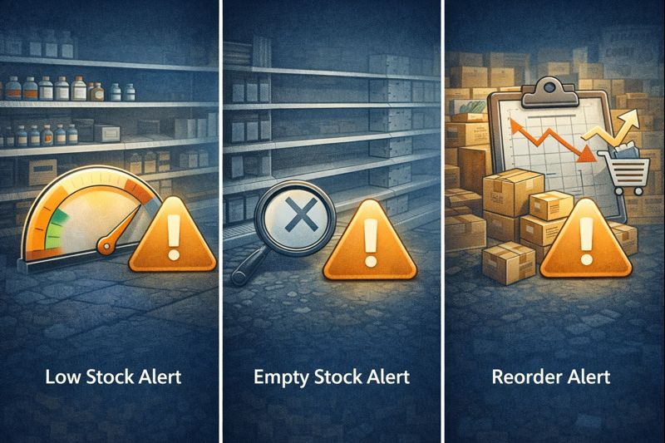

INVENTORY ALERTS
Low Stock Alert
Empty Stock Alert
Reorder Alert.
Alert = Predicted Sale > Inventory
The system suggests reorder for Low and Empty stock

Slide 11
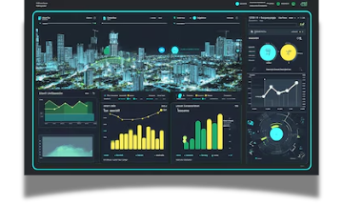

City Dashboard
City Selection
All Stores in City
Unique store Id
Store-wise Sales Data
City Dashboard Insights

Slide 12


Future Scope
Automated Best Supplier Identification
Integration with Email and SMS Alerts

Slide 13
Conclusion
The Smart Stock Inventory Optimization System successfully demonstrates how data analytics and machine learning can improve inventory planning and decision-making in retail. By predicting demand, tracking stock levels in real time, and generating intelligent alerts, the system minimizes stock-outs and overstocking issues. The integration of dashboards, role-based access, and an AI-powered chatbot enhances usability and operational efficiency. Overall, this project provides a scalable, practical, and data-driven solution for modern inventory management.
-

Slide 14
BUILDING A FUTURE OF EFFICIENT AND SUSTAINABLE STOCKS.
Thank
You..
-

