Slide 1
Frame the problem & set the baseline : Step 1 & Step 2
FDE lens: define the decision first, then quantify the current state before proposing a solution.
101,766
71,518
11.16%
46.09%
Hospital encounters
Unique patients
readmitted within 30 days
any recorded readmission
Rows in the file
Repeated encounters exist
11,357 / 101,766
Within 30 days or after 30 days)
Key Findings
Previous hospital visits → Higher chance of readmission
Longer hospital stay → More complicated cases
Medication changes → A possible warning sign
Missing data → Trying to solve a puzzle with missing pieces
Business Problem Statement
Hospitals face challenges in identifying patients at higher risk of readmission within 30 days of discharge. Analysis of the diabetic patient encounter dataset indicates that previous inpatient visits, longer hospital stays, and medication changes are associated with readmission patterns. However, incomplete clinical data limits the ability to assess patient risk accurately.
The business challenge is to identify high-risk patient groups, enable targeted post-discharge interventions, and evaluate whether these interventions can reduce avoidable readmissions, improve continuity of care, and optimize healthcare costs.
.
Baseline formula: 11,357 early readmissions ÷ 101,766 encounters = 11.16% resulted in readmission within 30 days.
WHY THIS BASELINE MATTERS
It is the reference point for measuring improvement—not proof that an intervention will work.
Readmitted within 30 days (<30) : 11,357
Readmitted after 30 days (>30) : 35,545
No recorded readmission : 54,864
Total Encounters: 101,766
Total Readmission: 11,357 + 35,545 = 46,902
Baseline formula for overall Readmission : 46,902/ 101,766 =46.09
1 / 5

Slide 2
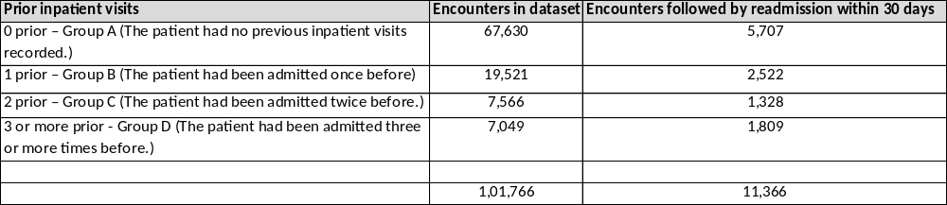
Find concentration: where is the risk clustered? : Step 3
Look for a segment with a materially higher rate and enough volume to make action worthwhile.
EARLY READMISSION BY PRIOR INPATIENT VISITS
“Find concentration” means identify where risk is elevated, quantify the gap, and check whether the segment is large enough to act on.
0 prior – Group A
8.44%
n=67,630
CONCENTRATION SIGNAL
3+ prior inpatient visits: 25.66% early readmission
0 prior visits: 8.44%
Absolute gap: 25.66 − 8.44 = 17.22 percentage points
Rate ratio: 25.66 ÷ 8.44 ≈ 3.04×
1 prev – Group B
12.92%
n=19,521
2 prior – Group C
17.43%
n=7,566
3 or more prior - Group D
WHY THIS SEGMENT?
7,049 encounters are in the 3+ group; 1,809 were readmitted within 30 days.
This is a candidate for targeted outreach—not yet a validated prediction rule.
25.66%
n=7,049
2 / 5

Slide 3
Size the value: translate a risk signal into an economic case : Step 4
Separate observed facts from scenario assumptions. The dataset contains no cost or intervention-effectiveness fields.
7,049
25.66%
1,809
181
encounters in 3+ prior-visit segment
observed early-readmission rate
early readmissions in segment
events avoided in example
7,049 × 25.66% ≈ 1,809
Assumes 10% relative reduction
ILLUSTRATIVE SCENARIO — NOT A FORECAST
Assume the intervention reduces early readmissions by 10% relative in the 3+ cohort.
Avoided events ≈ 1,809 × 10% = 181
Value = avoided readmissions × avoidable cost per readmission
Net value = value − intervention cost
BREAK-EVEN RULE
Maximum total intervention budget = 181 × avoidable cost per readmission.
Per eligible encounter: break-even cost ≈ 2.566% × avoidable cost per readmission.
Example only: if finance validates $10,000 avoidable cost/event, break-even spend ≈ $1.81M total or $257 per eligible encounter.
Before claiming ROI, obtain local cost data, intervention cost, reachable cohort size, and credible evidence of achievable reduction.
3 / 5

Slide 4
Build a claim ledger: evidence, confidence, and unknowns : Step 5
Every claim should be traceable to a calculation, with assumptions and validation gaps made explicit.
CLAIM
EVIDENCE / CALCULATION
STATUS
UNKNOWN / RISK
Prior inpatient use is a risk signal
25.66% vs 8.44%; gap 17.22 pp
OBSERVED
Confounding; needs adjusted model
High-use cohort is actionable
7,049 encounters; 1,809 early readmissions
CANDIDATE
Can the care team reach them?
Intervention can save money
Scenario: 10% relative reduction → ~181 avoided
ASSUMPTION
Effect and event cost unknown
Lab fields can refine risk
Weight 96.86%; glucose 94.75%; A1c 83.28% missing
LIMITED
Missingness may bias results
DATA LIMITATION TO SAY OUT LOUD
Repeated encounters exist (101,766 rows / 71,518 patients). Use patient-level splits in validation; results are descriptive and cannot establish causation.
4 / 5

Slide 5
Decide: pilot a targeted intervention, then validate before scaling : Step 6
Recommendation is a low-risk test—not a claim that readmissions will definitely fall.
RECOMMENDATION
Run a controlled pilot for encounters with 3+ prior inpatient visits.
Intervention: discharge checklist + medication reconciliation + follow-up scheduling / outreach within 7 days, subject to clinical approval.
Compare with usual care; do not deny standard care to any patient.
BUSINESS VALUE TEST
Primary KPI: 30-day readmission rate in eligible cohort.
Secondary KPIs: follow-up completion, medication reconciliation, ED visits, length of stay, patient safety, staff workload, cost per enrolled patient.
Scale only if outcomes improve and economics break even without safety harm.
VALIDATION PLAN
1
Data QA
Confirm labels, duplicates, eligibility, and follow-up window.
2
Baseline
Measure cohort rate over a defined recent period.
3
Pilot design
Use randomized or matched comparison; power the sample.
4
Evaluate
Compare absolute risk difference, confidence interval, safety, and cost.
5
Decision gate
Scale / refine / stop using pre-agreed thresholds.
OPEN UNKNOWNS: avoidable cost/readmission • intervention effect • cohort eligibility • data recency • capacity • clinical governance
5 / 5

