Slide 1
Consumer Finance Company Loan Data Analysis
EDA Case Study
upGrad – IIITB ML and AI Program - Feb 24 batch
Siva Vaddadi & Yukta Bajaj

Slide 2
Analysis Approach
Data Understanding: Load and inspect the loan dataset.
Data Cleaning: Handle missing values and drop irrelevant columns.
Drop columns having more than 35% null values
Drop columns having 100% duplicate values
Fill null values with median or mode
Do not consider rows with outlier values such as annual income > 0.2 million
Remove text from numeric columns such as percent sign
Univariate Analysis: Explore the distribution of each attribute after cleaning up such as loan amounts and interest rates, etc.
Bivariate Analysis: Investigate the relationship between columns such as loan amount and loan status.
Insights & Recommendations: Draw insights and provide recommendations for mitigating default risk.

Slide 3
Explanation of terms
For univariate analysis we have 2 terms
Most number of or mostly range between
Inter Quartile Range (IQR) or range between Q1 and Q3 of box plot for that column
Average
Median value of the column
Grade A is lowest, and F is highest. A is lower than B which is lower than C and so on
~ symbol represents around that number. For example ~25 means around 25
Most of the numbers and percentages are rounded off to nearest integer for easy reading

Slide 4
Loan Attribute Analysis
Charged off loans stand at 14.66% and this needs to be brought down.
The Consumer Finance Company has been giving loans mostly in the range of $5 to $15k with a spike at every 5k. Average loan amount is $9600
Interest rates mostly range between ~9% to 14%. Average interest rate is around 12%
Most of the Installment amounts range between $165 to $420. Average installment is ~$275
Loans are typically extended to borrower’s whose annual income ranges from $40,000 to $80,000, with an average annual income of $58,000.
The number of loans granted with a 36-month tenure at ~75% is nearly three times the number granted with a 60-month tenure (~25%).
Most number of loans are taken for the purpose of debt consolidation (47%), followed by credit card debt (13%). Small business, debt consolidation, house, credit card purposes got big loan amounts, at higher interest rates and installment amounts. Home improvement, small biz, renewable energy and wedding borrowers have higher annual incomes.

Slide 5
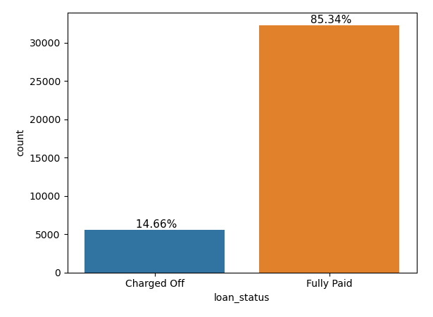
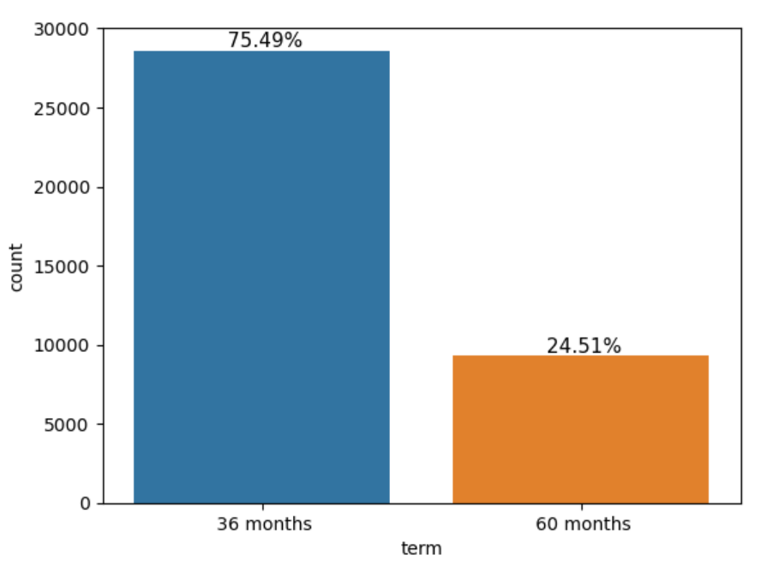
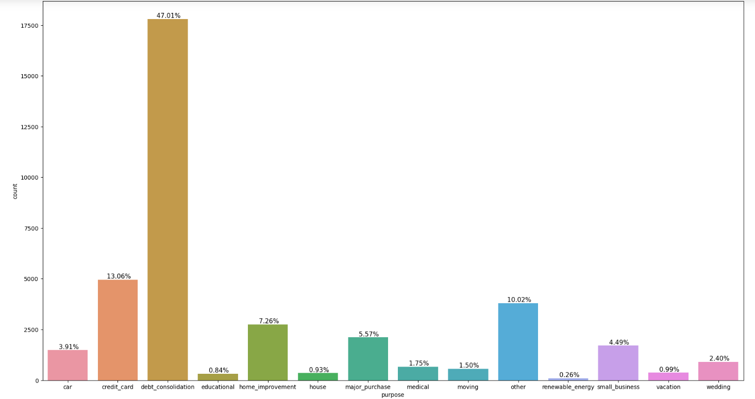
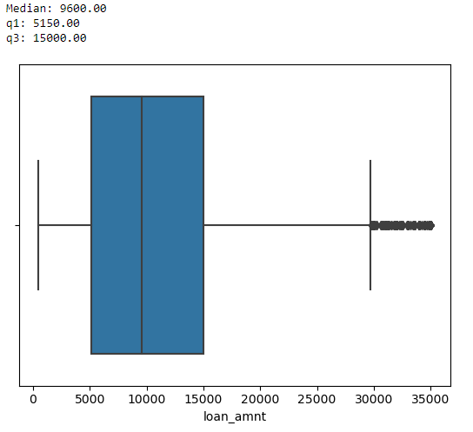
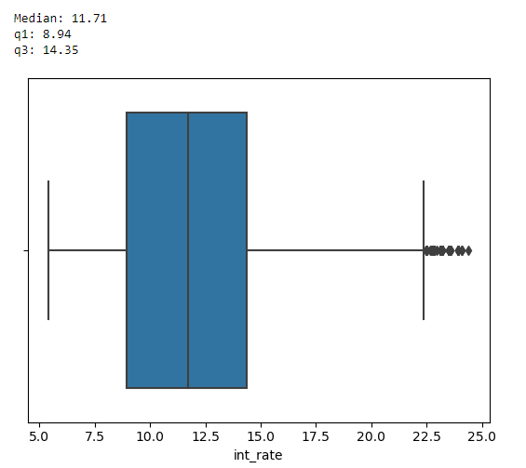
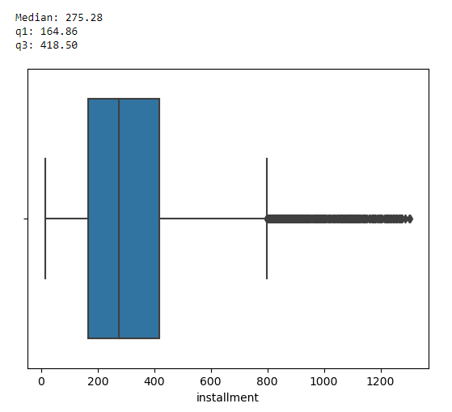
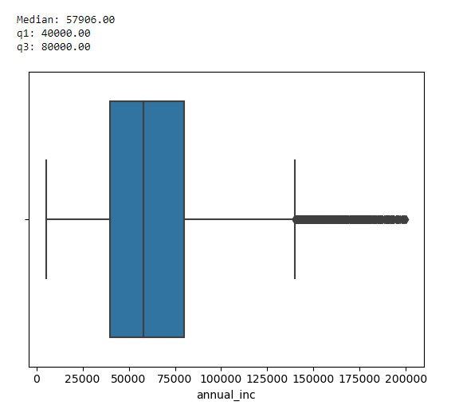
Loan Attribute Analysis

Slide 6
Consumer Attribute Analysis
Borrower Debt To Income ratio mostly ranges between ~8 to 18. Average is 13.47
Most borrowers are rated as B grade (30%), followed by A (26%), C (20%), D (13%), E (7%), F (3%), and G (1%).
The majority of loans are allocated to borrowers who either pay rent (48%) or a mortgage (44%), with homeowners comprising the remaining 8%.
Most loans are extended to unverified borrowers (43%), followed by verified borrowers (32%), and source verified borrowers (25%).
95% of borrowers have 0 public records, while 5% have 1. Additionally, 96% have 0 public bankruptcy records, with 4% having 1.
89% of borrowers do not have 30+ days past due incidences in last 2 years. 8% have had one such incident, 2% have had two, and 1% have had three.
Over the last 6 months, 49% of borrowers did not make any inquiries, while 28% made one, 15% made two, and 8% made three inquiries.

Slide 7
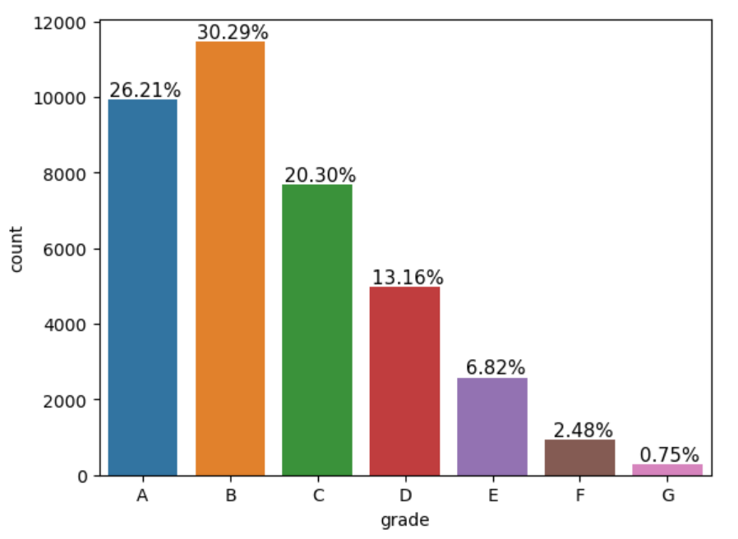
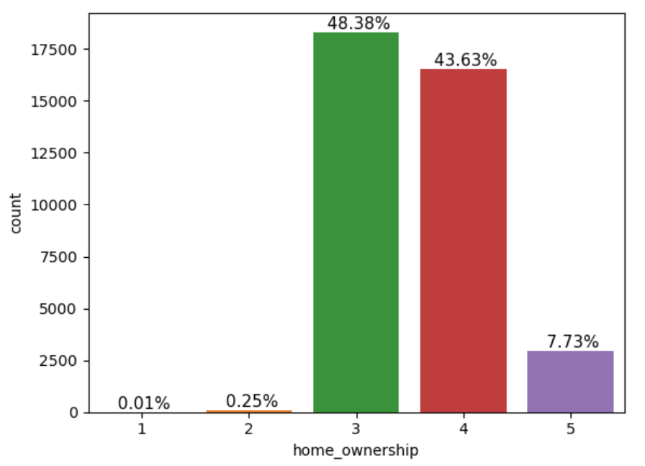
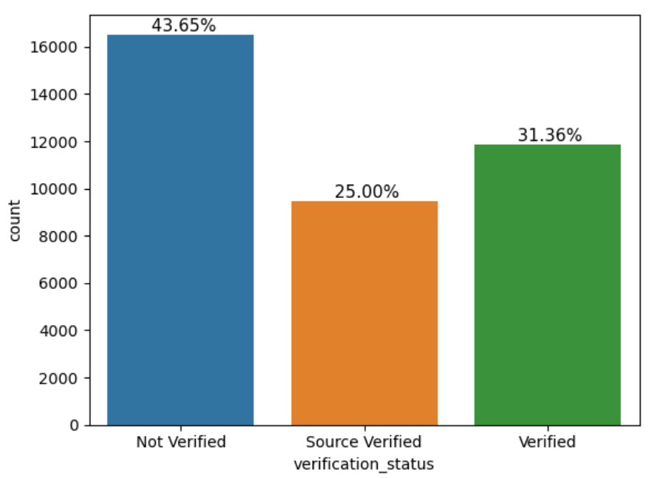
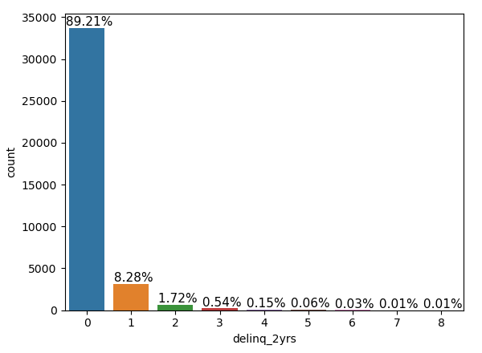
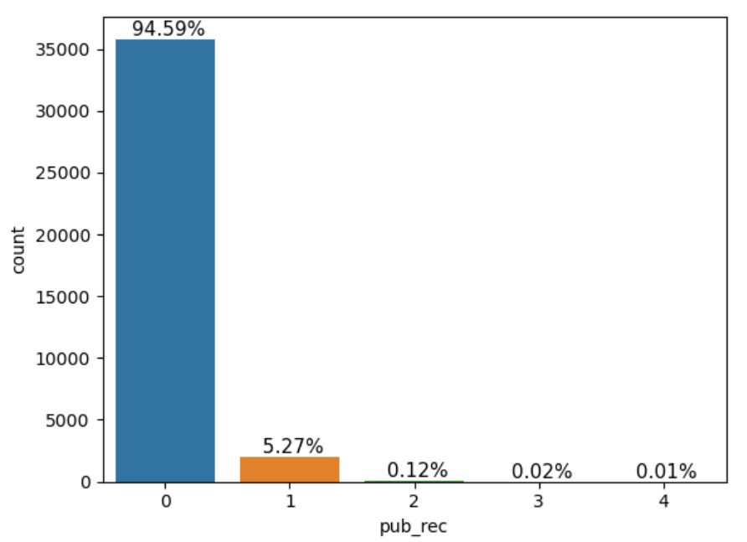
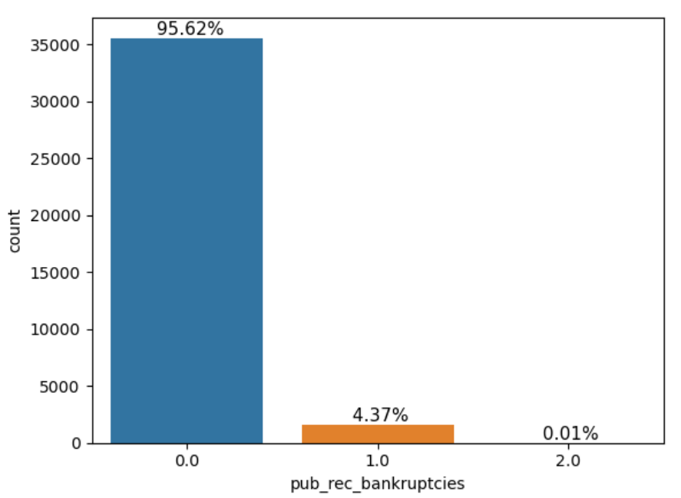
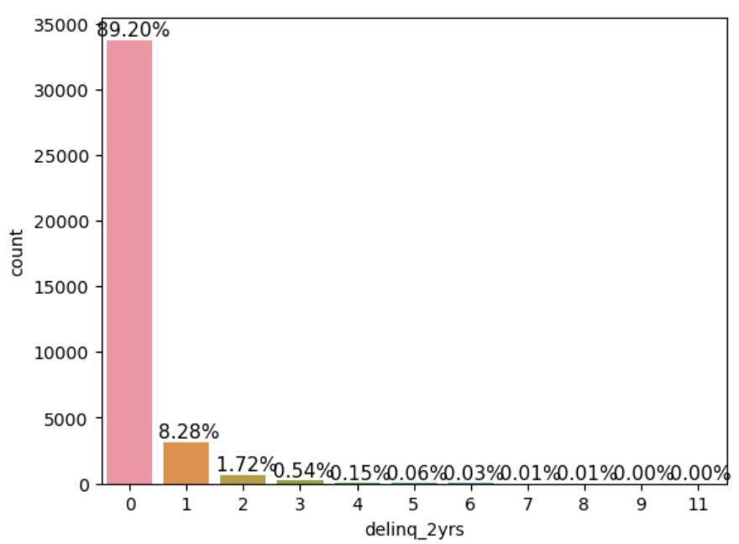
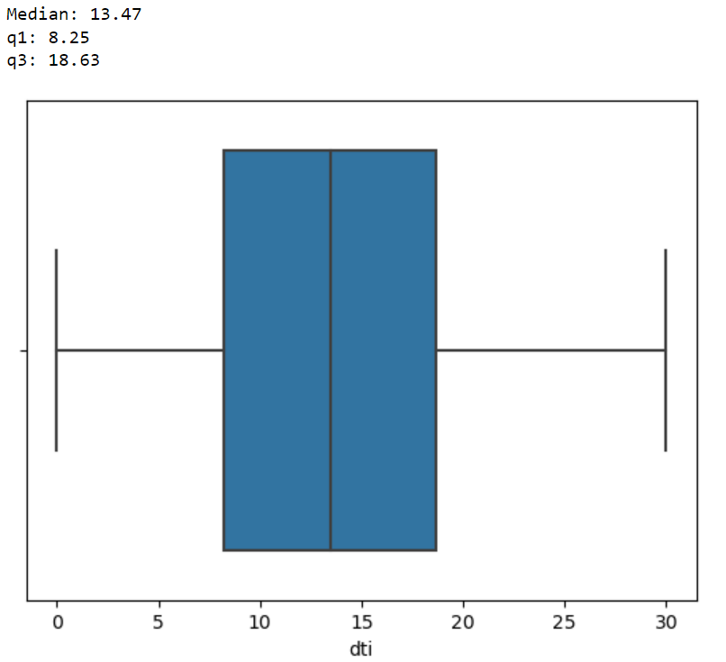
Consumer Attribute Analysis

Slide 8
Recommendations
The primary objective of this analysis is
Not to attack the main revenue generator for the company
Keep the recommendations few so company can implement them

Slide 9
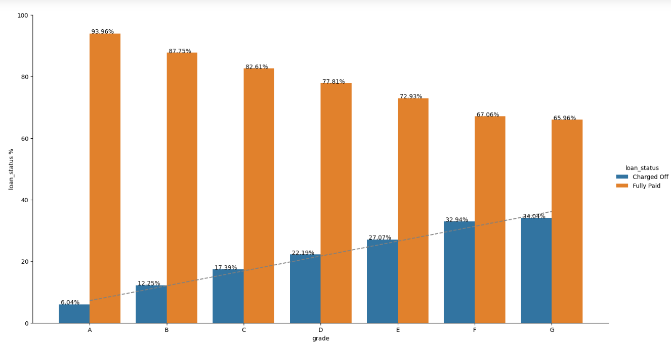
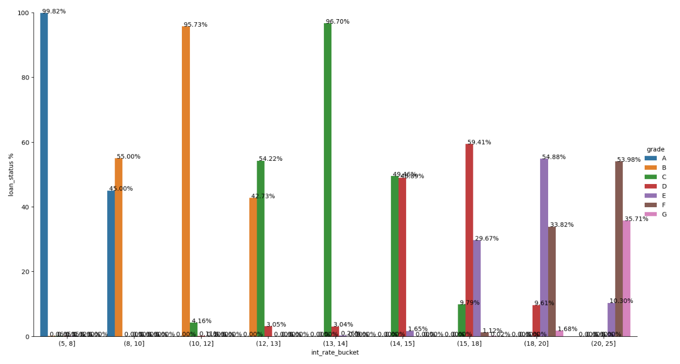
Recommendations
C, D, E, F, and G grade borrowers exhibit a higher default rate compared to A and B grade borrowers. Despite having annual incomes comparable to those of A and B grade borrowers, these higher-grade borrowers were extended larger loan amounts at interest rates above 12%. In contrast, A and B grade borrowers received loans with interest rates not exceeding 12% for most part. Default rate steadily increases with interest rate. Care need to be taken when interest rate goes beyond 12%.

Slide 10
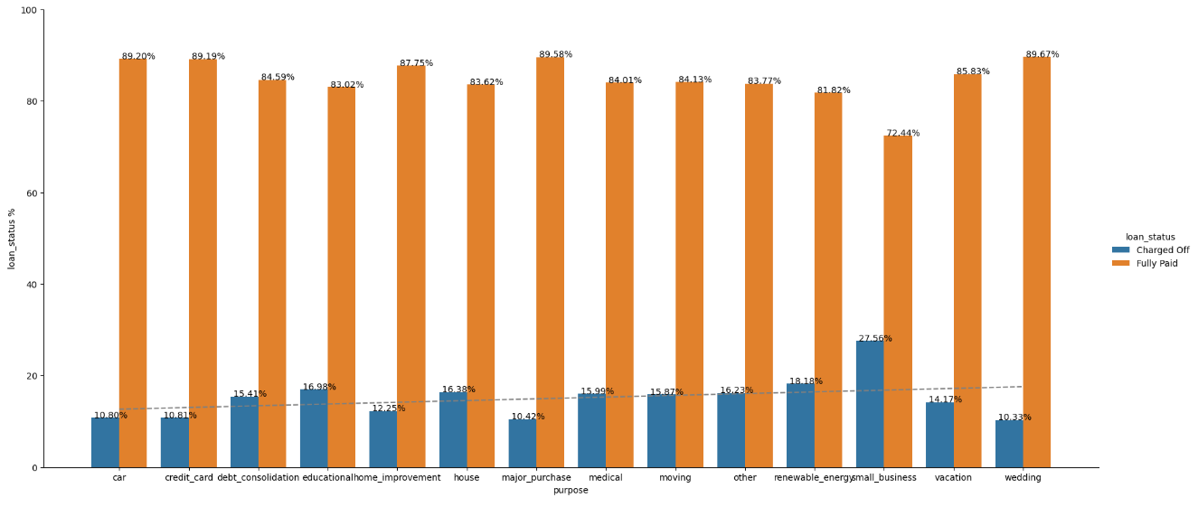
Recommendations
Debt consolidation loans amount to 47% of all loans given and have a significant default rate at 15.41%. This needs to be diversified to more safer purposes such as car, credit card and home improvement, wedding, major purchase which have lower default rates.

Slide 11
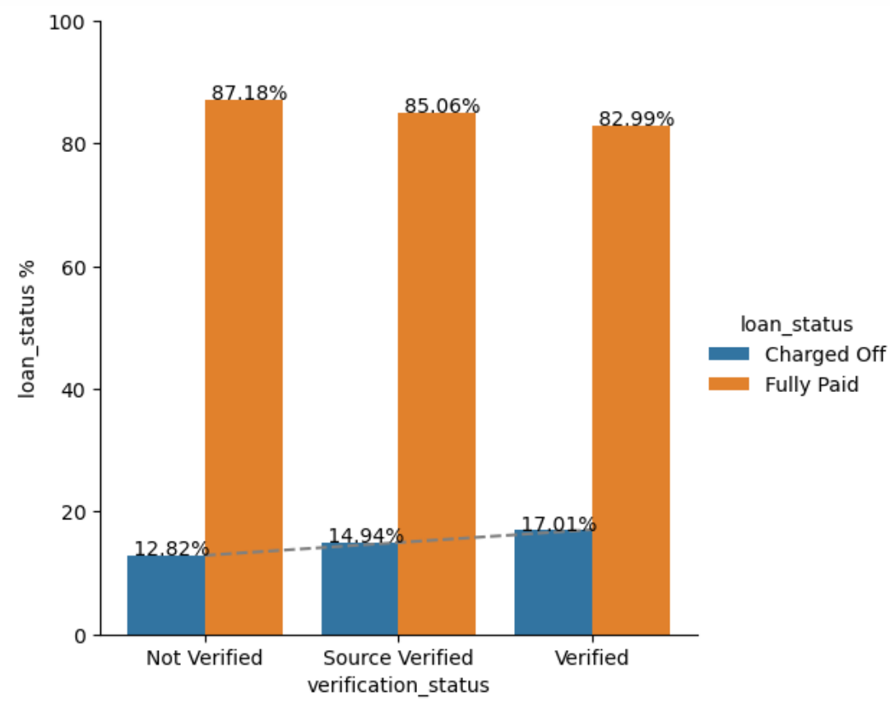
Recommendations
Default rate is higher for verified borrowers compared to unverified borrower. This suggests verification process needs to be strengthened. The annual incomes may be suspect based on which higher loans at higher interest rates are being given.

Slide 12
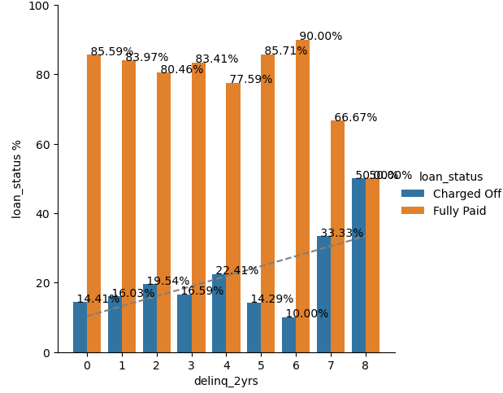
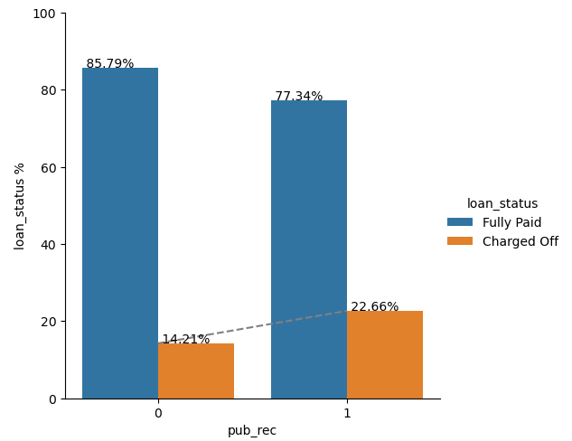
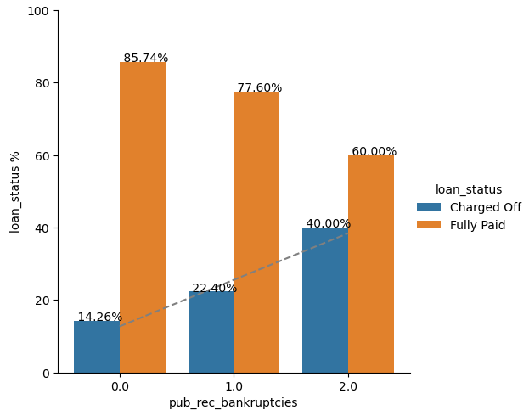
Recommendations
The default rate tends to rise with borrowers having 30+ days past due incidences (delinquencies), derogatory public records or public bankruptcy records.

Slide 13
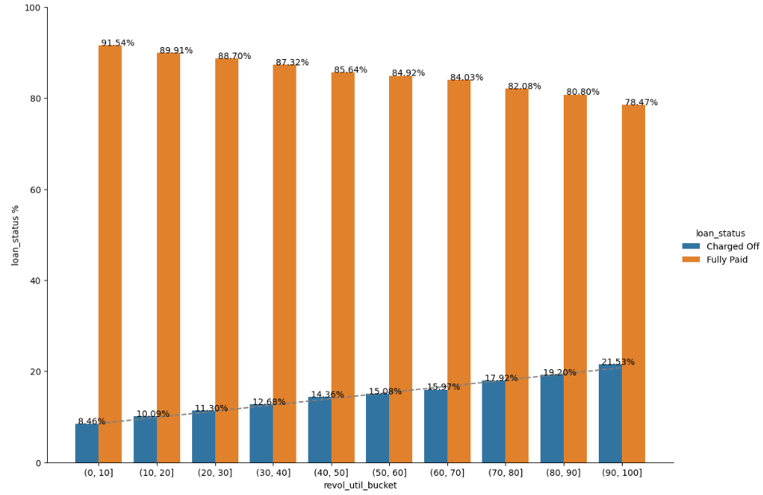
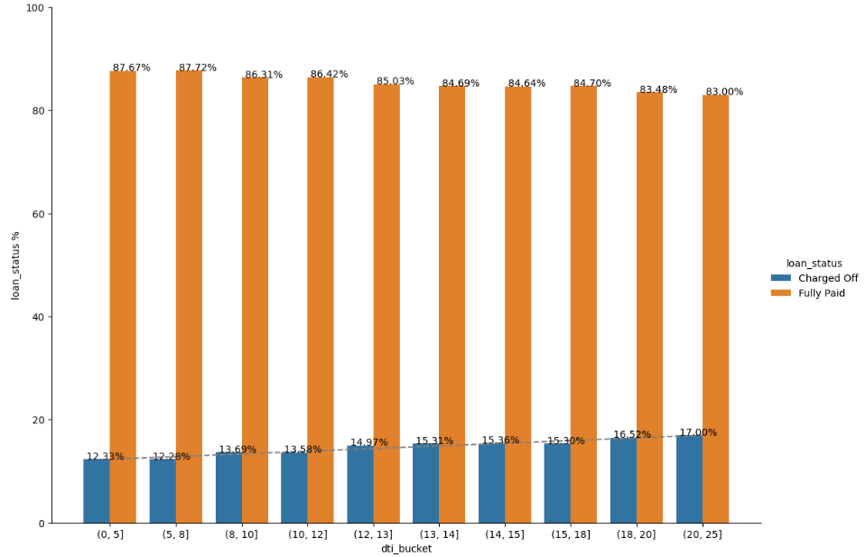
Recommendations
Default rate increases with revolving utilization rate. Above 30% utilization rate the chances of default increase significantly.
Default rate increases with DTI, anything above 8 has significantly higher default rate.

Slide 14
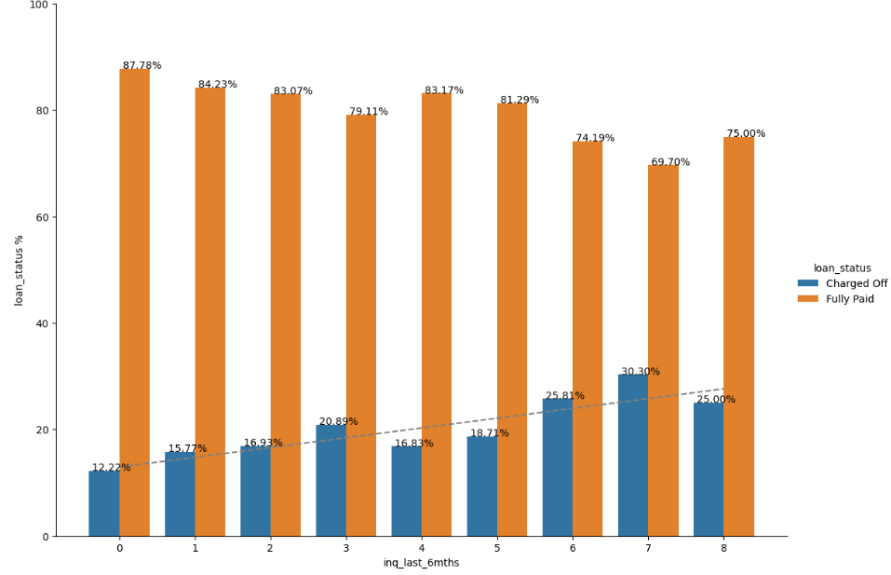
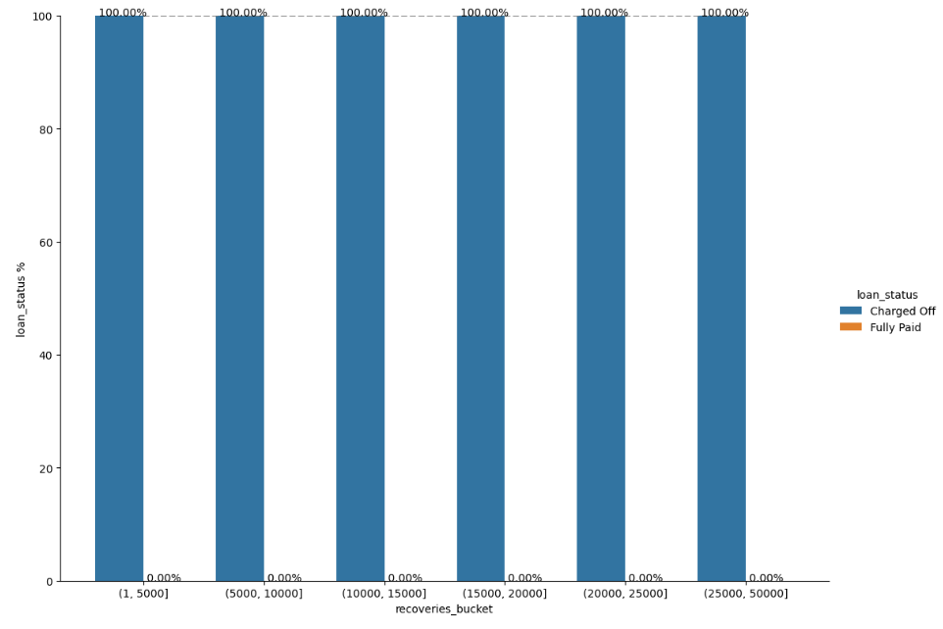
Recommendations
Default rate increases with number of inquiries in last 6 months in general.
Recovery fees paid by borrower is a lead indicator of loan default.

Slide 15
Conclusion
For future loans extended to borrowers satisfying conditions mentioned in the “Recommendations” slides, it is advisable to mitigate risk by offering smaller loan amounts and/or higher interest rates.
By leveraging insights from EDA, the consumer finance company can make informed decisions to mitigate default risk, improve lending practices, and ultimately minimize credit loss.

