Slide 1
Traffic management
system

Slide 2
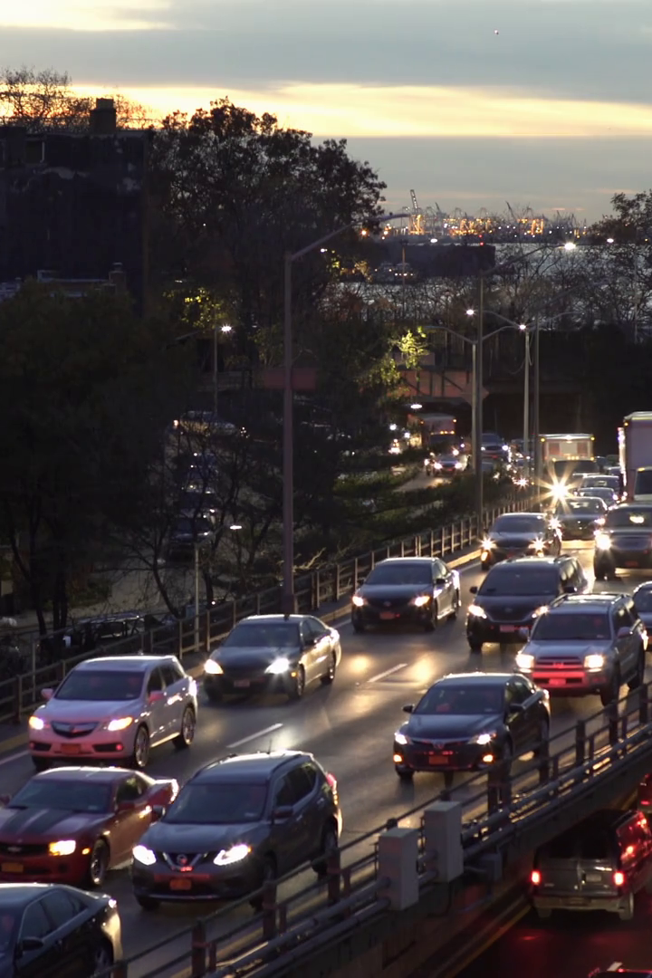
Building a Comprehensive Traffic Information Platform and Mobile App
As urban populations have grown, so has the need for a comprehensive traffic information platform. Our mobile apps will provide real-time traffic data, helping people navigate crowded cities with greater ease.

Slide 3
Platform Development
In this section, we will explore the key steps involved in the development of the traffic information platform and accompanying mobile apps. From platform development to deployment and maintenance, each stage plays a crucial role in creating a comprehensive and user-friendly system.
Expert programming
We'll use the latest software development methodologies and
tools to ensure maximum efficiency and quality.

Slide 4
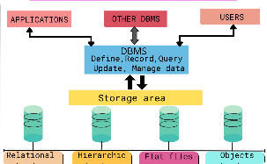
Robust architecture
Creating a scalable platform requires a robust architecture. We'll design our systems to handle high volumes of traffic and real-time information updates.

Slide 5
Technologies used:
HTML
A Traffic Management System using IoT and HTML involves creating a web-based interface for monitoring and controlling traffic through the integration of Internet of Things (IoT) devices. HTML (Hypertext Markup Language) is used to design and structure the user interface for this system.
IoT devices like sensors, cameras, and traffic control equipment collect data on traffic conditions, which is then processed and displayed through HTML-based web pages. This allows traffic operators and users to access real-time information about traffic flow, incidents, and road conditions through web browsers, facilitating better traffic management and informed decision-making.

Slide 6
CSS
In a Traffic Management System using IoT and CSS, CSS (Cascading Style Sheets) is used to define the visual presentation and layout of web-based interfaces that display information from IoT devices monitoring and managing traffic
.
CSS is responsible for styling and formatting the content, making it visually appealing and user-friendly.
It is used to control aspects such as colors, fonts, spacing, and the overall layout of the user interface, enhancing the aesthetics and usability of the traffic management system's web application, which provides real-time data from IoT devices to both traffic operators and users.

Slide 7
JavaScript
A Traffic Management System using IoT and JavaScript is a smart transportation solution that leverages Internet of Things (IoT) technology and the JavaScript programming language to monitor and control traffic flow in real-time.
It typically involves sensors and devices placed on roads, traffic lights, and vehicles to collect data, which is then processed and analyzed using JavaScript-based software to optimize traffic patterns, reduce congestion, and enhance road safety.
The system can provide real-time traffic updates to both authorities and drivers, helping to manage traffic more efficiently.

Slide 8
Simulate Transfer Data
Simulate Traffic Data:
import time
import random
def simulate_traffic_data():
# Simulate traffic data, e.g., vehicle counts or flow rates
while True:
vehicle_count = random.randint(0, 100)
yield vehicle_count
time.sleep(5) # Simulate data update every 5 seconds
# Test the traffic data simulation
if __name__ == "__main__":
for count in simulate_traffic_data():
print(f"Vehicle Count: {count}")

Slide 9
Traffic Information data
Send Data to a Traffic Information Platform: import time import random import requests # Simulate traffic data def simulate_traffic_data(): while True: vehicle_count = random.randint(0, 100) yield vehicle_count time.sleep(5)

Slide 10
# Server parameters server_url = "http://your_traffic_platform.com/api/traffic-data" headers = {"Content-Type": "application/json"} # Simulate and send data if __name__ == "__main__": for count in simulate_traffic_data(): data = {"vehicle_count": count} response = requests.post(server_url, json=data, headers=headers) if response.status_code == 200: print(f"Data sent: {count}") else: print("Failed to send data.")

Slide 11
HTML Based Design
```html <!DOCTYPE html> <html> <head> <title>Traffic Management System</title> <link rel="stylesheet" type="text/css" href="styles.css"> </head> <body> <header> <h1>Traffic Management Dashboard</h1> </header> <section id="trafficData"> <h2>Real-time Traffic Data</h2> <div id="trafficMap"></div> <div id="trafficStats"> <!-- Display traffic data such as vehicle count, congestion level, etc.

Slide 12
</div> </section> <section id="controlPanel"> <h2>Traffic Control</h2> <button id="adjustLights">Adjust Traffic Lights</button> <!-- Other control options --> </section> <footer> <p>&copy; 2023 Traffic Management System</p> </footer> <script src="script.js"></script> </body> </html

Slide 13
Javascript Based Design
**TrafficSensor.java (IoT Device):** ```java import java.util.Random; public class TrafficSensor { private String sensorId; private String location; private int vehicleCount; public TrafficSensor(String sensorId, String location) { this.sensorId = sensorId; this.location = location; } public void captureTrafficData() { // Simulate data collection from the sensor Random random = new Random(); vehicleCount = random.nextInt(100); // Simulated vehicle count

Slide 14
Send data to the central server sendDataToServer(sensorId, location, vehicleCount); } private void sendDataToServer(String sensorId, String location, int count) { // Implement code to send data to the central server (e.g., using HTTP or MQTT) } public static void main(String[] args) { TrafficSensor sensor = new TrafficSensor("Sensor001", "Main Street"); while (true) { sensor.captureTrafficData(); try { // Simulate data capture at regular intervals (e.g., every 1 minute) Thread.sleep(60000); } catch (InterruptedException e) { e.printStackTrace(); } } } } ```

