Slide 1

GUEST LECTURE · DATA ENGINEERING · OCTOBER 2026
Building a production data pipeline for financial market data
What I built, what it found, and what I’d tell you to learn.
Sive Jozi
Forex Technologies · Capitec
Currently: MEng Data Science · Stellenbosch University
From: BSc Computer Science and Mathematics
Notes:
Name, MEng Data Science
Tell them the shape up front: what I built, what it found, then jobs.

Slide 2
Twelve years of this breaking in production
WHO I AM
Forex Technologies — Capitec
  Currently. Johannesburg.
Before that: trading systems, mostly Java
  About ten years at Standard Bank.
MEng Data Science, Stellenbosch
Part of my job at Standard Bank was pulling market data out of Bloomberg and Murex and checking it was right before the desks traded on it.
I did not pick this research topic. A decade of watching that break picked it for me.
Notes:
This slide exists so part three has authority - do not dwell on it.
The line that matters is the last one: I did not pick this topic, a decade of production incidents picked it.
Mentioning Bloomberg and Murex by name tells them this is not a toy problem.

Slide 3
Three parts
ROADMAP
1
What I built
Ingestion, an event bus, feature computation, the models, deployment.
2
What it found
Prediction and validation results.
3
Getting your first job
What to learn, what to build, and how to talk about it.
Notes:
Three parts -
the build is the longest,
then the findings,
then jobs.
Invite interruptions on part one - it is the part they are being examined on.

Slide 4
Market data is small, and it has to be right
PART ONE · THE PROBLEM
Exchange rates and interest rate fixings, published daily
A customer is quoted off a bad rate — and accepts it
  That deal is binding. Nobody unwinds it in the morning because the feed was wrong.
Everything downstream consumes it
  Pricing, risk, regulatory reporting, trading.
One wrong rate propagates into every valuation that runs that night
6,417
4
daily observations for one currency pair, 2000–2025
instruments, two independent data providers
This is kilobytes, not terabytes. The engineering problem is not volume — it is knowing whether a number is correct.
Notes:
Lead with the customer, not the batch job: someone buys euros, the screen shows a rate that came from a bad feed, they accept, and the deal is done.
That is the difference between this and most data quality problems - the error is already outside the building before anyone notices.
These are not big-data volumes. The difficulty is correctness, not scale.
That distinction matters - most of data engineering is correctness.

Slide 5
How this is actually done today
PART ONE · THE PROBLEM
Static rules
  “Reject if it moved more than 5% from yesterday.” Cheap, and wrong in both directions.
Human review
  Someone scans a spreadsheet each morning. Does not scale, and does not run at 2am.
Post-hoc reconciliation
  You find out on Thursday that Tuesday was wrong.
A 5% threshold cannot distinguish a bad feed from a currency crisis. In March 2020 the correct answer was “yes, the market really moved that much”.

Slide 6
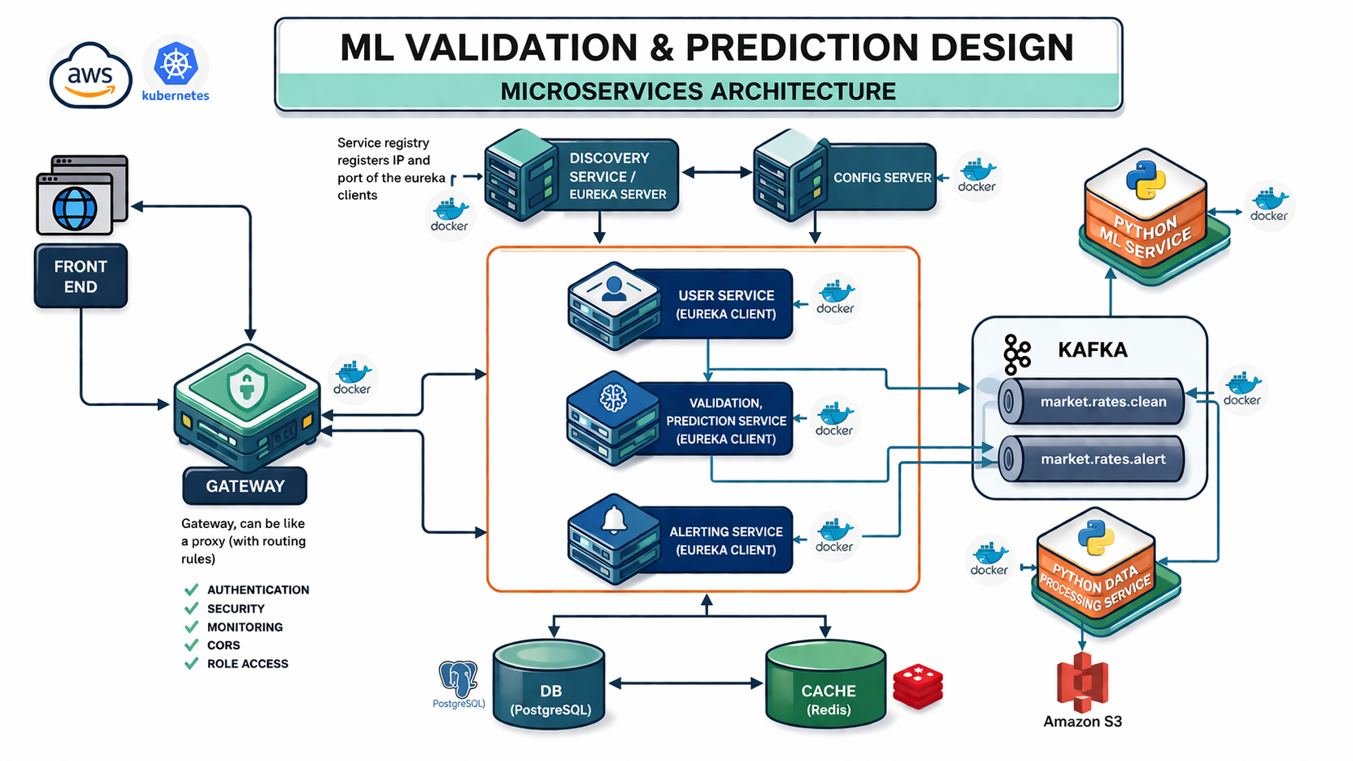
What I built
PART ONE · ARCHITECTURE
Seven services — Spring Boot for orchestration, Python FastAPI for the models, React for the interface, Kafka carrying clean rates in and alerts out, PostgreSQL underneath.
Notes:
Do not read the service list. Point at three boxes and move on.
Seven services: Java Spring Boot for orchestration and business logic, Python FastAPI for the models, React for the interface, Kafka between them, PostgreSQL underneath.
Say why services rather than one application: different languages, different scaling needs.
Be honest that seven services is arguably too many for this problem - it is in my future work.

Slide 7
Ingestion, end to end
PART ONE · THE PIPELINE
Amazon S3
Raw CSV, one file per instrument. Immutable.
Python preprocessing
Clean, remove outliers, compute features, normalise.
Kafka topic
market.rates.clean
Spring Boot consumer
Validates, persists, orchestrates inference.
PostgreSQL
Clean rates, alerts, model run history.
→
→
→
→
Raw data is never modified in place. Every derived value is computed once, in one service, and published on the record.
Notes:
This is the slide that matters for a data engineering module. Slow down.
Walk it left to right. Name what crosses each boundary.
Highlighted box is the one everything else depends on - the next two slides are about it.

Slide 8
Why an event bus, and not just an API call?
PART ONE · THE PIPELINE
A topic is an append-only log
What that buys you
Producers write to it
  Consumers read from it at their own pace.
Neither knows the other exists
Add a consumer without touching the producer
  The alerting service was added last. The preprocessor never changed.
Consumers can fail independently
  If the database is down, messages wait. Nothing is lost.
You can replay
  Rebuild a downstream store by reading the log again.
Notes:
Mixed audience: define a topic in one sentence before arguing for it.
Frame as a question - why not just have the preprocessor call the validation API directly?
Answer: because then it has to know about the second consumer, and the third.

Slide 9
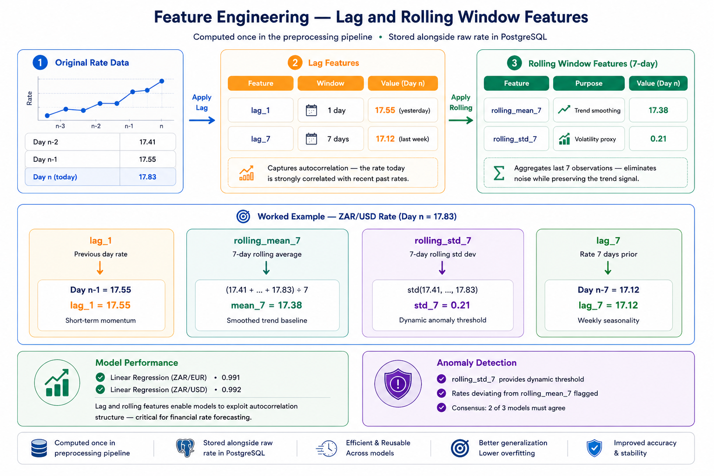
One service computes features. Once.
PART ONE · THE PIPELINE
Four features
  Yesterday’s rate, last week’s, a seven-day mean and a seven-day standard deviation.
Why seven days
  A trading week plus a buffer. A choice, not a result — I did not tune it.
Computed once, in the preprocessing service, and stored on the record.
So every model sees identical numbers, and one definition change propagates to all six.
Notes:
Feature engineering = Transforming raw data into meaningful input variables that improve the predictive power of ML models.
4 Features:
lag1 - previous day’s rate, capturing short-term momentum, strongest autocorrelation, detects sudden rate jump.
lag7 - rate seven days prior, capturing weekly seasonality and medium-term trend direction.
rollingMean7 - seven-day rolling average, providing a smoothed representation of the recent trend.
rollingStd7 - seven-day rolling standard deviation, measuring recent volatility, high standard deviation indicates a period
of market stress or heightened uncertainty.
Without lag features, the model cannot distinguish a rate that has been rising steadily from one that has jumped suddenly.

Slide 10
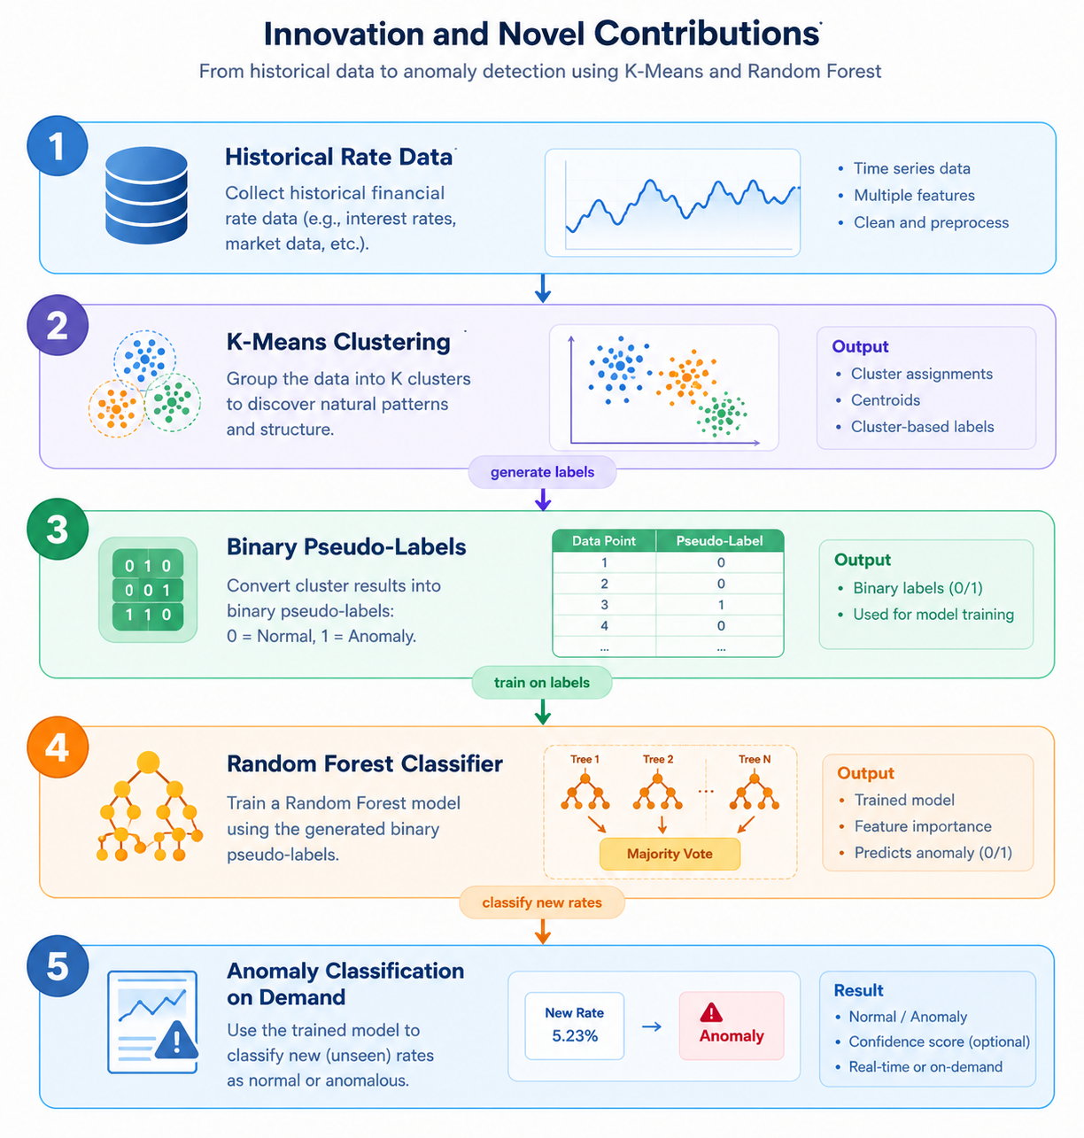
What do you do when there are no labels?
PART ONE · METHOD
Nobody hands you labelled anomalies
  There is no column marked “this rate was wrong”. So the clustering stage manufactures one.
The classifier makes scoring cheap
  Recomputing centroid distances needs the full history. A saved classifier does not.
But a model trained on another model’s output is not an independent opinion — and my escalation rule needs two votes of three.
Hold that thought. The numbers are in part two.
Notes:
Open with the problem: nobody gives you labelled anomalies. There’s no column saying “this rate was wrong”.
Walk the five steps quickly: cluster the history → distance from the nearest centre becomes a 0 or 1 label → train a classifier on those labels → score new rates from the saved model.
Why that last step matters: scoring one rate doesn’t get slower as the history grows.
Watch out: “majority vote” in step 4 is the trees inside one model voting — not my three detectors. They’ll mix those up.
The honest part: the classifier just learned the clustering’s own boundary. Not two opinions — one opinion twice.
The numbers for that come in part two.
This was my favourite bit of the design. It’s also what broke the thing built on top of it.

Slide 11
Training and serving are different workloads
PART ONE · MLOPS
 | Training | Serving
When | On new data arriving, or on demand | Every request
Cost | Seconds to minutes, full history | Must be milliseconds
Output | Artefact on disk plus a metadata file | An answer
Reads | The database | The artefact
My first version retrained the model on every request. Thirty seconds to validate one number. If you take one thing from this slide: never train in a request handler.
Notes:
Be honest here: my first version retrained on every request. Thirty seconds per call.
The fix is obvious in hindsight - train on a schedule, save the artefact, load it to serve.

Slide 12
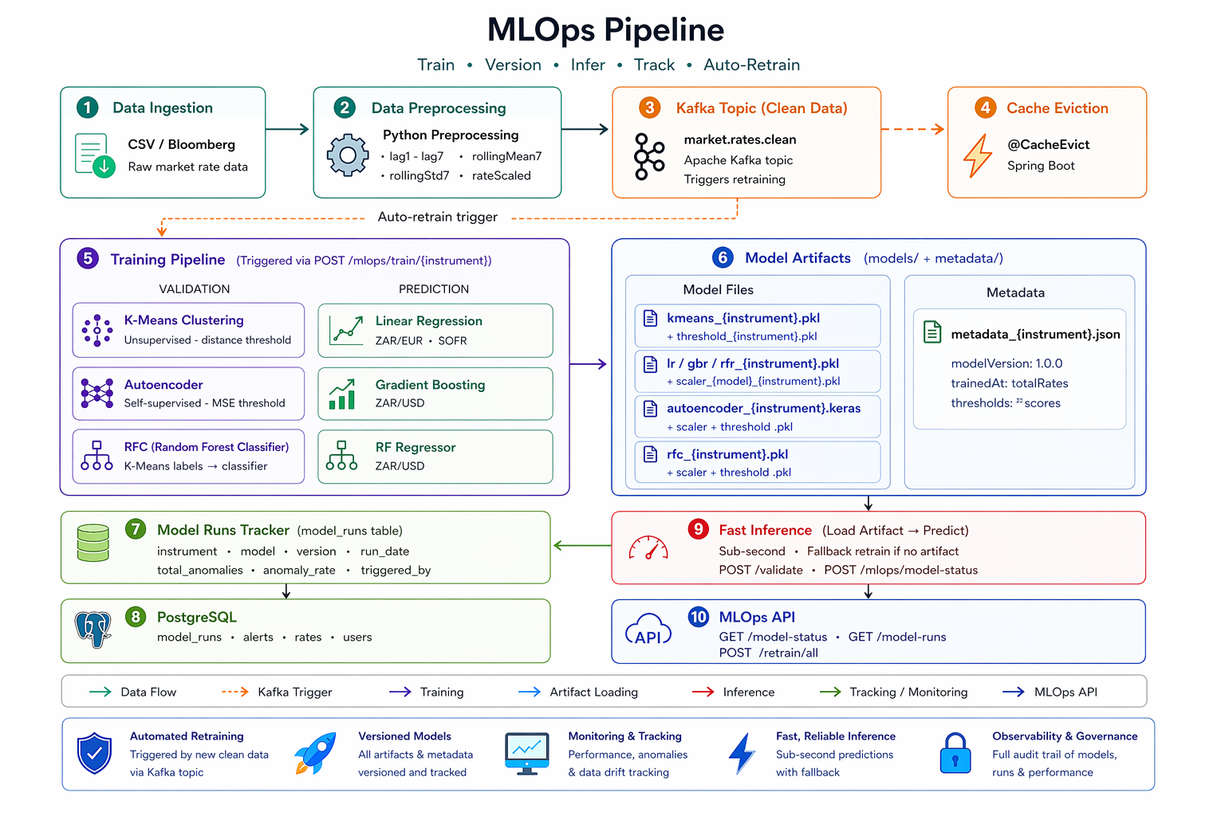
The whole loop, on one page
PART ONE · MLOPS
Two boxes here are design intent, not measurement.
Notes:
Recap slide. Do not narrate every box - trace one path: S3, preprocessing, Kafka, training, artefact, inference.
Then point at 'Auto-Retrain' and 'Sub-second' and say: that is the design.
My run log shows every retrain was triggered by hand, and I never measured latency.

Slide 13
Getting it running, repeatably
PART ONE · DEPLOYMENT
Push to main
GitHub Actions triggers.
Build image
Docker, multi-arch, pushed to a registry.
Update manifest
A second job bumps the image tag in a Git repo.
ArgoCD reconciles
Watches that repo and makes the cluster match it.
→
→
→
Nobody deploys by hand
  The cluster’s desired state lives in Git. If you change the cluster directly, ArgoCD changes it back.
Rollback is a revert
  And every change is attributable to a commit and an author. That is the part auditors care about.
Notes:
GitOps in one sentence: Git is the source of truth for infrastructure, not someone's laptop.
The practical consequence - every deploy is traceable to a commit, and rollback is a revert.
This is what auditors actually want, and it is why it matters in finance.

Slide 14
What the pipelines actually cost
PART ONE · DEPLOYMENT
Service | Jobs | Duration
React frontend | Build and push → update manifest | 4m 42s
Spring Boot service | Build JAR → build and push → update manifest | 1m 47s
Python ML service | Lint gate → build and push | 15m 54s
Same pipeline, same cluster — and the machine learning service takes nine times longer to deploy than the Java one. Its image installs NumPy, pandas, scikit-learn and TensorFlow; the Java one is a single JAR.
The modelling stack you choose quietly sets how fast you can ship a fix.
Notes:
Do not explain the build. Just let them read the last row.
The Java service deploys in under two minutes. The Python one takes nine times longer, and it is the same pipeline - the difference is entirely what is inside the image.
The point for them: the modelling stack you pick sets how fast you can ship a fix.
That is a cost nobody mentions when choosing TensorFlow.
If someone asks how to speed it up, say there are three or four levers and you are happy to go through them afterwards - do not spend class time on Docker.

Slide 15
The simplest model won
PART TWO · PREDICTION RESULT
Below the line: worse than predicting the test-set average.
A tree predicts by averaging the training values in a leaf — so it cannot output a number it has never seen. SOFR went from near zero to over five percent, and both tree models were trapped below it.
R² on levels — and “tomorrow equals today” scores about as well. These numbers describe the data more than the models.
Notes:
Point at the two bars hanging below the line and ask them why. Wait.
A negative score means the model did worse than just guessing the average. Both tree models managed it.
The answer, when you give it: a tree can only ever output a number it already saw in training. It averages the values sitting in a leaf.
SOFR went from near zero to over five percent. The trees had never seen numbers that high, so they could not go there.
Linear regression has no such ceiling. The simplest model won because of the shape of the data, not because it is cleverer.

Slide 16
Three detectors, three different answers
PART TWO · VALIDATION RESULT
Detector | ZAR/EUR | ZAR/USD | SOFR
K-Means clustering | 245 | 335 | 113
Autoencoder | 147 | 176 | 10
Classifier (trained on K-Means labels) | 241 | 343 | 116
Rows one and three track each other because one is trained on the other’s output. Only the middle row is independent — and it caught COVID on both currency pairs when clustering did not, and the September 2019 repo crisis at 21× its threshold, alone.
My rule escalates on two votes of three. It would have discarded the best detection the system ever made.
Notes:
Read the table, then stop on rows one and three: 245 against 241, 335 against 343, 113 against 116. Those two move together because one was trained on the other’s labels — the design from part one.
The middle row is the only independent one. Different method, different inputs, no shared training.
COVID is the clearest example: the Autoencoder flagged March 2020 on both currency pairs. Clustering missed it, because clustering only looks at the rate level, and the level still looked normal.
Then September 2019 on SOFR: 21 times the threshold, the most extreme reading in the whole study — and the Autoencoder found it alone.
The design point: my rule needs two votes out of three, so it throws that one away. The system discards its own best detection.
If asked what the detectors actually found: about two thirds of the ZAR/EUR flags are just the start of the series. Say it before someone else spots it.

Slide 17
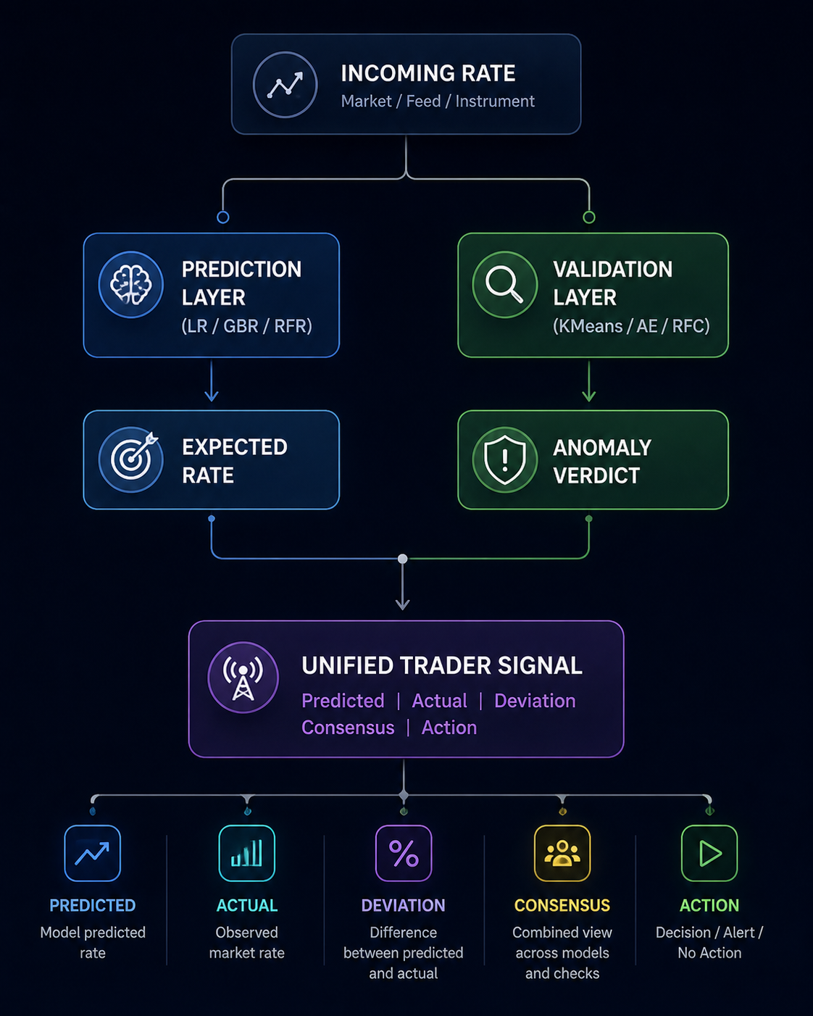
Two answers, at the moment of the quote
PART TWO · WHAT A DEALER GETS
A value to check the quote against
  An expected rate and the deviation from it. A reference point — not a forecast to trade on.
A verdict with a reason attached
  Which detectors flagged it, and how strongly. A dealer sees why, not just a refusal.
Before the quote, not after it
  The difference between catching a bad rate and explaining one the next morning.
Back to the customer on the first slide — this is where that deal stops being binding on a wrong number.
Notes:
Call back to the very first problem slide: a customer quoted off a bad rate, and the deal is binding. This is the point in the flow where that gets stopped.
Trace one path with the cursor. A rate arrives and goes down two branches at once - what did we expect this to be, and does it look like anything we have seen before. Different questions, different models.
For a dealer the two answers arrive together: an expected value, the actual value, the gap between them, whether the detectors agreed, and what to do about it.
Be precise about the first one. It is a reference value, not a forecast to trade on. My own results chapter says the prediction layer barely beats carrying yesterday forward.
The second benefit is the one dealers actually care about: the flag comes with a reason. Which detectors agreed, and how strongly. Not a black box saying no.
And the third: it runs before the quote, not in the morning reconciliation. That is the difference between catching a bad rate and explaining one.
Say plainly whether this screen is shipped or designed. Do not let them assume.

Slide 18
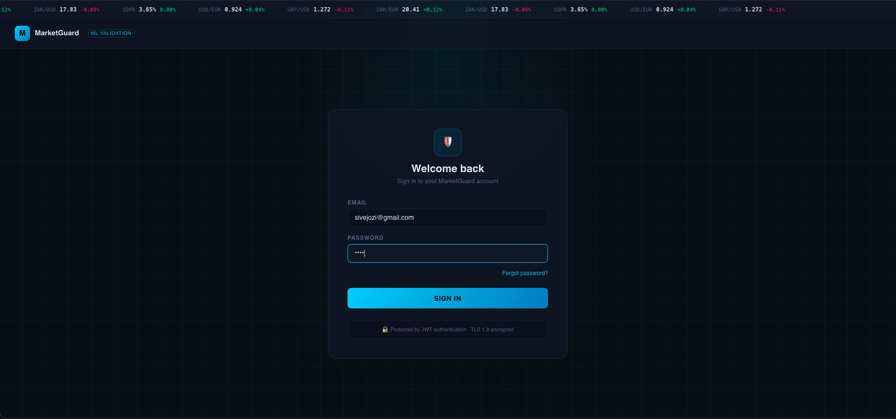
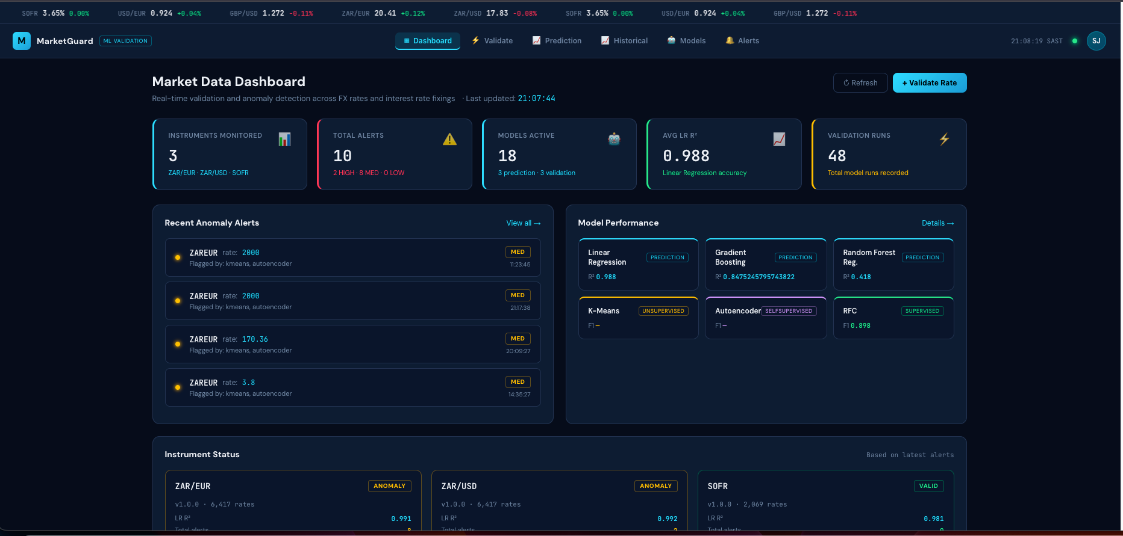
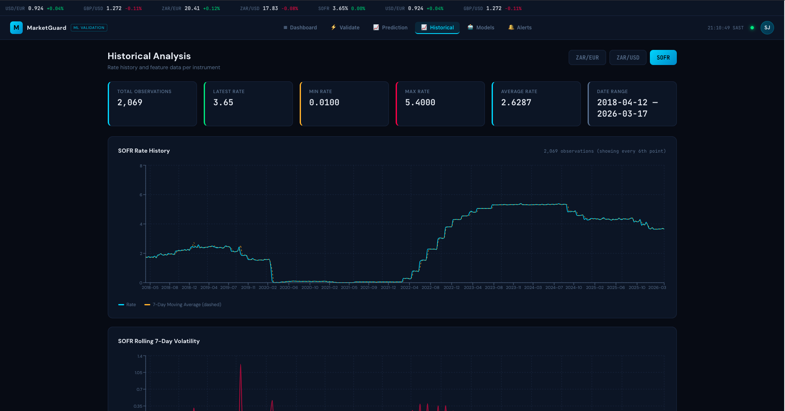
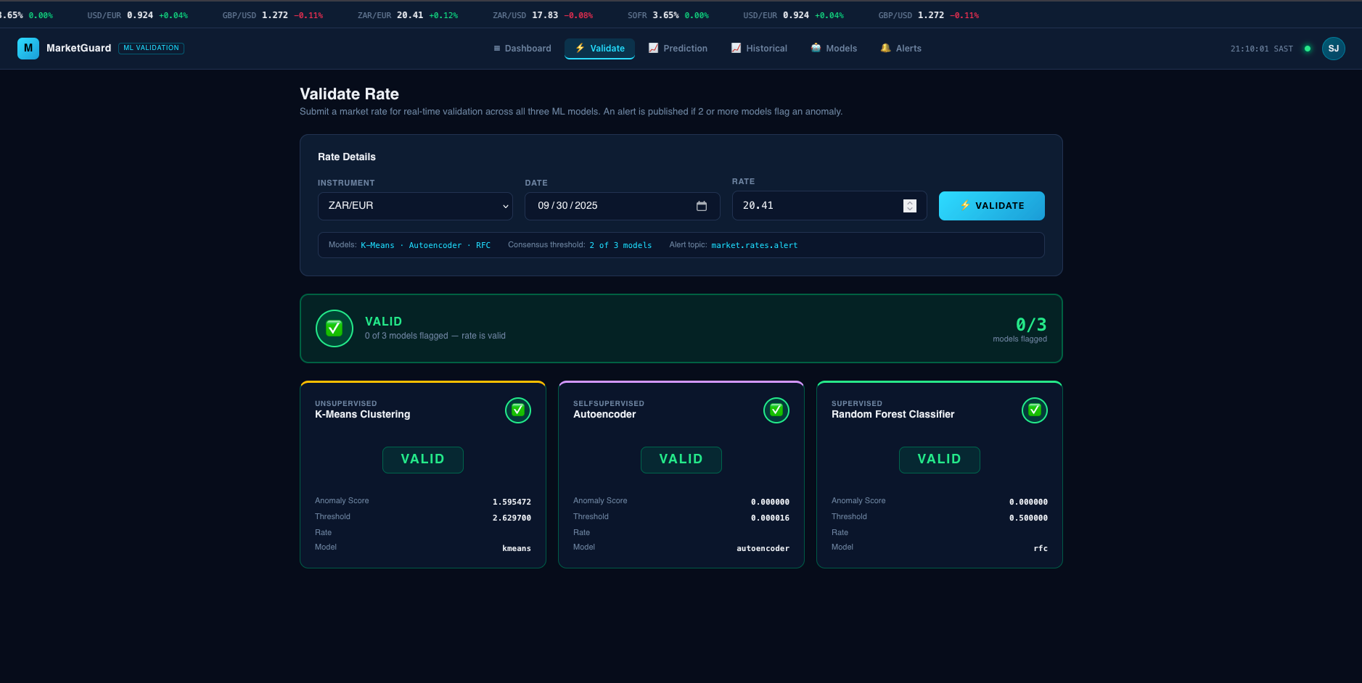
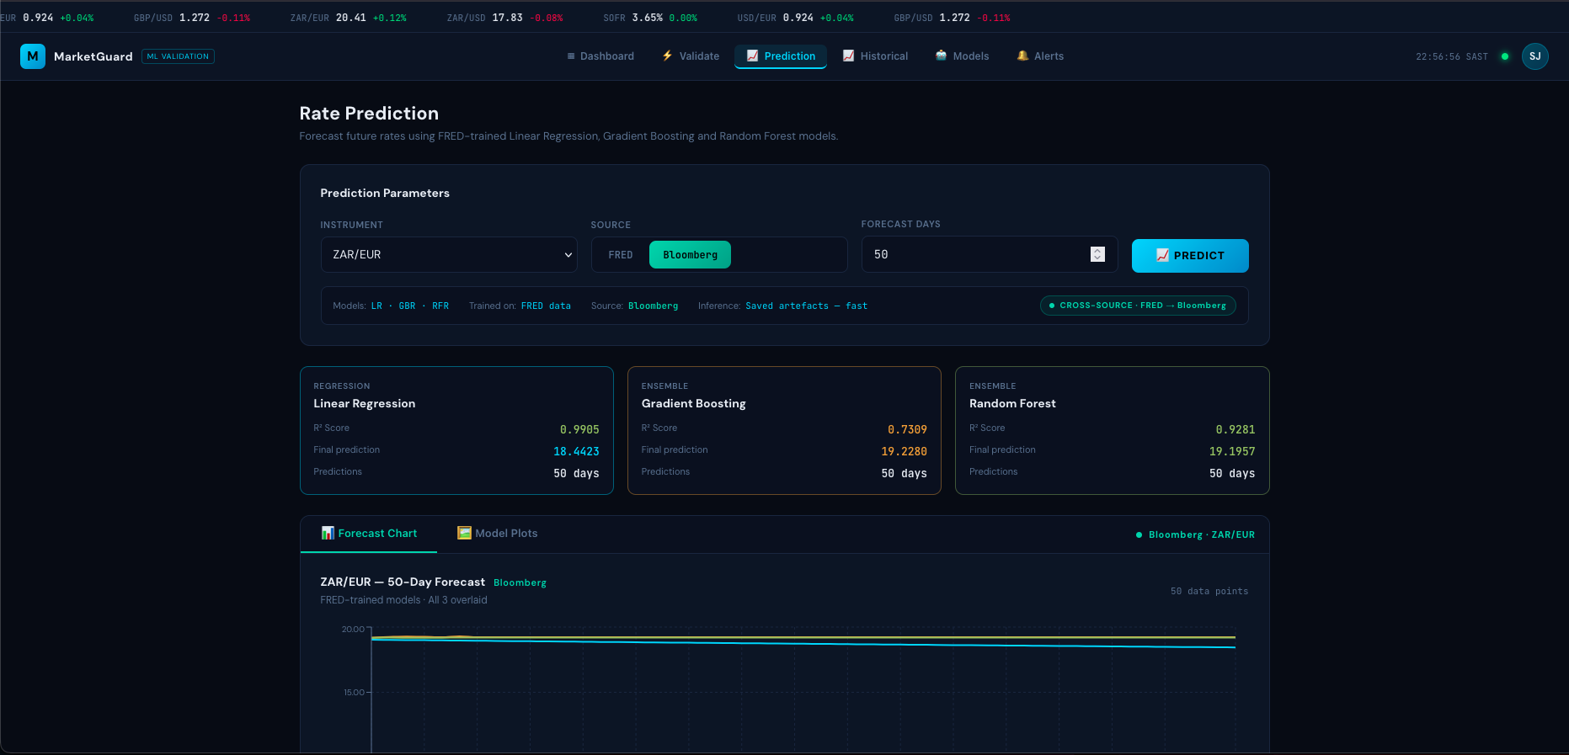
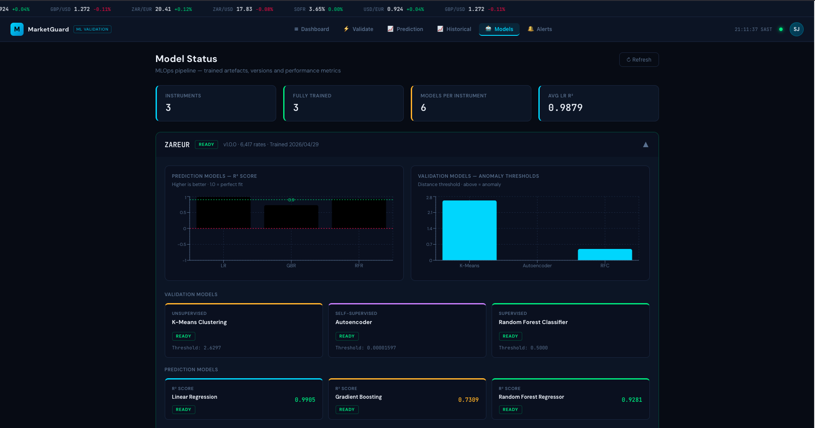
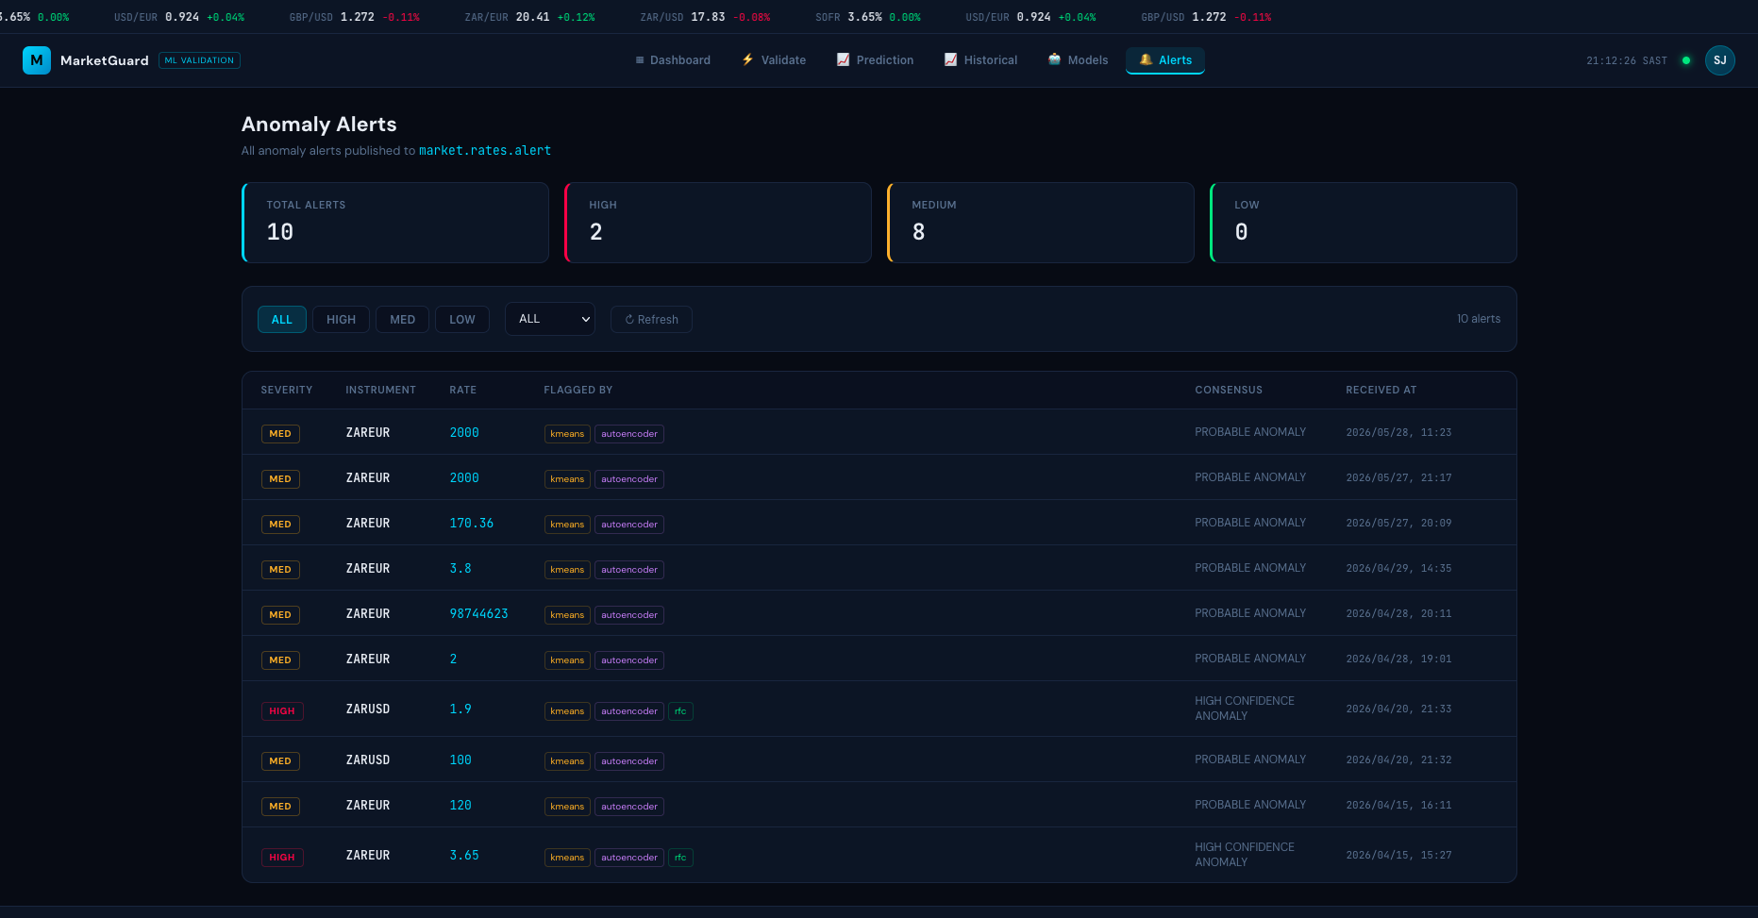
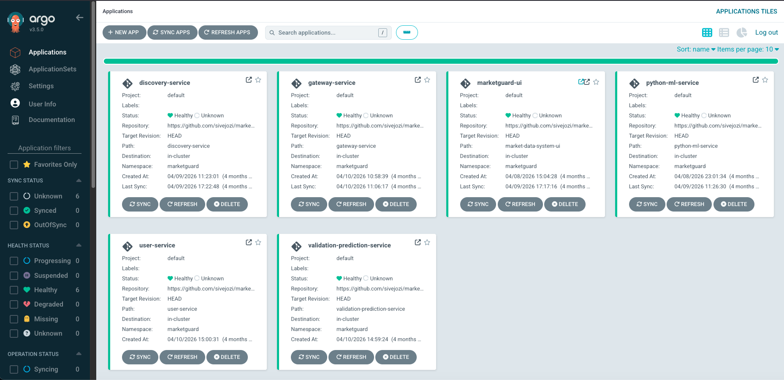
What it produces
PART TWO · THE SYSTEM
drop screenshot here
drop screenshot here
drop screenshot here
drop screenshot here
Sign-in ↗
Dashboard ↗
Historical rates ↗
Validate a rate ↗
drop screenshot here
drop screenshot here
drop screenshot here
drop screenshot here
Prediction ↗
Model artefacts ↗
Alerts ↗
ArgoCD ↗
Every label is a link — click one to open that screen full size, then click “back” to return here.

Slide 19
Getting your first job
PART THREE
What to learn, what to build, and how to talk about it.
Notes:
Transition. Ask if there are questions on the technical part before you move on.
Then shift tone - this section is advice, not findings.

Slide 20
The short list that actually matters
PART THREE · SKILLS
SQL, properly
  Joins, window functions, query plans, indexes. Not “I have used SELECT”.
One language well
  Python is fine. Well means testable, packaged, and readable by someone else.
Git, and CI
  Branches, reviews, and a pipeline that runs your tests automatically.
Containers
  Enough Docker to package your own work and explain what an image is.
One cloud, one orchestrator
  Depth in one beats a list of six. The concepts transfer.
How data actually moves
  Batch versus streaming, idempotency, schema change, late-arriving data.
Notes:
Be blunt: nobody in an interview asked me to explain K-Means.
They asked whether I could write SQL, and whether my code ran anywhere other than my laptop.
Breadth of algorithms is not the bottleneck. This surprises people.

Slide 21
One thing, end to end, actually running
PART THREE · WHAT TO BUILD
Ingest
A public API on a schedule.
Store
A real database with a real schema.
Transform
Tested, and idempotent.
Serve
An endpoint or a dashboard.
Deploy
Somewhere that is not your laptop.
→
→
→
→
Scope it deliberately small
  One source, one table, one view. Finished beats ambitious.
One finished project beats five notebooks
  Because only the finished one forces you to handle failure, scheduling and deployment — which is the actual job.
Notes:
My thesis is an example of this, but theirs can be a weekend project.
Emphasise finished and running over ambitious and abandoned.
Scope small deliberately - one data source, one table, one chart, deployed.

Slide 22
Make the unglamorous parts visible
PART THREE · WHAT TO BUILD
A schema, with constraints
Tests that run in CI
Ingestion you can safely run twice
A README with a diagram
One honest “known limitations” section
Anyone can train a model. Very few graduates can show me ingestion that is safe to re-run, or a constraint that prevents a class of bug.
That is what separates a project from a portfolio piece.
Notes:
This is the differentiator. Everyone can train a model; almost no junior can show idempotent ingestion.
Tell them: put the unglamorous work where a reviewer can see it.
A README with a diagram puts you ahead of most applicants. That is a low bar and a real advantage.

Slide 23
How to talk about what you built
PART THREE · INTERVIEWS
The problem
  In one sentence, without jargon.
The constraint
  No budget, no labelled data, one week. Constraints make choices sound deliberate.
What you chose, and what you rejected
  “I used Postgres over a queue because…” This is the part they are assessing.
What broke
  Have one real failure ready. Mine is the model that gave a different answer on the same data.
What you would do differently
  Shows you learned something rather than just finished something.
Notes:
Give them the five-beat structure and say it works for any project.
Insist on the failure story. Interviewers are listening for judgement, not features.
Mine is the unseeded autoencoder: two refits on identical data returned thresholds 57 percent apart, so the same rate could be flagged under one artefact and cleared under the other. Nothing in the pipeline told me - I found it in the run log. Tell it in about forty seconds, the way you would in an interview.

Slide 24
Data engineering or data science?
PART THREE · WHICH PATH
 | Data engineering | Data science
Optimises for | Correctness, reliability, cost | Insight, inference, decisions
Day to day | Pipelines, schemas, orchestration, on-call | Questions, models, analysis, communication
Judged on | Did the data arrive, correct and on time | Was the conclusion right and did it change anything
Shared: SQL, Python, version control, and a great deal of “is this number actually right?”
You do not have to choose now — a data scientist who can deploy is rare, and a data engineer who understands models is rarer.
Notes:
Useful for students still deciding. Keep it neutral, do not talk one down.
Say what you have observed about roles advertised, but flag it as your own impression.
The shared row is the real message - both jobs are mostly 'is this number right?'

Slide 25
Where to actually learn this
PART THREE · LEARNING
Official documentation, not courses
  For Docker, Kafka, Kubernetes and Postgres the docs are better and current. Courses go stale.
One book per area, read properly
  For this field, Kleppmann’s Designing Data-Intensive Applications is the one.
Build first, then read
  Reading about partitioning before you have hit a partitioning problem does not stick.
Read other people’s code
  Pick a small open-source project and follow one pull request end to end.
Notes:
Push documentation over courses for tools - docs are current, courses are not.
Kleppmann is the one book worth reading cover to cover for this field.
Order matters: build first, then read. Reading first does not stick.

Slide 26
Three things you can start now
PART THREE · THIS WEEK
1
Pick one public API and ingest it on a schedule
Into a real database, with a unique constraint so re-running is safe. One evening.
2
Put it in Git with a test and a CI workflow
Even one test. The habit matters more than the coverage.
3
Write the README as though a stranger will run it
Because in an interview, one will.
Notes:
Close with something they can act on today. Keep it to three.
Offer to look at their repo - and mean it. One or two will take you up on it.
Work wise
Bank Graduate Programmes – almost all banks, they run yearly.
Rotations – rotations, how they work?
Consulting Firms, these normally come with strong candidates.

Slide 27
Questions
THANK YOU
Notes:
Leave this up during questions.
If it goes quiet, ask them: how would you have found out that the same model was giving two different answers?
Consensus

Slide 28
Validate a rate
APPENDIX · SCREEN
drop validate-a-rate screenshot here
Submit a rate; three detectors vote; escalation needs two of three.
← back to all screens
Notes:
This is the whole thesis in one screen. Submit a rate, three detectors vote, two of three escalates.
Drop validate.png into the dashed frame.
Click back to return to the grid.

Slide 29
Alerts
APPENDIX · SCREEN
drop alerts screenshot here
The consensus verdict, and which detectors agreed.
← back to all screens
Notes:
Shows the consensus verdict and which detectors agreed.
Drop alerts.png into the dashed frame.
If the rows here are test data, say so before anyone asks.

Slide 30
ArgoCD
APPENDIX · SCREEN
drop argocd screenshot here
The cluster reconciled against what is in Git.
← back to all screens
Notes:
Closes the deployment story from part one — the cluster matching what is in Git.
Drop argocd.png into the dashed frame.

Slide 31
Sign-in
APPENDIX · SCREEN
drop sign-in screenshot here
Where a user enters the system.
← back to all screens

Slide 32
Dashboard
APPENDIX · SCREEN
drop dashboard screenshot here
Instruments monitored, alerts raised, artefacts trained, validation runs logged.
← back to all screens

Slide 33
Historical rates
APPENDIX · SCREEN
drop historical-rates screenshot here
The stored series behind every check.
← back to all screens

Slide 34
Prediction
APPENDIX · SCREEN
drop prediction screenshot here
The expected value an incoming rate is measured against.
← back to all screens

Slide 35
Model artefacts
APPENDIX · SCREEN
drop model-artefacts screenshot here
What was trained, when, and on how many observations.
← back to all screens

