Slide 1










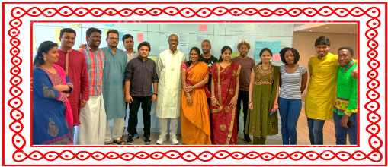


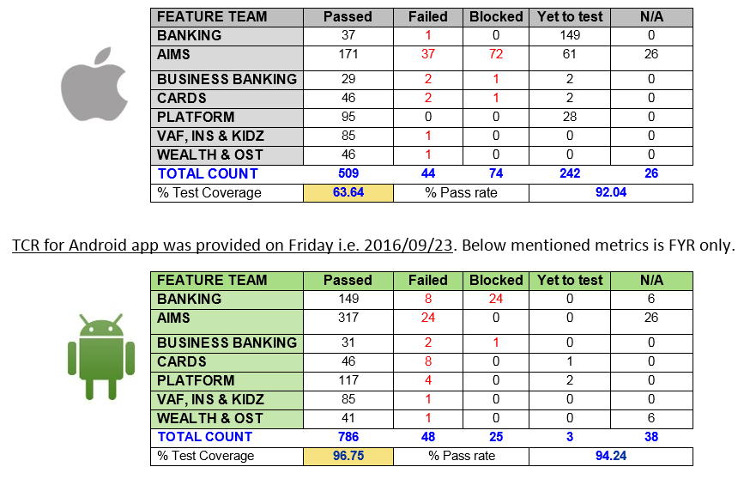



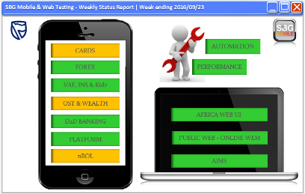






What we do?
Know our team ☺
Tools used in our Garage
Beyond Testing
Fun & Chill
- Semi automated Regression report
- Holistic view of week tasks through WSR
- Daily stand-ups
Testing Agile board
Every day automation reports
Team meetings
Trainings through Testing guild
POCs on new tools & technologies (Browser stack, Jmeter, applitools etc)
In Feb 2016,
Testing team – 40
Wipro - 28
HCL - 12
After the nWoW initiative, team size is optimized to 31 people
As of now:
Functional Testing - 25
Automation testing - 3
Performance testing - 2
Wipro - 17
HCL - 13
Pot Luck Events
Fun events
& Team outings ☺
Mobile App functional testing for SBG mobile releases
Web application functional testing for ROA countries
Automation testing
Performance testing
Follow Test Driven development
Leveraging tools for better quality
Agile process adherence
Release testing on iOS and Android
Backward compatibility testing
MTFR testing
Prod-fix/enhancements testing
Regression testing
Moving towards own Test data management
We are split across these teams
Platform feature team
Banking feature team
VAF, HL, Kidz banking feature team
Online share trading feature team
Cards feature team
Forex feature team
nBOL feature team
ROA Web team
Public web team
Global web team
Team video for Successful Colossus Release
Learning Videos on Features
During Testing Guild, trainings were conducted on:
GIT STASH
RUBY RAKE
XAMARIN TEST CLOUD
MOBILE PERFORMANCE TESTING
Trained 20 people

Slide 2







Target State for SBG
Automation to be include part of ‘DONE-DONE’ criteria in the feature team sprints
100% Continuous Integration
Leverage Xamarin Test cloud for execution of scripts on different types of devices
Maintain Automation test suite for future Regression
Reduced Release Testing timelines
Functional Testing
Build Regression suite & Maintenance of scripts
Implement continuous performance tests through Bamboo
Research on new mobility tool for innovation solutions to offer
Non-Functional Testing

