Slide 1
Introduction to Pandas
Definition: Pandas is a Python library for data manipulation and analysis.
Explanation: Pandas provides Series and DataFrame structures that help users work with structured data efficiently.

Slide 2
Pandas Series
Definition: A Series is a one-dimensional labeled array capable of holding any data type.
Example Code:
s = pd.Series([10,20,30])
print(s)
Explanation: Output shows index and corresponding values.

Slide 3
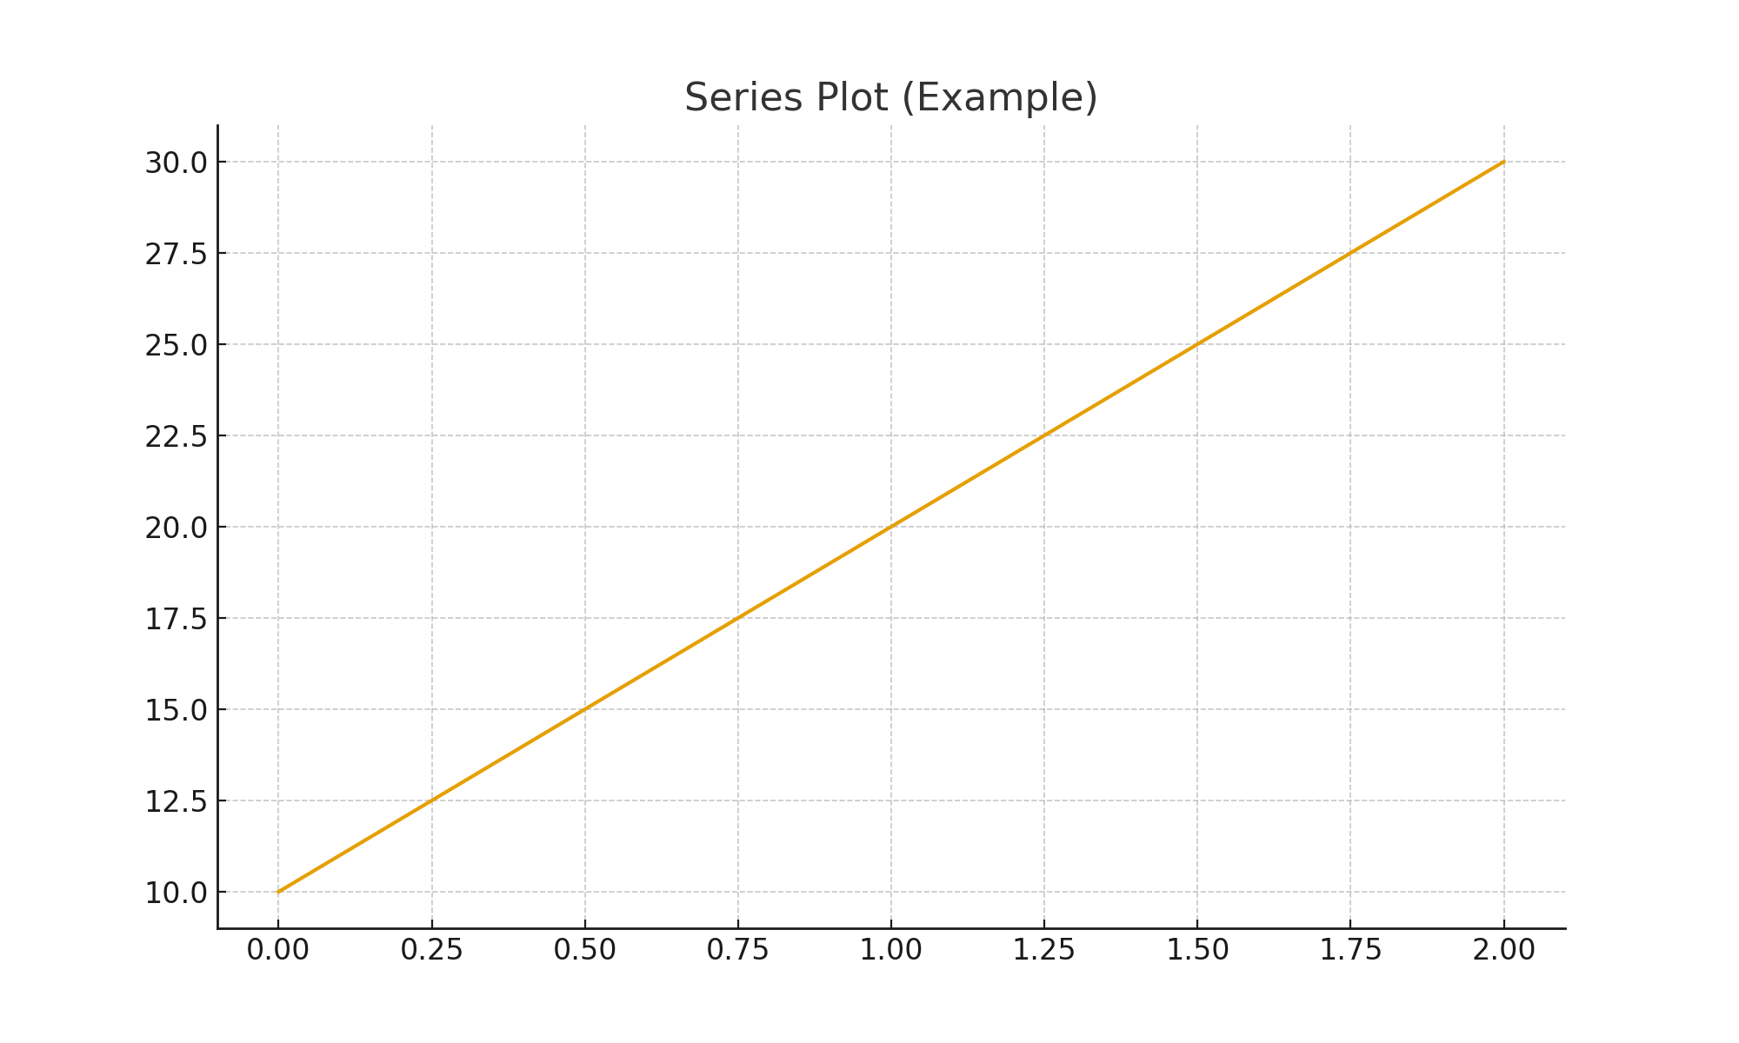
Series Plot Diagram
Below is a visual diagram showing how a Series is plotted:

Slide 4
DataFrame
Definition: A DataFrame is a two-dimensional tabular data structure with labeled axes.
Example Code:
data={'Name':['Ana','Ben'],'Age':[21,22]}
df=pd.DataFrame(data)
print(df)
Explanation: Output appears similar to an Excel table.

Slide 5
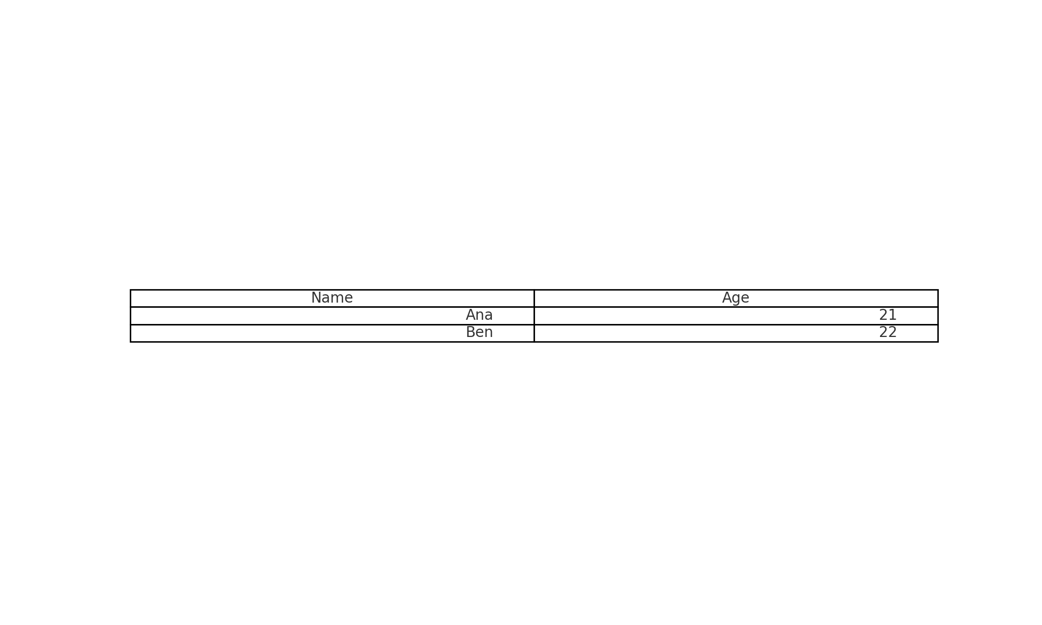
DataFrame Diagram
Below is a table diagram representation of the DataFrame:

Slide 6
Exercises
1. Create a Series of 5 numbers and plot it.
2. Create a DataFrame with 3 columns and 5 rows.
3. Filter rows where a column value is greater than 10.
4. Plot a bar chart using your DataFrame.

Slide 7
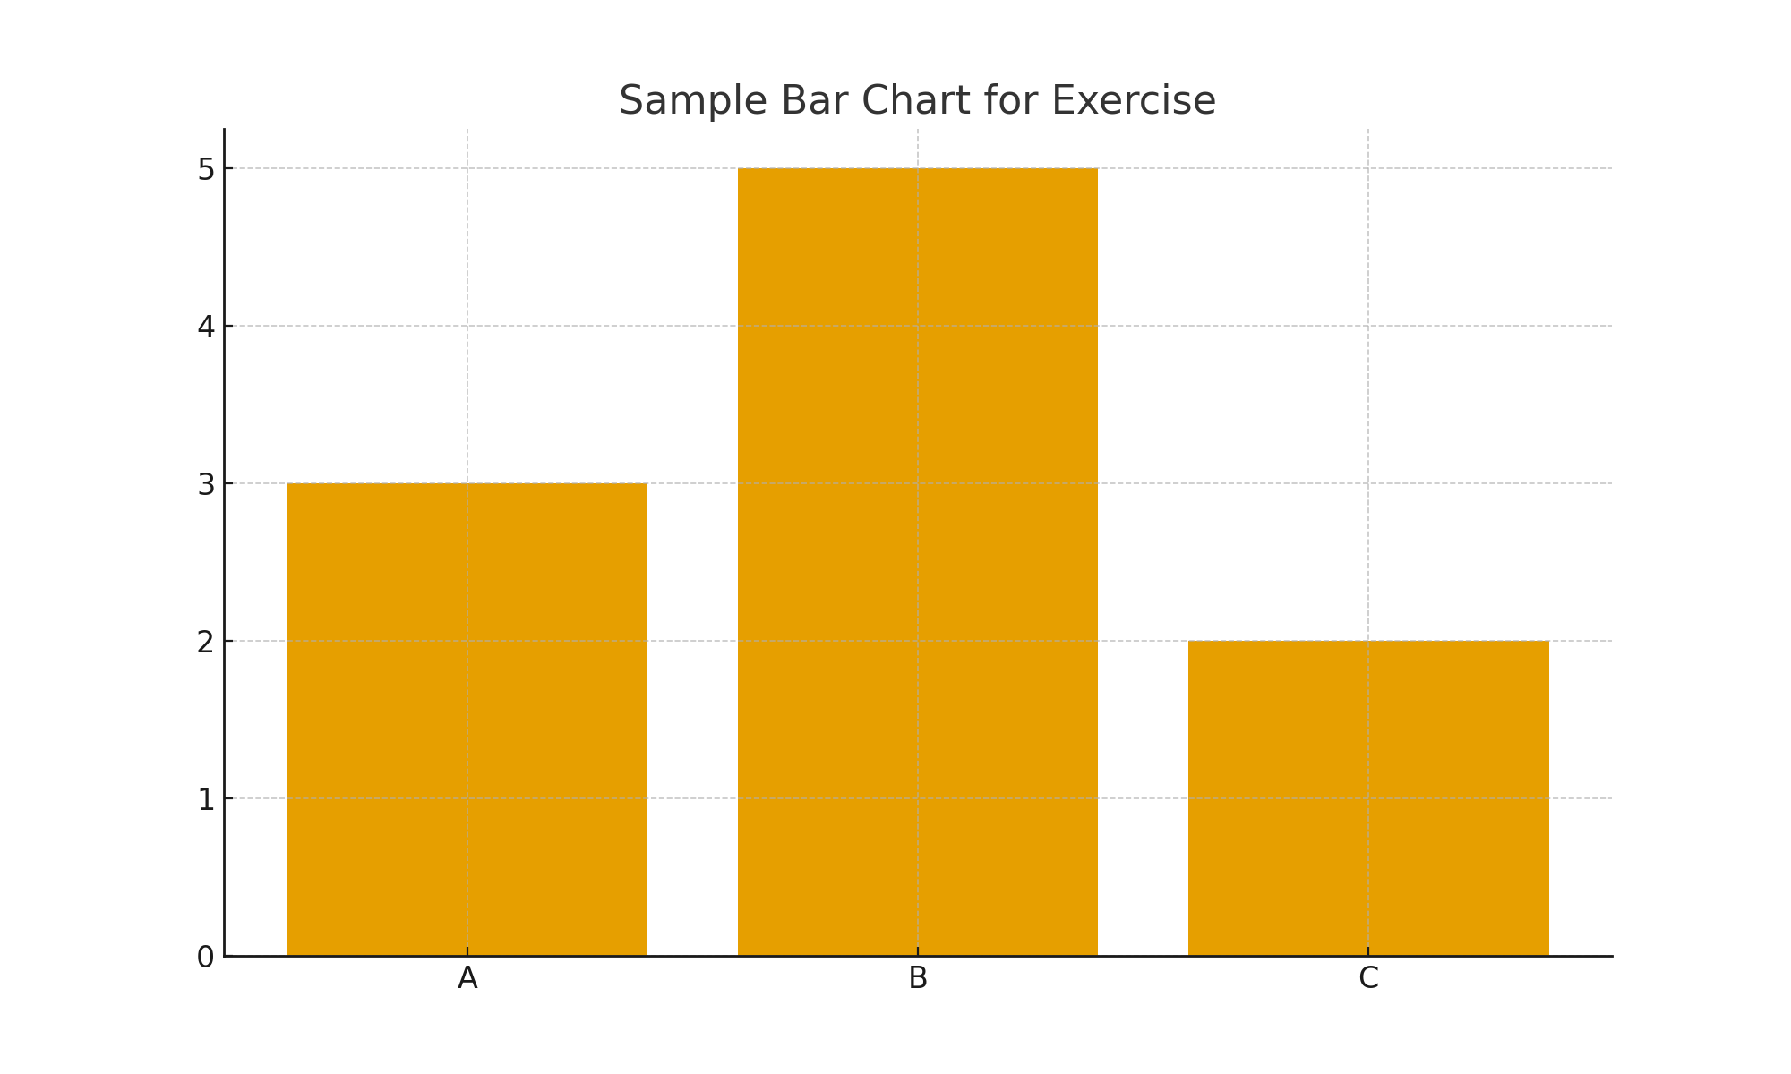
Sample Exercise Plot
Here is an example bar chart to guide students:

