Slide 1
Statistics & Probability for Industry Applications
Making sense of data for real-world decisions

Slide 2

Why This Matters in Industry
Companies don’t make decisions on raw data — they rely on summaries and probabilities.
Examples:
  Netflix analyzes viewing time
  Banks analyze loan default risk
  Amazon analyzes delivery times
  Hospitals analyze patient wait times
Statistics answers:
  - What is typical?
  - How spread out is the data?
  - How likely is an event?

Slide 3
What is statistic??
Sample
Sample
Population
Sample
Sample
Parameter: value that describes a population
Statistic: a value that describes a sample
PSYCH → always using samples!!!

Slide 4
Types
Descriptive Statistics
Inferential Statistics
Organize
Summarize
Simplify
Presentation of data
Generalize from samples to population
Hypothesis testing
Relationships among variables
Make predictions
Describing data

Slide 5

What is Descriptive Statistics?
Techniques to summarize, organize, and describe data
Industry analogy:
Like a dashboard instead of raw sensor logs
Like a resume instead of a life story

Slide 6
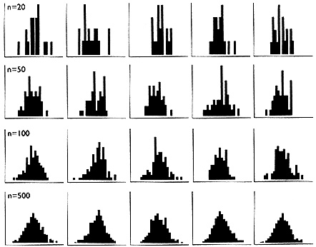
jagged
smooth
Central Limit Theorem: the larger the sample size, the closer a distribution will approximate the normal distribution
A distribution of scores taken at random from any distribution will tend to form a normal curve

Slide 7

Measures of Central Tendency – Mean
Question: What is a typical value?
Mean (Average): Sum ÷ count
Example:
  Average monthly salary in a company
Industry Use:
  Average customer spending
  Average delivery time
Sensitive to outliers

Slide 8
Median
Middle value when data is sorted
Example:
  Median house price (not affected by mansions)
Industry Use:
  Median income
  Median app response time
  Median customer wait time
Preferred when data is skewed

Slide 9

Mode
Most frequent value
Examples:
Most common shoe size sold
Most frequent product defect
Industry Use:
Retail inventory planning
Marketing personalization

Slide 10

Comparing Mean vs Median vs Mode
Salary Example:
  CEO salary = $1M
  Employees = $50K
Mean: Inflated
Median: Realistic
Mode: Most common
Key Insight: Choose measure based on business context

Slide 11
Measures of Central Tendency
Quantitative data:
Mode – the most frequently occurring observation
Median – the middle value in the data (50 ~50 )
Mean – arithmetic average
Qualitative data:
Mode – always appropriate
Mean – never appropriate

Slide 12
Measures of Dispersion
Question: How spread out is the data?
Why it matters:
Two datasets can have the same mean but very different risks

Slide 13

Range
Definition: Max − Min
Example:
Fastest vs slowest delivery time
Industry Use:
Quality control
SLA violations
Too sensitive to extremes

Slide 14

Variance
Average squared deviation from mean
Layman Explanation:
Measures inconsistency
Industry Use:
Manufacturing consistency
Financial risk modeling
Units are squared → less interpretable

Slide 15

Standard Deviation
Square root of variance
Example:
How much delivery times vary around the average
Industry Use:
Stock volatility
Forecasting demand
ML model stability
Most commonly used dispersion metric

Slide 16

Interquartile Range (IQR)
Definition: Q3 − Q1
Why it’s powerful:
  Ignores extreme outliers
Industry Use:
  Fraud detection
  Salary benchmarking
  Performance reviews

Slide 17
Percentiles & Quartiles
Percentile:
Value below which X% of data lies
Examples:
90th percentile latency
95th percentile response time
Industry Use:
Cloud SLAs
Network performance
Exam grading

Slide 18
Five-Number Summary
Includes:
Minimum
Q1 (25%)
Median
Q3 (75%)
Maximum
Industry Tool:
Box plots
Executive dashboards

Slide 19
Frequency Distributions
Counts of values in intervals
Examples:
Age groups of customers
Time buckets of deliveries
Industry Use:
Market segmentation
Demand planning
HR analytics

Slide 20
data
Are our inferences valid?…Best we can do is to calculate probability
about inferences

Slide 21

Interpreting Summary Statistics
Common Mistakes:
Blindly trusting averages
Ignoring spread
Missing skewness
Best Practice:
Combine central tendency
Dispersion
Distribution shape

Slide 22

Probability

Slide 23
Why Probability Matters
Industry decisions are uncertain:
Will a customer churn?
Will a machine fail?
Will demand spike?
Probability quantifies risk and uncertainty

Slide 24
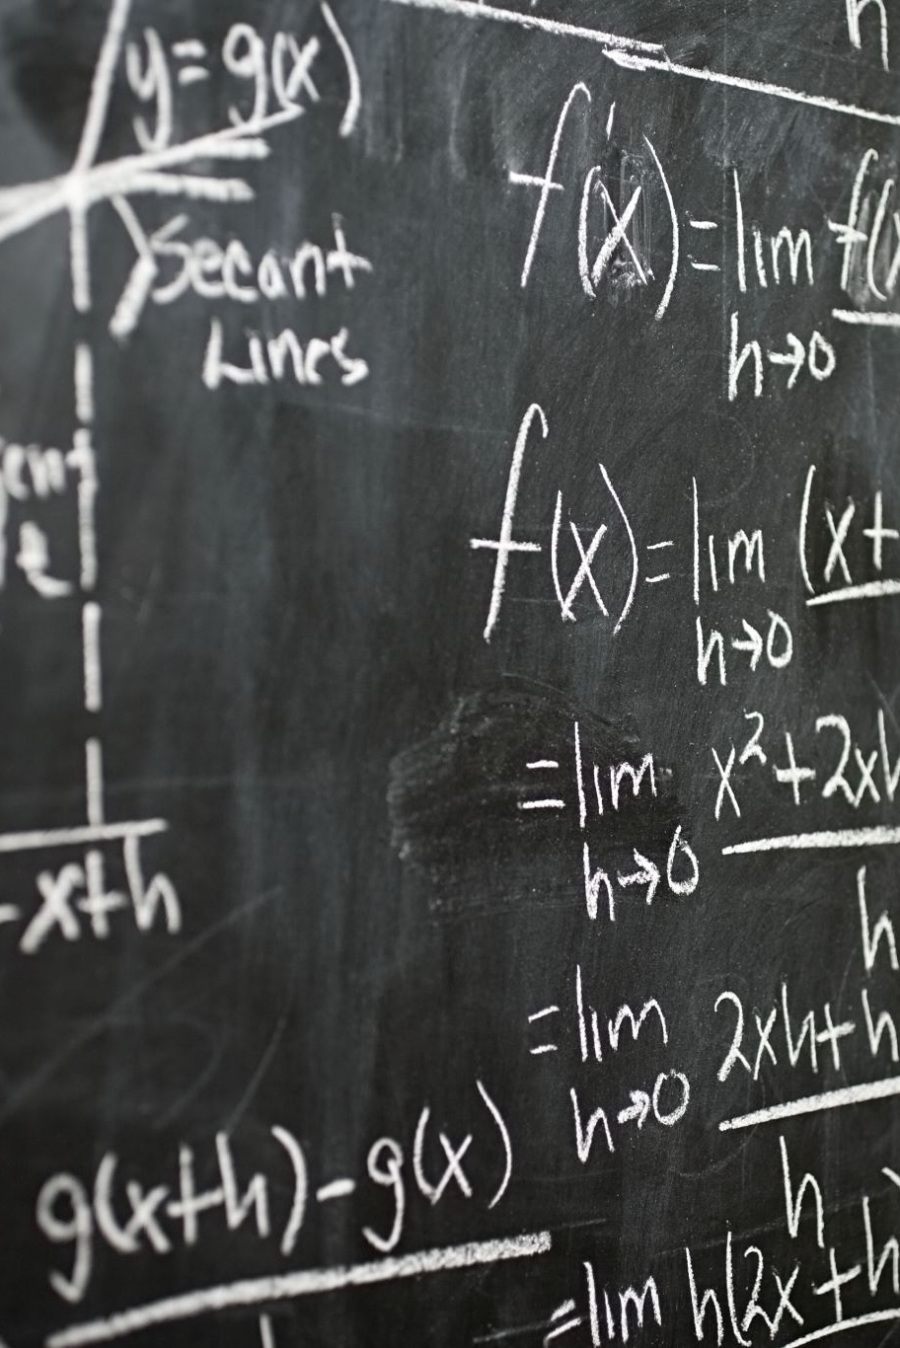
Basic Probability Concepts
Likelihood of an event
Formula:
  Favorable outcomes ÷ Total outcomes
Industry Examples:
  - Loan default probability
  - Ad click probability

Slide 25

Random Variables
Numeric outcome of a random process
Examples:
  Customers per hour
  Daily sales
  Website errors per day
Industry Use:
  Forecasting
  Simulation
  AI models

Slide 26
Joint, Conditional & Marginal Probability
Joint Probability: P(A and B)
Example: Customer clicks and buys
Conditional Probability: P(A | B)
Example: Buys given clicked
Marginal Probability:
- Probability of one event ignoring others

Slide 27
Probabilistic Sampling
Every data point has a known chance of selection
Examples:
Random customer surveys
A/B testing
Industry Use:
Market research
Clinical trials
Bias reduction

Slide 28
Synthetic Data Generation
Artificially generated data mimicking real data
Why industry uses it:
Privacy protection
Data scarcity
Model testing
Examples:
Synthetic patient records
Fake transaction data

Slide 29
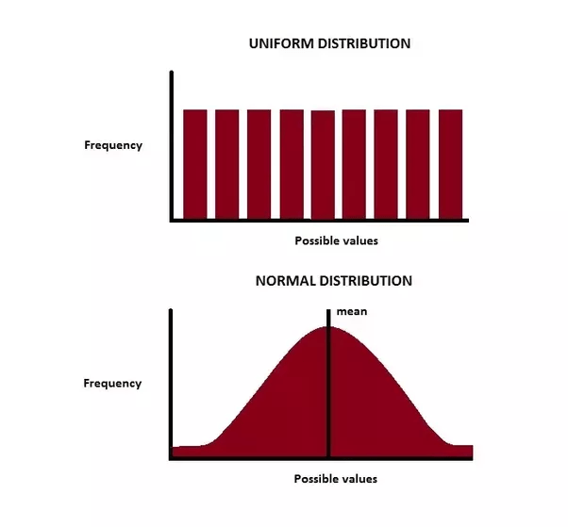
Uniform Distribution
All outcomes equally likely
Examples:
Random number generator
Lottery ticket
Industry Use:
Randomized experiments
Load balancing

Slide 30
Normal Distribution
Bell-shaped curve
Examples:
Heights
Test scores
Manufacturing tolerances
Key Rule:
68–95–99.7 rule

Slide 31
Normal Distribution in Industry
Examples:
Employee performance scores
Sensor noise
Financial returns (approximate)
Why it’s powerful:
Many models assume normality
Enables prediction & thresholds

Slide 32
Connecting Statistics to AI & Analytics
Descriptive stats → Data understanding
Probability → Risk estimation
Distributions → Model assumptions
Sampling → Bias control
Synthetic data → Privacy & scale

Slide 33
Key Takeaways
Statistics tells the story behind data
Averages alone are dangerous
Spread = risk
Probability enables smarter decisions
Industry success = correct interpretation

