Slide 1


Introduction to Data Analytics
Understanding how data shapes decisions in our daily lives.

Slide 2
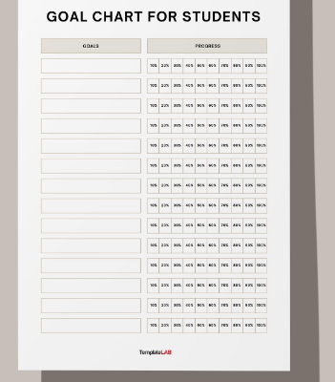
Learning Outcomes:
Explain
Explain what data analytics means
Identify
Identify real-world applications
Understand
Understand data types and visualizations
Notes:
Start with a question: 'How many of you check your phone’s daily screen time report?' — That’s data analytics at work!

Slide 3

What is Data?
Data is a group of facts that can take many different forms, such as numbers, pictures, words, videos, observations, and more.
We use and create data everyday, like when we stream a show or song or post on social media.

Slide 4

What is Data Analytics?
Definition :
Process of turning raw data into useful insights.
Example:
Analyzing your monthly expenses to find out where most of your money goes.
Notes:
Use relatable examples like Netflix recommending shows based on watch history.

Slide 5

Why Data Matters Today
Every click, swipe, and view generates data.
Businesses, governments, and individuals use data to make smarter decisions.
Engineers, doctors, and even farmers rely on analytics daily.
Notes:
Ask: 'Can data help us decide when to leave home to avoid traffic?'

Slide 6

Everyday Examples of Data Analytics
Weather Forecasting – analyzing past temperature and rainfall.
YouTube & Netflix – recommending videos.
Google Maps – suggesting fastest routes.
Health Apps – tracking steps and calories.
Cricket Analytics – player performance and strategy.
Notes:
Encourage students to share one app they use that applies data analytics.

Slide 7
Why start a career in data analytics?
Companies must continually adjust their products, services, tools, and business strategies to meet consumer preferences and demand and to react to emerging trends.

Slide 8
In-demand jobs
Data analyst
Operations analyst
Business systems analyst
Data science analyst
Business intelligence analyst
Business intelligence engineer
Business intelligence developer

Slide 9
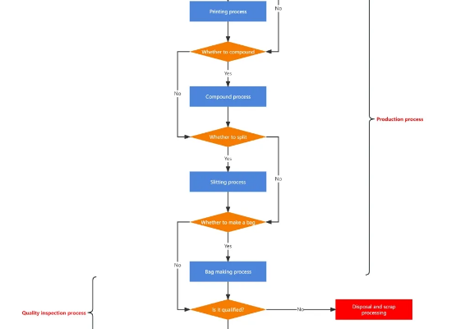
The Data-to-Insight Journey
Collect Data
Clean & Prepare Data
Analyze & Interpret
Visualize Results
Make Decisions
Notes:
Draw parallels with how we analyze marks after exams — collecting, comparing, and deciding how to improve.

Slide 10
Types of Data analytics
Descriptive (What happened in the past)
Diagnostic (Why did it happened)
Predictive (How can we make it happen)
Prescriptive (What will happen)
Complexity

Slide 11
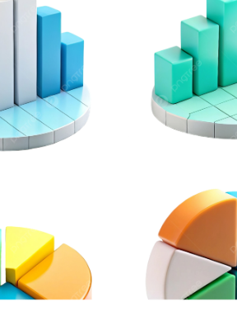
Types of Data
Numerical Data – measurable (e.g., age, temperature)
Categorical Data – labels (e.g., gender, city)
Time Series – values over time (e.g., daily rainfall)
Textual Data – words (e.g., tweets, reviews)
Notes:
Ask students to classify examples: 'Your daily attendance percentage – which type?'

Slide 12
Types of Variables
Independent – cause (hours studied)
Dependent – effect (exam score)
Continuous – can take any value (temperature)
Discrete – countable (number of subjects passed)
Notes:
Run a mini quiz: ask which variable type applies to 'monthly income' or 'student grade'.

Slide 13
Data Exploration
Exploration means understanding your data by asking questions:
What is the average value?
Are there any missing or odd entries?
What patterns can we see?
Notes:
Use Excel or Google Sheets to show simple averages and charts of random data.

Slide 14

Data Cleaning and Preprocessing
Cleaning data means fixing problems:
Removing duplicates
Filling missing values
Correcting errors (like misspelled city names)
Example: Your contact list with repeated or wrong phone numbers.
Notes:
Compare with cleaning a messy study table before exams — you can work better when things are organized.

Slide 15

Feature Engineering
Creating new information from existing data.
Example: From 'Date', extract 'Month' or 'Weekday'.
From 'Height' and 'Weight', calculate BMI.
It’s like combining ingredients to make a better recipe.
Notes:
Relate to 'adding filters' on social media — turning simple data into something more meaningful.

Slide 16
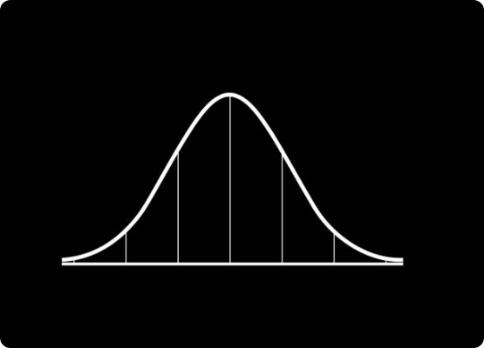
Statistical Analytics
Definition : Using math to find meaning in data.
Examples:
Correlation – how study hours affect grades.
Regression – predicting expenses from salary.
Probability – chance of rain tomorrow.
Notes:
Keep it fun — ask: 'Is there a correlation between mood and number of assignments due?'

Slide 17
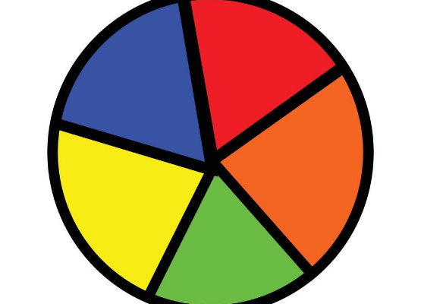
Data Visualization
Turning numbers into visuals:
Line Chart – trends (temperature change)
Bar Chart – comparison (sales per month)
Pie Chart – proportions (budget split)
Scatter Plot – relationships (height vs weight)
Notes:
Encourage: 'Let’s describe one of our charts in words — what story does it tell?'

Slide 18

Summary & Reflection
In this session, we learned:
• Data is everywhere
• Analytics turns data into insights
• Clean data = clear understanding
• Visuals tell powerful stories
Reflection: Where can YOU apply analytics in your daily life?
Notes:
Close with examples like personal fitness tracking, or managing study time efficiently.

