Slide 1
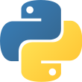
Python Programming Basics

Slide 2
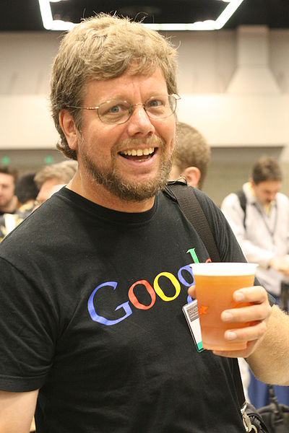
Introduction to Python
Python is a high-level, interpreted programming language.
Created by Guido van Rossum in 1991.
Used for Analytics, Web development, Data science, AI, ML and Automation.
Features: Easy to learn, open-source, portable, and has rich libraries.
Popular IDEs: IDLE, PyCharm, VS Code, Jupyter Notebook, Colab.

Slide 3
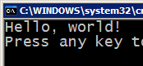



Difference
Many languages require you to compile (translate) your program into a form that the machine understands.
Python is instead directly interpreted into machine instructions.
compile
execute
source code
Hello.java
byte code
Hello.class
output
interpret
source code
Hello.py
output
3

Slide 4

Python Basics
Python files use the .py extension (.ipnyb)
Case sensitive and indentation-based syntax.
Use # for comments.
Example:
  x = 10 # Variable declaration
  print(x) # Output

Slide 5
Data Types and Variables
Example:
a = 9 # int
b = 3.14 # float
name = 'Siva' # string
is_active = True # boolean
Common data types: int, float, str, bool

Slide 6
Operators in Python
Arithmetic: +, -, *, /, //, %, **
Comparison: ==, !=, >, <, >=, <=
Logical: and, or, not
Assignment: =, +=, -=, *=, /=

Slide 7
Conditional Statements
Used to make decisions in programs.
Syntax Example:
if condition:
# code block
elif another_condition:
# another block
else:
# default block

Slide 8
Loops in Python
For Loop – used to iterate over a sequence.
Example:
for i in range(5):
print(i)
While Loop – repeats while condition is true.
Example:
while count < 5:
count += 1

Slide 9
Lists and Tuples
List: Ordered and mutable collection.
Example: fruits = ['apple', 'banana', 'cherry']
Tuple: Ordered and immutable collection.
Example: point = (3, 4, 5)

Slide 10
Sets and Dictionaries
Set: Unordered, unique elements.
Example: s = {1, 2, 3, 4}
Dictionary: Key-value pairs.
Example: student = {'name': 'Alice', 'age': 20}

Slide 11
Functions in Python
A block of reusable code defined with def keyword.
Syntax:
def greet(name):
print('Hello,', name)
greet('Alice')

Slide 12
Input and Output
Use input() to take user input.
Use print() to display output.
Example:
  name = input('Enter your name: ')
  print('Hello', name)

Slide 13
File Handling Basics
Open file using open() function.
Read/Write using read() or write() methods.
Always close file after operations.
Example:
file = open('data.txt', 'w')
file.write('Hello World')
file.close()

Slide 14
Error Handling
Used to handle runtime errors gracefully.
Syntax:
Try
# code that might cause error
except Exception as e:
print('Error:', e)

Slide 15
Summary
Python is beginner-friendly and powerful.
You learned about syntax, data types, control flow, and functions.
Next Steps: Learn modules, OOP, and libraries like NumPy or Pandas.
Practice is key to mastering programming!

Slide 16
Assessment 1. Data analytics exercise
Create a line graph interpreting the data and mention the steps one by one.
Create a bar chart and interpret the data and mention stepwise procedure.
Create a pie chart and interpret the result and mention stepwise procedure.
Mention three Excel formulas and method of applying it, paste the formula along with both input and output.
Apply statistics to any of the columns and interpret the findings.

