Slide 1


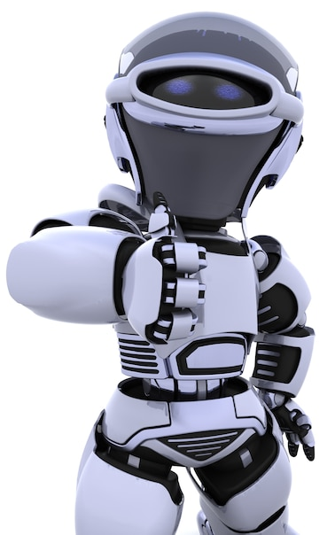
Artificial Intelligence – 30 Days Challenge - தமிழ்
Face recognition & its application | Overview on Libraries used
| Real-time face emotion recognition
DAY 7 / 30

Slide 2
Prerequisites for this Course
Laptop with Good Internet
No basic knowledge is required.
Note & Pen

Slide 3
Face Emotion recognition
Facial emotion recognition is the process of detecting human emotions from facial expressions. The human brain recognizes emotions automatically, and software has now been developed that can recognize emotions
AI can detect emotions by learning what each facial expression means and applying that knowledge to the new information presented to it. Emotional artificial intelligence, or emotion AI, is a technology that is capable of reading, imitating, interpreting, and responding to human facial expressions and emotions.

Slide 4
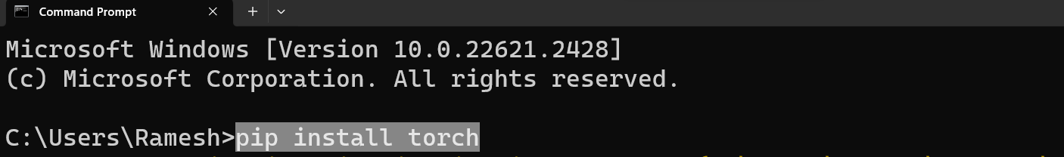
Installing Libraries
OpenCV-Contrib : pip install torch ; pip install torchvision

Slide 5

Installing Libraries
OpenCV-Contrib : pip install facial-emotion-recognition

Slide 6
Configuring Torch for CPU
./site-package/torch/serialization.py
Change:
def load(f, map_location=None, pickle_module=pickle, **pickle_load_args):
to
def load(f, map_location='cpu', pickle_module=pickle, **pickle_load_args):

Slide 7
Ready For Hands On

Slide 8




THANK YOU☺
NOVITECH COIMBATORE
novitechresearchanddevelopment

