Slide 1
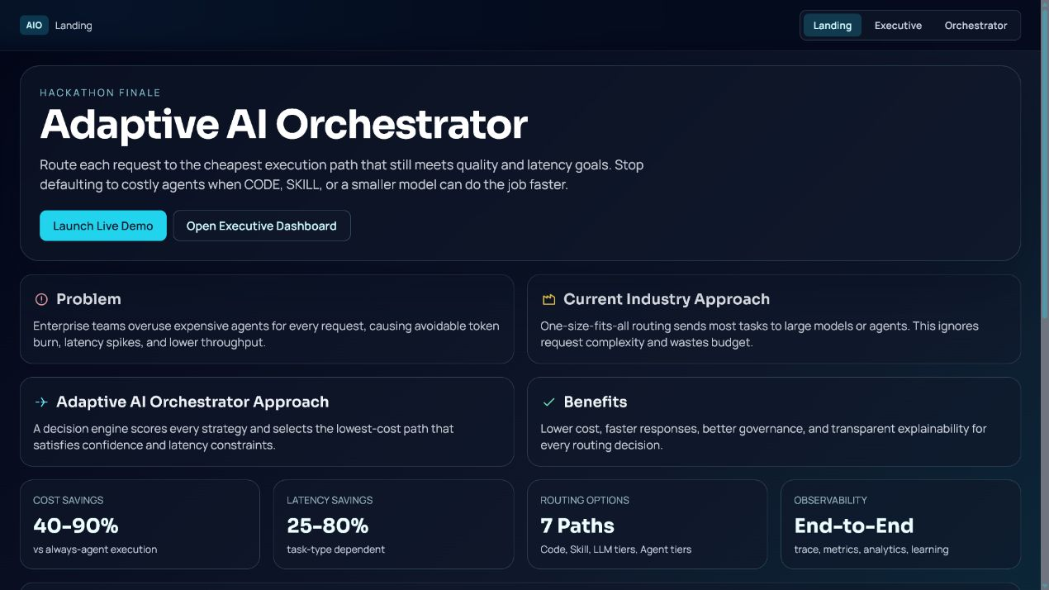

Adaptive AI Orchestrator
Cost-aware routing for enterprise AI workloads.
The platform selects the cheapest acceptable execution path while preserving confidence, speed, and governance.
Explainable route selection with cost, latency, confidence, and rationale

Slide 2
Right-sized routing for every task
Code, skills, LLMs, agents, and multi-agent workflows are all available.
The decision engine evaluates complexity, reasoning depth, context, cost, latency, and confidence before selecting a route.
Explainable route selection with cost, latency, confidence, and rationale

Slide 3
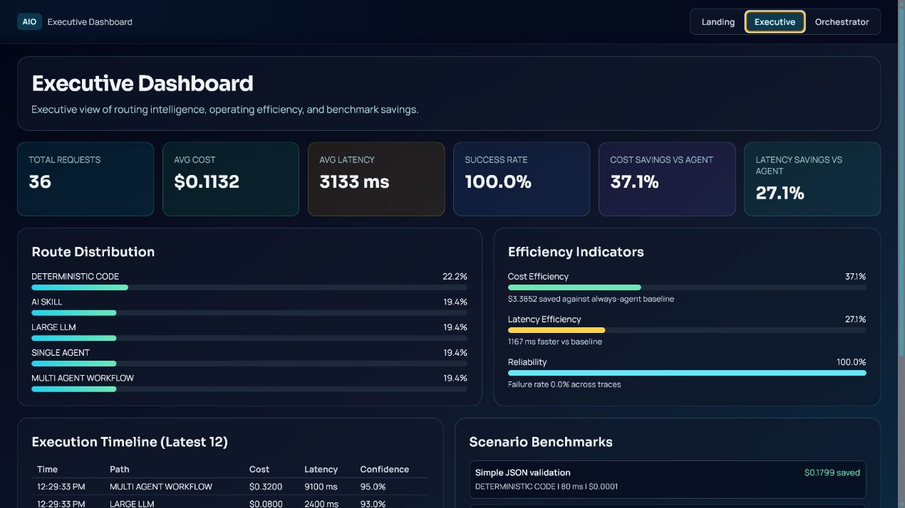
ROI evidence from repeated trials
35.3 percent lower execution cost and 25.1 percent lower latency.
Average cost dropped from $0.1800 to $0.1164 per request while maintaining 100 percent success in the controlled demo.
Explainable route selection with cost, latency, confidence, and rationale

Slide 4
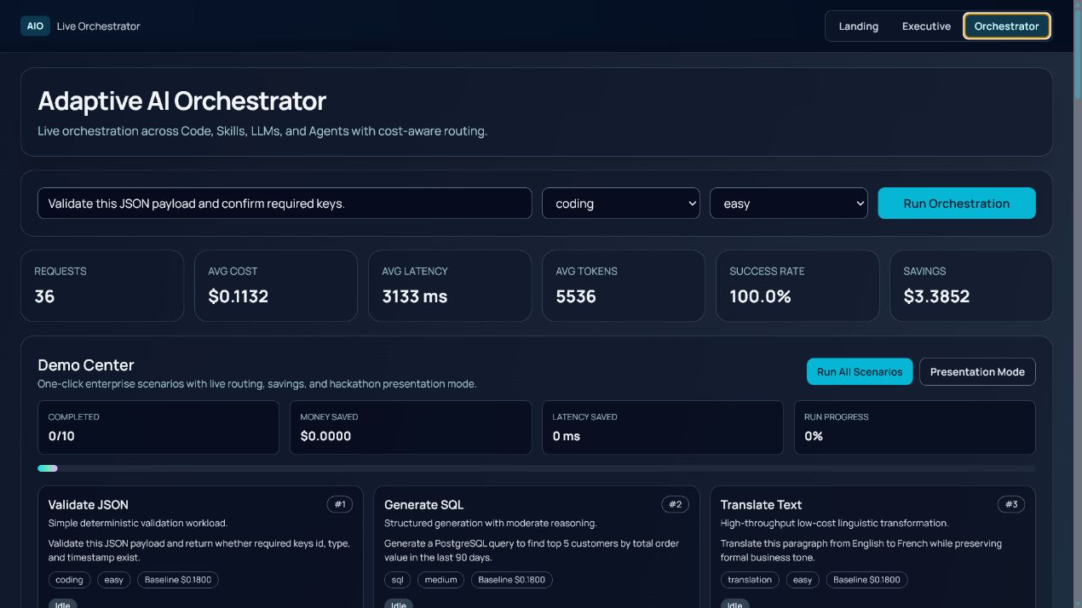
Live decisions are explainable
Every response includes route, confidence, cost, latency, and rationale.
This is important for enterprise governance: decisions are auditable, not hidden inside a black box.
Explainable route selection with cost, latency, confidence, and rationale

Slide 5
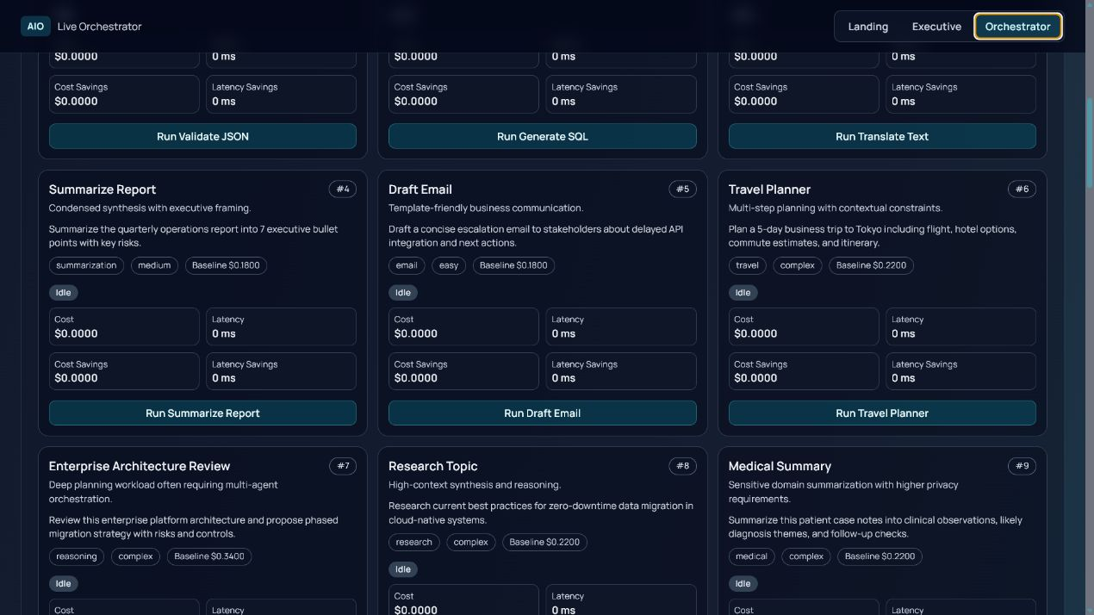
Benchmarks show selective escalation
Simple work avoids agents; complex work still escalates when needed.
JSON validation and email drafting are routed cheaply. Travel and enterprise migration planning still use agentic paths for quality.
Explainable route selection with cost, latency, confidence, and rationale

Slide 6
Business value scales with volume
Projected at one million similar requests: $63.6K saved and 300 response-time hours avoided.
Production validation can connect this framework to real provider billing, latency, quality scores, and business outcomes.
Explainable route selection with cost, latency, confidence, and rationale

