Slide 1
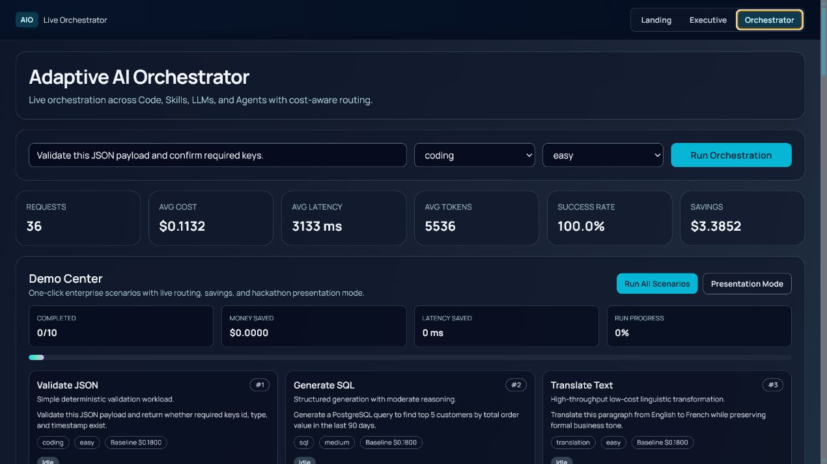

Adaptive AI Orchestrator
A runtime control layer for enterprise AI.
Routes each request to the lowest-cost execution path that still satisfies quality, latency, and confidence requirements.
Project overview for hackathon evaluation

Slide 2
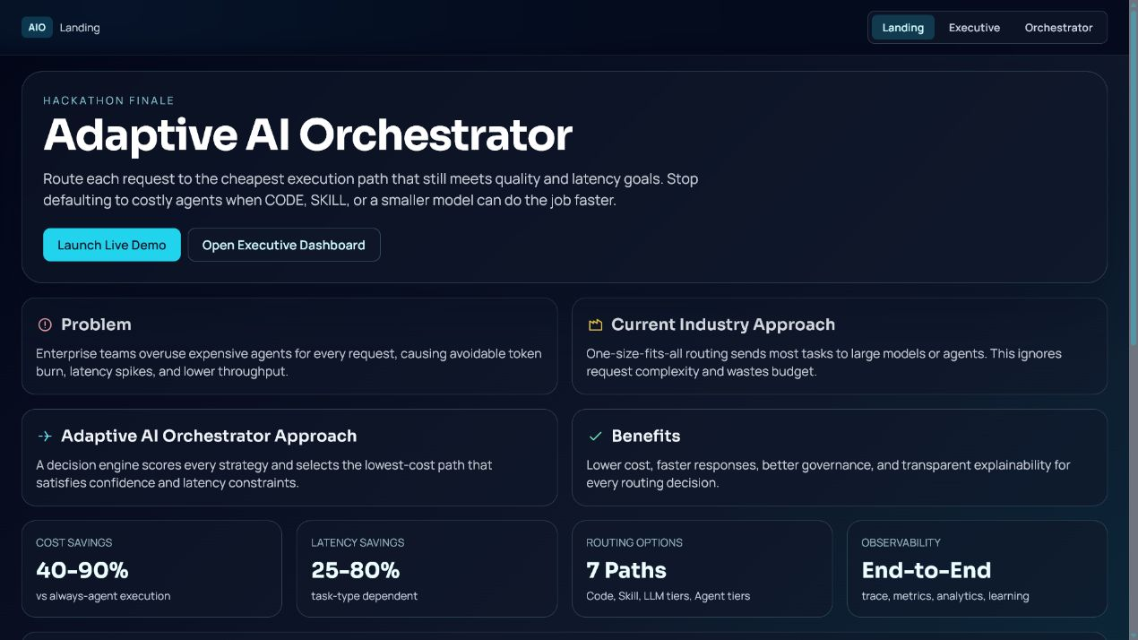
The problem
Enterprise AI often overuses costly execution paths.
Simple tasks do not always need large models or agents. Without routing, teams absorb avoidable cost, latency, and governance risk.
Goal: control cost without blindly reducing quality

Slide 3
How it works
The decision engine scores each path at runtime.
It considers complexity, policy, cost, latency, confidence, and historical outcome signals before selecting Code, Skill, LLM, Agent, or Multi-Agent Workflow.
Every response includes route, rationale, cost, latency, confidence, and evaluated alternatives

Slide 4
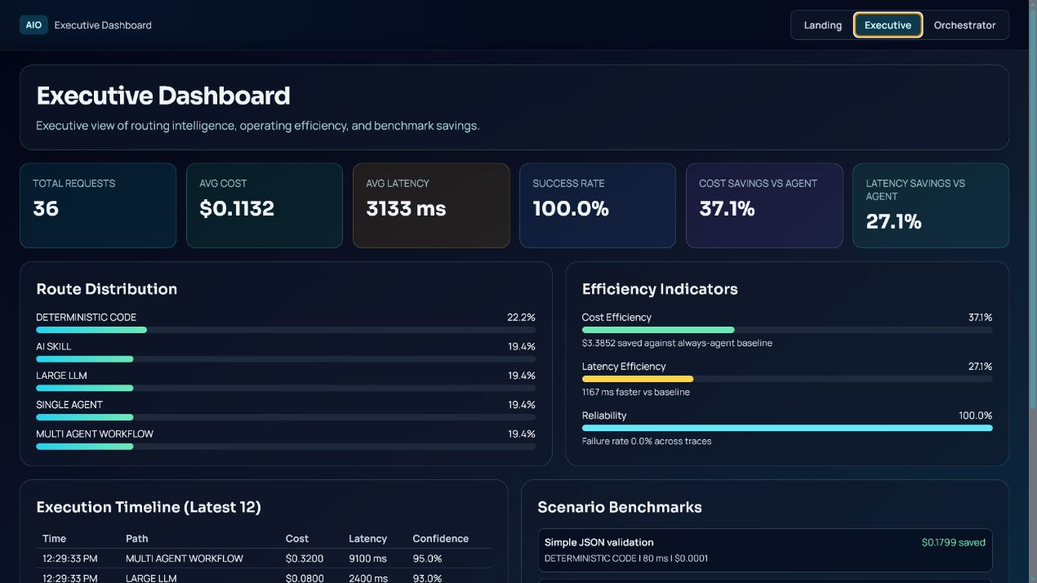
Business impact
Measured savings from repeated demo trials.
35.3%
25.1%
lower execution cost
lower latency
100%
$63.6K
controlled demo success
projected savings / 1M
The prototype reduced average cost from $0.1800 to $0.1164 per request, lowered average latency from 4.30 seconds to 3.22 seconds, and maintained 100 percent controlled demo success.
Projected at one million similar requests: about $63.6K saved and 300 response-time hours avoided

Slide 5
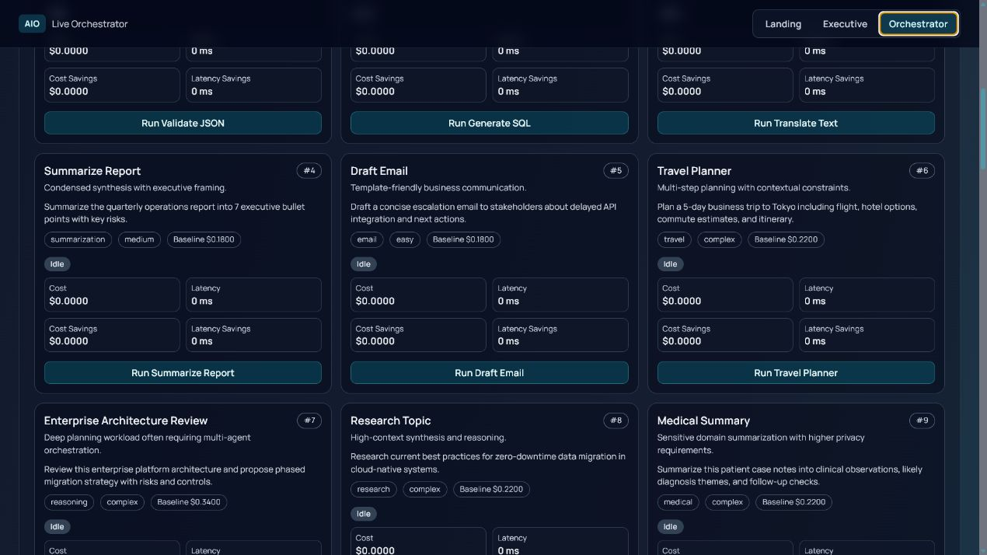
Built for governance
Explainable routing makes AI spend auditable.
Platform teams can monitor route mix, business teams can review ROI, and governance teams can inspect why each workload used a cheaper or more advanced path.
Designed for platform, product, FinOps, and AI governance stakeholders

Slide 6
Why it matters
A foundation for an enterprise AI control plane.
The hackathon build uses deterministic local demo adapters. In production, the same orchestration pattern can connect to real providers, billing telemetry, quality feedback, approval workflows, and enterprise policy controls.
Adaptive routing helps scale AI adoption with cost, quality, and governance under control

