Slide 1
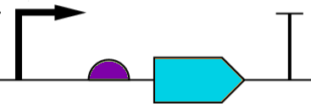
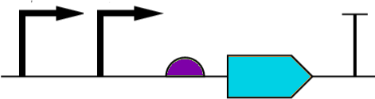
Uses of Boolean Logic in Biology
Premalignant cell
expressing only
SSX1
Tumor cell
expressing both
SSX1 and CXCL1
SSX1
CXCL1
Targeting cell containing AND gate
Premalignant cell
expressing only
CXCL1
Premalignant cell
expressing neither
SSX1 or CXCL1

Slide 2
Biological NOR Gate
tf2
pro1
pro2
tf1
ip1
ip2
rbs1
t1
rp1
rbs2
t2
cds1
cds2

Slide 3
Crosstalk inside cell

Slide 4
Distributing gates in multiple cells

Slide 5
Crosstalk between cells
Function 1: (Blue NOR Red) NOR Cyan
Function 2: (Cyan NOR Pink) NOR Red
If colonies are not separated, green creates crosstalk between F1 and F2.

Slide 6
Physical separation of cells

Slide 7
Computational Problems of Interest
When to open?
Where to place cells

Slide 8
Hypothetical Architecture
Cells and Media
Signal Inputs
Signal Outputs
Cell Trap Array

Slide 9
Design Flow
module half_adder (a, b,
sum, carry );
input a;
input b;
output sum;
output carry;
assign sum = a^b;
assign carry = a&b;
endmodule
a
a
b
s
c
s
0
0
0
0
0
1
1
0
b
1
0
1
0
1
1
0
1
c
1. Obtain function from input file
2. Construct function from devices
L1 open
L2 closed
L3 closed
L4 open
L5 closed
L6 open
3. Assign cells to locations in array
4. Generate valve control patterns

Slide 10
Input Format
Generation of canonical form
INPUT
Technology independent logic minimization
LOGIC
SYNTHESIS
Technology mapping
Flow Layer Layout
Control Layer valve and port placement
PHYSICAL DESIGN
Control Layer routing
Valve control pattern generation
Automatic mask generation
MANUFACTURING
AND
SIMULATION
Behavioral simulation

Slide 11
Example: AND
A
Out
B
A
B

Slide 12
Graph representation
Legend
Flow layer port
Control layer port
Flow layer node
Control layer valve
Flow layer channel
Control layer channel
Flow layer channel
with cell trapsl
Maps valve to flow layer
channel

Slide 13
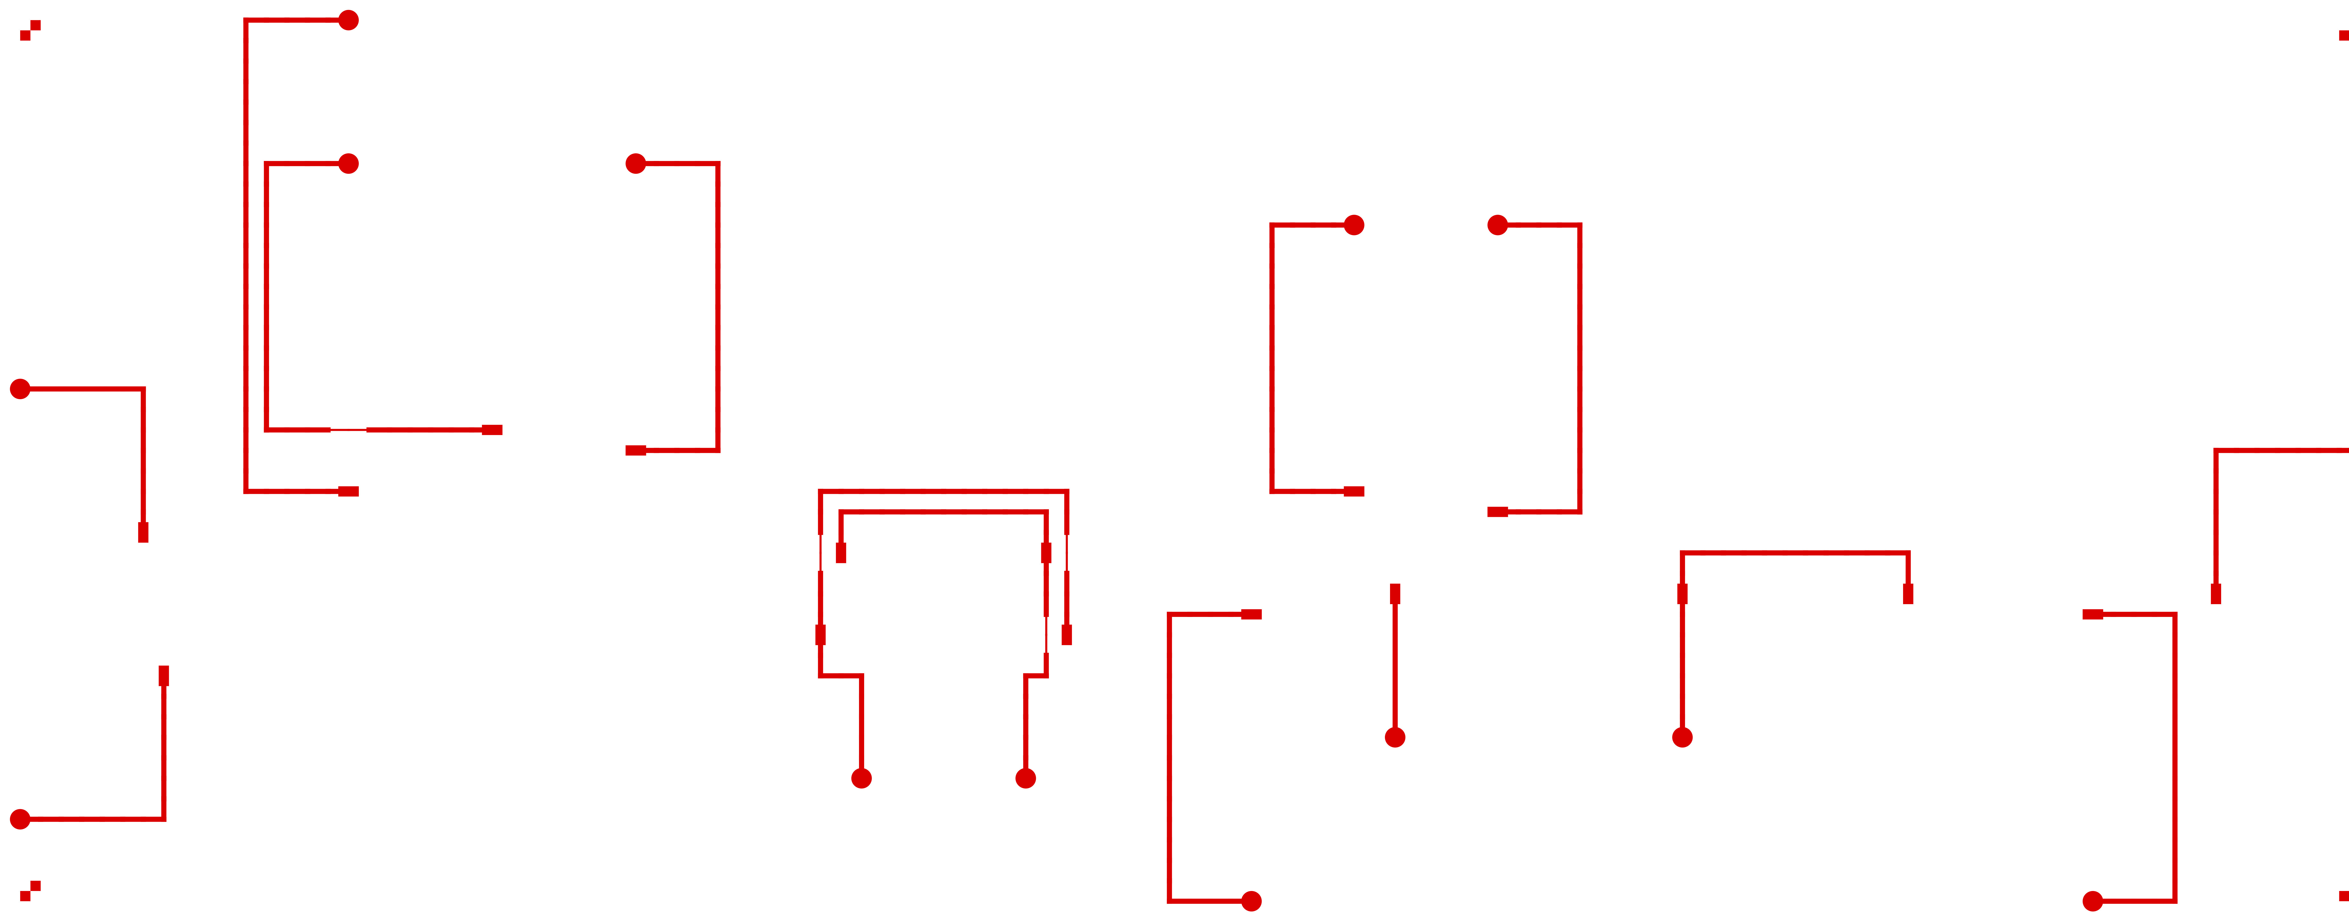
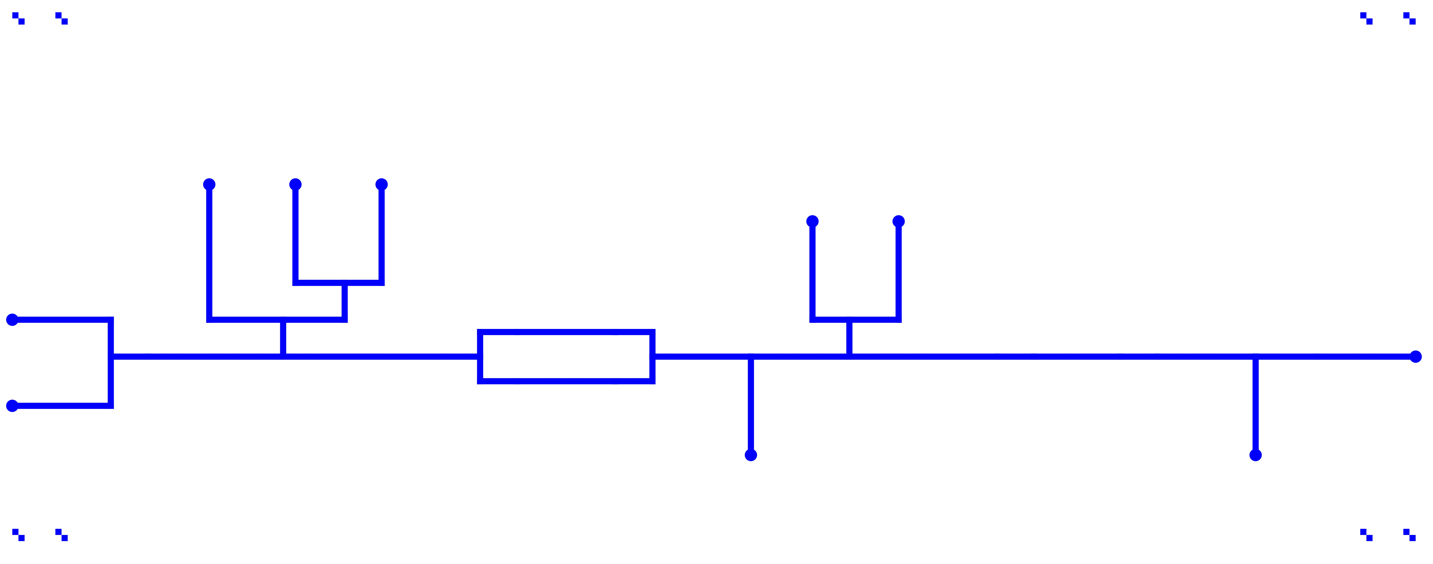

Masks
Control Layer
Flow Layer
Cell Trap Layer

Slide 14
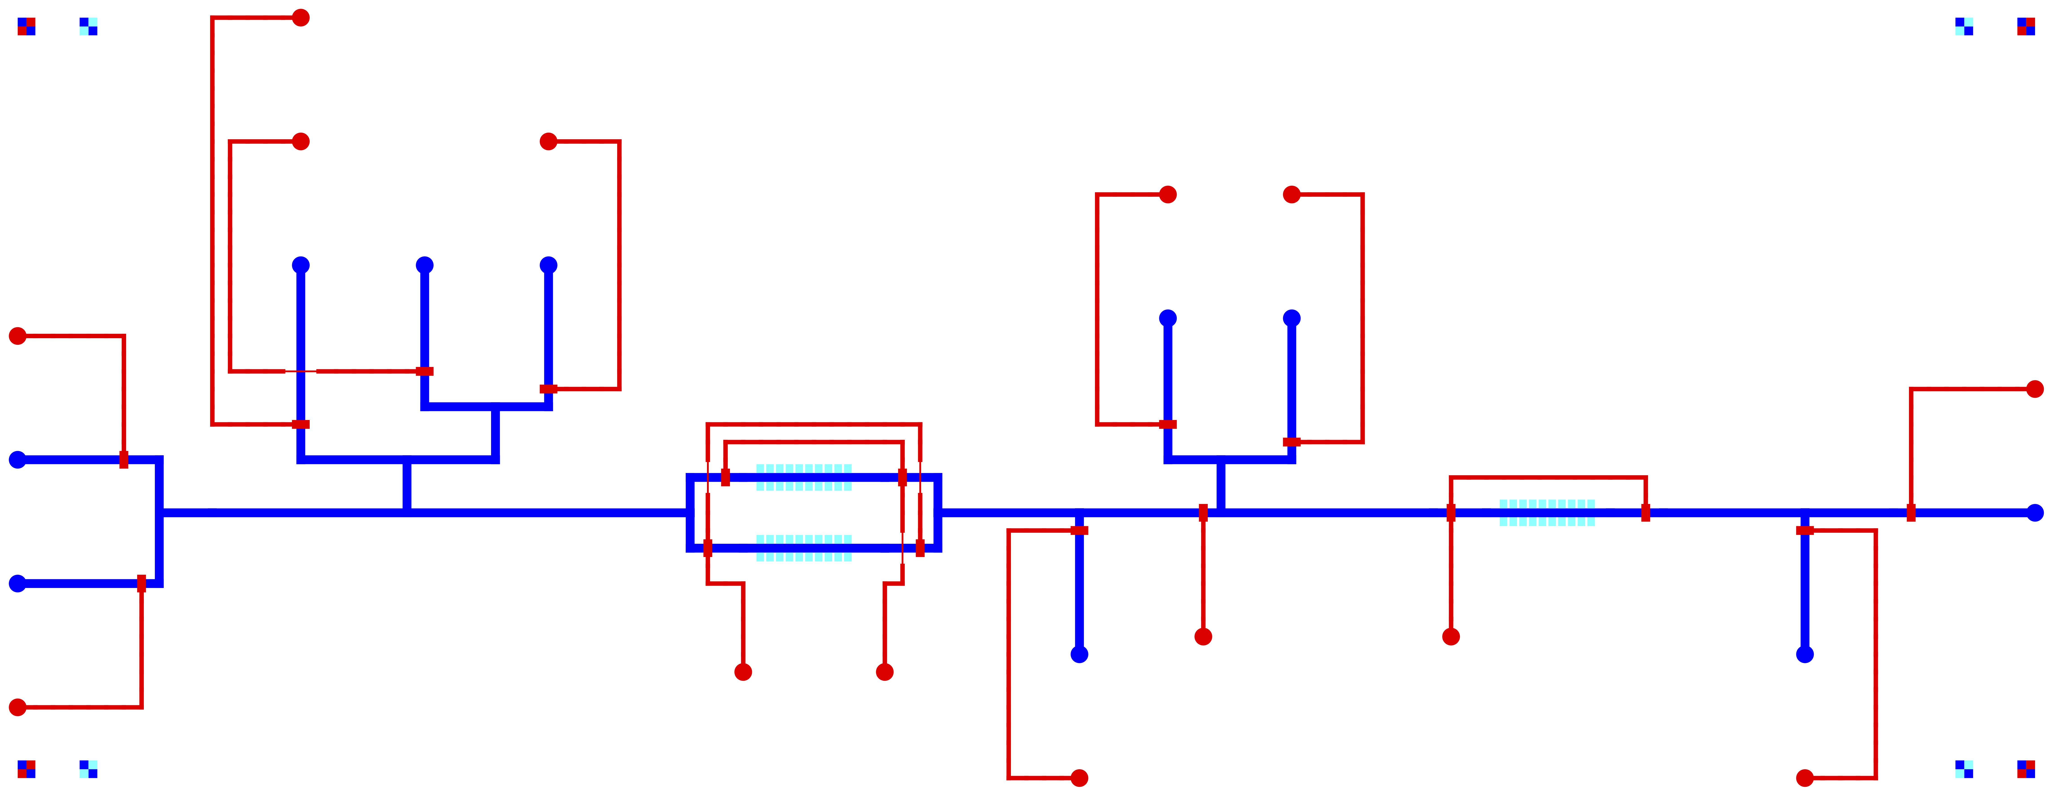
Composite view of layers

Slide 15
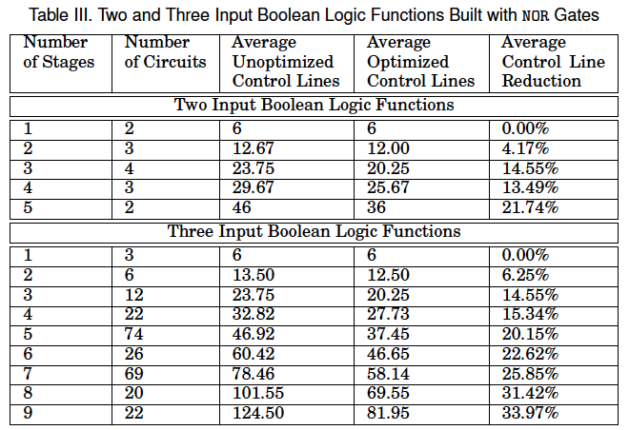
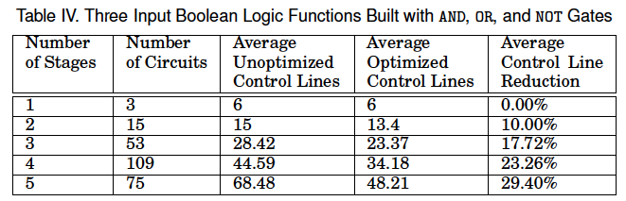
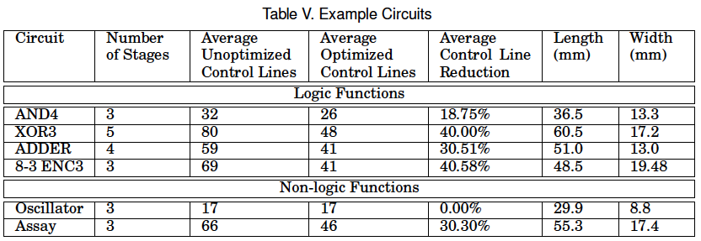
Preliminary Results

Slide 16
High level program flow
Generate graph representation based on gates
Convert graph into the flow layer and control layer
Determine layout of flow layer starting at the output and moving towards the input
Determine location of valves and ports on the control layer to minimize routing problems
Route valves to ports on the control layer using negotiated congestion
Generate valve control patterns to execute function
Define operations of 'load cells', 'grow', 'apply inputs' and 'flush output' for each cell trap
Combine operations to generate valve control patterns to execute function

Slide 17
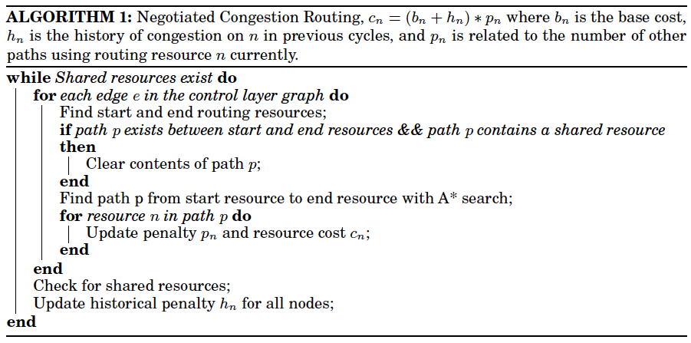
Negotiated Congestion Routing

