Slide 1
Block Ciphers
CSCI 6331/4331
GW
Some of this slide set is from Section 2,
H. M. Heys, "A Tutorial on Linear and Differential Cryptanalysis", Technical Report CORR 2001-17, Centre for Applied Cryptographic Research, Department of Combinatorics and Optimization, University of Waterloo, Mar. 2001. (Also appears in Cryptologia, vol. XXVI, no. 3, pp. 189-221, 2002.)
The Heys’ reference is considered indispensable for this lecture, i.e., it is compulsory reading

Slide 2
Substitution-Permutation Networks (SPNs)
Basic building block of several symmetric-key block ciphers (AES):
A substitution
A permutation
A pad with key
Repeated over many “rounds”

Slide 3
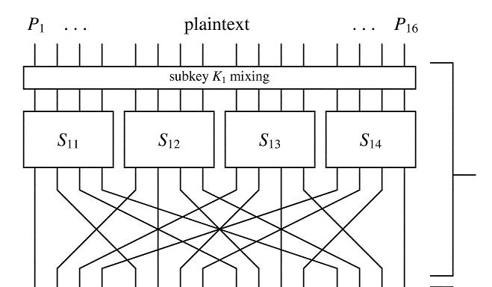
Single SP block
From: Heys’ paper, part of Figure 1
One part of key
“S” box
permutations

Slide 4
Example S-box
0 A 8 E
1 F 9 0
2 3 A C
3 9 B 1
4 B C 5
5 8 D 6
6 2 E D
7 4 F 7
0000 → 1010
0001 → 1111
0010 → 0011

Slide 5
Example Permutation
(Table 2, Heys’ paper)
0 0 8 2
1 4 9 6
2 8 A A
3 C B E
4 1 C 3
5 5 D 7
6 9 E B
7 D F F
1011 0101 0100 0110
1000 0111 1001 1100

Slide 6
Example

Slide 7
Invert single box?
From: Heys’ paper, part of Figure 1

Slide 8
Example

Slide 9
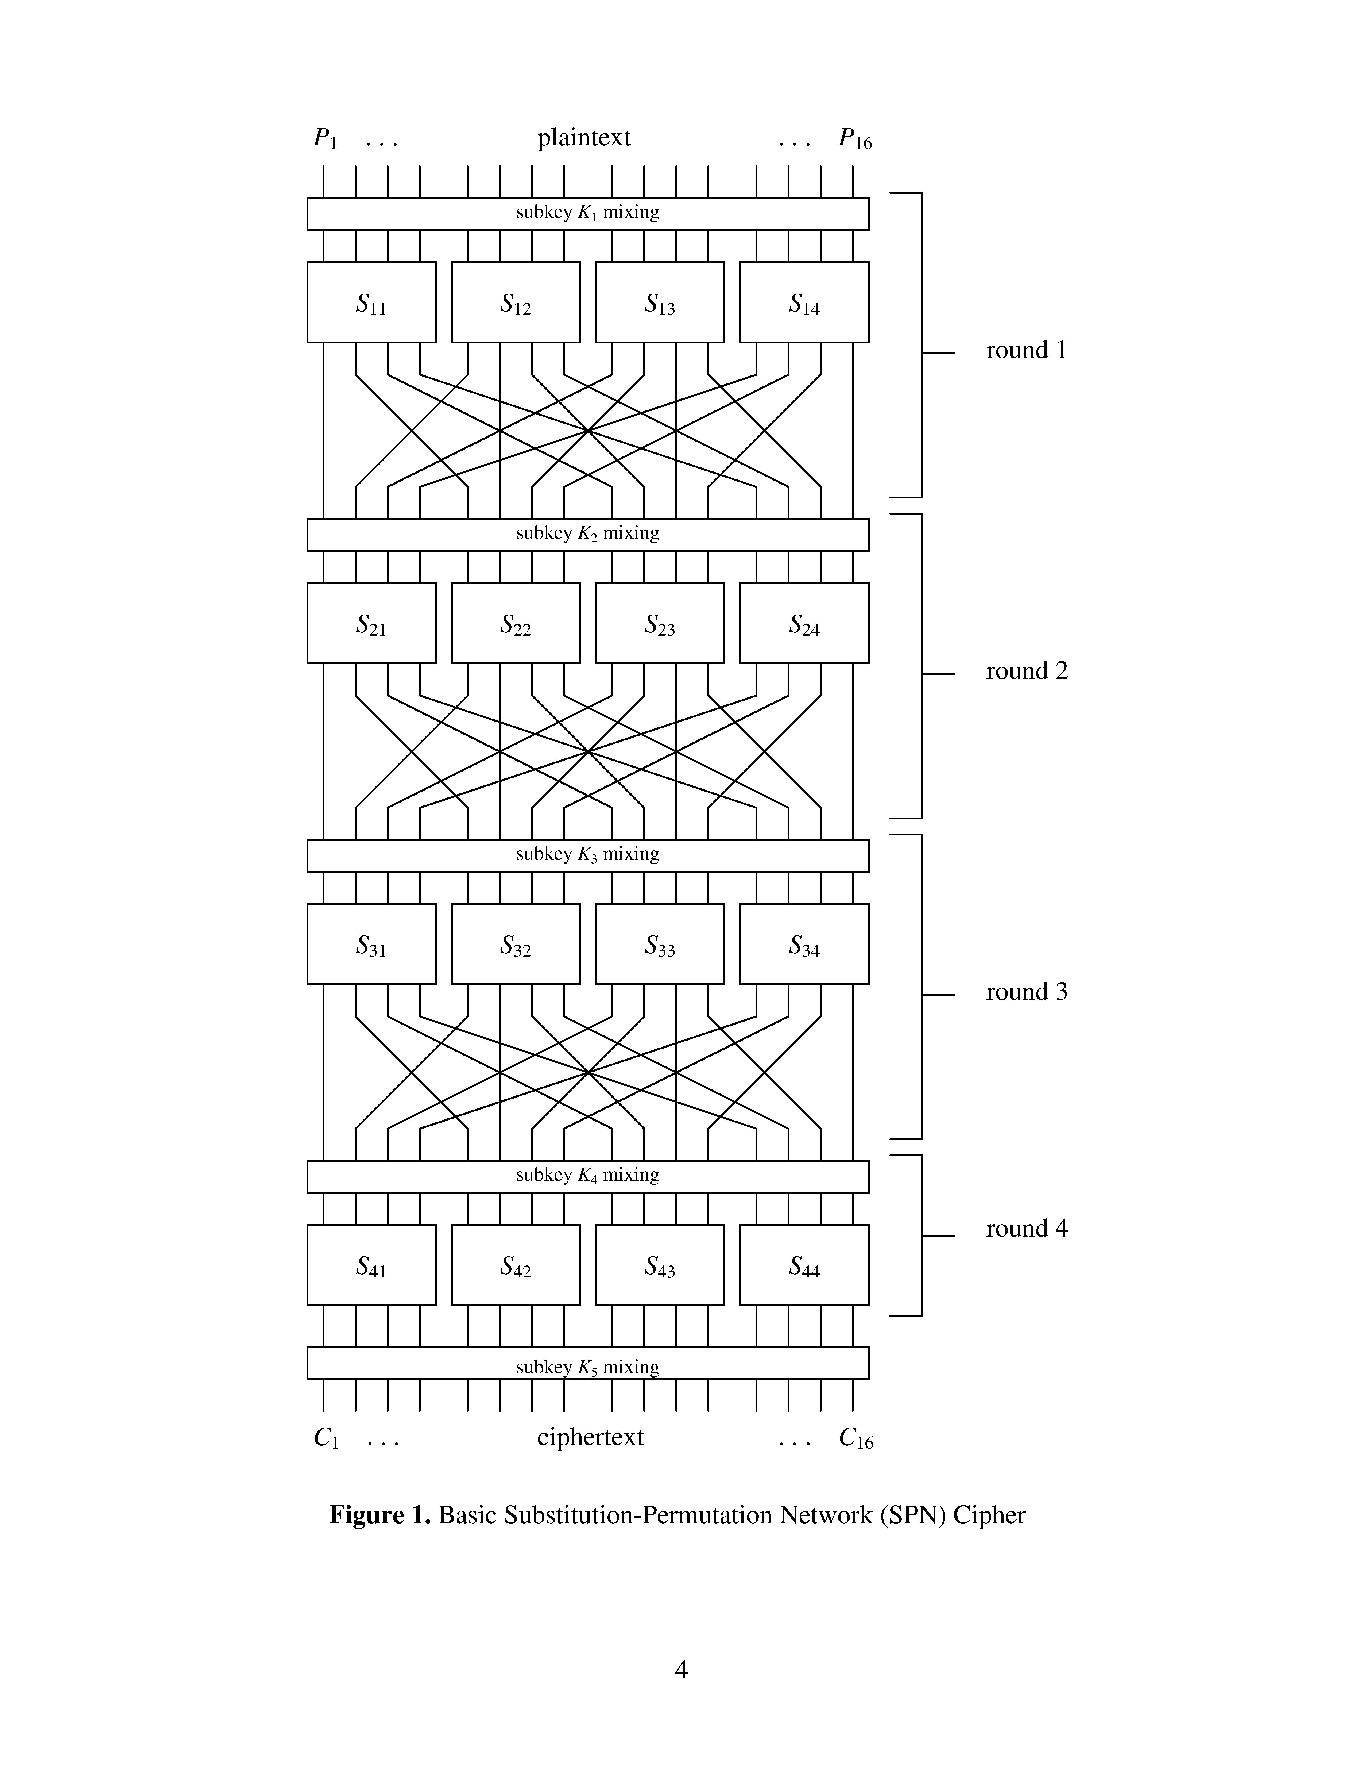
4 Rounds
From: Heys’ paper, Figure 1
Inversion: No permutation before mixing

Slide 10
Example Encryption and Decryption

Slide 11
General Iterated Block Cipher
Plaintext is divided into blocks of size n
A single key K is used to generate N_{r} keys: K⁽¹⁾, K⁽²⁾, … K^{(Nr)} through a key schedule
A round function, g, is used to repeatedly encrypt the plaintext N_{r} times, each time using a key generated by the key schedule

Slide 12
General Iterated Block Cipher: More Formally
P, C ∈ ∑^{n} where ∑ = {0, 1}
KeySchedule(K) = K⁽¹⁾, K⁽²⁾, … K^{(Nr)}
w⁰ ← P, plaintext
w¹ ← g(w⁰, K⁽¹⁾)
:
:
w^{i} ← g(w^{i-1}, K^{(i)})
:
w^{(Nr)} ← g(w^{(Nr-1)}, K^{(Nr)}) = C, ciphertext

Slide 13
Inverse of Iterated Block Cipher
The round function, g, should be invertible, i.e
∃ g⁻¹ such that g⁻¹ (g(x, K) K) = x
The decryption should be computed as follows:
w^{(Nr)} ← C, ciphertext
w^{(Nr-1)} ← g⁻¹(w^{(Nr)}, K^{(Nr)})
:
:
w^{i} ← g⁻¹(w^{i+1}, K^{(i+1)})
:
w⁽⁰⁾ ← g⁻¹(w⁽¹⁾, K⁽¹⁾) = P, plaintext

Slide 14
An SPN is an Iterated Block Cipher
g is the composition of a substitution, permutation and an XOR with the round key:
g(x, K) = π_{K°}π_{P°} π_{S}
Except for first and last rounds
where
π_{S} is the S-box – a look-up table/substitution cipher, taking l bits to l bits
π_{P} is a permutation taking n=lm bits to n=lm bits
π_{K} is a pad, taking lm bits to lm bits
There are m S-boxes in each layer, and a total of n=lm bits in each block

Slide 15
An SPN is an Iterated Block Cipher
π_{S} : {0, 1}^{l} → {0, 1}^{l} S-box
X = (x₁ x₂ .. x_{m} ) where x_{i} ∈ {0, 1}^{l}
is transformed to (π_{S}(x₁) , π_{S}(x₂) , … π_{S}(x_{m}))
π_{P}: {0, 1}^{lm=n} → {0, 1}^{lm} permutation
π_{K} : {0, 1}^{lm} → {0, 1}^{lm} pad

Slide 16
In the textbook
Both π_{S} and π_{P} are referred to as “permutations” The author means that both of these permute the elements of the set of all possible inputs, i.e. they are both one to one functions.
However, π_{P} scrambles the bits, and is hence a permutation of the bits themselves, while π_{S} is a substitution.
Hence for a b-bit input string, π_{S} is defined by 2^{b}-1 values, while π_{P} is defined by b values

Slide 17
An SPN is an Iterated Block Cipher
E_{K} (x) =
_{KNr °} π_{S} °(π_{KNr-1°}π_{P°} π_{S} ) ° … °(π_{K2°}π_{P°} π_{S} )(π_{K1°}π_{P°} π_{S} )° π_{K0}
In general,
u^{i} is the input to the i^{th} layer of S-boxes,
v^{i} the output, and
w^{i} the output of the i^{th} permutation layer

Slide 18
One round of DES: Feistel Cipher
Equal length
L^{i-1}
R^{i-1}
f
K^{i}
L^{i} = R^{i-1}
R^{i} = L^{i-1}⊕f_{Ki}(R^{i-1})

Slide 19
Feistel Cipher Inverse
L^{i} = R^{i-1}
R^{i} = L^{i-1}⊕f_{Ki}(R^{i-1})
R^{i} = L^{i-1}⊕f_{Ki}(R^{i-1})
L^{i} = R^{i-1}
f
K^{i}
R^{i-1}
L^{i-1}

Slide 20
Block Ciphers Standards: AES and DES

Slide 21
AES
Chosen for security, efficiency, implementation
Key lengths:
128 bits (10 rounds)
192 bits (12 rounds)
256 bits (14 rounds)
Consists of: XOR with key, S-box substitution, permutation, mixcolumns

Slide 22
High-level AES (all byte operations, 1 round shown)
XOR with key
S-box is an algebraic operation
S-box
Shift Rows
Mix Columns

Slide 23
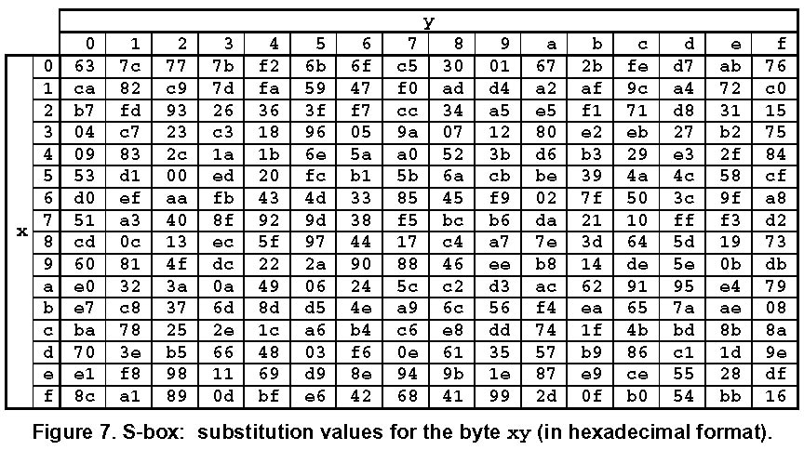
AES S-box
Cut and paste From: Federal Information Processing Standards Publication 197
November 26, 2001
http://csrc.nist.gov/publications/fips/fips197/fips-197.pdf

Slide 24
AES S-box is an algebraic operation
Treat 8-bit input to S-box as a polynomial of degree 7
Find inverse of the polynomial in the field of polynomials over Z₂ such that x⁸ + x⁴ + x³ + x¹ + 1 = 0
This gives 8 bits, say a₇ a₆ a₅ a₄ a₃ a₂ a₁ a₀
The output is 8 bits: b₇ b₆ b₅ b₄ b₃ b₂ b₁ b₀
Such that b_{i} = a_{i} ⊕ a_{i+4} ⊕ a_{i+5} ⊕ a_{i+6} ⊕ a_{i+7} ⊕ c_{i}
For some constant vector c = c₇ c₆ c₅ c₄ c₃ c₂ c₁ c₀

Slide 25
Shift Rows
Plaintext consists of 16 bytes for block size 128
x₀ | x₄ | x₈ | x₁₂
x₁ | x₅ | x₉ | x₁₃
x₂ | x₆ | x₁₀ | x₁₄
x₃ | x₇ | x₁₁ | x₁₅
x₀ | x₄ | x₈ | x₁₂
x₅ | x₉ | x₁₃ | x₁
x₁₀ | x₁₄ | x₂ | x₆
x₁₅ | x₃ | x₇ | x₁₁

Slide 26
Mix Columns
a | b | c | d
x₀ | x₄ | x₈ | x₁₂
x₅ | x₉ | x₁₃ | x₁
x₁₀ | x₁₄ | x₂ | x₆
x₁₅ | x₃ | x₇ | x₁₁
(Aa)₀ | (Ab)₀ | (Ac)₀ | (Ad)₀
(Aa)₁ | (Ab)₁ | (Ac)₁ | (Ad)₁
(Aa)₂ | (Ab)₂ | (Ac)₂ | (Ad)₂
(Aa)₃ | (Ab)₃ | (Ac)₃ | (Ad)₃
Multiplication by A is a multiplication in the finite field of polynomials described earlier, and not a regular multiplication

Slide 27
Key Schedule
A key is 4 words; each word is 4 bytes
The key has to generate 10 other keys to get a total of 11 for a 10-round AES
The 11 keys are represented by 44 words:
w[0, ..43]

Slide 28
Algorithm 4.6 in the book
First 4 words = given key;
i.e. first round key = given key
for i=0 to 3
w[i] = (key[4i], key[4i+1], key[4i + 2], key[4i +3])
Thereafter, if word is not first word in key, i.e. i ≠ 0 mod4
word = corresponding word in previous key ⊕ previous word
w[i] = w[i-4]⊕w[i-1]

Slide 29
When word is first word of key
word = first word of previous key ⊕ stuff
w[i] = w[i-4]⊕SUBWORD(ROTWORD(w[i-1])⊕Rcon[i/4]
SUBWORD: AES S-box to each byte
ROTWORD: rotate word to left
Rcon: constant array of 10 words
CS284-162/Spring10/GW/Vora/Block Ciphers. Some figures and accompanying text from Heys

Slide 30
One round of DES: Feistel Cipher
Equal length
L^{i-1}
R^{i-1}
f
f
K^{i}
L^{i} = R^{i-1}
R^{i} = L^{i-1}⊕f_{Ki}(R^{i-1})

Slide 31
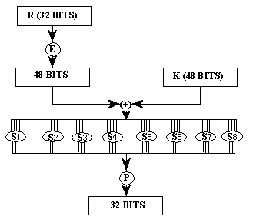
f in DES
Diagram from: FIPS PUB 46-2, 30 Dec 1993, http://www.itl.nist.gov/fipspubs/fip46-2.htm
Expansion
Input 6 bits
Output 4 bits
permutation

Slide 32
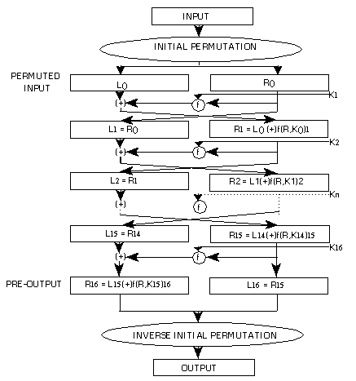
Diagram from: FIPS PUB 46-2, 30 Dec 1993, http://www.itl.nist.gov/fipspubs/fip46-2.htm

Slide 33
Block Cipher Modes as originally developed for DES
Electronic Codebook (ECB) Mode
Regular, each 64-bit plaintext encrypted with the same key
Cipher Block Chaining (CBC) Mode
64-bit ciphertext XORed with next plaintext, then encrypted
y_{i} = e_{K}(y_{i-1}⊕ x_{i})
Stream Cipher Modes: y_{i} = x_{i} ⊕ z_{i}
Output Feedback (OFB) Mode: z_{i} = e_{K}(z_{i-1})
Cipher Feedback (CFB) Mode: z_{i} = e_{K}(y_{i-1})

