Slide 2
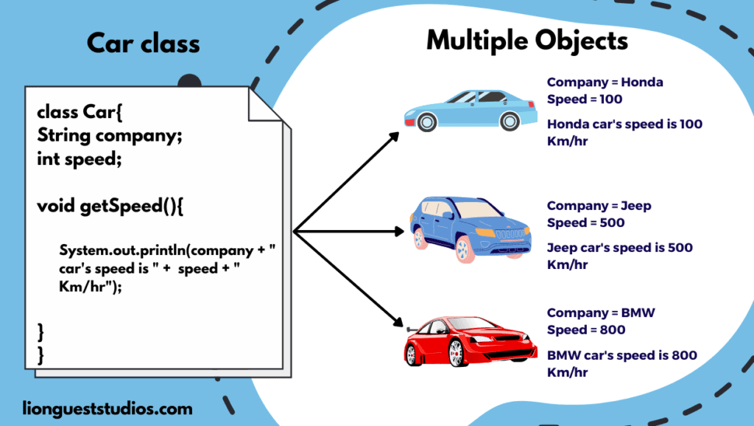
Unit 2 Overview
Object-Oriented Programming (OOP): A core feature of Java, which you can created digital blueprint called classes for various things, such as cars, bank account etc. An object is an instance of a class.
Classes: A template or blueprint
Objects: Instances of a class

Slide 3
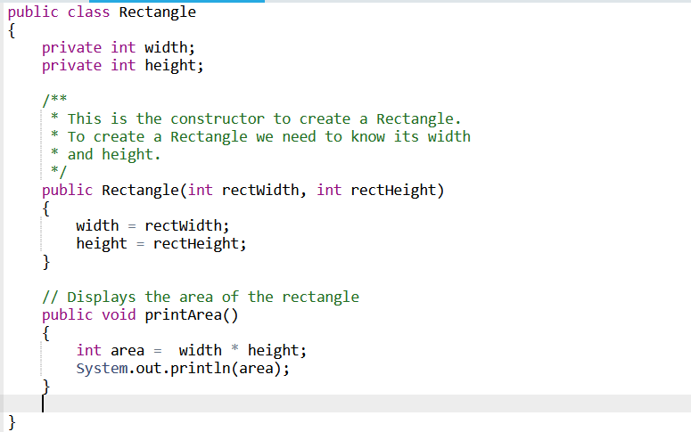
Class Structure
A class consists of:
State (Instance Variables)
Constructor (Initialize state value)
Behavior (methods)

Slide 4
2.2 Creating and Storing Objects
Class: A template or blueprint
Objects: Instance of a class

Slide 5
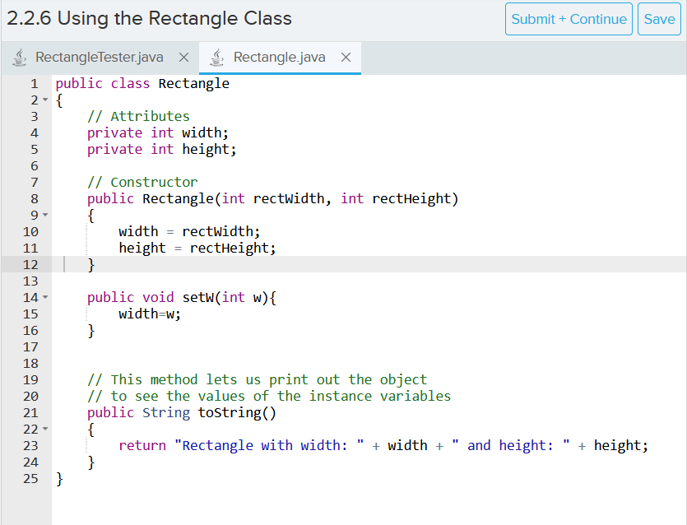
Class Structure
A class consists of:
State (Instance Variables)
Constructor (Initialize state value)
Behavior (methods)

Slide 6
Key things to remember:
Class name must match file name
Constructor name must match class name, all instance variables should be initialized with a value
toString method is used to print out the desired information about the current object

Slide 7

How to instantiate Object

Slide 8
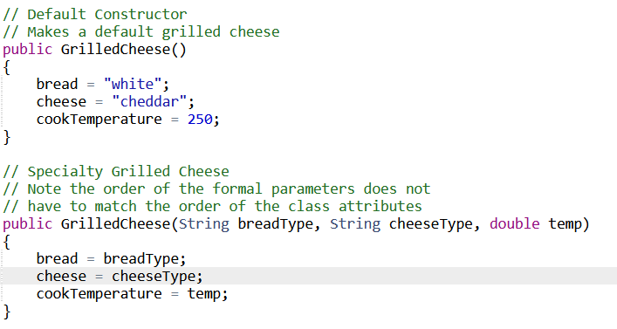
2.3 Method Overloading
Overload means having multiple constructors with the same name but different parameters
Gives more freedom to object declaration, makes code writing more convenient

Slide 9
Memory Storage
Primitive Types (int, double, char, Boolean) stores the exact value
Reference Types (classes) stores the address
null means the absence of an object
Example:
int a=5;
rectangle r1=new rectangle(5,10);
rectangle r2= null;
Address
Data
x01
a | 5
r1 | x05
R2 | null
x02
x03

Slide 10
2.4 Calling a void method
A class consists of:
State (Instance Variables)
Constructor (Initialize state value)
Behavior (methods)

Slide 11

How to write a method

Slide 12
How to call a method
Call methods using objectName.methodName()
Ex: Rectangle r1 = new Rectangle(10, 2);
r1.printArea();

Slide 13

2.5 Calling a void method with parameter

Slide 14
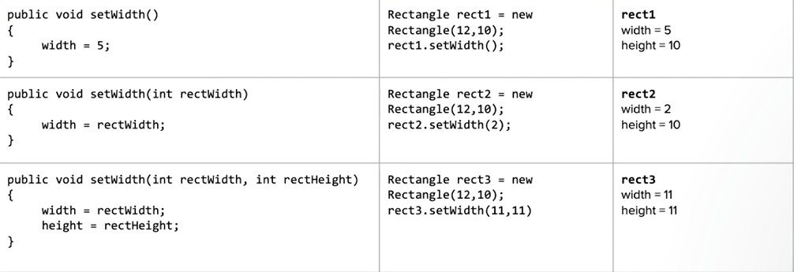
You can also overload method
You could have multiple methods with the same name but different parameters, just like constructors

Slide 15
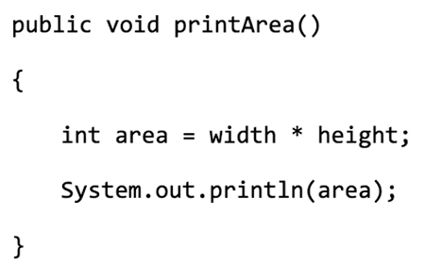
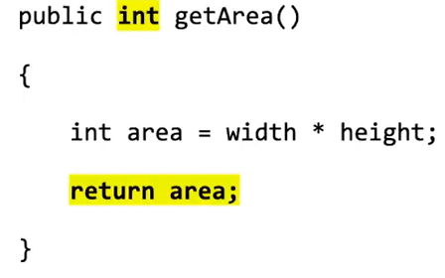
2.6 Calling a non-void method
Non-void method are method that return something, often the answer from the computation carried inside the method
A void method is like a command, it executes, but then do not give an answer back
A non-void method is like asking a question, it executes, and then give an answer back

Slide 16
Why is non-void method useful?
It keeps the result from the method call, and you can create a new variable to store it.
Ex. Rectangle r1 = new Rectangle(4, 8);
int area = r1.getArea();

Slide 17
What happens if you do not use non-void method?
You only get to see the result, but you can never use it elsewhere
Ex. Rectangle r1 = new Rectangle(4, 8);
r1.printArea();

Slide 18
Key things to remember when declaring non-void method
1. Must return
2. Return type must match

Slide 19
2.7 String Object
Revisiting String variable definition: String s1=“Monday”
You can also write as: String s1=new String(“Monday”)

Slide 20
String Immutability
Immutable means “cannot be changed”
Strings are immutable, meaning once they are created, they cannot be changed, but only reassigned
Example
String fName=“Siwen”
fName + “ Wang”

Slide 21
String Concatenation
Simple Case:
String fName=“Siwen ”
String lName=“Wang”
String fullName=fName+lName
Slightly complicated case:
String fName=“Siwen”
int age=26
System.out.println(fName+” is” + age)
Exam Question:
String fName=“Siwen”
int age =14
int age2 = 12
System.out.println(fName+” is ” + age + age2)
Notes:
2.7.4

Slide 22
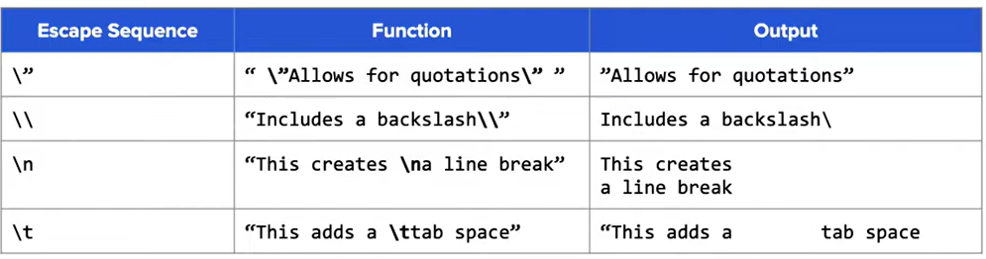
Use Escape Sequence (\) to type special letters
Notes:
2.7.4

Slide 23
2.8. String Methods
Strings are Object, so they also have methods
Introducing Java Quick Reference Sheet

Slide 24
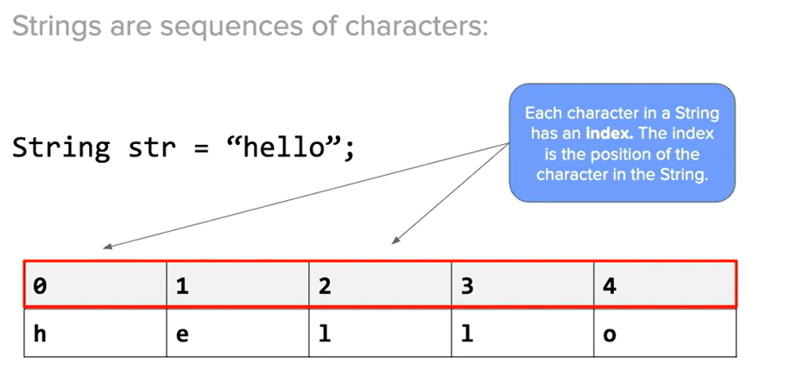
String Index
Strings are sequence of characters
You can use the .charAt(int index) method to extract characters from String, the return type is char
For example:
String str = “hello”;
char l=str.charAt(1);

Slide 25
Common String Methods to Know
String s1=“hello”
s1.length() returns the number of character in the string as int
s1.substring(2,5) returns substring from index 2 and ending at 4
s1.substring(1) returns the substring from index 1 to the end
s1.indexOf(“e”) returns the index of the first occurrence of “e”, returns -1 if not found
s1.equals(“helo”) returns true if s1 is equal to “helo”, false otherwise
s1.compareTo(“helo”)

Slide 26
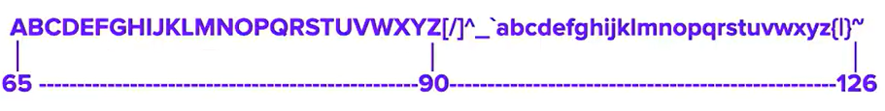
compareTo()
compareTo() compares the value of the first character that NOT equal in both strings. It returns a numeric value based on the comparison
Example:
int value = “D”.compareTo(“d”);
int res = “Karel”.compareTo(“Karen”);
Notes:
-32
-2

Slide 27
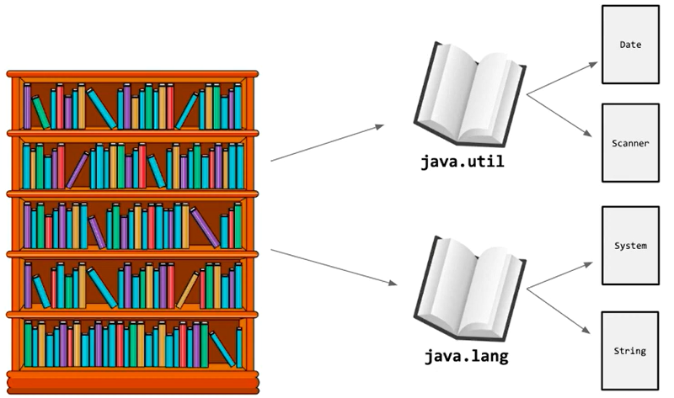
Where did the String class come from?
Package
Library
Classes
Notes:
2.8.6 show import scanner

Slide 28
API (Application Programming Interface)
API is a set of instruction on how to use the class, it allows us to use the class and methods without knowing how its implemented by reading the documentations
Example:
Search “Java String class API”

Slide 29
2.9 Wrapper Class
int, double are called primitive types
Integer and Double are its corresponding wrapper class, which are reference types (objects)
The “only reason that you are learning this wrapper class is that in the future we will learn a new data structure which only takes in reference types

Slide 30
Key Takeaway
In most scenarios, especially in computation, you can treat Double & double, Integer&int as the same thing due to autoboxing and unboxing
The exceptions are:
1. You cannot call methods from a primitive type, autoboxing will not happen here
int x=5
int y = x.intValue()
2. You cannot directly typecast on the wrapper class
Double x=5.5;
int y = (int) x;

Slide 31
2.10 Using the Math class
Non-static method: This is what we have learned so far. First create an object, then call the method on the object. For example:
Rectangle r1=new Rectangle(3,4);
int x=r1.getWidth();
Static method: Static methods are methods in Java that can be called without creating an object, you can call the method on the class name.
double x=Math.random()

Slide 32
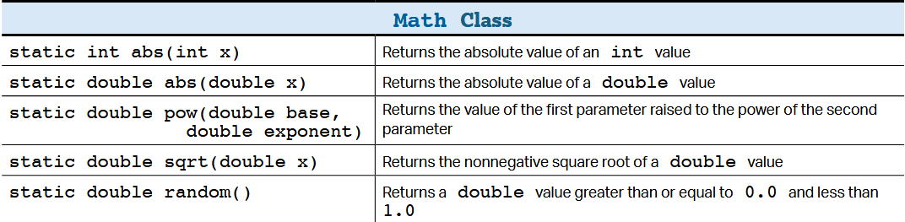
The Math class methods

Slide 33
Small Exercise: Generating a random int between 0 to 5
Math.random() returns a double greater or equal to 0.0, but less than 1.0
What would be the range of values if we do Math.random() * 5?
How do we convert the value from a double to int?
Now how do we fix the off-by-one error?
Finally, the formula to generating an int from range 0 to x:
(int) (Math.random() * (x+1))

Slide 34
Now what if we want to generate int numbers from any range between x (min) and y (max)
(int)(Math.random() * (max - min + 1)) + min;
Try the example: [2,4] and see if it works

