Slide 2
3.1 Boolean Expressions
boolean: true/false

Slide 3
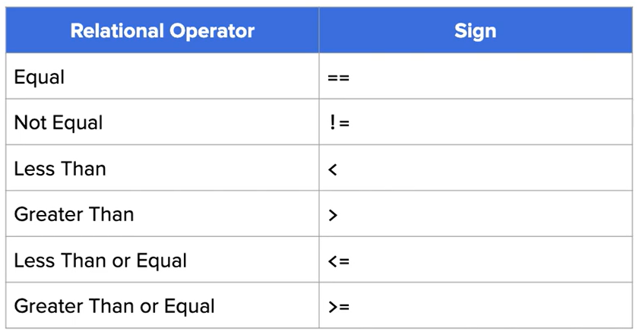
Relational operators

Slide 4
Examples of using relational operators
boolean x = 5 == 5;
char y = ‘A’;
boolean z = y == ‘A’;
Notes:
True
True

Slide 5
You cannot directly compare objects using relational operators
String x = new String(“xyz”);
String y = new String(“xyz”);
boolean z = x == y;

Slide 6
3.2 If statement and Control flow
“if statement” allows you selectively execute blocks of code based on the result of the Boolean expression

Slide 7
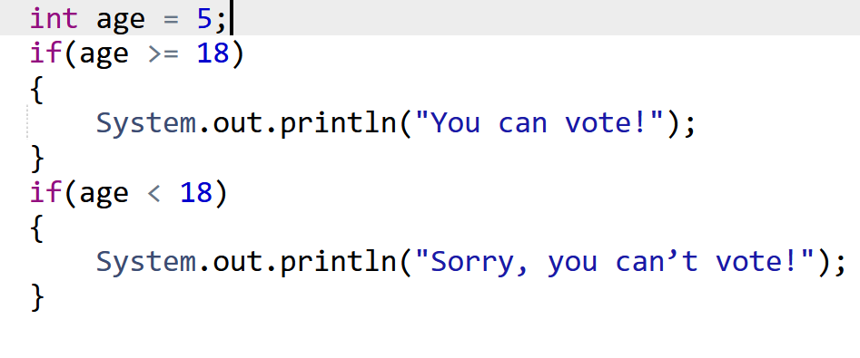
Example of Execution

Slide 8
3.3 if-else statements
If-else statements allow you to efficiently represent cases which there are only two possible outcome:
Even or odd
Pass or fail
…

Slide 9
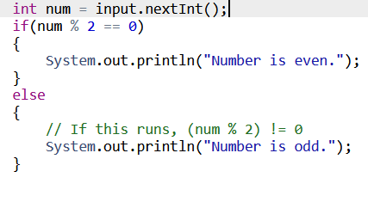
Example of Execution

Slide 10
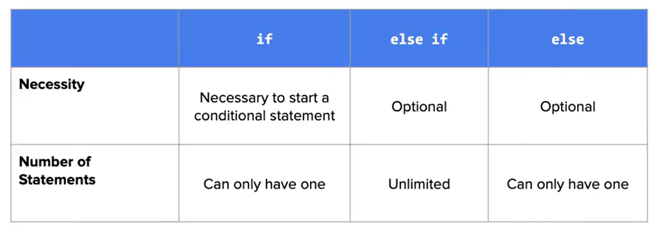
3.4 Else-if Statements
If-Else statements only let you represent two possible scenarios, however if you have more than two possible outcomes, the else-if statements allow you to represent that

Slide 11
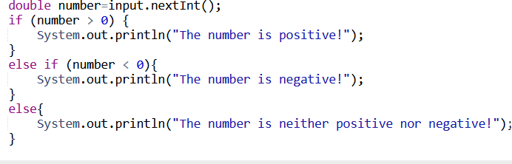
Example of Execution (positive, negative and 0)

Slide 12
Key difference between consecutive if statements and if, else-if statements
Open PDF

Slide 13
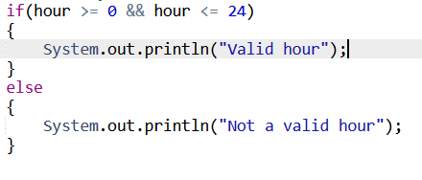
3.5 Compound Boolean Expression
We can make decisions based on multiple conditions by using logical operators
&& (and)
|| (or)
! (not)

Slide 14
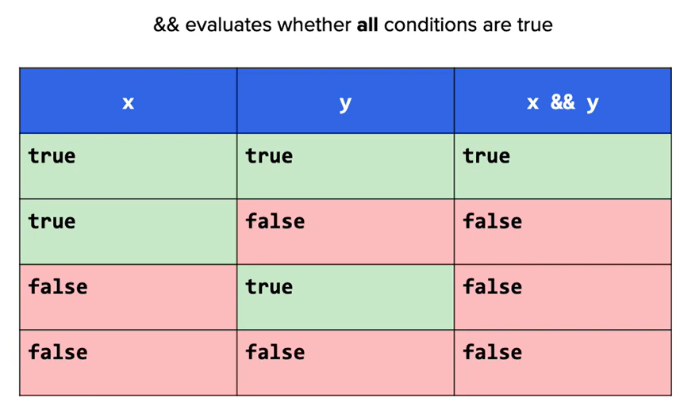
The && (and) Operator

Slide 15
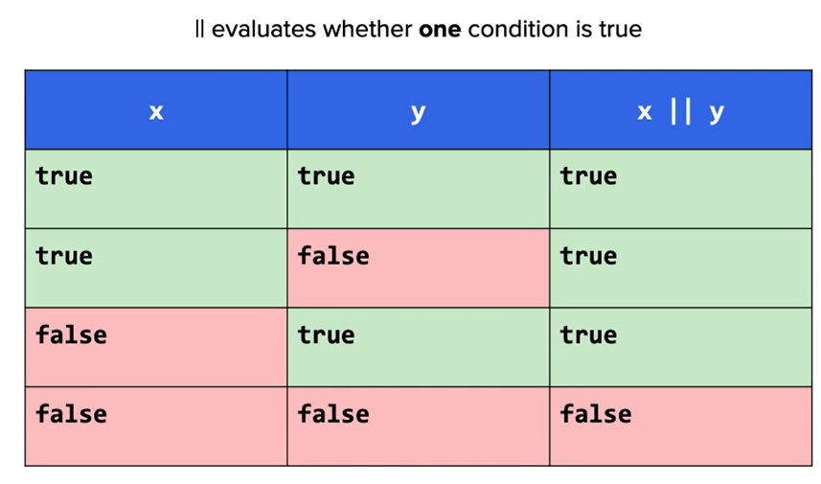
The || (or) Operator

Slide 16
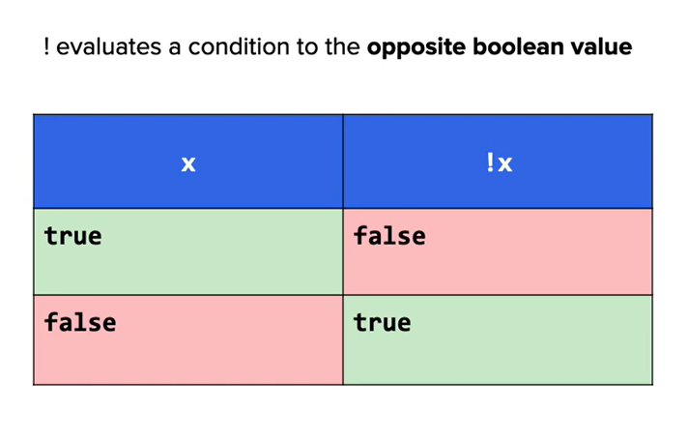
The ! (not) Operator

Slide 17
Operator Precedence
The order of precedence for evaluating logical operators is:
!
&&
||
First, evaluate !(not), then && (and), finally || (or)

Slide 18
Operator Shortcut
(X && Y) If X is false, then the whole expression must be false, the result of Y is never evaluated
(X || Y) If X is true, then the whole expression must be true, then result of Y is never evaluated

Slide 19
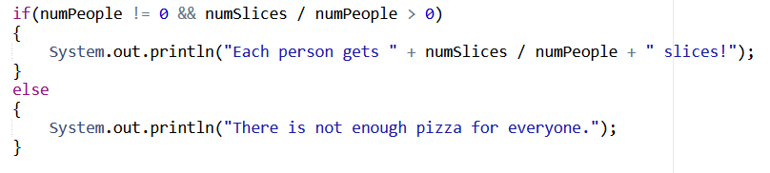
Example of Execution (Operator Shortcut)

Slide 20
3.6 Equivalent Boolean Expressions
Last time: Logical operators (&&,||,!)

Slide 21
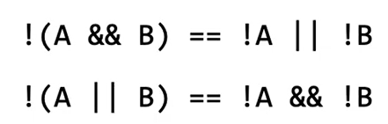
Demorgen’s Law
Hardware: Demorgen’s Law helps to simplify physical circuits by reducing number of transistors used
Software: Demorgen’s Law makes the code more readable and clean in some cases

Slide 22
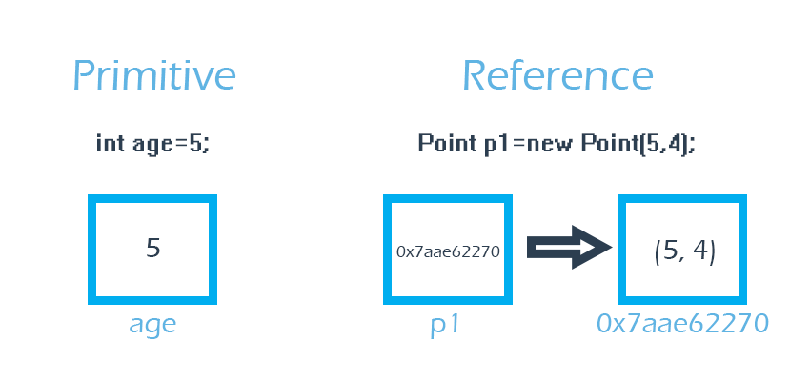
3.7 Comparing Objects
Primitive Types: Store by value
Reference Types: Store by address

Slide 23
Summary for comparison
To compare primitive types, you can directly use “==“
To compare objects of the String class, you need to use .equals()
To compare objects of other class, you need to write your own .equals() method before using it

Slide 24
The null comparison
null is a special phrase that indicates the absence of an object reference
You can compare the current object directly with null using “==“ to verify that it is not empty

Slide 25
Example of Execution 3.7.7

