Slide 2
4.1 Iteration
By using iteration, we avoid writing repetitive code, and by combining with conditional (if) statement, we can achieve more complex logic
Ex. Guess the number game
Notes:
https://www.mathsisfun.com/games/guess_number.html

Slide 3
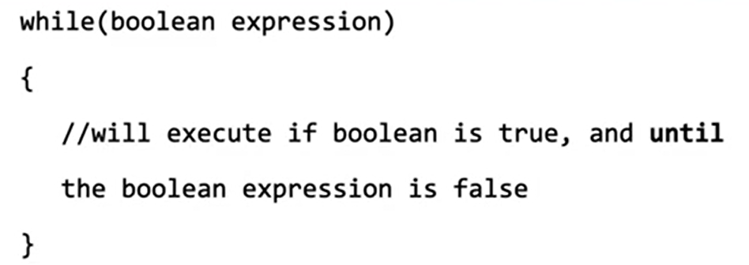
While-loops

Slide 4
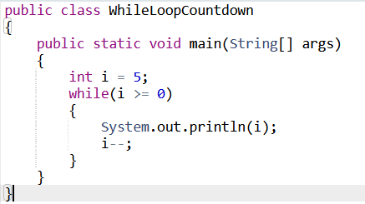
Example of Execution

Slide 5
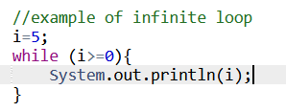
Avoid Infinite loops!

Slide 6
4.2 For Loops
There are two ways of implementing iteration statement:
While loops (4.1)
For loops

Slide 7
Recap: While loops

Slide 8
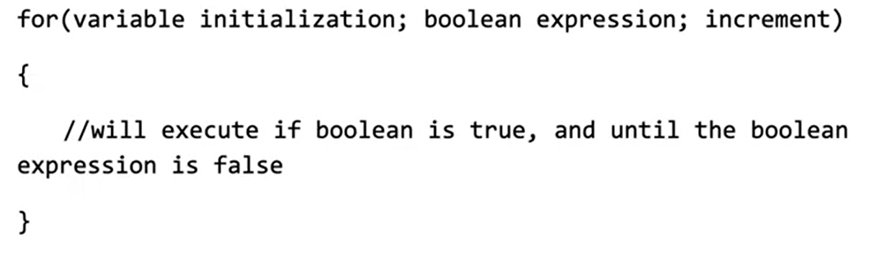
For Loops

Slide 9

Example of Execution

Slide 10
When should you use while loops and for loops?
Usually, you use while loops if you do not know in advance how many times the loop will execute
When you write for loops, you know exactly how many times it will execute because the conditions has already been defined before execution

Slide 11
4.3 Developing Algorithms Using Strings

Slide 12
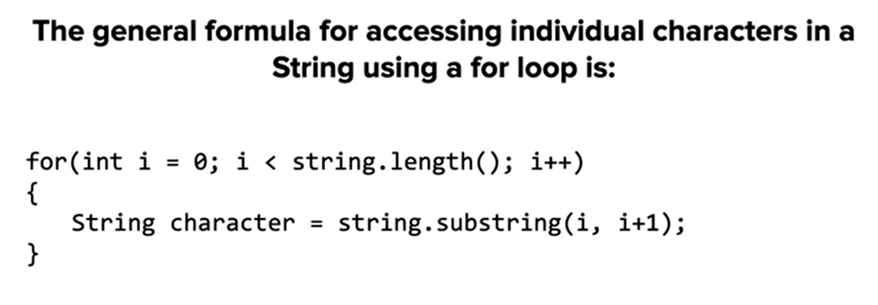
String Traversal (replace, find etc.)

Slide 13
Example Problem 4.3.6 Replace Letter – Problem Solving Process
Step 1: Read and understand the assignment
replaces all except the first instance of one letter with another
Modify the replaceLetter method
Step 2: Formulate a plan in your head
I probably should use a loop to iterate though the given string, then I need to use if to check whether the letter matches the letter to place
How can I modify the original String since strings are immutable? Em...Maybe I should probably create a new one
Then finally, how do I keep the first one, I will need some mechanism to check whether the letter appears the first time, maybe a counter would do?
Step 3: Turn your plan into Code
Step 4: Run and Debug
Step 5: Check Code

Slide 14
4.4. Informal Run-time Analysis
Algorithms: A step-by-step process to solve a problem
Correctness
Efficiency
Readability

Slide 15
Algorithm Efficiency
Running programs take CPU time, which often is positively correlated cost. Thus, we prefer algorithms that gives correct answer and use the least time.
To quantify how efficient the algorithm is, we use a simple metric called execution count. Generally speaking, the algorithm that has less execution count is more efficient

Slide 16
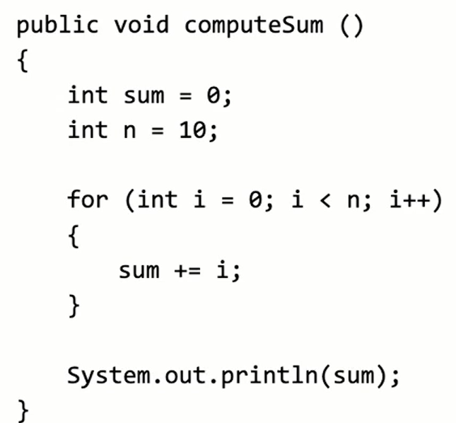
Example of Execution count

Slide 17
See Practice Midterm Q9

