Slide 2
A slightly modified Homework Policy
More strict deadlines
Late work will be accepted before the unit test, but will receive 50% off
However, you will have longer time working on your homework

Slide 3
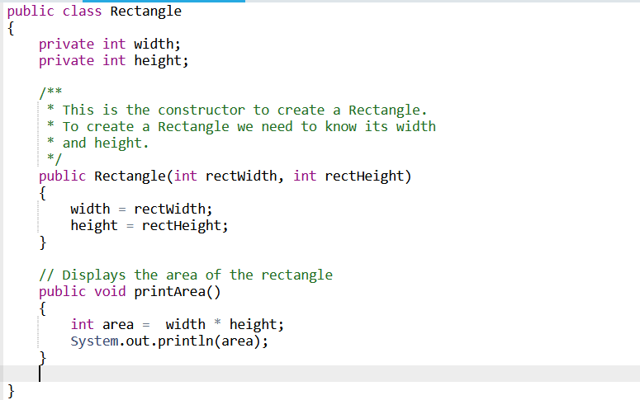
5.1 Anatomy of Classes
A class consists of:
State (Instance Variables)
Constructor (Initialize state value)
Behavior (methods)

Slide 4
Access Specifier
Public: allows access from classes outside of the declaring class
Private: can only access within the class

Slide 5
Encapsulation v.s. Abstraction
Abstraction: hiding the detail of how something works. For example, methods are ways of abstraction, and to use it, you can just read the description
Encapsulation: strategically using access specifier to decide access scope, hides implementation detail from the user. For example, you can choose to declare your instance variables private because you do not want users accidentally change it

Slide 6
Why do we need encapsulation? Why can’t all methods and variables be public?
Suppose you are developing a platform for a bank
Things we want users to control (public methods):
Deposit
Withdraw
View transaction history
But there are also things we don’t users to control or change (private method)
Interest rate

Slide 7
Accessor and Mutator Methods
We write specific methods to users to access and modify data
Methods to access private instance variables are called the Accessor (getter) methods
Methods to modify private instance variables are called the mutator (setter) methods

Slide 8
5.2 Constructors (Advanced)

Slide 9
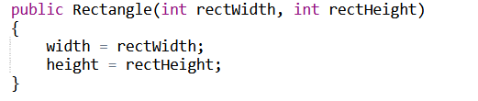
Recap: Constructors (basic)
Constructors are used to set the initial value of the instance variables

Slide 10
Default Constructor
If you do not define a constructor, Java will create one for you with default values:
int:0
double: 0.0
String: null
boolean: false
However, if you created any constructor, Java will not create the default no-argument constructor for you
Notes:
5.3.4

Slide 11
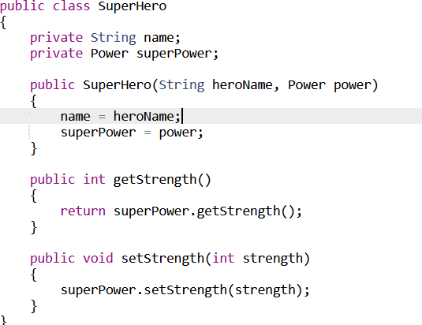
Using Objects as instance variables
You can also use objects as instance variables
However, you must be very careful with the declaration

Slide 12
Let’s illustrate the problem of writing “superpower = power” with an example
5.2.3 superheroTester

Slide 13
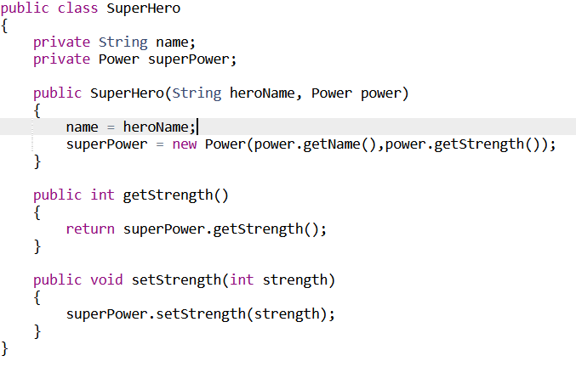
The correct way to initialize objects with value in constructors
By creating a new power object, it makes sure that each superhero object has independent Power linked to it

Slide 14
5.3 Documentation with Comments
Comments: allows us to tell other people what the program does, so it’s easier to read and understand. You can also use comments to debug code
// single line comments
/* Multi-Line comments */
/** Javadocs Documentation */

Slide 15
Vocabulary
Precondition: Conditions that must be true prior to the execution in order for the code to behave as expected
Postcondition: Conditions that must be true after the execution is executed, often describing the outcome which the method should return
Notes:
5.3.4

Slide 16

5.4 Accessor Method
Accessor Method (getter) is used to extract the value of the private instance variables, it has a return type

Slide 17
One one little thing to be careful with
If your return type is an object, it returns a reference, NOT a new copy
5.4.4

Slide 18
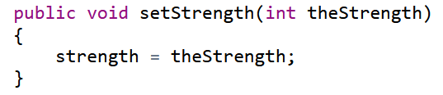
5.5 Mutator Method
Mutator (setter) methods are used to set the value of instance variables, they are often void methods

Slide 19


5.6 Writing Methods
Void Method
Non-void Method

Slide 20
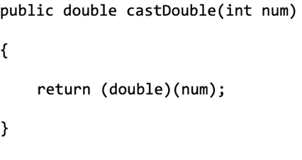
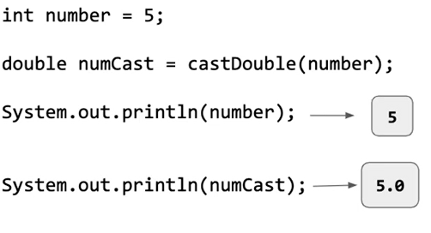
Primitive Parameters
When you pass in a primitive parameter to a method, it creates a new copy, thus does NOT change the original parameter

Slide 21
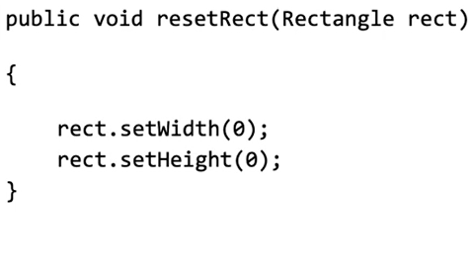
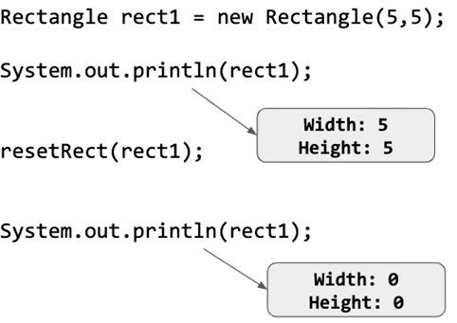
Reference Parameters
When the actual parameter passed in is a reference to the object, it creates a copy of that reference, not the copy of the object. Thus, it will modify the original object.

Slide 22

5.7 Static Variables and Methods
Static variables and methods belong to the class, you call a static method by using the class name, not the object name
For example: Math.random()
The getter and setter method for static variables should also be static

Slide 23
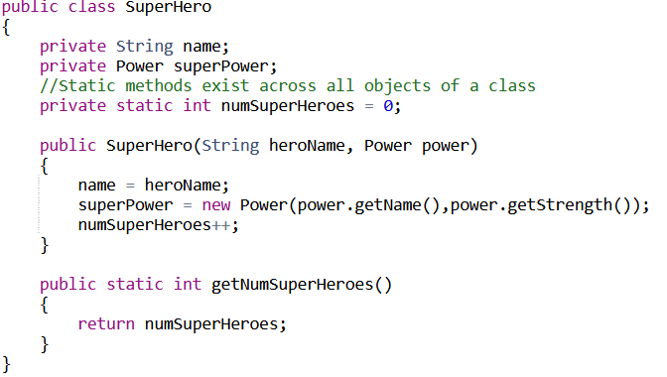
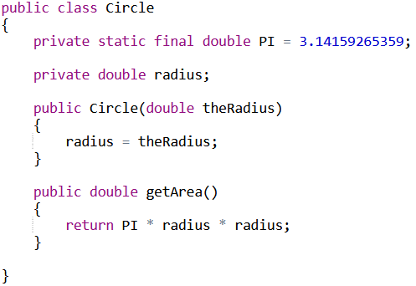
When might you want a static variable?
To keep a universal count of some variable
To define a variable that has the same value regardless of objects (pi)

Slide 24
When might you want a static method?
Helper and utility functions which does not depend on any specific object
Math.abs()
Math.sqrt()
The main method
public static void main(String[ ] args)

Slide 25

Method summary
Access specifier + static (optional) + return type + Method Name + (parameter) + {body}

Slide 26
5.8 Scope and Access
A {…}
If statement (1.1.3)
for loops (1.1.3)

Slide 27
Shadowing
If two variables with the same name inside the same scope: Variables with more specific scope takes precedence over the variable with more general scope
Example: 5.8.5

Slide 28
Problem Solving with Method decomposition
Method decomposition: The process of breaking down large problems into smaller subproblems by creating methods to solve each individual subproblem
Example: 5.7.6, 5.8.6

Slide 29
5.9.1 this Keyword
this refers to the current object
There are two scenarios which you need it:
You want to name your parameter the same name as your instance variable (5.9.3)
You are referring to the current object as a parameter to another method (5.9.7)

