Slide 1
Unit 6 Array

Slide 2
6.1 Array
Array definition: Stores a fixed number of elements of the same type

Slide 3

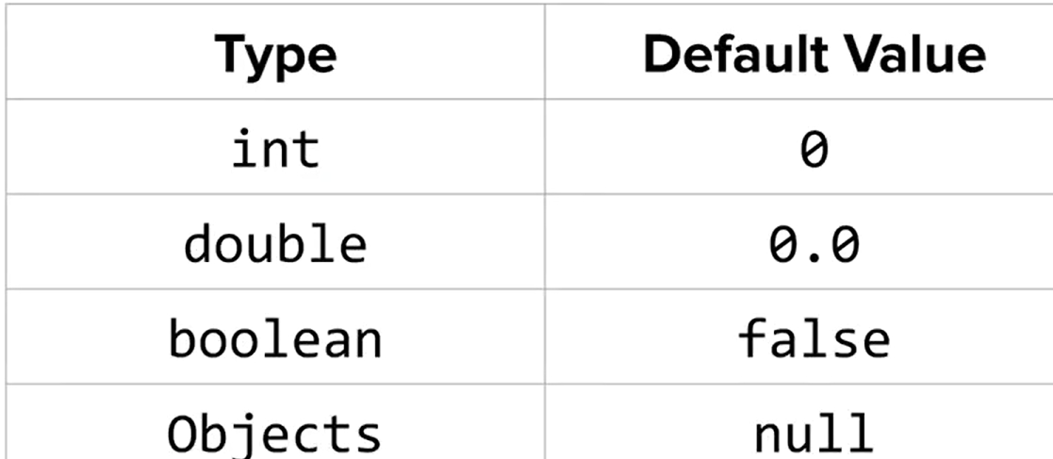
Array Initialization
With Default Value:
int[ ] arr1=new int[5]
With predefined Value:
Int[ ] arr2={2,3,4,5,6}

Slide 4
Get Value & Set Value for elements in an array
int[ ] scores = {80, 92, 91, 68, 88}
Get value: int a = scores[2]
Set value: scores[2]=55
Array index starts with 0!

Slide 5
Get length of Array
int[ ] scores = {80, 92, 91, 68, 88}
int len = scores.length

Slide 6
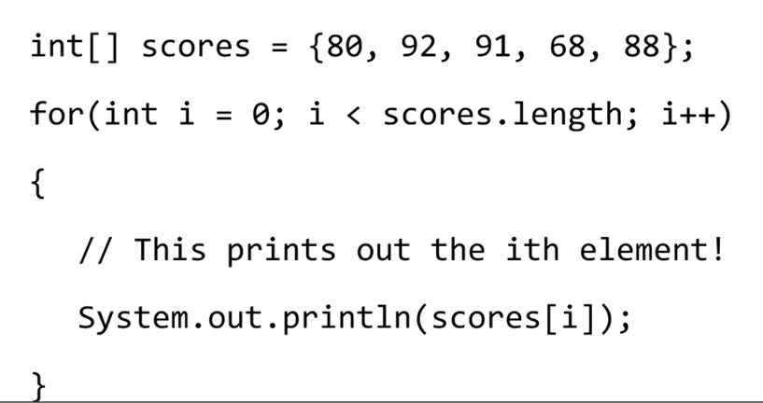
6.2 Array Traversal
Similar to String traversal, you need to use loops
Example with for loop

Slide 7
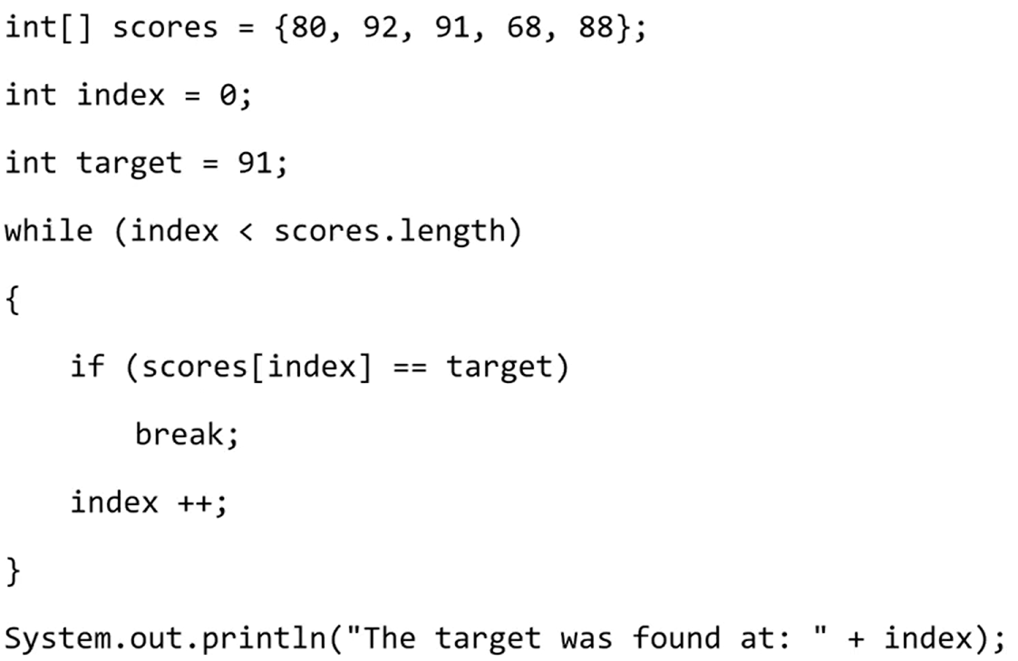
Another Example with while loop

Slide 8
6.3 Enhanced for loops
An enhanced for loop is an alternative method for array traversal
However, you can only access element using enhanced for loops, but cannot change any value.

Slide 9
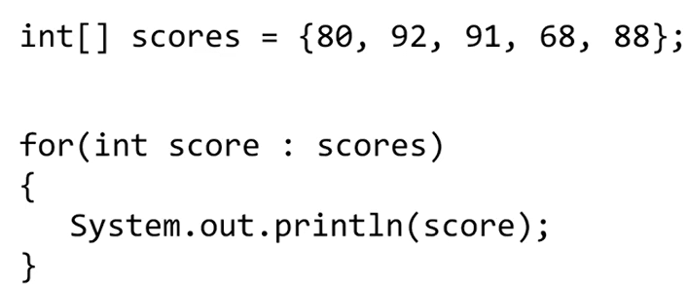
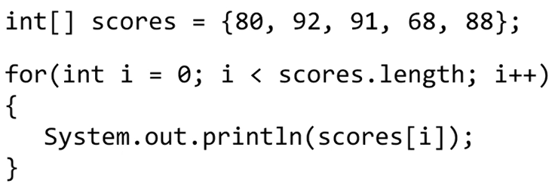
Traversal Example using regular for loop v.s. Enhanced for loops
Regular For loop
Enhanced For loop

Slide 10
A deeper look into limitation of enhanced for loop
Enhanced for loop cannot be used to modify the value of the original array
6.3.5

