Slide 2
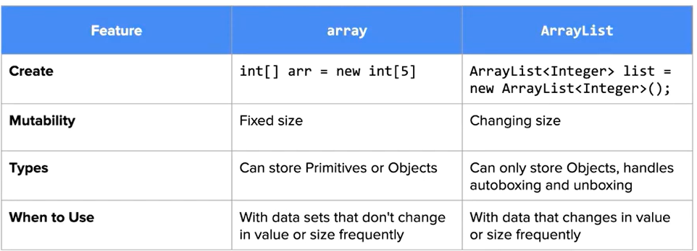
7.1 ArrayList
ArrayList is a mutable list of object references

Slide 3
7.2 ArrayList Methods
int size()
boolean add(E obj)
void add(int index, E obj)
E get(int index)
E set(int index, E obj)
E remove(int index)

Slide 4
CodeHS 7.2.4 arraylist method demo

Slide 5
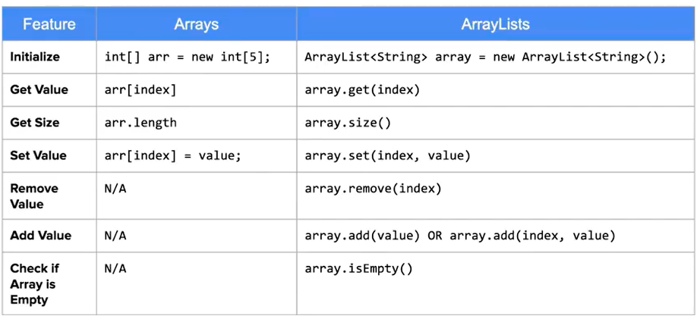
7.3 Traversing ArrayList
Array v.s. ArrayList Recap

Slide 6
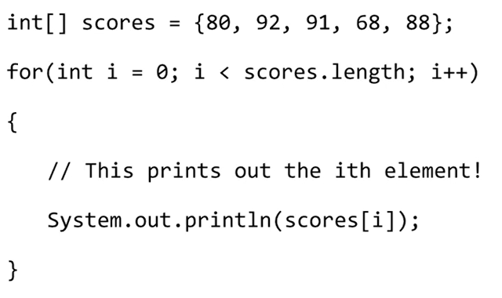
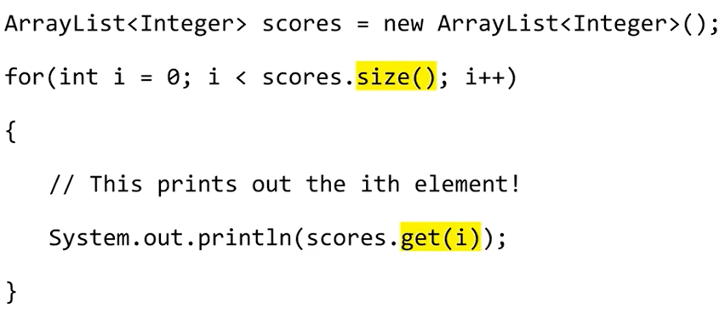
Array Traversal v.s. ArrayList Travsersal Regular for loop
Array Traversal
ArrayList Traversal

Slide 7
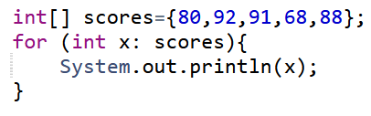
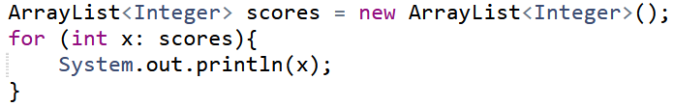
Array Traversal v.s. ArrayList Travsersal Enhanced for loop
Array
ArrayList
Exactly The same!

Slide 8
Be careful removing element from an ArrayList!
Example: Remove every value that is equal to 4 in the arraylist
7.3.4

Slide 9
7.5 Linear Search
[2,3,5,7,8,15,24,158,350,351,1000]
What is the index of 350 in the list? (index starts at 1)
How many numbers did you look through to get the correct answer?
Best case scenario: 1 operation
Average case scenario: 6 operations
Worst case scenario: 11 operations

Slide 10
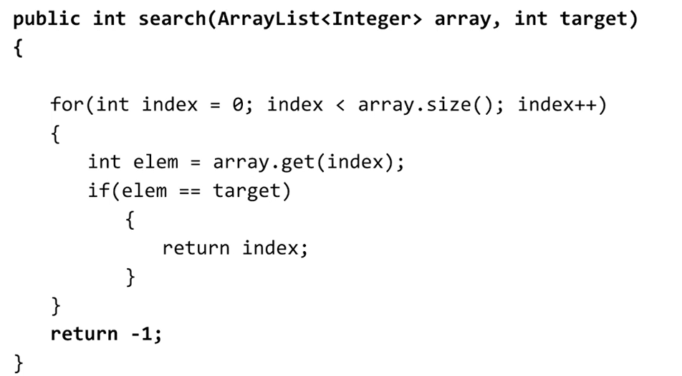
Linear Search for numbers

Slide 11
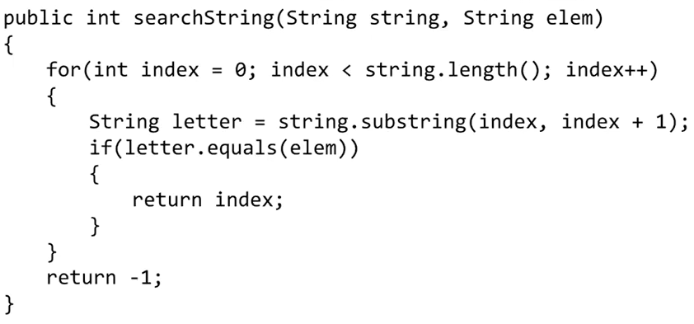
Linear Search for Strings

Slide 12
7.6 Sorting
Selection Sort
Insertion Sort

Slide 13
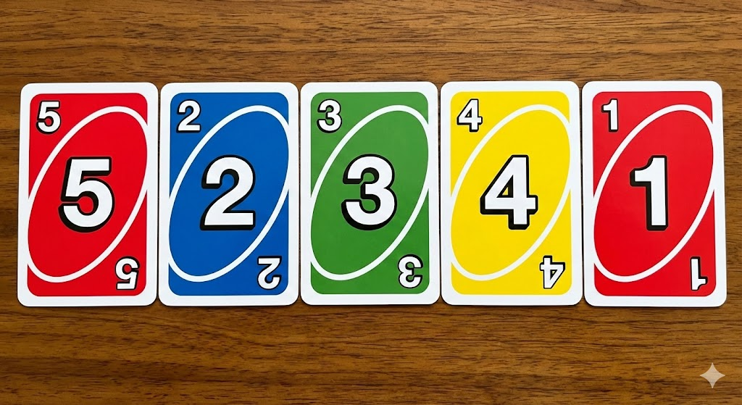
Selection Sort with Example
Number of Operations: n(n-1)/2
Always takes the same number of searches regardless whether the list is almost sorted or not

Slide 14
Insertion Sort
Number of Operations Best Case: n
Number of Operations Worst Case: n(n-1)/2
Best for almost sorted list!
Notes:
https://www.youtube.com/watch?v=TZRWRjq2CAg

Slide 15
Additional Material
static int parseInt(String s)
static double parseDouble(String s)
Ethical Issues & Dataset analysis (see curriculum)

