Slide 2
8.1 2D Arrays

Slide 3
2D Array Initialization
1. Initialize with preset values:
int[][] array = {{3,5,7,8,0}, {5,5,0}, {2,5,9,6,5}
2. Initialize with default values:
String[][] array = new String[2][5] //default is null for String array

Slide 4
2D Array modification
Modify the entire row
String[][] arr = new String[2][4]
String[] row1 = {“bishop”, “King”, “Queen”, “Knight”}
arr[0] = row1
Modify single element:
int[][] arr = new int[2][4]
arr[1][2] = 5;
row
column

Slide 5
Traversing 2D Arrays
Row-major order
Column-major order

Slide 6
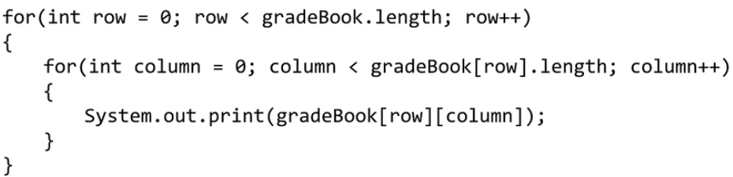
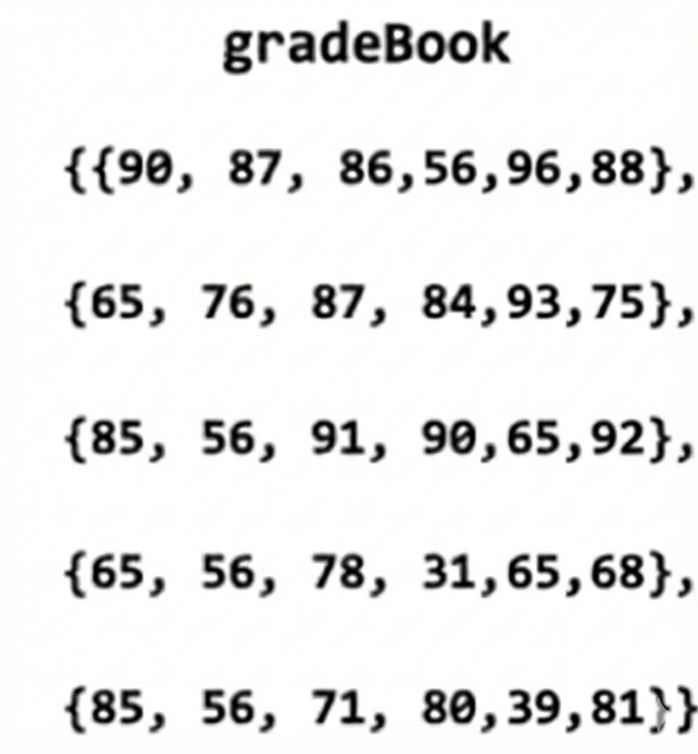
Row-major order Traversal

Slide 7
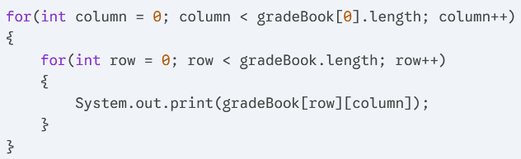
Column-major Traversal

Slide 8
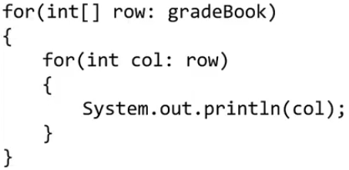
Row-major Traversal with Enhanced for-loops

Slide 9
Generally speaking, use row-major order traversal when traversing 2D arrays, it’s easier to implement and faster to execute

