Slide 1
Chapter7 Online Data Security

Slide 2
Online data security
Personally identifiable information (PII)
User data tracking
Cyber attacks
Data encryption techniques
Secure internet protocols
User authentication methods

Slide 3
Online data security
Personally identifiable information (PII)

Slide 4
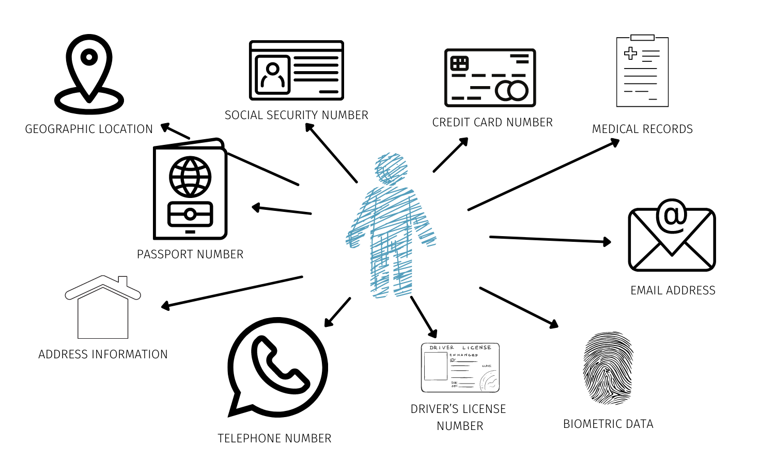
Personally identifiable information (PII)
Personally identifiable information (PII) refers to data that can directly or indirectly identify individuals.

Slide 5
Online data security
Personally identifiable information (PII)
User data tracking

Slide 6
User data tracking
Web cookies
Search history
Browsing history
Geolocation

Slide 7
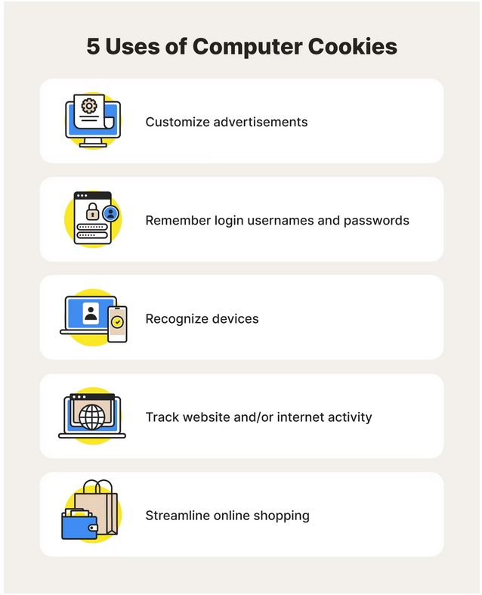
Web cookies
A cookie is a small amount of text that helps a website track information about a user across multiple pages of the website and personalize the user's experience on the website

Slide 8
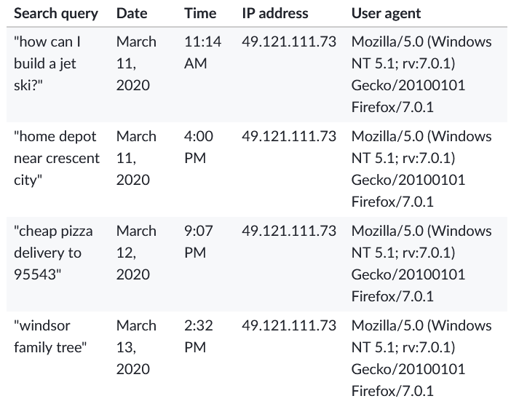
Search history
Search engines such as Google, Microsoft Bing, Baidu etc. can store users’ search queries, which could be used as Personally identifiable information to identify a user
Search queries stored in Mozilla database

Slide 9
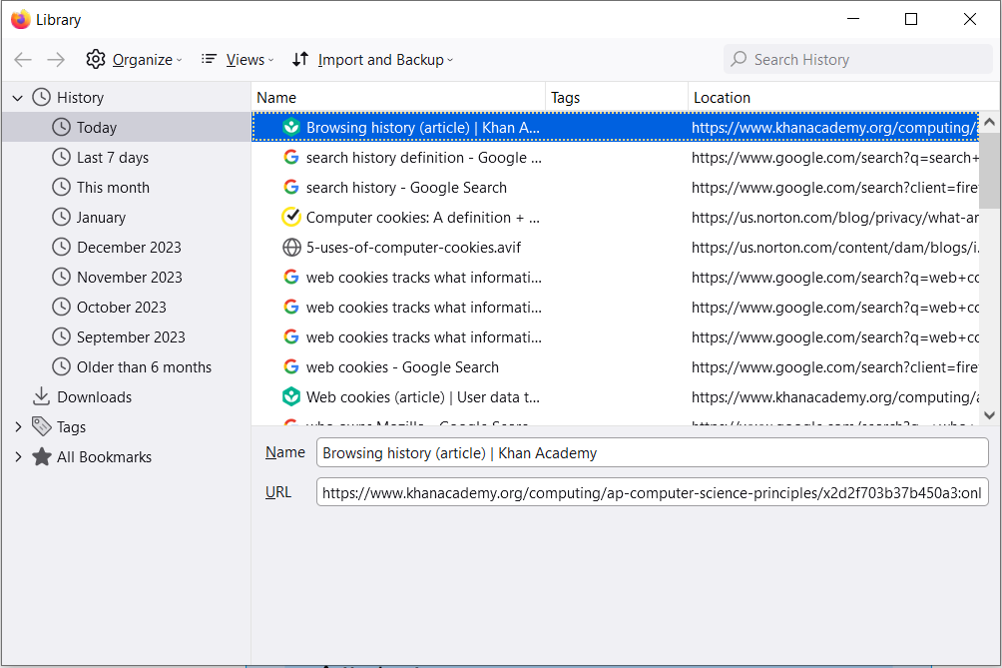
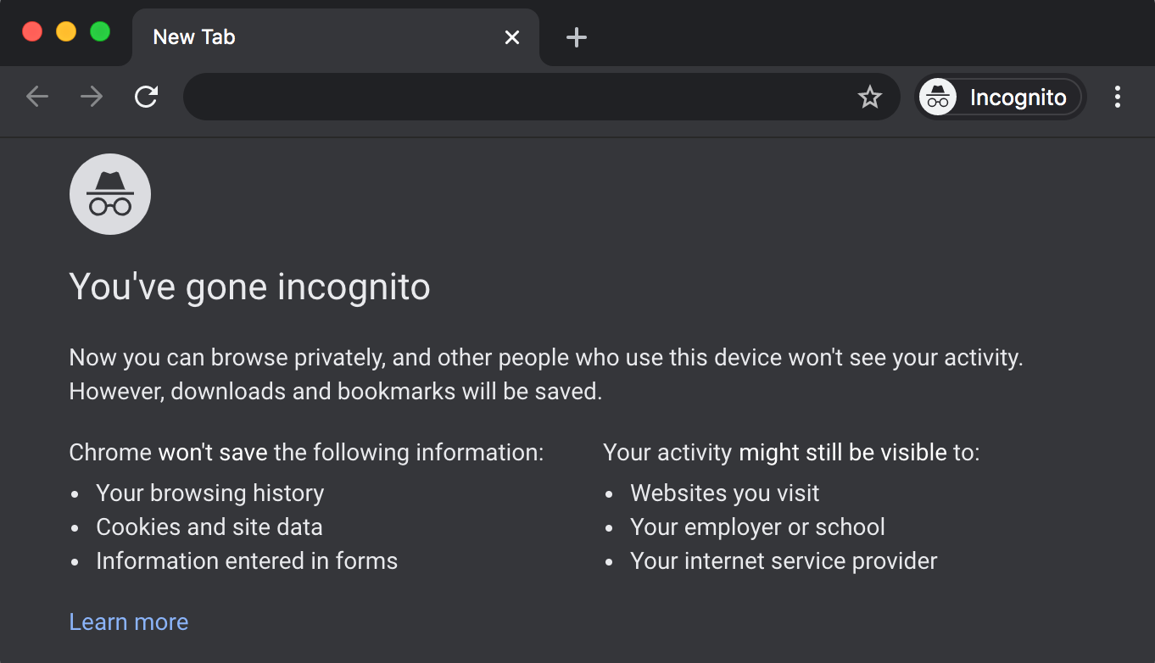
Browsing History
Browsers such as Chrome, Firefox, Microsoft edge etc. can store users’ browsing history
Many browsers also provide an incognito browsing mode, a new browser window that will not store browsing history at all.
Browsing history stored in Firefox
Incognito browsing

Slide 10
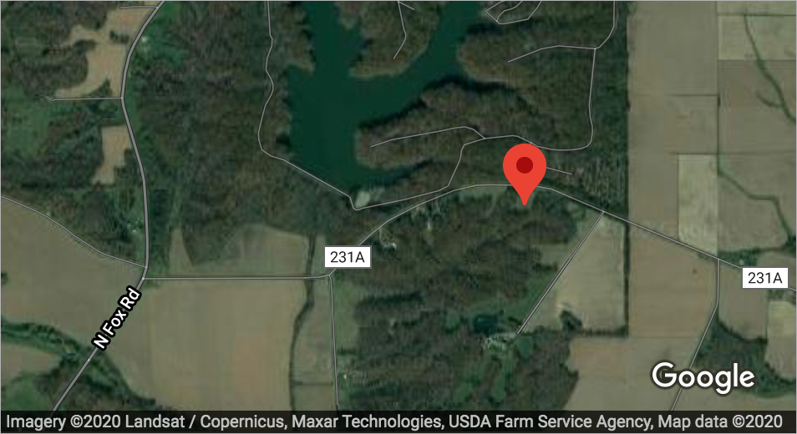
Geolocation
Applications such as Google map, Baidu Map etc. can store users’ current, work and home address through the Global positioning system (GPS), which could be used as PII to identify an individual

Slide 11
Online data security
Personally identifiable information (PII)
User data tracking
Cyber attacks

Slide 12
Cyber attacks
Phishing attacks
Rogue access point
Computer malware

Slide 13
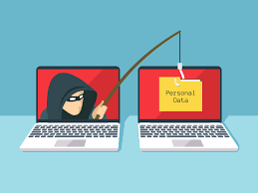
Phishing attacks
“Phishing” refers to an attempt to steal sensitive information, typically in the form of usernames, passwords, credit card numbers etc. By masking as a reputable source with an enticing request, an attacker lures in the victim to trick them, similarly to how a fisherman uses bait to catch a fish.

Slide 14
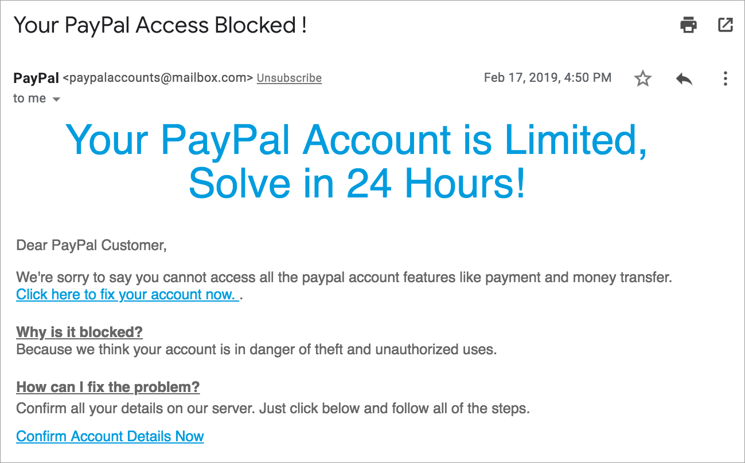
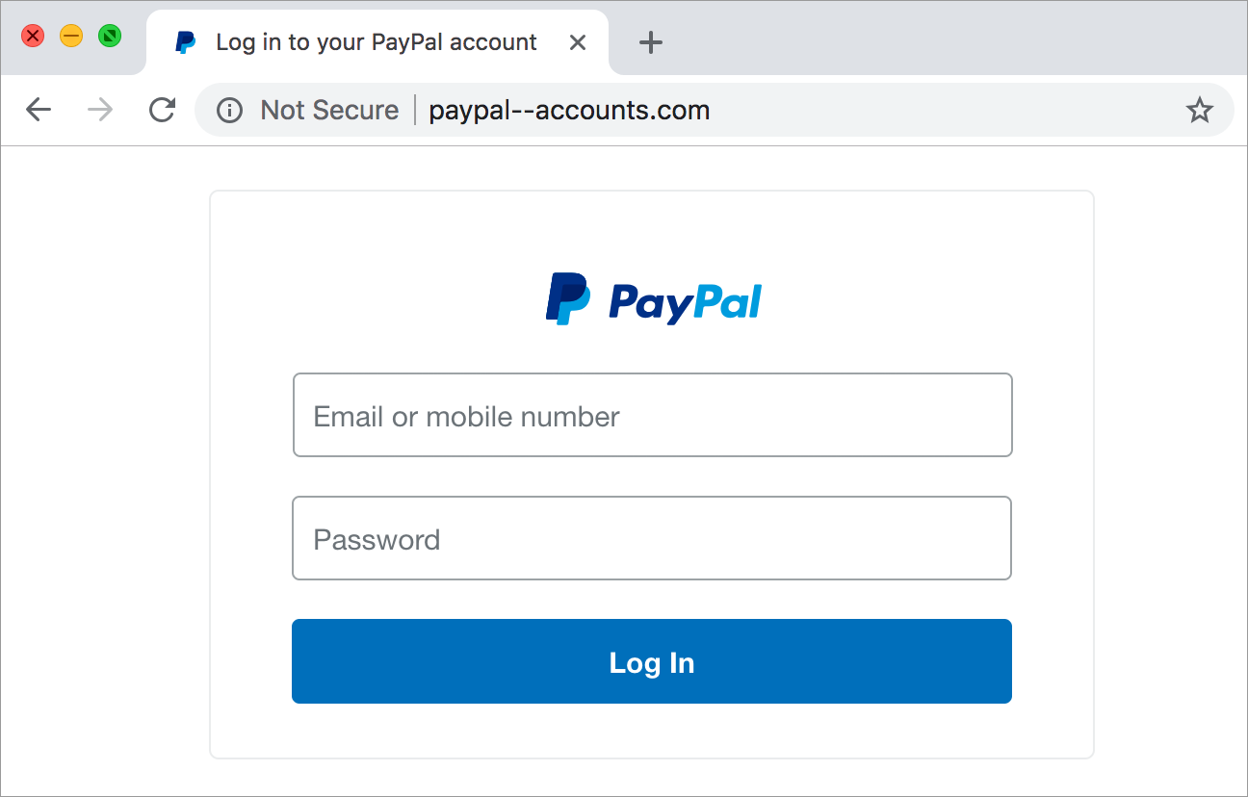
Phishing attack examples
A phishing attack typically starts with an email that claims to be from a legitimate website, like a banking website or online store
Then it asks you to enter sensitive information such as credit card number

Slide 15
Signs of phishing attacks
Suspicious email address
Urgency and Scare tactic
Suspicious URL
Non-secured HTTP connections
Requests for sensitive information

Slide 16
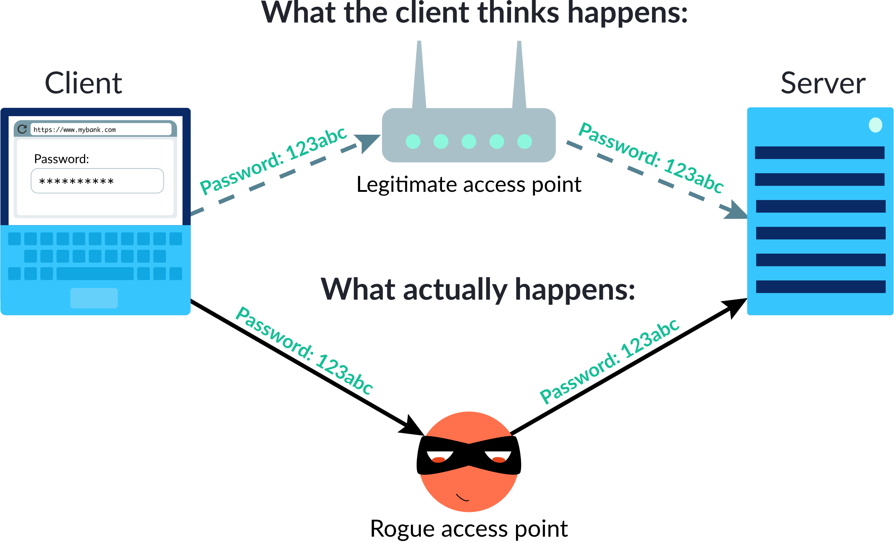
Rogue access points
A rogue access point is a wireless access point that has been installed on a secure network without the permission of the network owner. If an attacker owns the access point, they can intercept the data (e.g. PII) flowing through the network

Slide 17
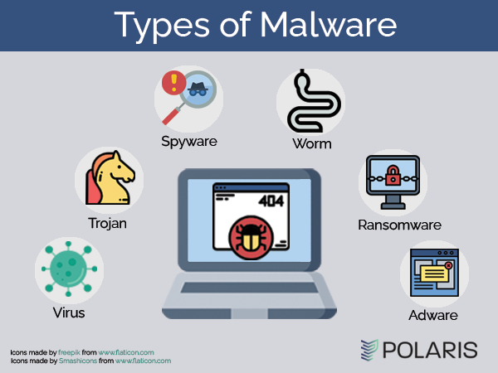
Computer malware
Malware is malicious software that's unknowingly installed onto a computer. Once installed, malware often tries to steal personal data or make money off from the user.

Slide 18
Types of malware
Trogan horse
Virus
Worm
Spyware

Slide 19
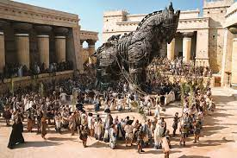
Trogan Horse
A trojan horse is a harmful program that masquerades as a legitimate program, and is often downloaded onto computers by unknowing users. Once the user runs the program, it can start inflicting its damage.

Slide 20

Virus
A virus is self-replicating: it contains code that copies itself into other files on the system. Viruses may hide in the code of a legitimate program.

Slide 21
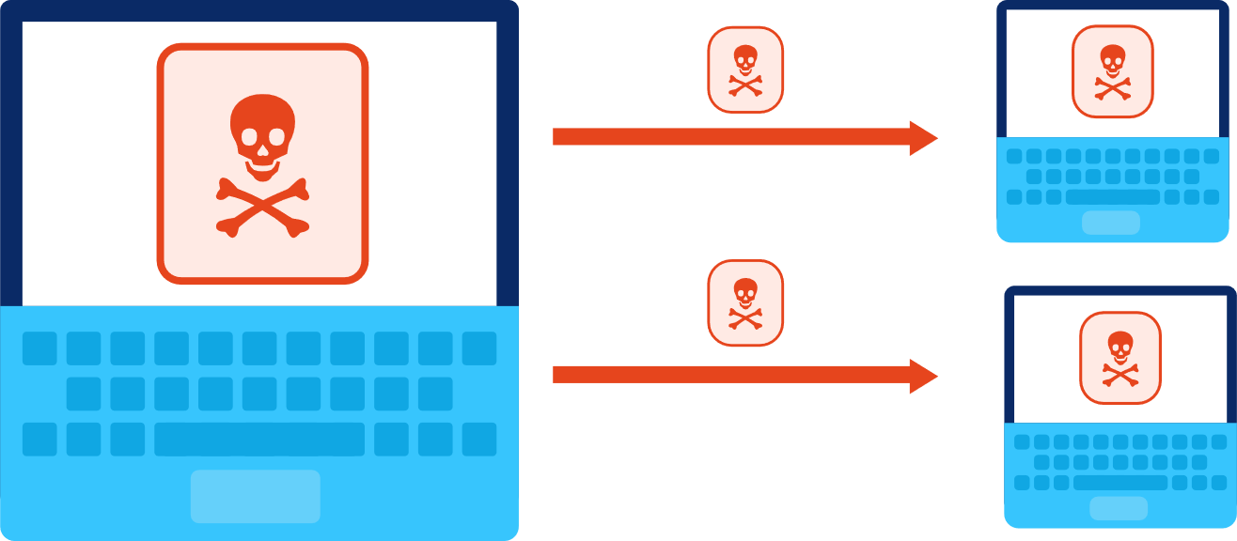
Worm
A worm is also self-replicating, but it copies itself into entirely different computers within the network. It can travel along networked protocols such as email, file sharing, or instant messaging.

Slide 22
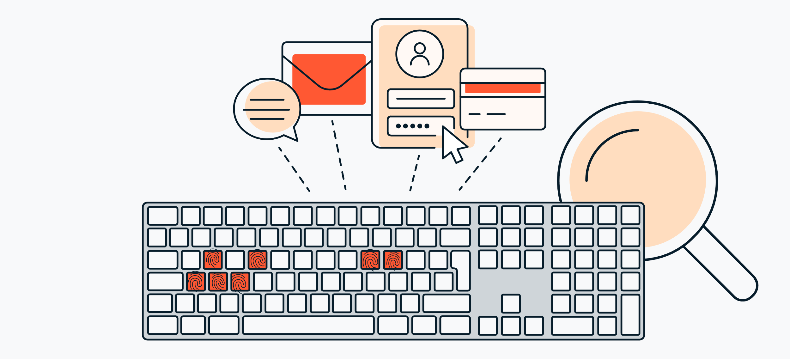
Spyware
Spyware steals data and sends it back to the malware creators. A common form of spyware are keyloggers, programs that monitor everything a user types including, of course, their many passwords

Slide 23
Malware protection
Security patch is an update to the code of an application or the entire operating system, and often fixes a bug that's been exploited by malware
Firewall is a system that monitors incoming and outgoing network traffic to a computer or internal network, and determines what traffic to allow
Antivirus software protects an individual computer by constantly scanning files and identifying malware

Slide 24
Online data security
Personally identifiable information (PII)
User data tracking
Cyber attacks
Data encryption techniques

Slide 25
Data encryption techniques
Why use data encryption
Symmetric encryption
Asymmetric encryption (Public key encryption)

Slide 26
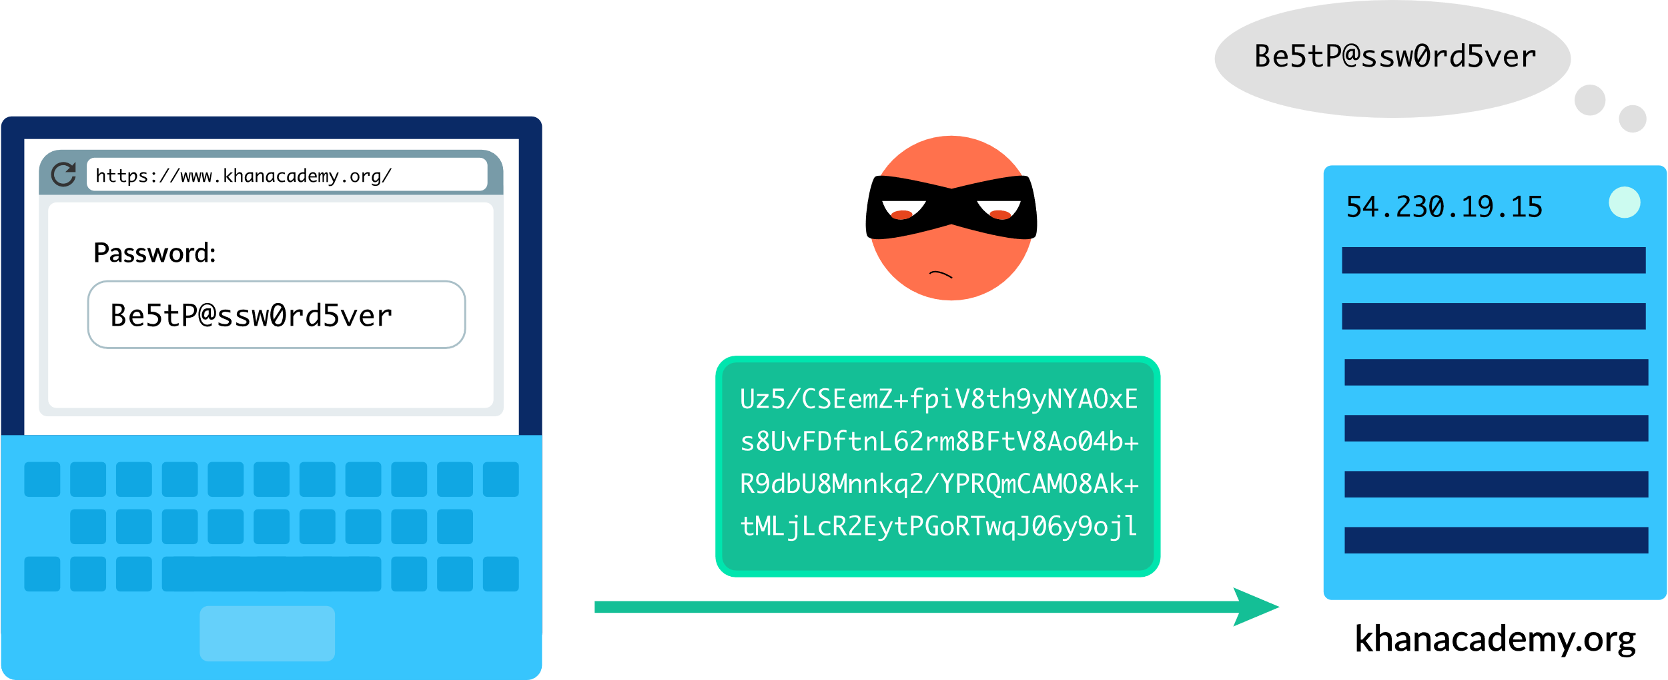
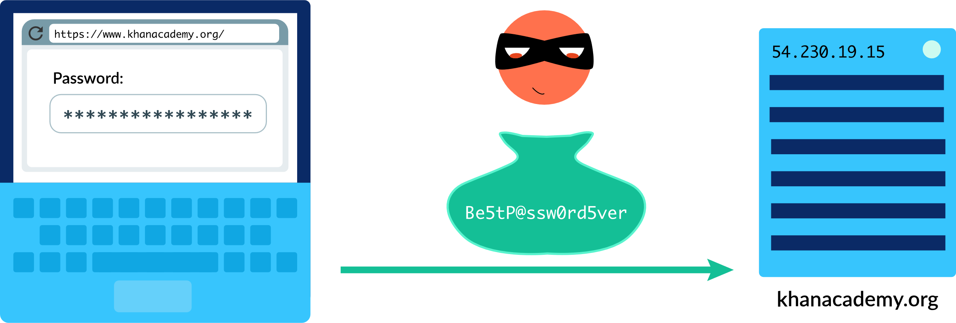
Why do we need to encrypt data?
Encryption: the process of encoding data to prevent unauthorized access
Decryption: the process of decoding the data.
Unencrypted data transmission
Encrypted data transmission

Slide 27
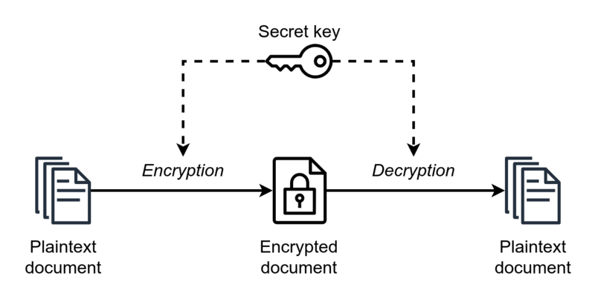
Data encryption techniques – Symmetric encryption
A symmetric encryption is any technique where the same key is used to both encrypt and decrypt the data
Problem: The process of secret key exchange could be monitored

Slide 28
Data encryption techniques – public key encryption
Public key encryption is an asymmetric encryption technique which uses different keys for encryption and decryption, allowing computers over the Internet to securely communicate with each other
There are 5 steps involved in public key encryption:
Step 1: Public and private key generation
Step 2: Key exchange
Step 3: Encryption
Step 4: Sending encrypted data
Step 5: Decryption
Notes:
https://www.khanacademy.org/computing/ap-computer-science-principles/x2d2f703b37b450a3:online-data-security/x2d2f703b37b450a3:data-encryption/a/public-key-encryption

Slide 29
Online data security
Personally identifiable information (PII)
User data tracking
Cyber attacks
Data encryption techniques
Secure internet protocols

Slide 30
Digital Certificate
Certificate authorities issue digital certificates that validate the ownership of encryption keys used in secure communications
Certificate request
Certificate
Verification
Certificate sent
data
Client
Server

Slide 31
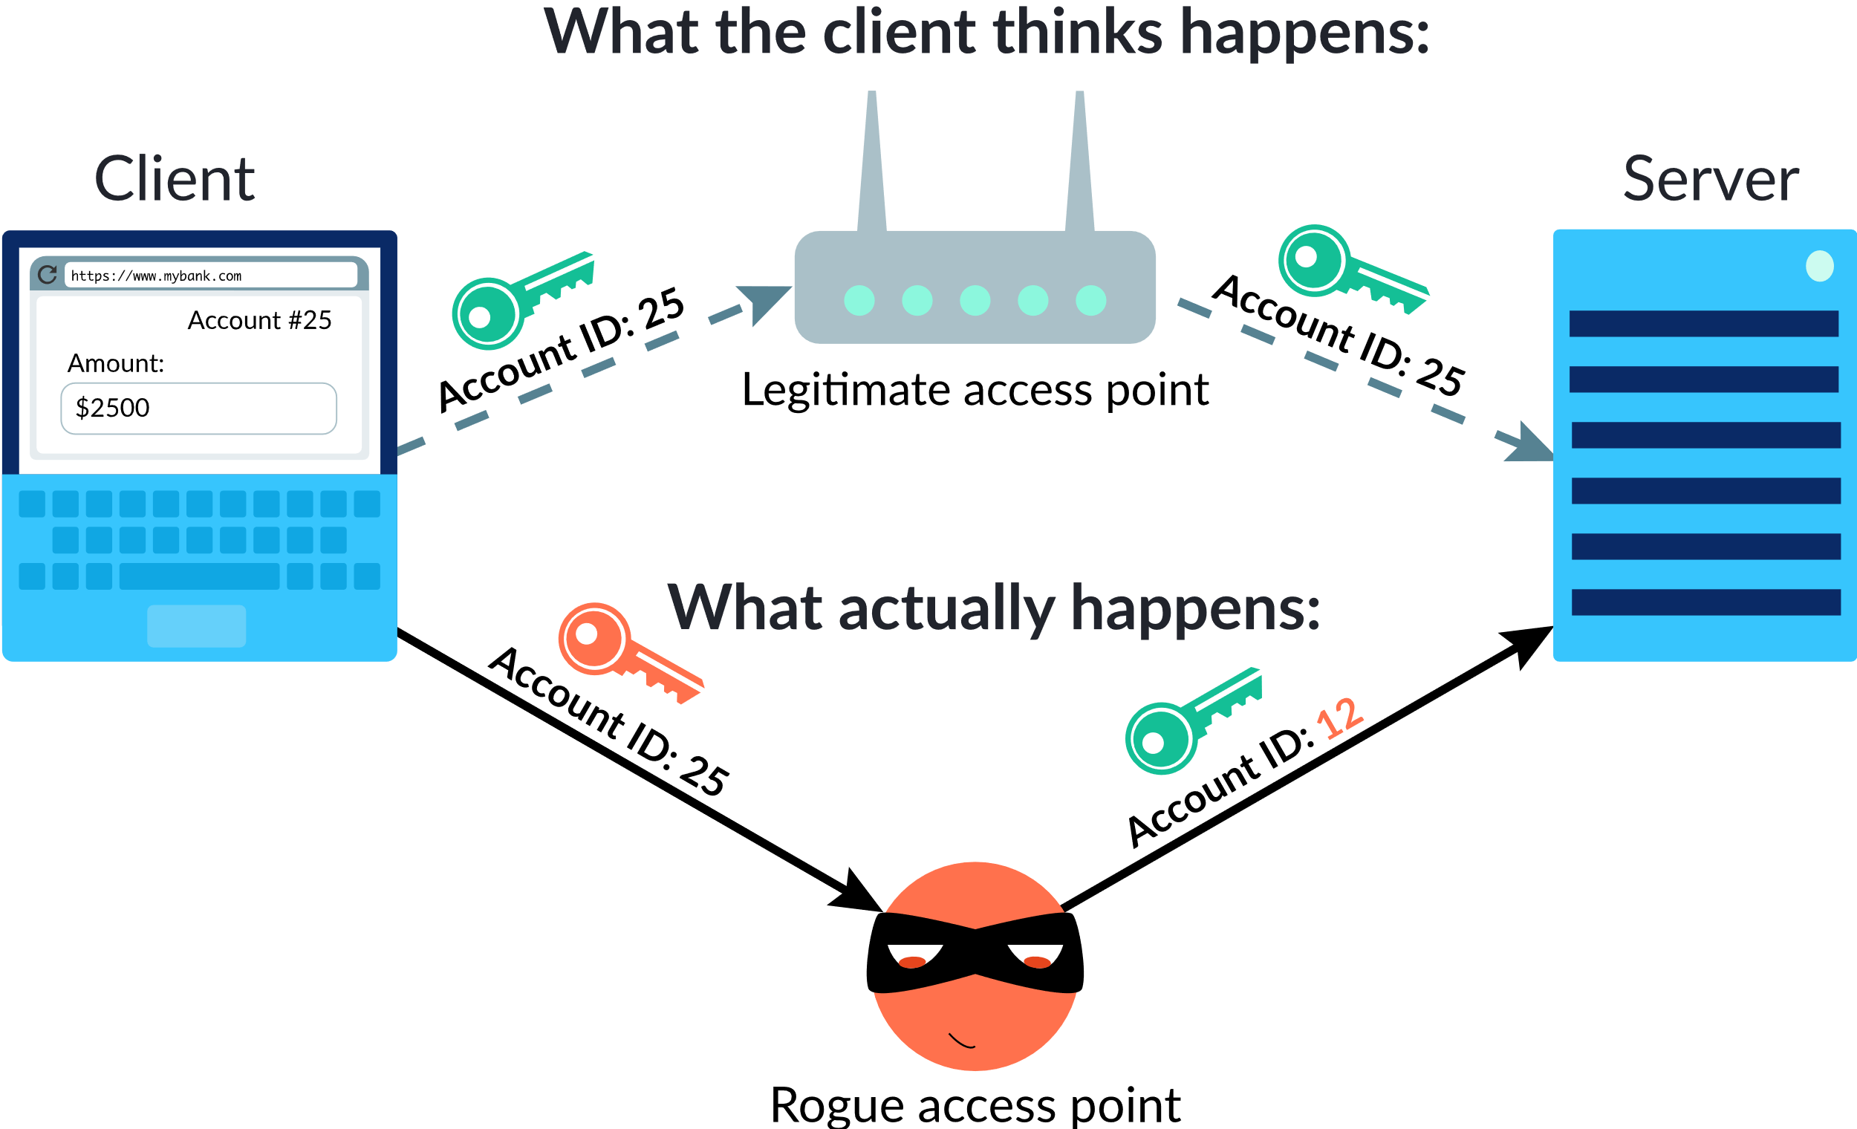
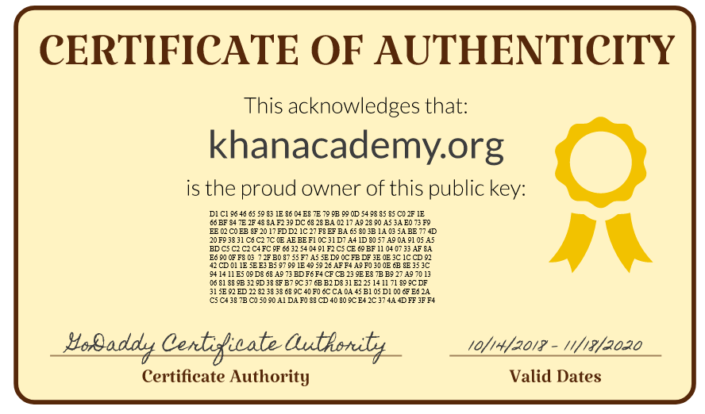
Why is digital certificate necessary?

Slide 32
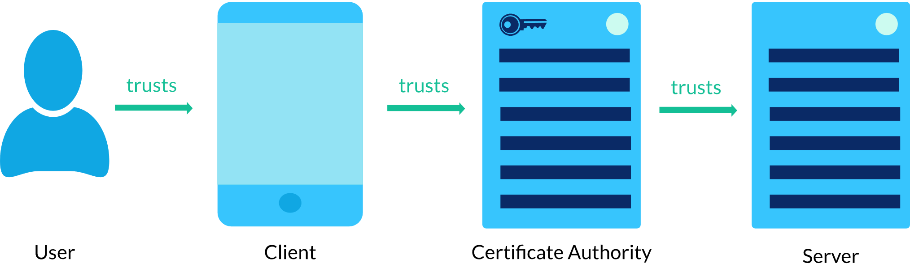
Digital certificate trust model
How can you be sure that the server with digital certificate is 100% legit?
You can’t, it’s based on trust

Slide 33
Online data security
Personally identifiable information (PII)
User data tracking
Cyber attacks
Data encryption techniques
Secure internet protocols
User authentication method

Slide 34
Strong password
A password is a form of authentication; a way of proving that yes, this is the user that owns this account
To defend against the attacks of guessing, brute-forcing, and stuffing (where attackers find the credentials for one service and try them on another service), users need a strong password
Features of a strong password:
Irregular
Complex
Single-use

Slide 35
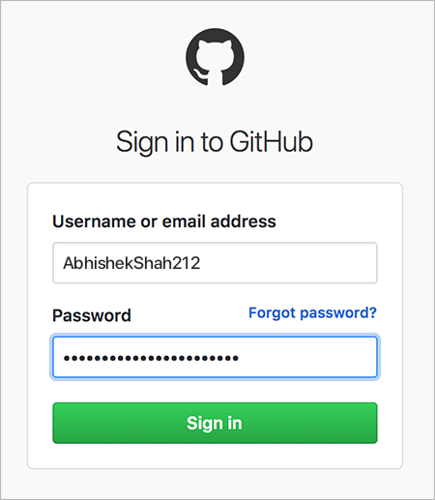
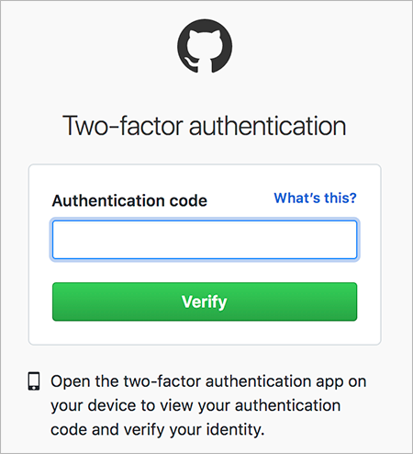
Multi-factor authentication
A more secure way to protect unwanted access to private data is multi-factor authentication, which requires multiple pieces of information to authenticate
Authentication requires you to present evidence to prove your identity. This evidence comes in three common forms:
1. Knowledge, i.e. something you know, such as password
2. Possession, i.e something you have, such as a physical credit card
3. Inherence, i.e. biometrics, such as fingerprints

Slide 36
End of Chapter 7

