Slide 1
Chapter 4 Algorithms

Slide 2
Chapter 4 outline
Building algorithms
Evaluating algorithms
Solving hard problems
Parallel and distributed computing

Slide 3
Chapter 4 outline
Building algorithms

Slide 4
Building algorithms
Algorithm: An algorithm is a step-by-step process to solve a problem
Sequencing: An algorithm is a step-by-step process, and the order of those steps are crucial to ensuring the correctness of an algorithm
Selection: Algorithms can use selection to determine a different set of steps to execute based on a Boolean expression.
Iteration: Algorithms often use repetition to execute steps a certain number of times or until a certain condition is met.

Slide 5
Expressing an algorithm
Natural Languages (English, Chinese, Korean etc.)
Flow Chart
Pseudocode
Programming Languages

Slide 6
Flowchart
A flowchart is a type of diagram that represents a workflow or process. The flowchart shows the steps as boxes of various kinds, and their order by connecting the boxes with arrows (Wikipedia).

Slide 7
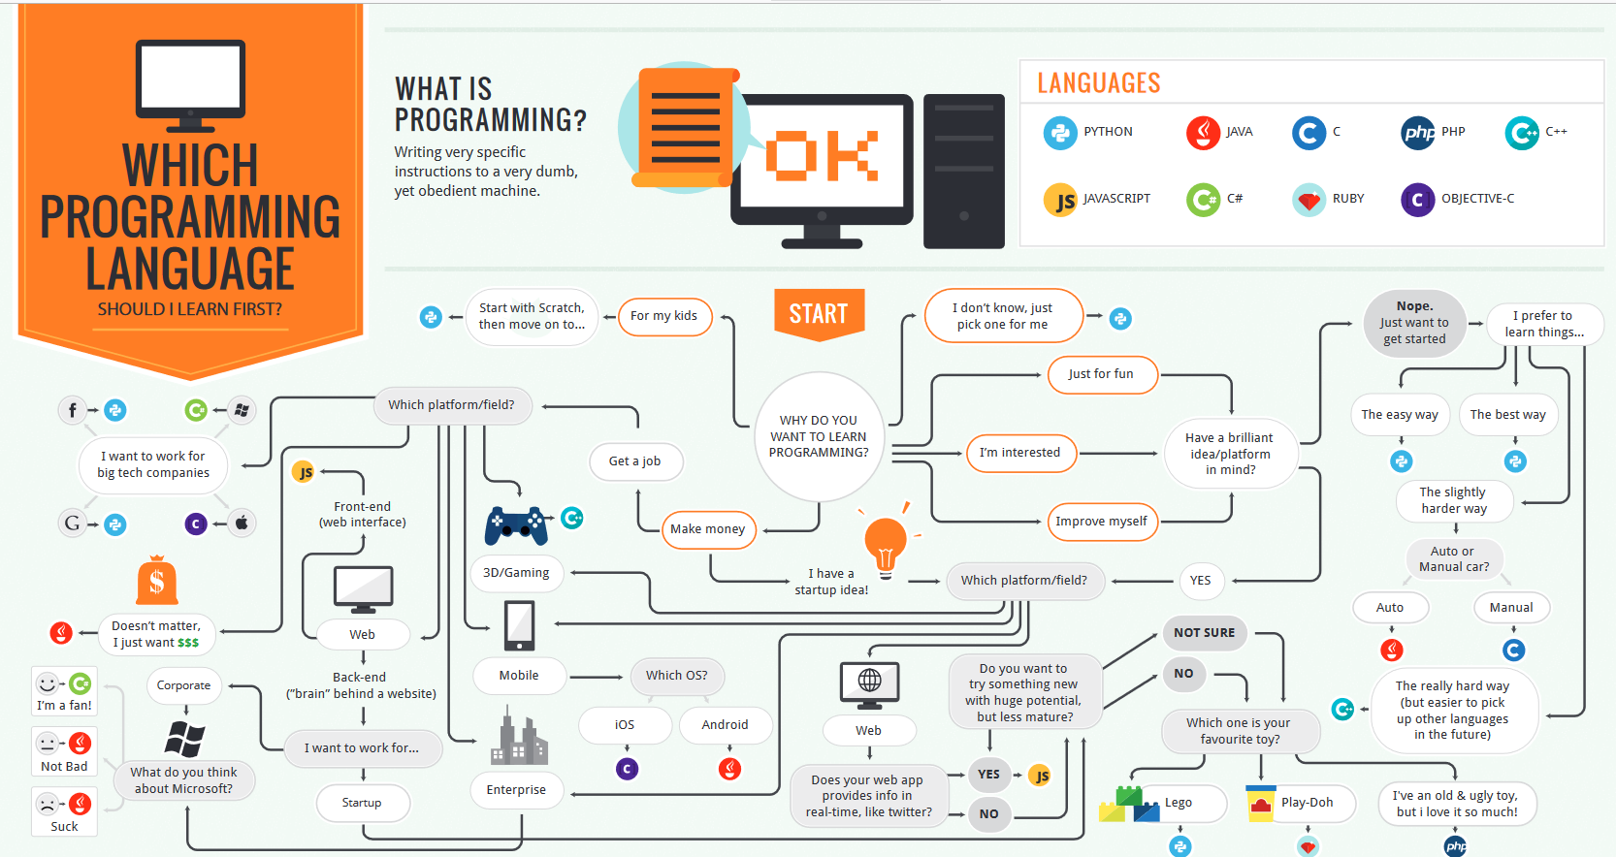

Slide 8
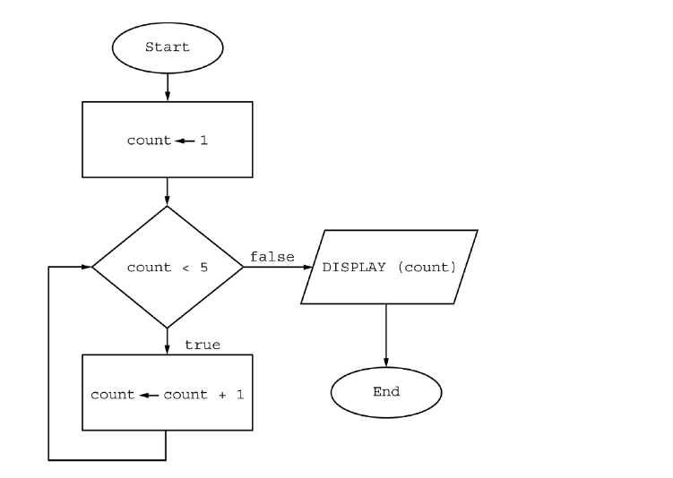
5
15
1 2 3 4
1 2 3 4 5

Slide 9
Pseudocode
Pseudocode uses all the constructs of a programming language, but doesn't actually run anywhere. It allows computer scientists a language-independent way to express an algorithm, so that programmers from any language can come along, read the pseudo-code, and translate it into their language of choice.

Slide 10
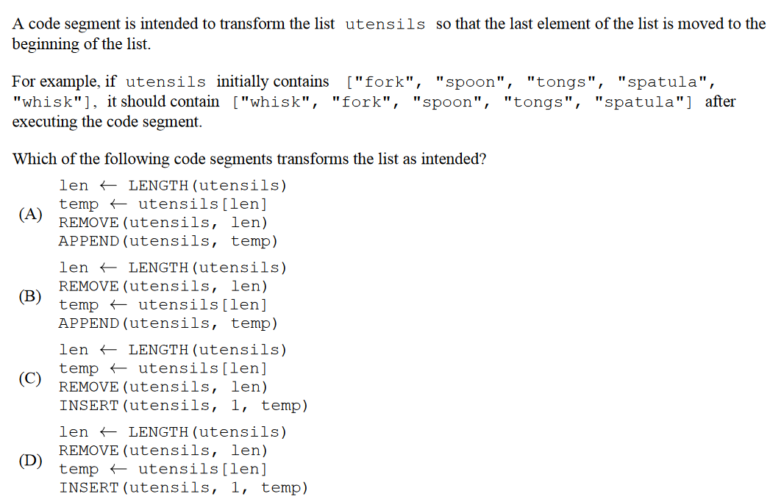

Slide 11
Programming language
Programming language is a set of instructions programmer write to communicate with a computer
Python print(“I love AP CSP”)
Java System.out.println(“I love AP CSP”);
C printf(“I love AP CSP”);
C++ cout << “I love AP CSP”;

Slide 12
Chapter 4 outline
Building algorithms
Evaluating algorithms

Slide 13
Verifying the algorithm
An important aspect of any algorithm is that it is correct: it always produces the expected output for the range of inputs and it eventually terminates
How do we determine if an algorithm is correct?
Empirical Analysis
Formal reasoning (to prove total correctness)

Slide 14
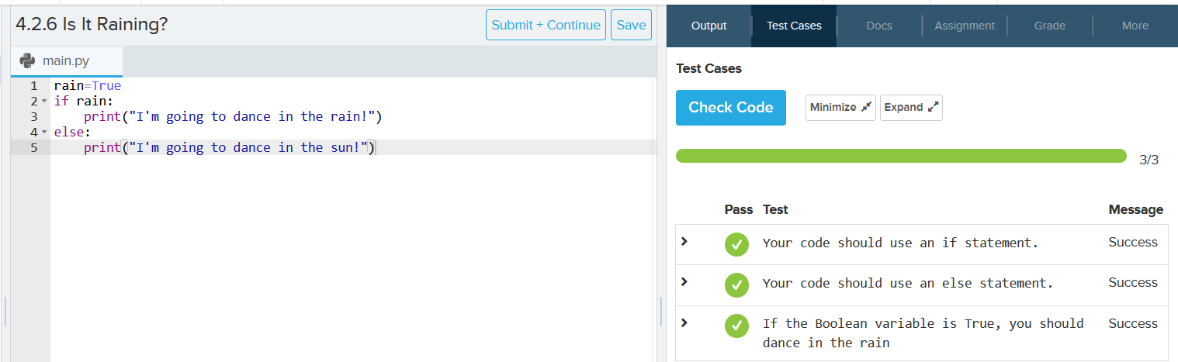
Empirical analysis
An "empirical" analysis is one based on actual experimentation and observation of the results
All the codes you wrote in CodeHS are tested using empirical analysis

Slide 15
Formal reasoning
The only way to prove the correctness of an algorithm over all possible inputs is by reasoning formally or mathematically about it
Formal reasoning example: Mathematical Induction

Slide 16
Measuring an algorithm’s efficiency
The most efficient algorithm is one that takes the least amount of execution time and memory usage possible while still yielding a correct answer.
In this class, we are only going to talk about time efficiency

Slide 17
Case study - linear search
[2,3,5,7,8,15,24,158,350,351,1000]
What is the index of 350 in the list? (index starts at 1)
How many numbers did you look through to get the correct answer?
Best case scenario: 1 operation
Average case scenario: 6 operations
Worst case scenario: 11 operations

Slide 18
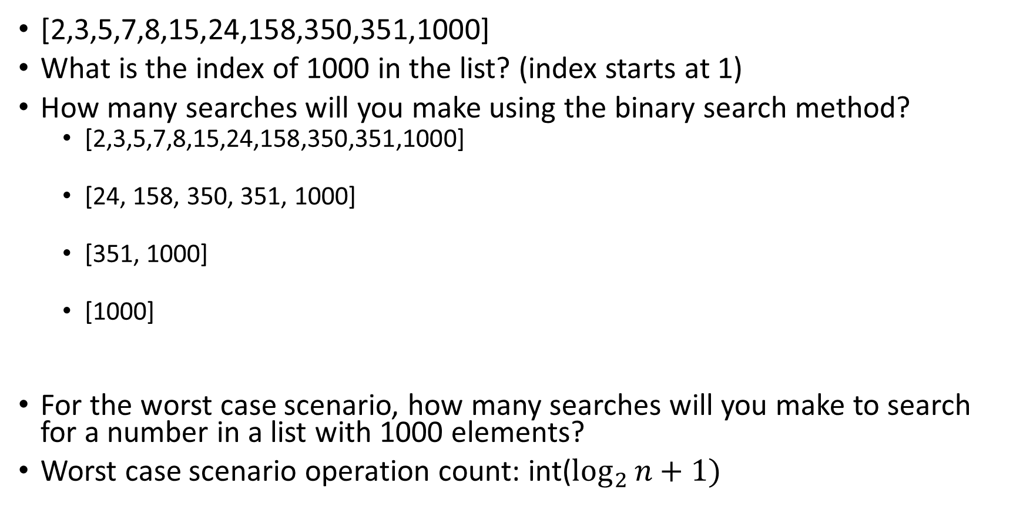
Case study – Binary Search
[2,3,5,7,8,15,24,158,350,351,1000]
What is the index of 1000 in the list? (index starts at 1)
How many searches will you make using the binary search method?
[2,3,5,7,8,15,24,158,350,351,1000]
[24, 158, 350, 351, 1000]
[351, 1000]
[1000]
For the worst case scenario, how many searches will you make to search for a number in a list with 1000 elements?
Worst case scenario operation count: int($\log_{2}{n+1)}$

Slide 19
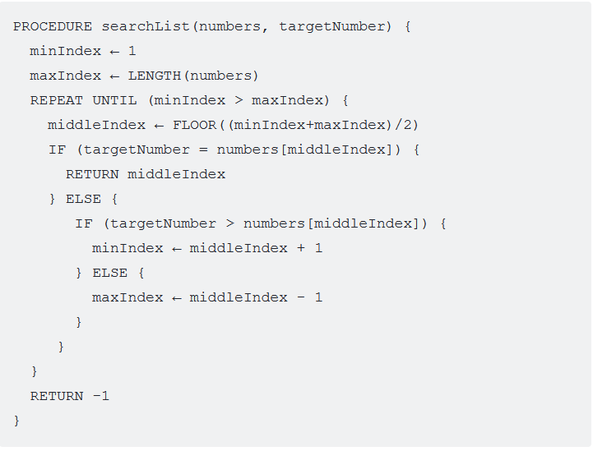
Case study – Binary Search (10min)
minIndex
middleIndex
maxIndex
[2,3,5,7,8,15,24,158,350,351,1000]
minIndex
maxIndex
[2,3,5,7,8,15,24,158,350,351,1000]
[2,3,5,7,8,15,24,158,350,351,1000]
minIndex
maxIndex

Slide 20


Binary Search number of steps in the worst case scenario
Ceil ($\log_{2}{n}$)
https://www.desmos.com/calculator

Slide 21

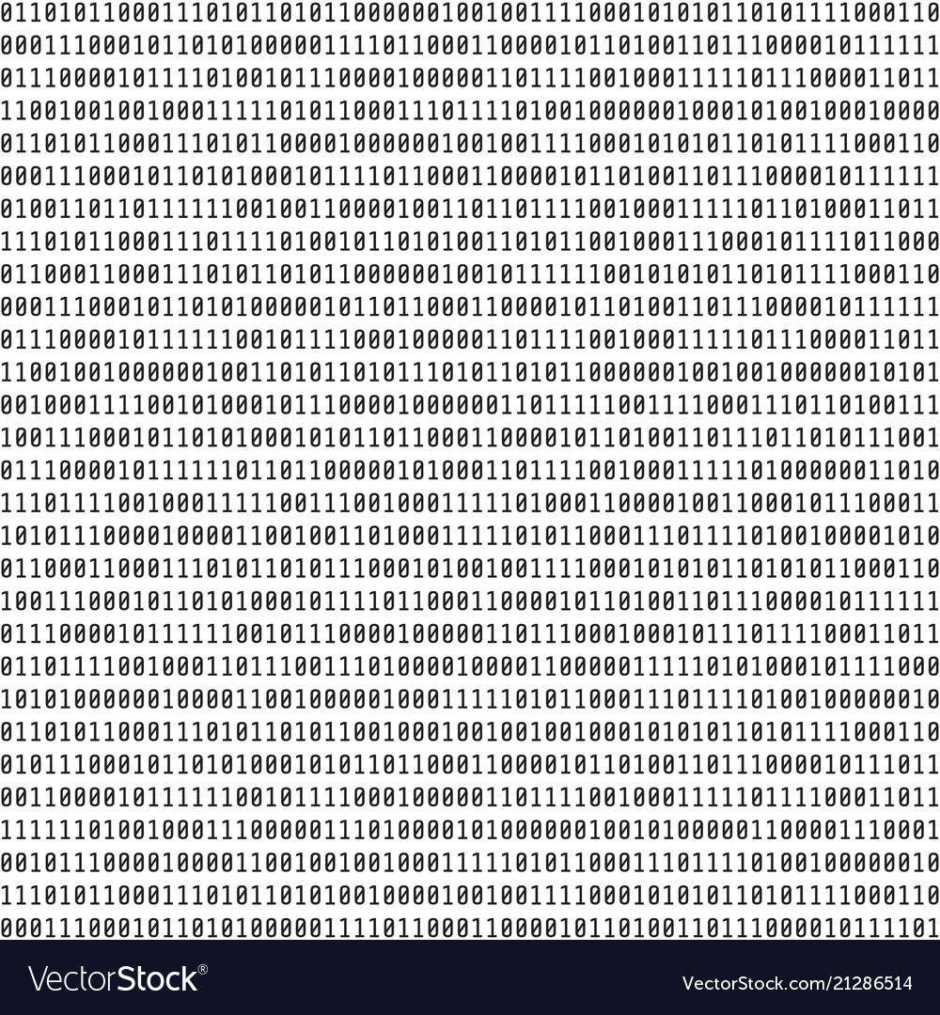
Empirical Measurement
Measures the actual running time of an algorithm on a computer
This kind of measurement is rarely used to measure the efficiency of algorithms because it is dependent on many different factors such as speed of the computer and the programming language
Jupyter Notebook Example

Slide 22
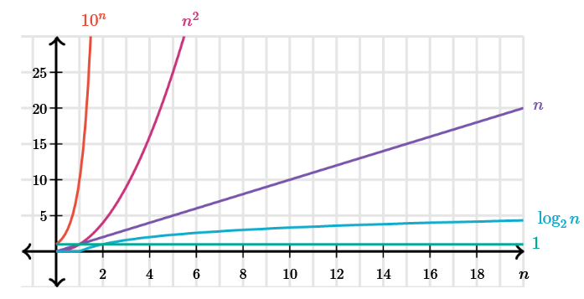

Categorizing run time efficiency
Constant time${ n}^{0}$
Logarithmic time $\log{n}$
Linear time $n$
Quadratic time $n^{2}$
Exponential time ${10}^{n}$
Factorial time$n!$

Slide 23
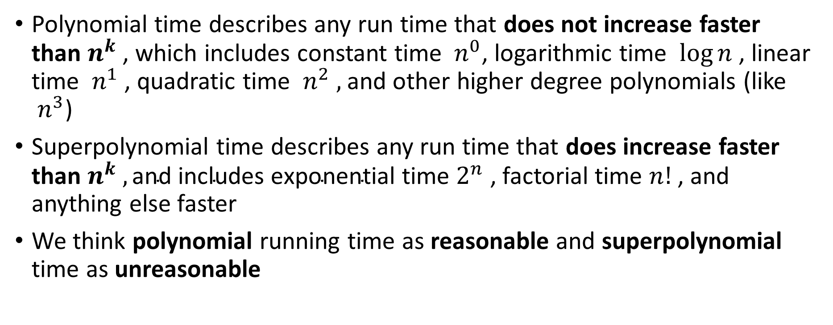
Polynomial v.s. Superpolynomial run time
Polynomial time describes any run time that does not increase faster than $n^{k}$ , which includes constant time ${ n}^{0}$, logarithmic time $\log{n}$ , linear time ${ n}^{1}$ , quadratic time ${ n}^{2} ,$and other higher degree polynomials (like ${ n}^{3}$)
Superpolynomial time describes any run time that does increase faster than $n^{k} ,\text{and} \text{includes} \text{exponential} \text{time}$ $2^{n}$ , factorial time $n!$ , and anything else faster
We think polynomial running time as reasonable and superpolynomial time as unreasonable

Slide 24
Chapter 4 outline
Building algorithms
Evaluating algorithms
Solving hard problems

Slide 25
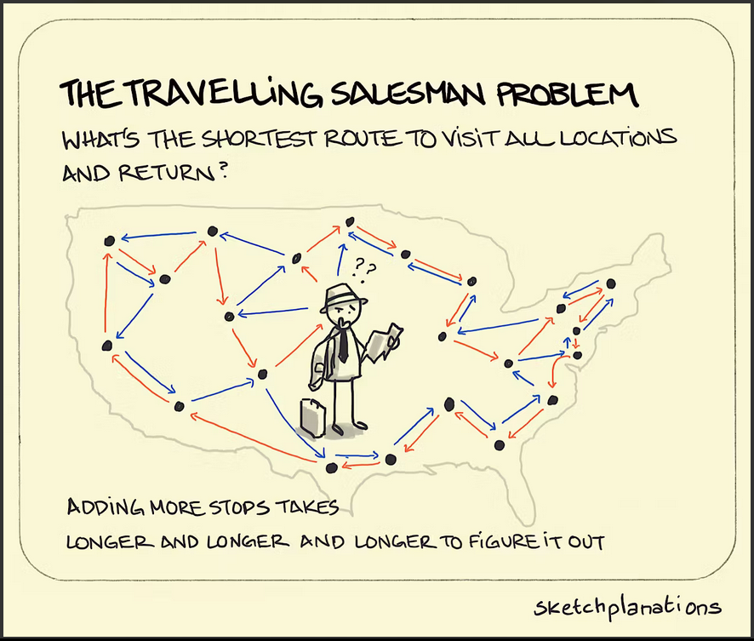

What are hard problems in computer science?
Hard problems are the ones that cannot be solved in polynomial time

Slide 26
Heuristics
In mathematical optimization and computer science, heuristic is a technique designed for problem solving more quickly when classic methods are too slow for finding an exact solution. This is achieved by trading optimality for speed (Wikipedia)

Slide 27
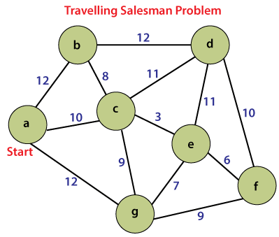
Case Study – Traveling Salesman Problem (TSP)
Problem definition:
Given a list of cities and the distances between each pair of cities, what is the shortest possible route that visits each city exactly once and returns to the origin city?

Slide 28
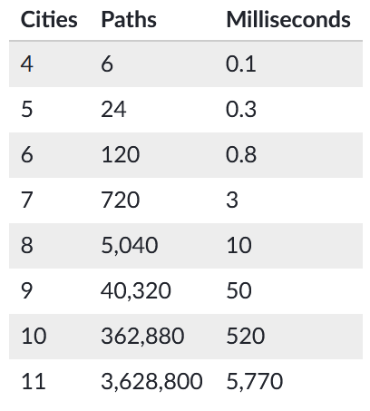
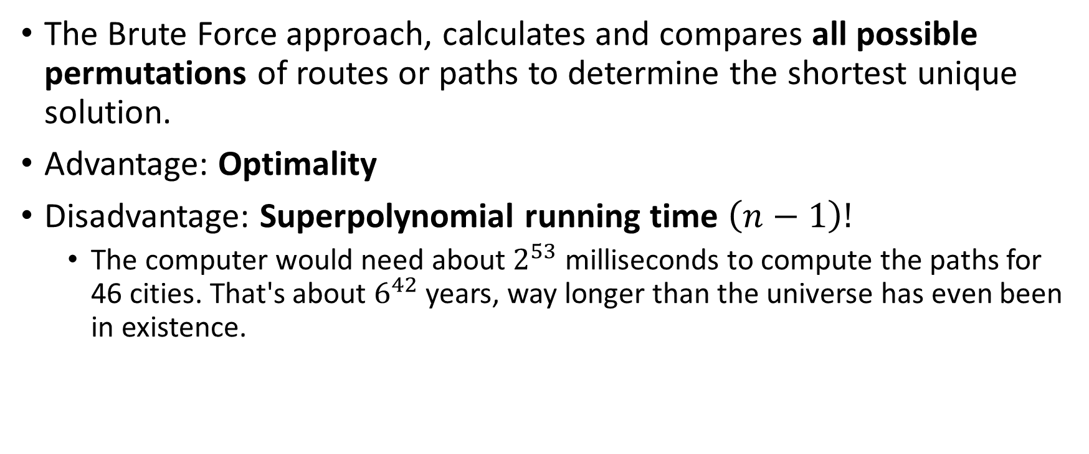
TSP Solution – The brute force approach
The Brute Force approach, calculates and compares all possible permutations of routes or paths to determine the shortest unique solution.
Advantage: Optimality
Disadvantage: Superpolynomial running time $\left(n−1\right)!$
The computer would need about $2^{53}$ milliseconds to compute the paths for 46 cities. That's about $6^{42}$ years, way longer than the universe has even been in existence.

Slide 29
TSP Solution – Dynamic Programming
* Optional

Slide 30
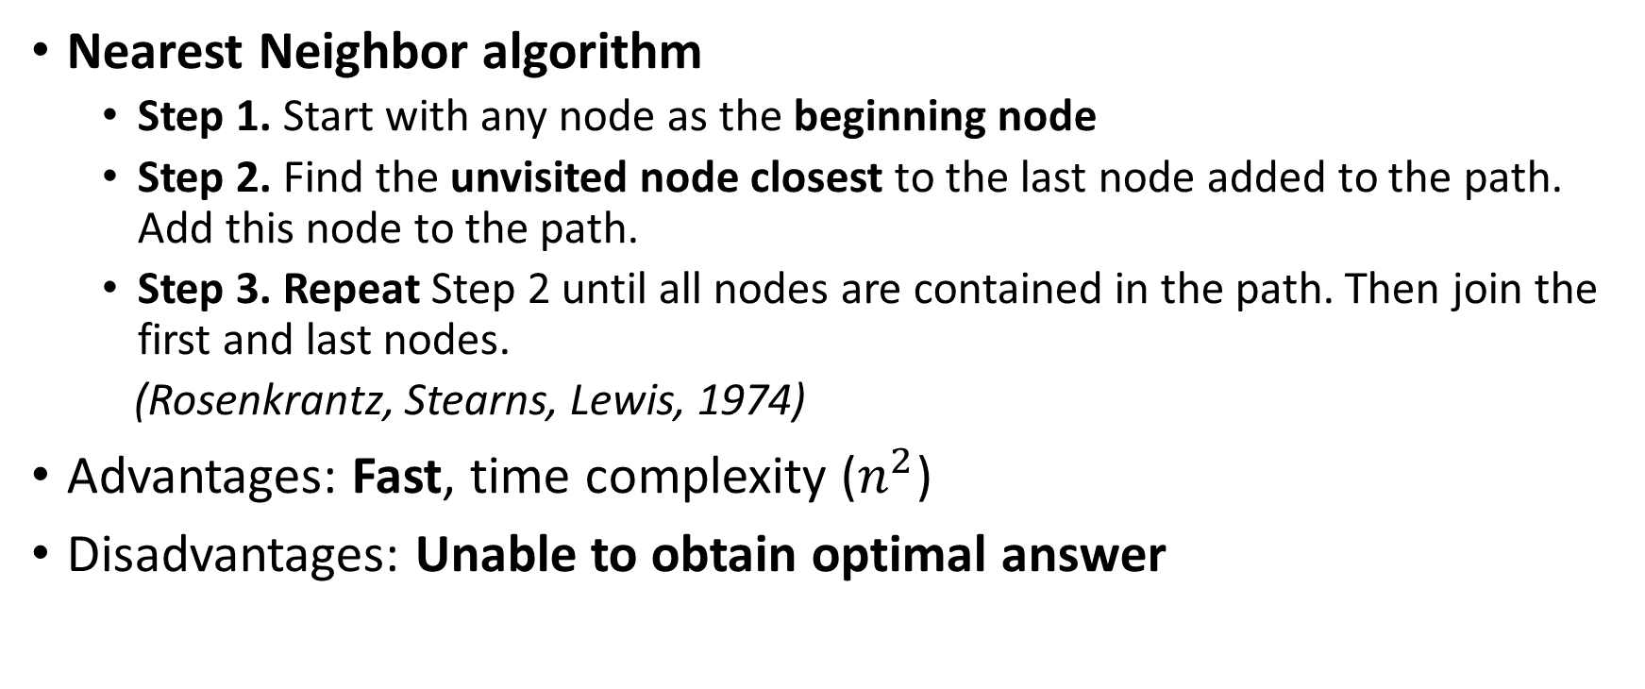
TSP Solution – Using Heuristics (Nearest Neighbor)
Nearest Neighbor algorithm
Step 1. Start with any node as the beginning node
Step 2. Find the unvisited node closest to the last node added to the path. Add this node to the path.
Step 3. Repeat Step 2 until all nodes are contained in the path. Then join the first and last nodes.
(Rosenkrantz, Stearns, Lewis, 1974)
Advantages: Fast, time complexity ($n^{2}$)
Disadvantages: Unable to obtain optimal answer

Slide 31
Another Interesting heuristic algorithms - Genetic Algorithms
https://www.youtube.com/watch?v=XP2sFzp2Rig

Slide 32
Undecidable problems
An undecidable problem is a type of computational problem that requires a yes/no answer, but yet no algorithm exists that can answer correctly on all inputs.

Slide 33
Undecidable Problem example – The Halting problem
https://www.youtube.com/watch?v=92WHN-pAFCs

Slide 34
Chapter 4 outline
Building algorithms
Evaluating algorithms
Solving hard problems
Parallel and Distributed computing

Slide 35
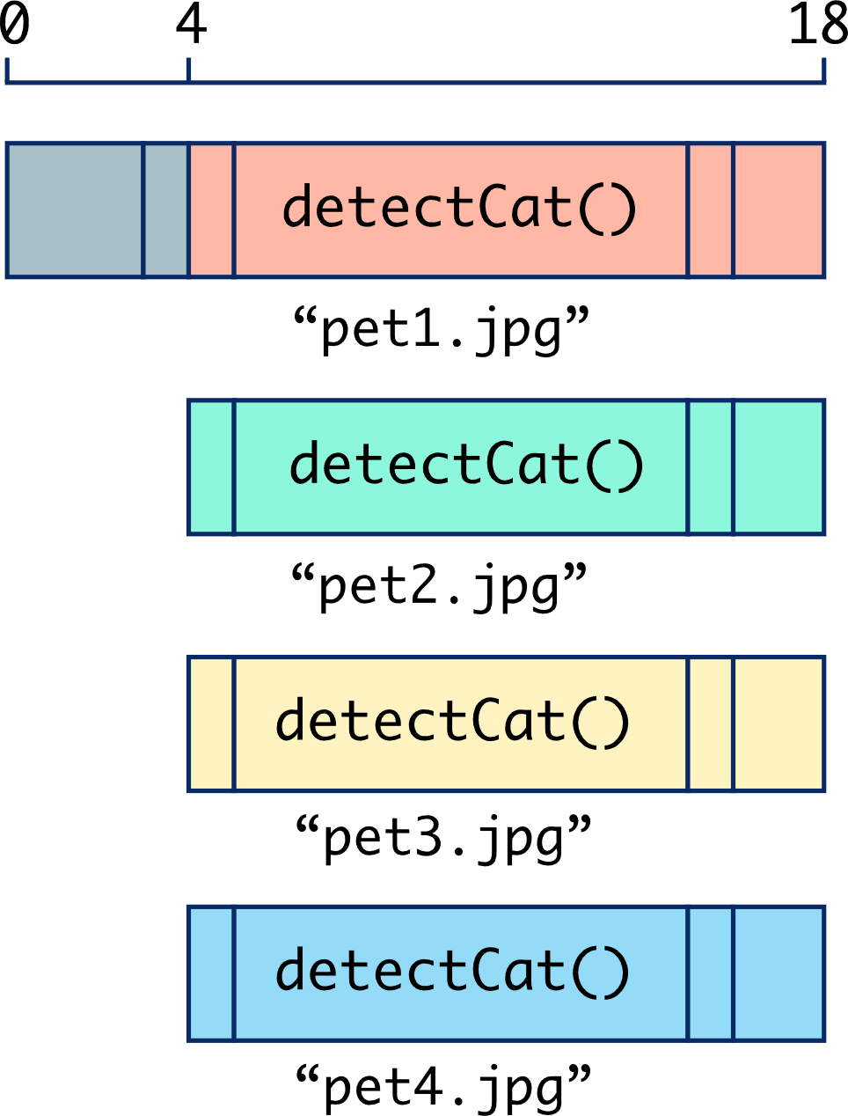
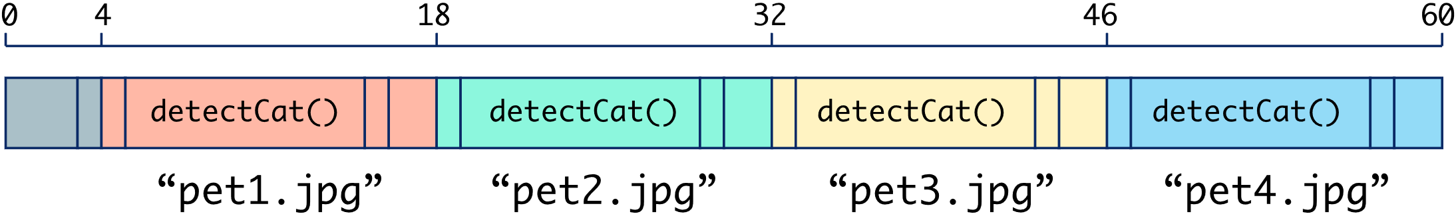
Sequential v.s. Parallel Computing
Sequential computing:
the computer executes each operation of the program in order, one at a time
Parallel Computing:
Parallel computing is a type of computation in which many calculations or processes are carried out simultaneously

Slide 36

Calculating speedup
Speedup: $\frac{t_{sequential}}{t_{parallel}}$
Notes:
https://pamelafox.github.io/parallel-demo/

Slide 37
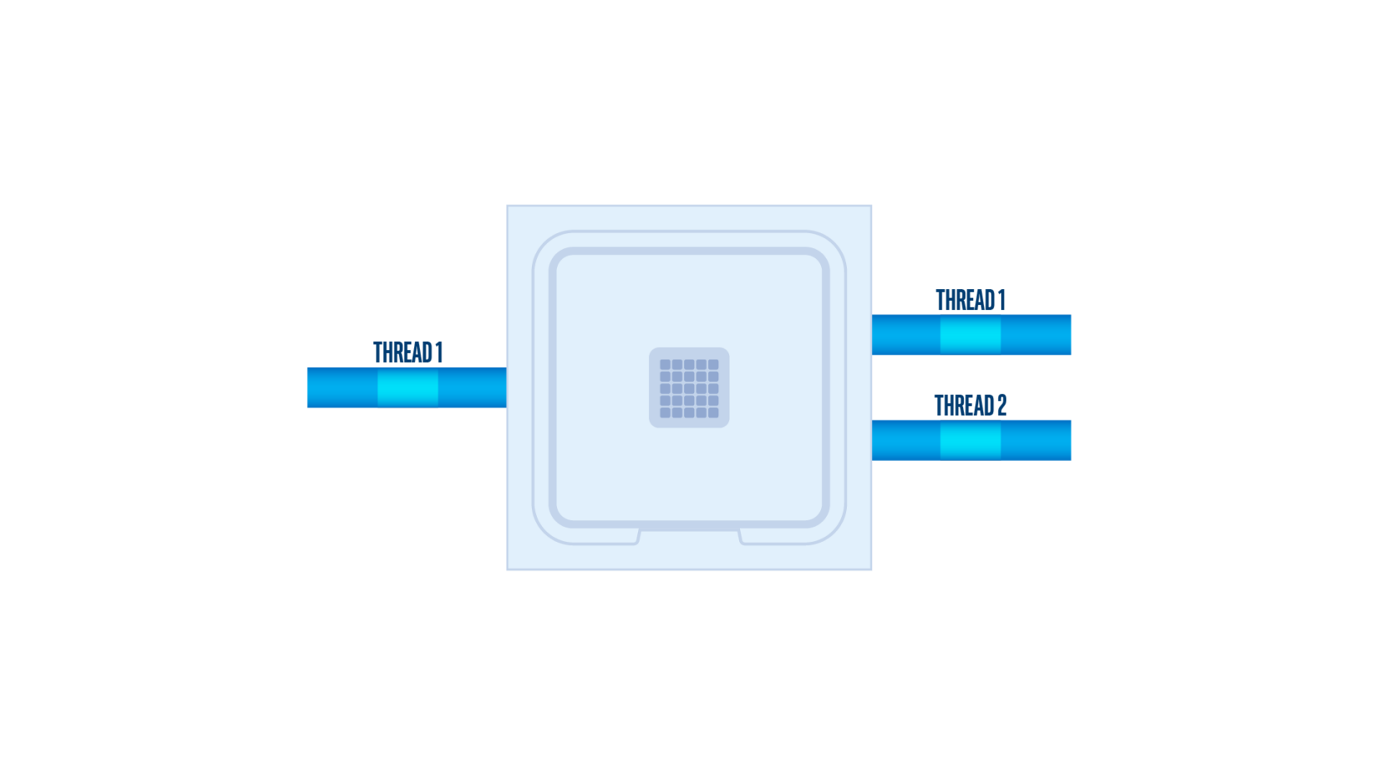
Hyperthreading
* Optional
Intel® Hyper-Threading Technology is a hardware innovation that allows more than one thread to run on each core. More threads means more work can be done in parallel.
Two logical cores can work through tasks more efficiently than a traditional single-threaded core. By taking advantage of idle time when the core would formerly be waiting for other tasks to complete, Intel® Hyper-Threading Technology improves CPU throughput.

Slide 38
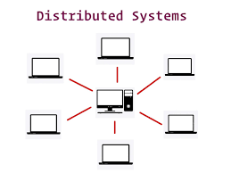
Distributed Computing
Distributed computing is the method of making multiple computers work together to solve a common problem.

Slide 39
End of Chapter 4 Algorithms

