Slide 1
APCSP FRQ Common Questions and Feedback

Slide 2
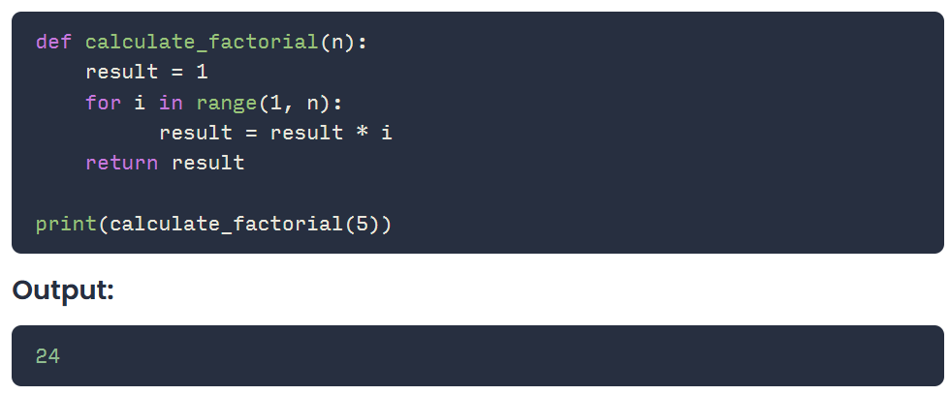
Logic error
A mistake in the algorithm or program that causes it to behave incorrectly or unexpectedly

Slide 3
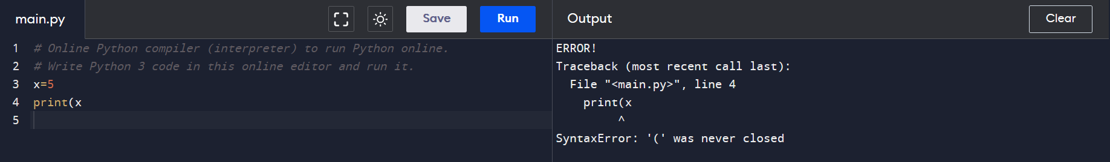
Syntax error
A mistake in the program where the rules of the programming language are not followed

Slide 4
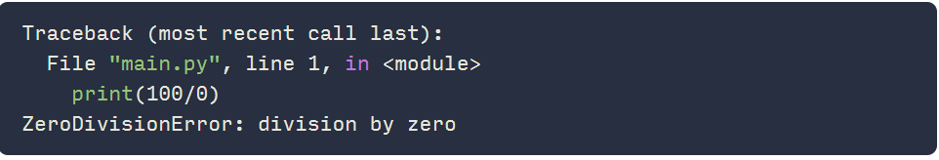
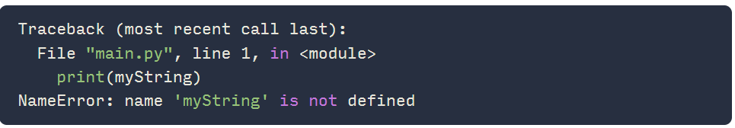
Common Python run-time errors
Division by 0
Using a undefine variable or function name
Notes:
https://rollbar.com/blog/python-runtime-error/#

Slide 5
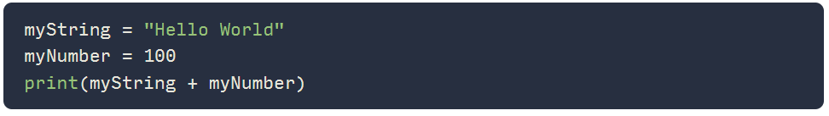
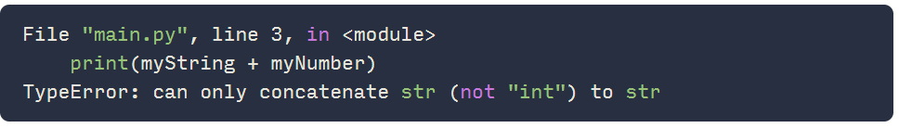
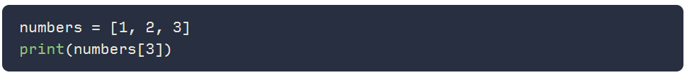
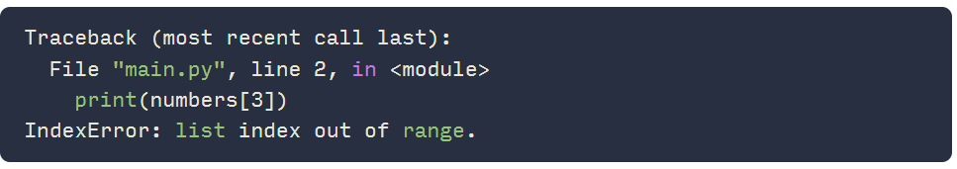
Performing an operation on incompatible types
Accessing a non-existent list element

Slide 6
Testing
In the development process, testing uses defined inputs to ensure that an algorithm or program is producing the expected outcomes
Defined inputs used to test a program should demonstrate the different expected outcomes that are at or just beyond the extremes (minimum and maximum) of input data

Slide 7
Written prompt common problems
Did not to use complete sentences
Did not explicitly answer the question

Slide 8
Prompt 1: Identify an expected user of your program. Describe one way your program’s design meets the needs of this user.
A user that hopes hone vocabularies can use my program. Users need to have a memory of the spelling of the words in the wordlist in order to win the game, thus strengthening the user’s ability to user their words in their life
My program is a vocabulary-guessing game. One expected user of my program could be someone who wishes to learn and practice customized vocabulary sets in fun and interactive way. My program meets the need of the user by allowing the user to choose and import any sets of vocabularies he would like to practice, and the game provides feedback to the user’s learning with the update to the HP point of the in-game character---the stick man. By spelling the word correctly, the users can save the stick man, enabling users to learn vocabularies in an entertaining fashion

Slide 9
Prompt 2: Consider the first iteration statement included in the Procedure section of your Personalized Project Reference. Identify the number of times the body of your iteration statement will execute. Describe a condition or error that would cause your iteration statement to not terminate and cause an infinite loop. If no such condition or error exists, explain how the loop could be modified to cause an infinite loop.
The procedure will keep running until the time when user inputs the correct number – “stake”. The number of times depends on user’s input. If the user always inputs a number less than 0 or bigger than their fund, the statement will cause an infinite loop . Vice versa, if the user inputs a number bigger than 0 and less than their fund, the loop will stop.

Slide 10
Prompt 3: Consider the procedure included in part (i) of the Procedure section of your Personalized Project Reference. Describe a change to your procedure that will result in a run-time error. Explain why this change will result in a run-time error
Do not let the equation total counts = total_counts_week1+total_counts_week2. If there was no this equation, the total counts is not defined. So the “return total_counts” would be invalid
If I change the result from “count” to “percent”, which is equal to “count” divided by the number of question x and I called the function using a parameter of 0, the procedure will result in a run-time error. This is because the calculation of percent has x on its denominator, and dividing by 0 will cause a run-time error

Slide 11
Prompt 4: Suppose you are provided with a procedure called isEqual (value1, value2). The procedure returns true if the two parameters value1 and value2 are equal in value and returns false otherwise. Using the list you identified in the List section of your Personalized Project Reference, explain in detailed steps an algorithm that uses isEqual to count the number of times a certain value appears in your list. Your explanation must be detailed enough for someone else to write the program code.
To count the number of times a specific value appears in a list using the isEqual procedure, you can initialize a variable called count and set it to 0. Then, iterate through the list using a loop and for each element, use the isEqual procedure to check if it matches the target value. If the isEqual procedure returns true, increment the count variable by 1. After iterating through the entire list, the count variable will contain the total number of occurrences of the target value in the list.

